Slide 1
Comment Python va dominer le monde
  Pycon FR 2009, Paris La Villette
  Kamon Ayeva
  kamon.ayeva@gmail.com
Notes:
disclaimer:
1. Member, no representante
2. Sugerencias no must or have... if you don't agree please, interrupt me! --- la idea de la charla es comentar algunas experiencias y ver si pueden ser utiles......

Slide 2
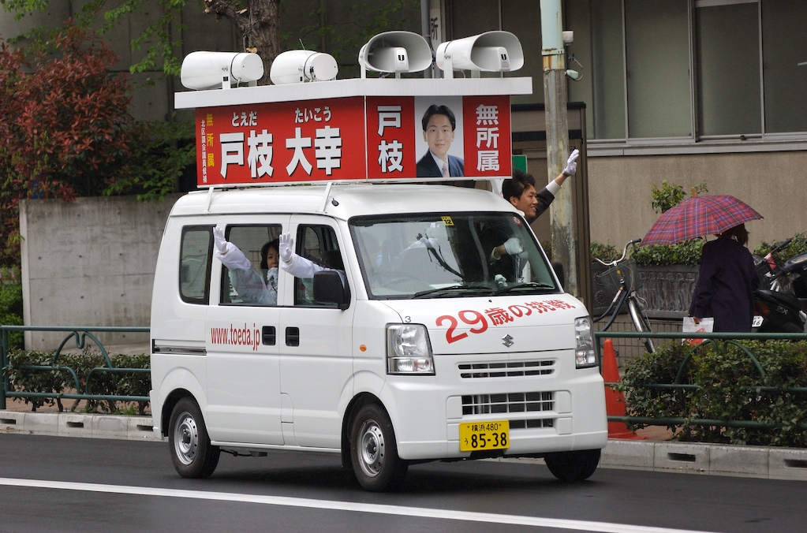
Notes:
Awareness
If you don't do it it won't happen. If you don't promote Python, nobody will do it.
This talk is about promotion, why do we need to promote ? Why is it important ?

Slide 3
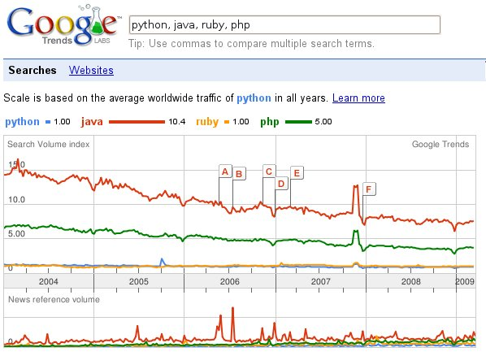
Source: Google Trends
Notes:
Python is not doing bad at all but...

Slide 4
Visibilité
Formation
Communauté
Notes:
Many people discover python because its success stories

Slide 5
Visibilité
Presse
Blogs
Evénements
Success Stories
Notes:
Many people discover python because its success stories

Slide 6



Presse
Impact : Très important
Effort requis : ~ 20 heures / article
Notes:
I wrote 3 articles during and had 3 intervies during 2008. Press has a hugh impact, many people will be aware if you write or being interview.
Conventions like PyCon are great opportunity to write articles, if you are here, why don't you write about pycon for a local magazine or blog at least :D

Slide 7
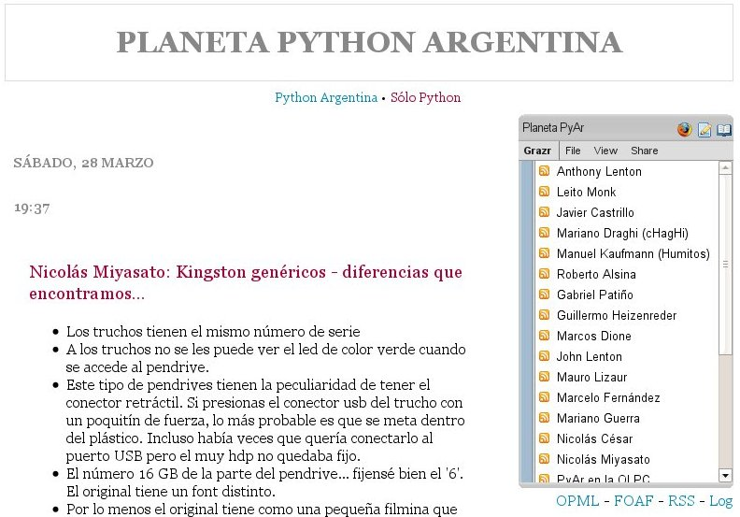
Planet Python Argentina
Impact : Important
Effort requis : Faible
http://planeta.python.org.ar/
Notes:
Many people discover python because its success stories

Slide 8
“Planets” connues
http://planet.python.org
http://afpy.org/planet
http://planet.plone.org
http://djangoproject.com/community
http://planet.scipy.org
Notes:
Begeno
UNC
Goverment

Slide 9
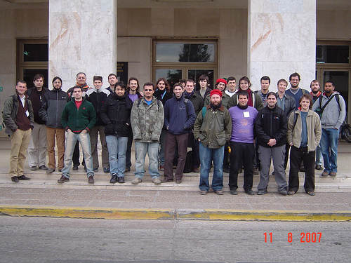
Evénements : Conférence
Impact : Important
Effort requis : Important
Notes:
Many people discover python because its success stories

Slide 10

Evénements : Conférence
Impact : Important
Effort requis : Important
Notes:
Many people discover python because its success stories

Slide 11

Evénements : WPD
Impact : Important
Effort requis : Faible (distribué)
Notes:
Many people discover python because its success stories

Slide 12
Appel :
Participez aux événements !
Allez présenter votre utilisation de Python !
Notes:
Begeno
UNC
Goverment

Slide 13
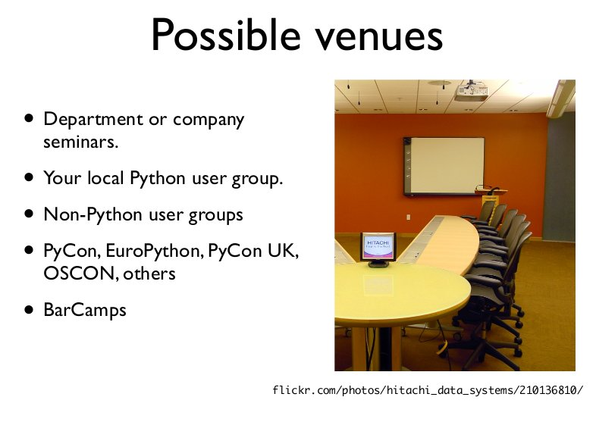
Source: Andrew Kuchling at PyCon 2009

Slide 14
Success Stories
Plone CMS
http://plone.org
LaunchPad
(Canonical)
https://launchpad.net
Django
http://www.djangoproject.com/
Notes:
Begeno
UNC
Goverment

Slide 15
Success Stories (suite)
OLPC
One Laptop Per Child
http://laptop.org
Bungeni
Système d'information pour les parlements africains,
basé sur Plone (PloneGov)
http://www.bungeni.org
.
Notes:
Begeno
UNC
Goverment

Slide 16
Formation

Slide 17
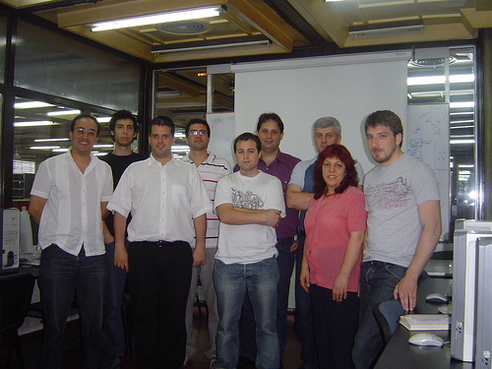
Formation
Impact : Important
Effort requis : ~ 30 heures
Notes:
Begeno
UNC
Goverment

Slide 18
Formations sponsorisées
Python African Tour
Maroc
Décembre 2008
Impact : 30 étudiants formés
Effort requis : 2-3 coordinateurs + 2 formateurs volontaires
Notes:
Begeno
UNC
Goverment

Slide 19
Python African Tour
Sénégal
Juillet 2009
Zambie
Novembre / Décembre 2009
Nigéria
Janvier / Février 2010
Venez aider !
http://openplans.org/projects/python-african-tour
Notes:
Begeno
UNC
Goverment

Slide 20
Communauté
User Groups
Sprints

Slide 21



Local User Groups
Impact : Important
Effort requis : Moyen (distribué)
http://afpy.org
http://python.com.ar
http://plone.com.ar
Notes:
Begeno
UNC
Goverment

Slide 22
Sprints / Hackathons
Découvrir
Documenter
Coder
Faire des screencasts
Apprendre aux débutants
Notes:
Begeno
UNC
Goverment

Slide 23

On continue au bar...
“Afpyro”
Notes:
Begeno
UNC
Goverment

Slide 24
Python va dominer le monde ?
“Python domine le monde !”
“...ça prend moins d'octets”
Thomas NOEL, membre de DakarLUG, co-organisateur “PAT-Sénégal”
Notes:
Begeno
UNC
Goverment

Slide 25
Crédits
Roberto Allende
Menttes, Argentine
Notes:
Begeno
UNC
Goverment

Slide 26
Merci !
  Kamon Ayeva
  http://kayeva.wordpress.com/

