Slide 1
Cocos2d
Ecrire un jeu en 2d avec

Slide 2
Composants
Director
Scenes
Layers
Sprites
Events
Resources

Slide 3
Director
window = director.init(
width=800,
height=600,
do_not_scale=True, resizable=True)
director.run(somescene)

Slide 4
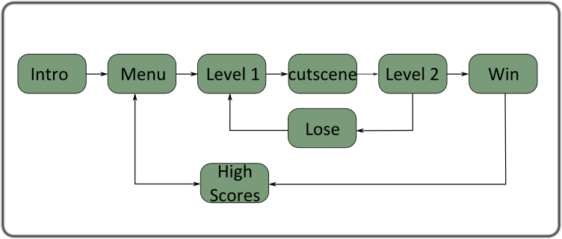
Scenes
Organiser votre jeu avec cocos.scene.Scene
utilisation cocos.scene.Scene(somelayer)

Slide 5
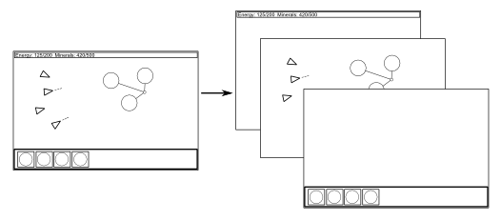
Layers
scroller = cocos.layer.ScrollingManager(
viewport=director.window)

Slide 6
Sprites
class Asteroid(cocos.sprite.Sprite):
def __init__(self):
super(Asteroid, self).__init__('asteroid.png')
Fourni
transformations (rotation, move)
Peut contenir des sprite qui héritent des transformations du parent

Slide 7
Mais Aussi
from pyglet.gl import (gluNewQuadric, glColor4f, glPushMatrix,
glPopMatrix, glTranslatef, glRotatef, gluDisk)
class Circle(cocos.batch.BatchableNode):
[...]
def draw(self, *args, **kwargs):
glColor4f(*self.color)
glPushMatrix()
glTranslatef(self.x, self.y, -self.z)
glRotatef(self.rotation, 0, 0, 0.1)
[...]
gluQuadricDrawStyle(self.quad, self.style)
gluDisk(self.quad, inner, self.radius, self.resolution, self.loops)
glPopMatrix()

Slide 8
Events
class EventEmitter(pyglet.event.EventDispatcher):
def do_something(self):
self.dispatch_event(
'on_purchase_order', **kwargs)
class EventListener(cocos.layer.Layer):
is_event_handler = True
def on_purchase_order(self, **kwargs):
pass
EventEmitter.register_event_type('on_purchase_order')
emitter = EventEmitter()
listener = EventListerner()
emitter.push_handlers(listener)

Slide 9
Resources
pyglet.resource.path.append('@pyco.data')
pyglet.font.add_directory(
pkg_resources.resource_filename('pyco', 'data'))
pyglet.resource.reindex()

Slide 10
Bonus
interactive console (CTRL-i)
toggle full-screen (CTRL-f)

Slide 11
Liens
cocos2d.org
  Licence BSD
  Works on Mac, Linux, Windows
  Pure Python
bitbucket.org/faide/pyco
  Licence MIT
  Pure Python

