Slide 1
Have you test your backup?
Boriss Mejías
Holistic system software engineer

Slide 2
Quick Survey

Slide 3
But it worked once!

Slide 4
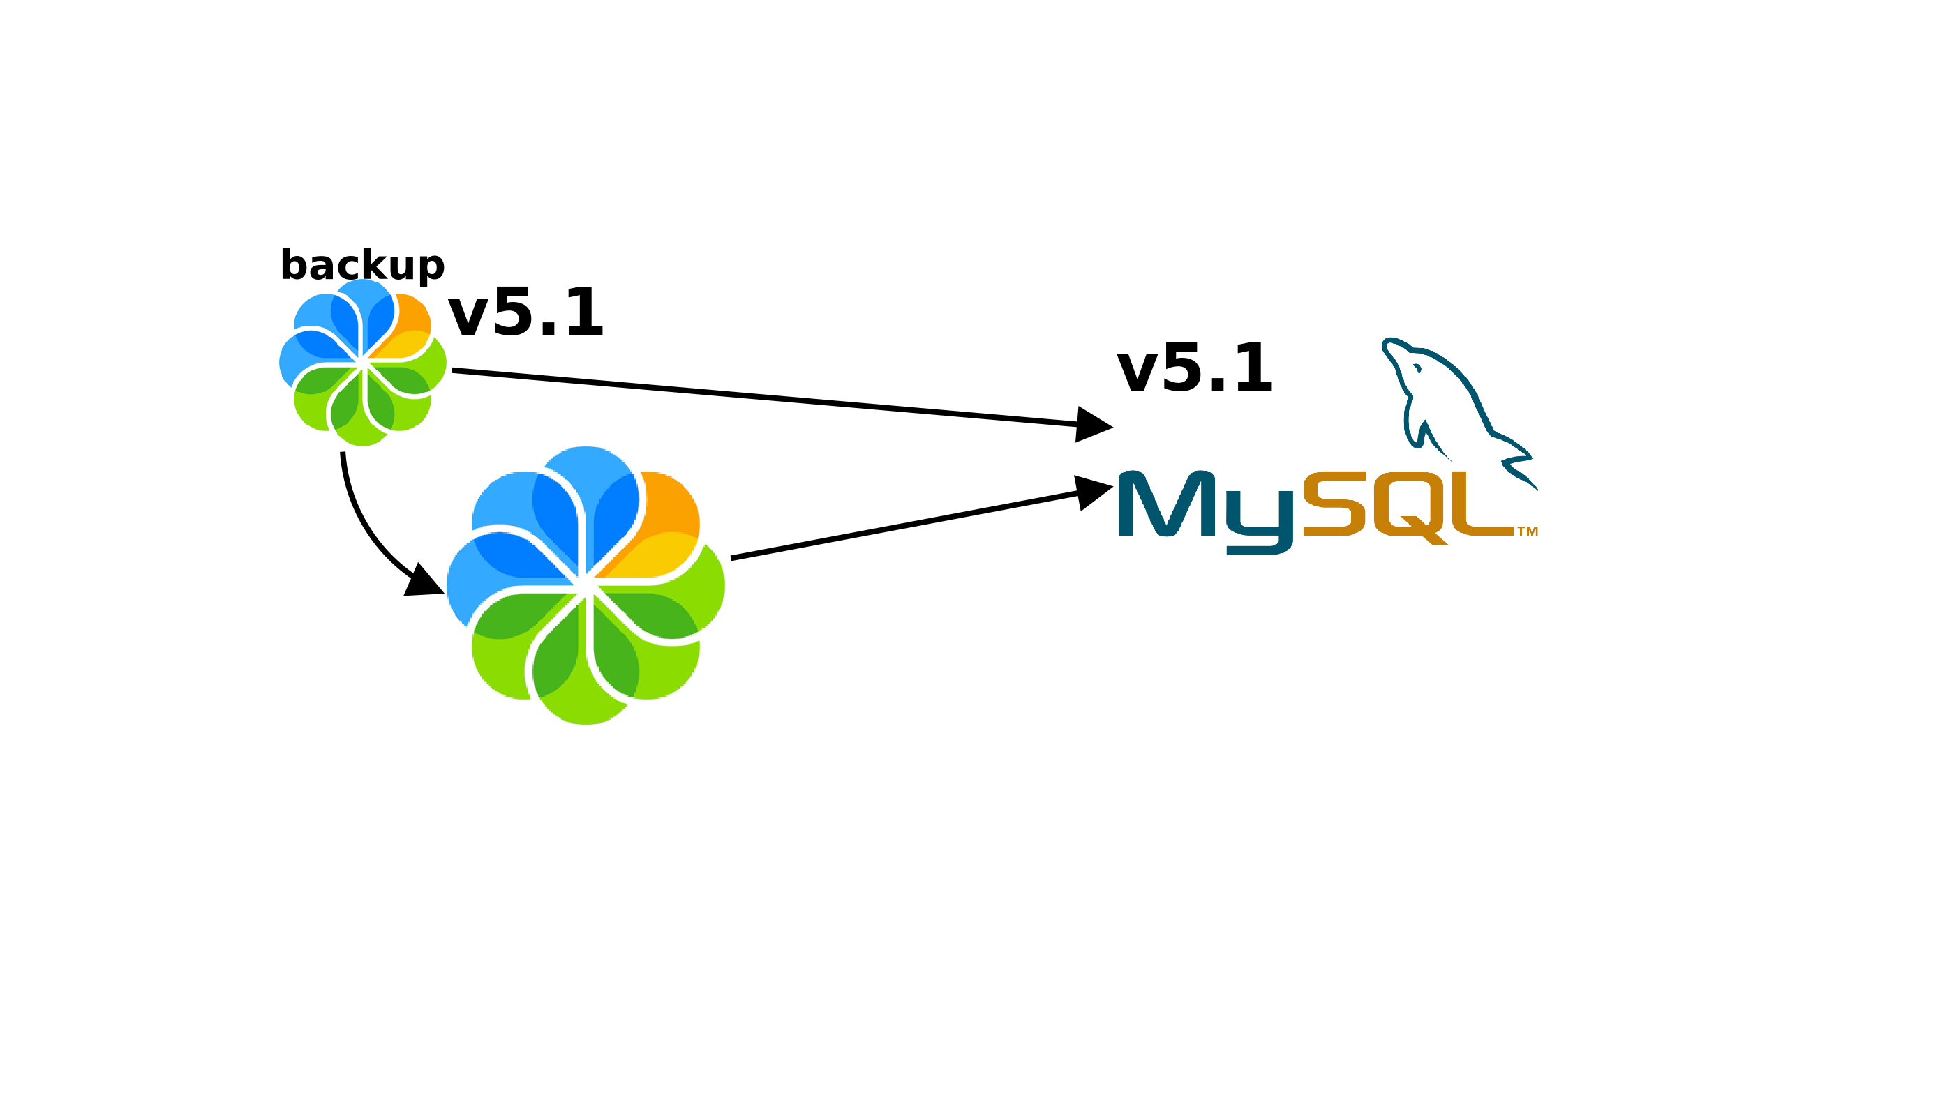
mysqldump incompatibility

Slide 5
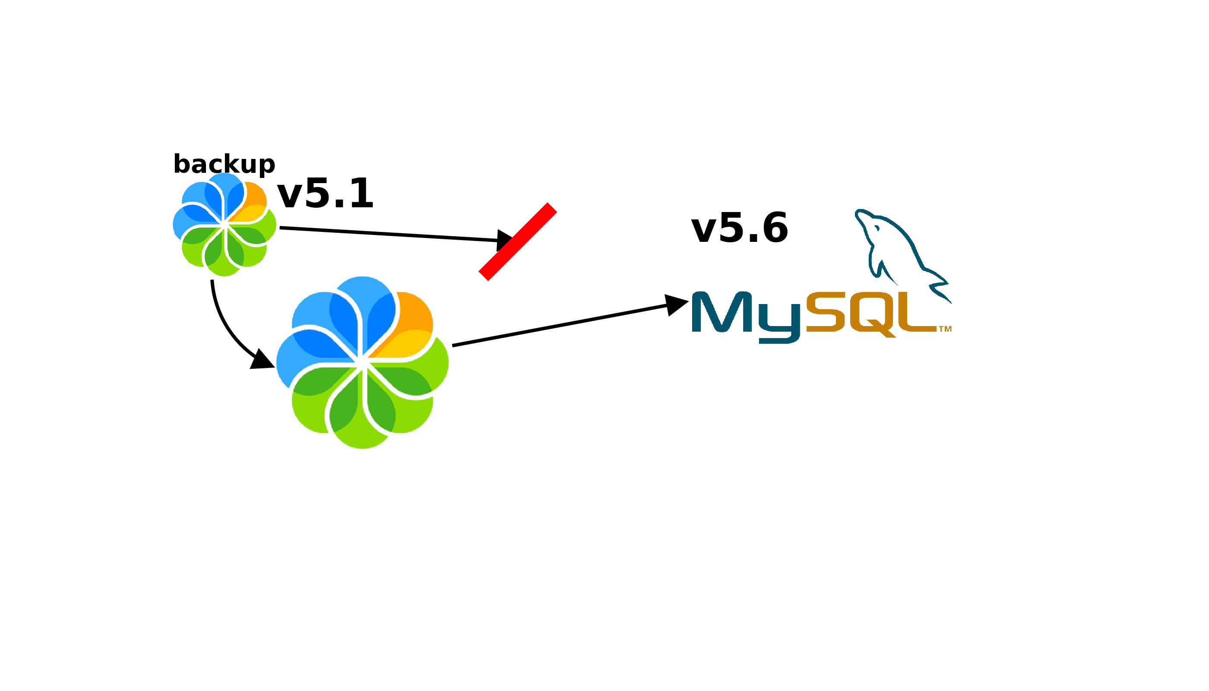
mysqldump incompatibility

Slide 6
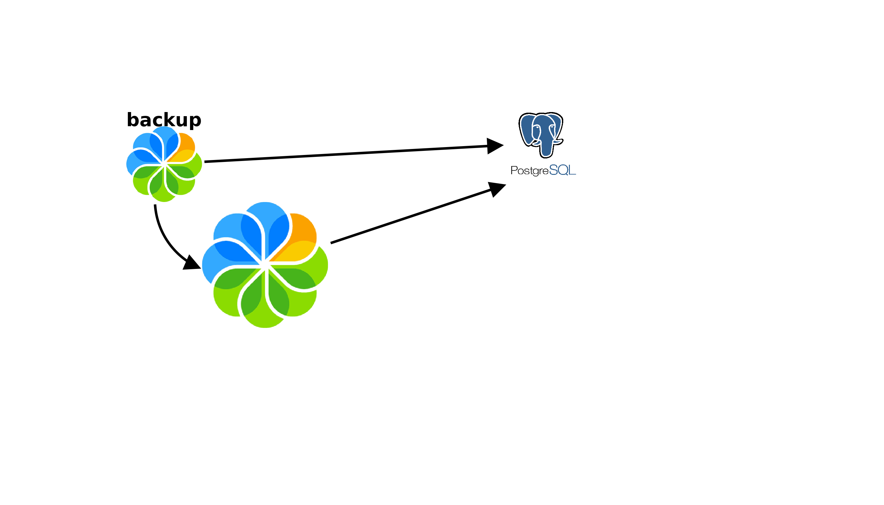
Database needs love

Slide 7
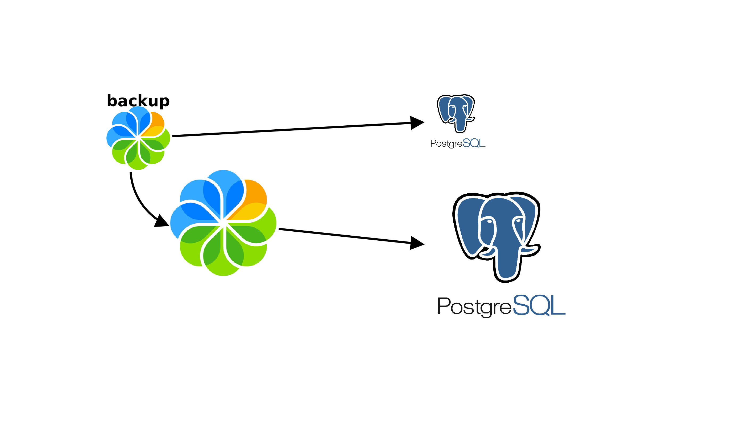
Database needs love

Slide 8
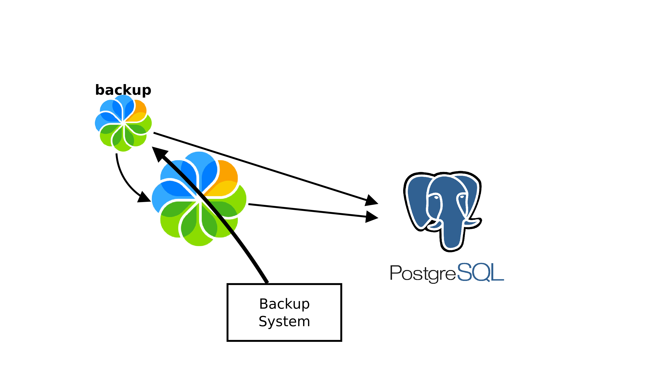
Upgrade Backup Software

Slide 9
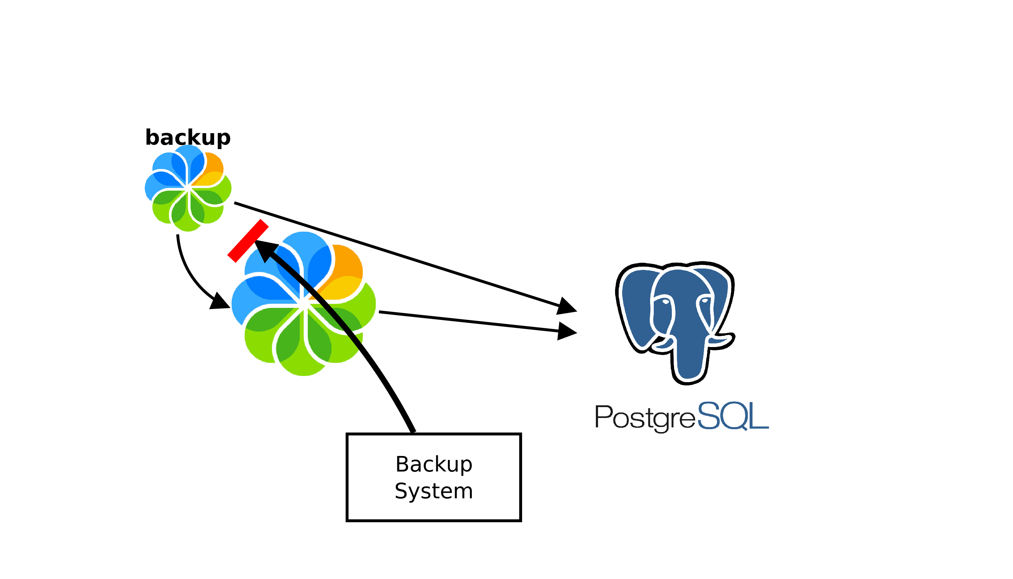
And stop reading network mounts

Slide 10
But it worked once!
And I didn't change the backup script

Slide 11
Let's start with
manual recovery tests

Slide 12
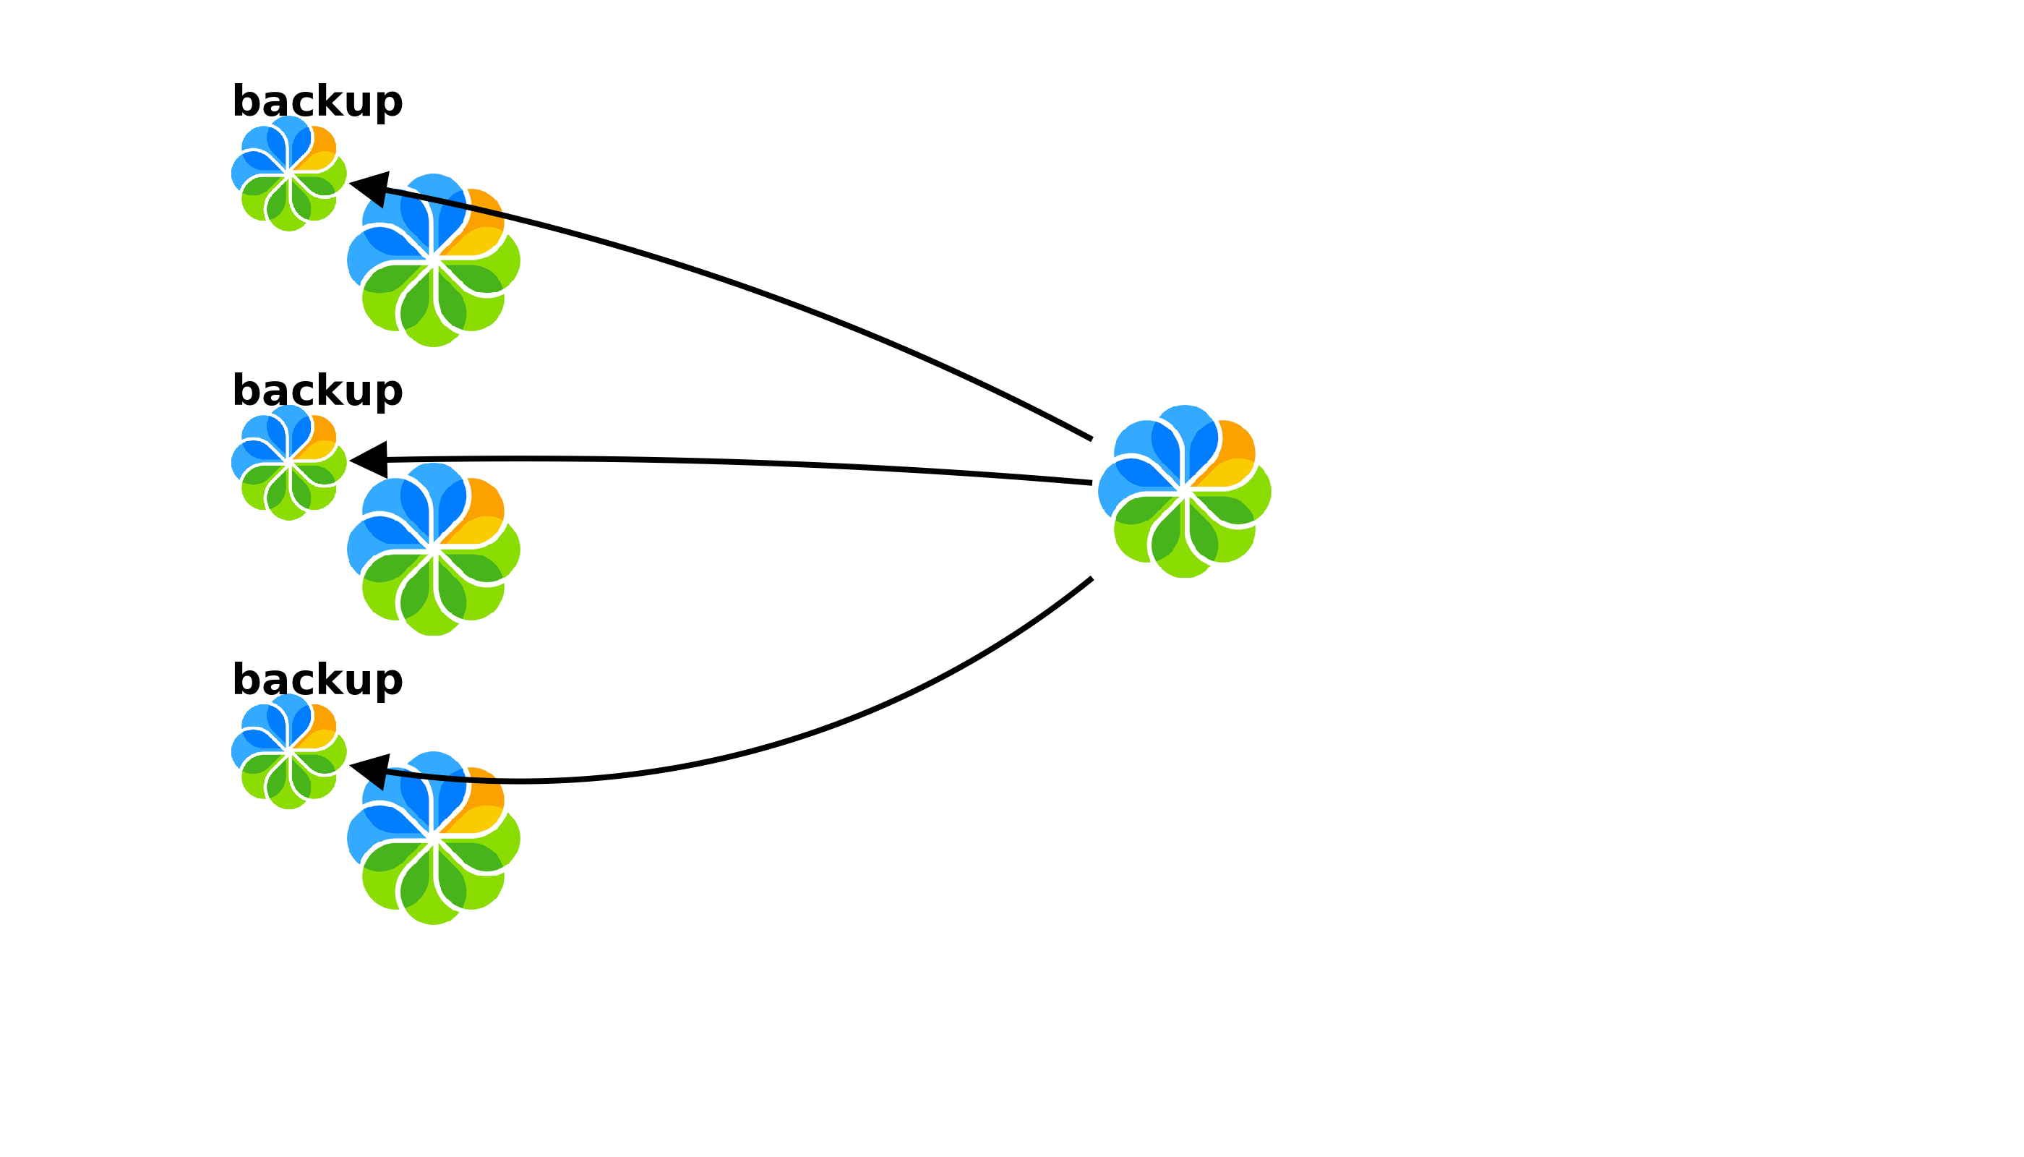
Automated daily recovery test

Slide 13
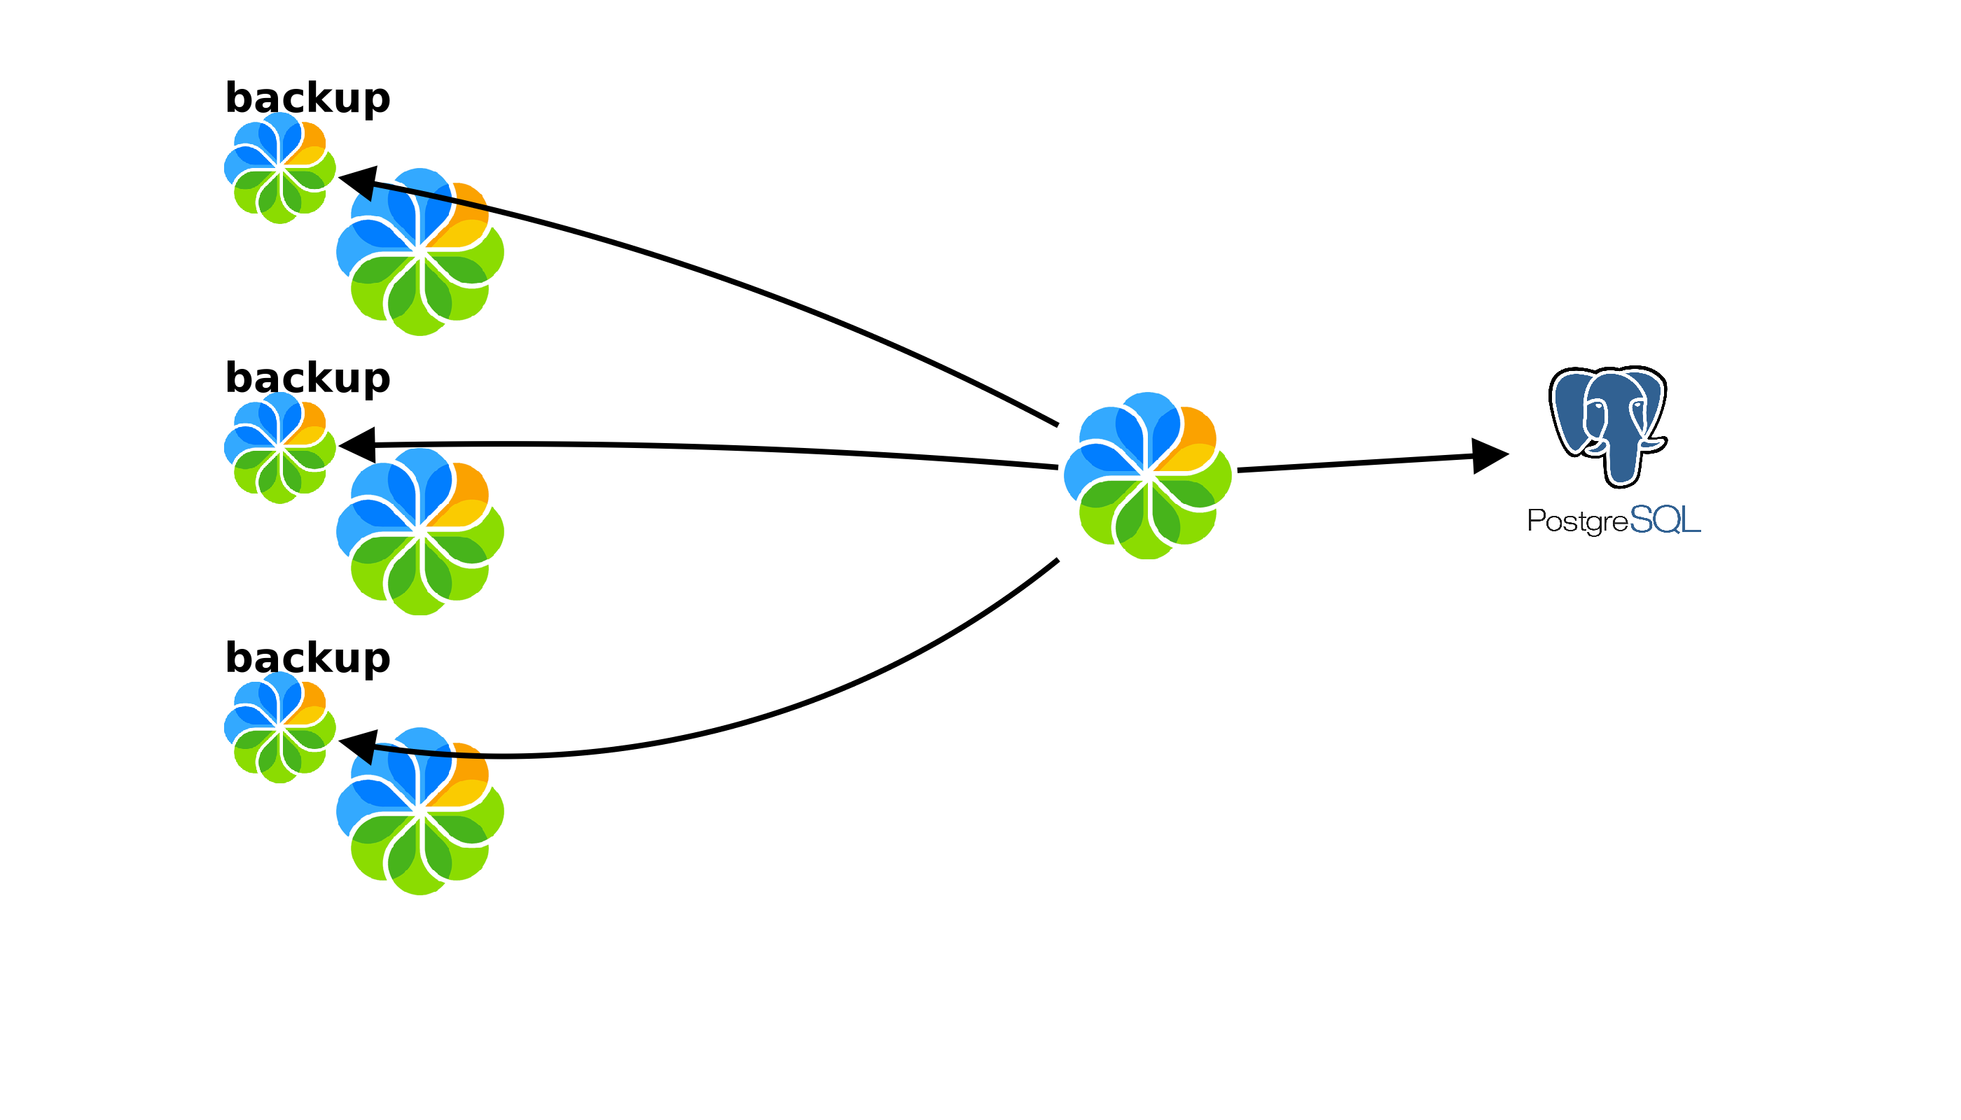
Automated daily recovery test

Slide 14
Does it start?
Can I login?
Correct content store?

Slide 15
Report
Server startup in 134961 ms
alf_nodes: 13623
Login: OK
Total files: 18697
Validated: 18697
Size NOK: 0
Orphans: 0

Slide 16
When it goes wrong
Total files: 88343
Validated: 88338
Size NOK: 0

Slide 17
When it goes wrong
Total files: 88343
Validated: 88338
Size NOK: 0
Orphans: {'noderef': 'archive://SpacesStore/b2d080ac-xxx-4acb29', 'filename': '$PATH/2014/2/12/15/25/242xxx.bin'}

Slide 18
When it goes wrong
Total files: 88343
Validated: 88338
Size NOK: 0
Orphans: {'noderef': 'archive://SpacesStore/b2d080ac-xxx-4acb29', 'filename': '$PATH/2014/2/12/15/25/242xxx.bin'}
Orphans: {'noderef': 'no node',
'filename': '$PATH/2014/2/12/15/19/511xxx.bin'}

Slide 19
What's next
Improve reporting
Verify Solr Indexes

Slide 20
What's next
Improve reporting
Verify Solr Indexes
Cold backups and Hot backups

Slide 21
From 4 restore tests a year
to
7 per day

Slide 22

Have you test your backup?
Boriss Mejías
Holistic system software engineer

