Slide 1
Load Testing Your Alfresco Add-ons
Michael Suzuki
Software Engineer
Notes:
----- Meeting Notes (26/04/16 13:00) -----
Who am I
Share the story of benchmark tools

Slide 2
Love Match Add-on
Alfresco Benchmark
Benchmark Goals
Demo
Additional Information
Source Code

Slide 3
Love Match Add-on
An Alfresco Add-on, built with the latest Alfresco SDK.
An endpoint that returns a JSON message.
An app that randomly picks 2 users from Alfresco and calculates their compatibility.

Slide 4
Alfresco Benchmark
Benchmark is made of 2 components, the drivers and a server.
Benchmark server manages configuration.
Benchmark drivers performs the actions.

Slide 5
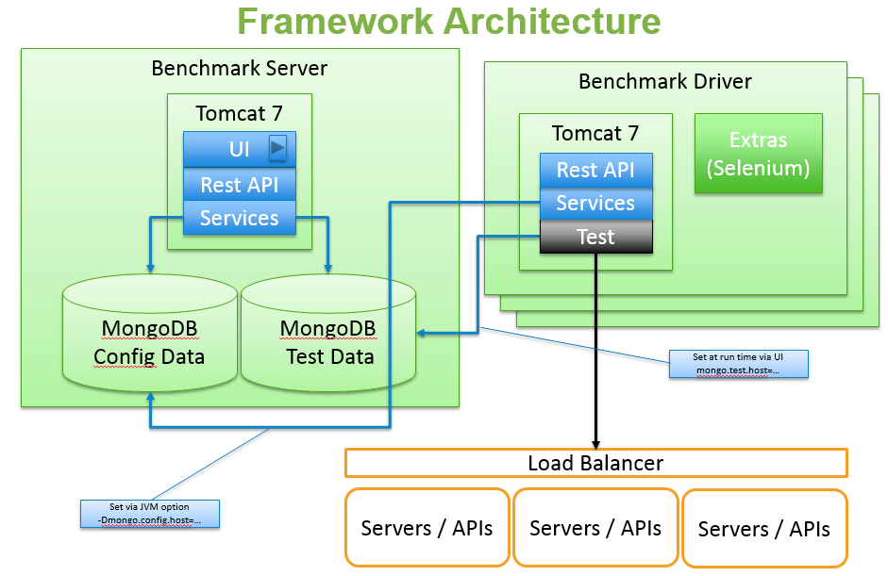

Slide 6
Benchmark Drivers
Signup
Dataload
PublicAPI
Share(Selenium)

Slide 7
Benchmark goals
Response time of 200 requests with:
4 users.
1000 users.
10,000 users.
50,000 users.

Slide 8
Demo

Slide 9
Additional Information
Benchmark Framework 2.0
Creating Benchmark Drivers
Benchmark Testing With Alfresco
Using Alfresco Benchmark Toolkit for Load and Scalability Testing
Alfresco SDK Demo Setup

Slide 10
Source Code
Love Match Sample AMP
Love Match Benchmark Driver
Benchmark Framework 2.0
Benchmark Drivers

Slide 11


@suzukimichael
github.com/AlfrescoBenchmark
github.com/michaelsuzukisagi

Slide 12
Thank you
Michael Suzuki
Software Engineer

