Slide 1

Alfresco 5.1: separating Platform and Share
Samuel Langlois Build engineer at Alfresco

Slide 2
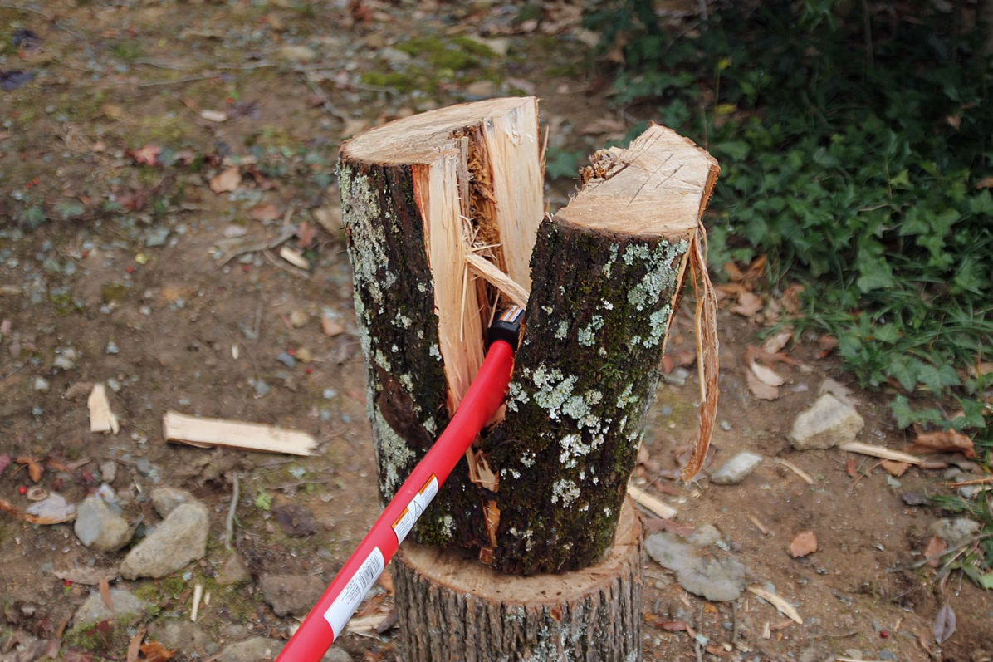
Splitting Platform and Share
Why?
What?
How?
What now?

Slide 3
Why?
Separate release lifecycles
More frequent releases of Share
Smaller, more incremental releases
Upgrade Share and Platform separately (Many customers don’t use Share anyway…)

Slide 4
Why?
Two smaller, more manageable code bases
Clearer code ownership
Smaller backlog
More agile!

Slide 5
What?
Where to chop?
Each jar/artifact: alfresco-core.jar | alfresco-data-model.jar | etc… ⇒ a bit too many!
Each war: alfresco.war | share.war ⇒ can’t update Share APIs

Slide 6
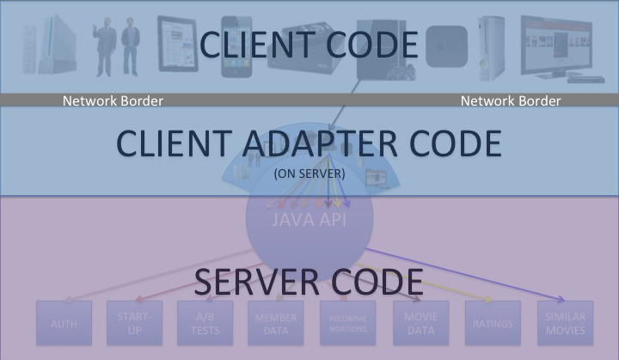
What?
Where to chop?
The « Netflix » model
Client side
Server side

Slide 7
What?
The share-services AMP
Alfresco One Platform (alfresco.war)
Alfresco One Share (share.war)
share- services AMP

Slide 8
What?
"Full packaging" still needed
Alfresco One aggregates:
Alfresco One Platform 5.1
Alfresco One Share 5.1
GoogleDocs integration 3.0.3
Alfresco Office Services module 1.1
…
How do we call it?
201601(-EA|-LA)

Slide 9
What?
Alfresco One 201603 - Installers (Win, OSX, Linux) - Distribution zip - EAR
Alfresco One Platform 5.1 - Installers (Win, OSX, Linux) - Distribution zip - Solr - EAR - File Transfer Receiver
Alfresco One Share 5.1 - Installers (Win, OSX, Linux) - Distribution zip - Web Quick Start / Web Editor

Slide 10
What?
What about Community Edition?
"Full packaging" only, because
No cluster: most installations are single-node
Little need for separate release lifecycle
No hotfix releases
Used for evaluations -> KISS!

Slide 11
How?
Needed to separate common components
alfresco-core (should really be called Common…)
JLan
surf-webscripts
Surf
These are now released separately

Slide 12
How?
Alfresco One Platform
Alfresco One Share
JLan
Surf
core

Slide 13
How?
Needed to cut a few cyclic dependencies
Moved Share, Surf, etc. in different codebases
Same Subversion server, for maintenance reason
Maven FTW!

Slide 14
What now?
Technical side done
We didn’t go as far as we wanted
5.1.X Service packs/hotfixes still provided as one packaging
Compatibility between Share 5.1.X and Platform 5.1.Y?
Need
More tests for independent modules
Reliance on public API exclusively

Slide 15
What now?
Alfresco One
Alfresco One Platform
Surf
Alfresco One Share
JLan

Slide 16

What now?
Alfresco One Platform
Surf
Alfresco One
JLan
Alfresco One Share

Slide 17

What now?
More separations considered
Search?
REST APIs?
…
Moving to Git?

Slide 18
?

