Slide 1
ACTIVITI 6
The Next Evolution Of BPM Awesomeness

Slide 2


whoami
Co-founder of the Activiti project
Principal Software Engineer @ Alfresco
https://github.com/jbarrez
https://twitter.com/jbarrez
Tweets are appreciated!
#beecon2016 #Activiti

Slide 3

Let’s talk about
The Why
The How
Pluggable Persistence
Upgrading/Compatibility
Dynamicity
Performance
Q&A

Slide 4
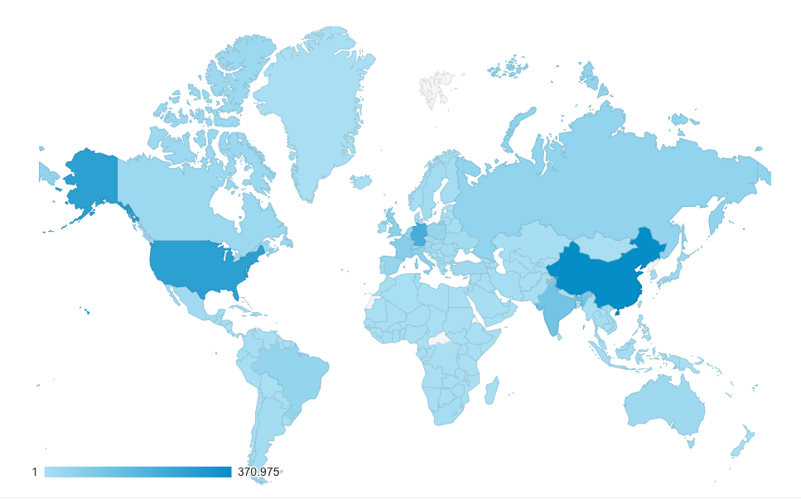
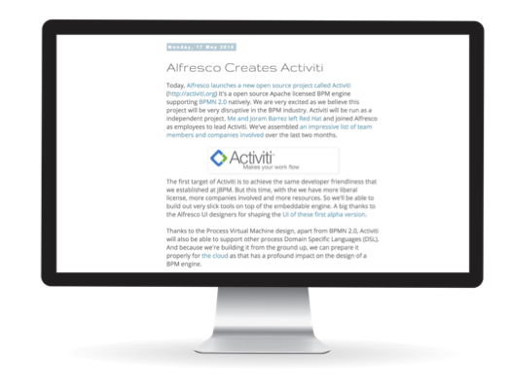
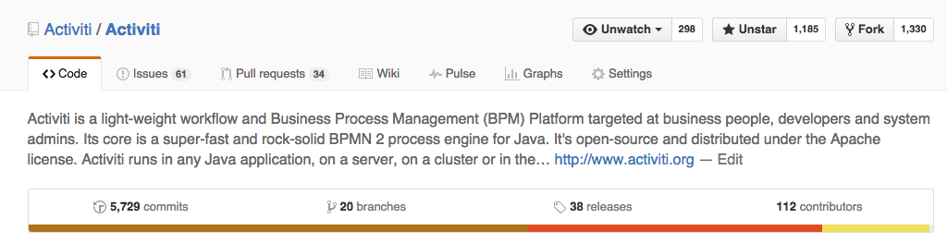
Six years ago…
1 March 2010 : Joram & Tom join Alfresco
17 May 2010 : Alfresco launches Activiti 5.0.alpha1
39 releases since

Slide 5
Over the past years
Has not changed
The API’s
Concepts
Database schema
BPMN 2.0
The number of features/integrations has only grown
Always in a flexible and pluggable way
A core goal has always been stability
Without comprimising in use cases, with a clear focus on performance

Slide 6
Over the past years
The codebase has grown seriously
By different people/companies, with different focus/use cases
We have learned a lot on how Activiti is used
Open source channels
Alfresco Activiti’s customers

Slide 7

Things that make Activiti great
Clean and easy to use API
Lightweight, embeddable engine
Many pluggability points
Stateless scaling
Docs
Standardized on BPMN 2.0
Liberal Apache license
A UI to demonstrate the features
And needs only minutes to set up

Slide 8
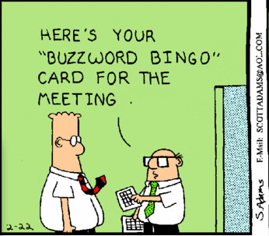
Software development is changing
Commodization of server hardware / Cloud
REST
Docker
Microservices
Reactive
NoSql
BigData
…
Activiti is already compatible with most/all of these!

Slide 9
The processes are changing
Automation is still necessary
Knowledge workers vs line workers
The software needs to reflect that
Handling the out-of-bounds
Software needs to summarize and give eagle-eye view and help in decision making

Slide 10
So why Activiti 6?
Activiti v6 is not a rewrite and not a new engine
Activiti v6 is an evolution of the core engine
Taking in account all what is good about Activiti
Supporting the architectures of today/future
Supporting the users of today/future
After all these years of we were really tired of the ‘5’

Slide 11
Design Goals
Backwards compatibility
- API, DB Schema, concepts, integrations, …
2. Simple runtime structure and execution
3. Evolution of core execution of process logic
No more model transformation
Direct execution/interpretation of Bpmn Model
One algorithm for defining runtime structure
4. Dynamic process instance/definition modification support
5. Performance

Slide 12
A deployed process
Feed BPMN 2.0 XML into engine
Parse XML to in-memory object representation
In v5: ‘PVM model’
In v6: BPMN model
Type of step determines ‘activity behaviour’
ServiceTaskActivityBehaviour
UserTaskActivityBehaviour
Feed
Parse
Visit

Slide 13
The Execution Tree
Process definitions: instantiate process instance
One run of the process definition
Represented as ‘execution tree’
A representation of ‘where we are’
Why a tree?
Efficient relational storage
Optimized to reduce collisions
Maps well to the process graph
Process instance node
Subprocess scope
Usertask A
Service task x

Slide 14
Interceptor
stack
Activiti v6 Engine
Service
Command
logic
Service
Command
API call
Service
Command
…
…
Service
Command
Typically: 1 Service API call == 1 Command

Slide 15
TaskEntityManager
ProcessDefinitionEntityManager
A typical command:
Fetch state from db
Plan operation on agenda
Execute behaviours
Plan new operations
Operations manipulate execution tree
Changes get persisted
CommandContext
…
Command
HistoryManager
ContinueProcessOperation
Agenda
TakeOutgoingSeqFlowOp.
…

Slide 16
DEMO
https://github.com/jbarrez/beecon-2016-examples/tree/master/agenda-example

Slide 17
Pluggable Persistence
Goal
Data objects (the entity) should be pluggable
(eg jpa impl uses annotations, nosql could store data in different layout)
Data services (the entity managers) should be pluggable
A huge refactoring
V5 did not have any interfaces in this layer
No clear responsabilities
Consolidating methods calls
Consistency

Slide 18
Pluggable Persistence
Not implemented in isolation
One dedicated customer
Community feedback
Tested for NoSQL
Non-transactional is still a challenge

Slide 19
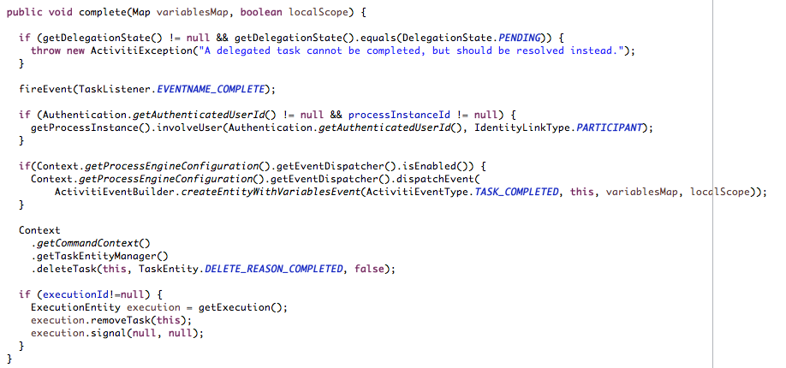
Example
TaskEntity complete method in v5

Slide 20
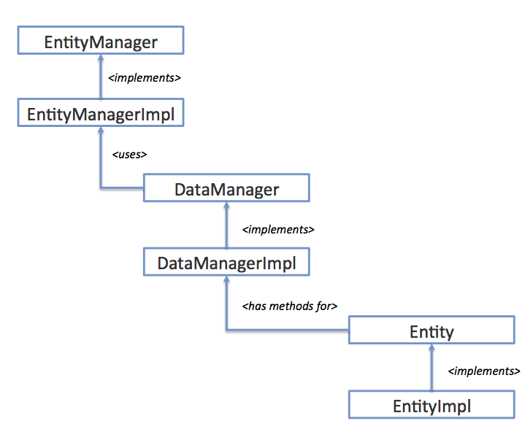
Version 6
See TaskEntityImpl

Slide 21
DEMO
https://github.com/jbarrez/beecon-2016-examples/tree/master/pluggable-persistence-example

Slide 22
Backwards Compatibility
API
DB Schema
Process Definitions
Java Delegates
Integration with other frameworks (Spring, Camel, …)
Embeddability
Concepts

Slide 23
Not backwards compatible?
Core changes are in org.activiti.impl
Job Executor
Minor stuff that is quickly migrated:
Method signature changed for JavaDelegate/ActivityBehaviour
‘throws Exception’ is gone
signal() is now called trigger()
ActivityBehaviours that use PVM datastructures/methods
Custom BpmnParseHandlers probably use ActivityImpl
Assuming that an execution == process instance for simple processes

Slide 24
Just drop the jar
The upgrade of 5.x.x → 6.0.0 is like any regular Activiti update
Drop jar, auto upgrade db (or execute DDL changes)
During that upgrade, existing deployments are tagged with ‘V5’

Slide 25
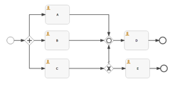

runtimeService.startProcessInstanceByKey(“”)
Activiti v6 Engine
Mini v5 engine
Get process definition
DB
Execute V5 process instance
Same applies for every point where
A process instance can be continued:
Task complete
Signal
Event triggered
Job executed
…
v5

Slide 26
Migration of process definition to v6
Backwards compatibility is enabled by having ‘activiti5-compatibility’ dependency on classpath
Old process instances keep running against v5 ‘mini-engine’
Runtime execution is different from v6
Running process definition in v6 is
Migrating your custom logic
Running your tests
Deploying a new version of the process definition

Slide 27
DEMO
https://github.com/jbarrez/beecon-2016-examples/tree/master/upgrade-example

Slide 28
Dynamicity: Why it becomes easier
Runtime structure predictable
dynamically adapting it becomes easier
No edge cases that can be forgotten
Direct BPMN model execution
No two layer mapping to internal model
(theoretically) Dynamic change means going from one model to a derived one

Slide 29
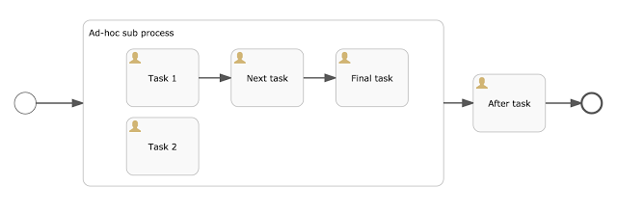
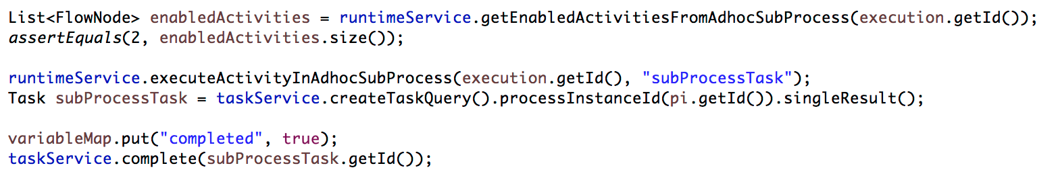
Adhoc subprocesses

Slide 30
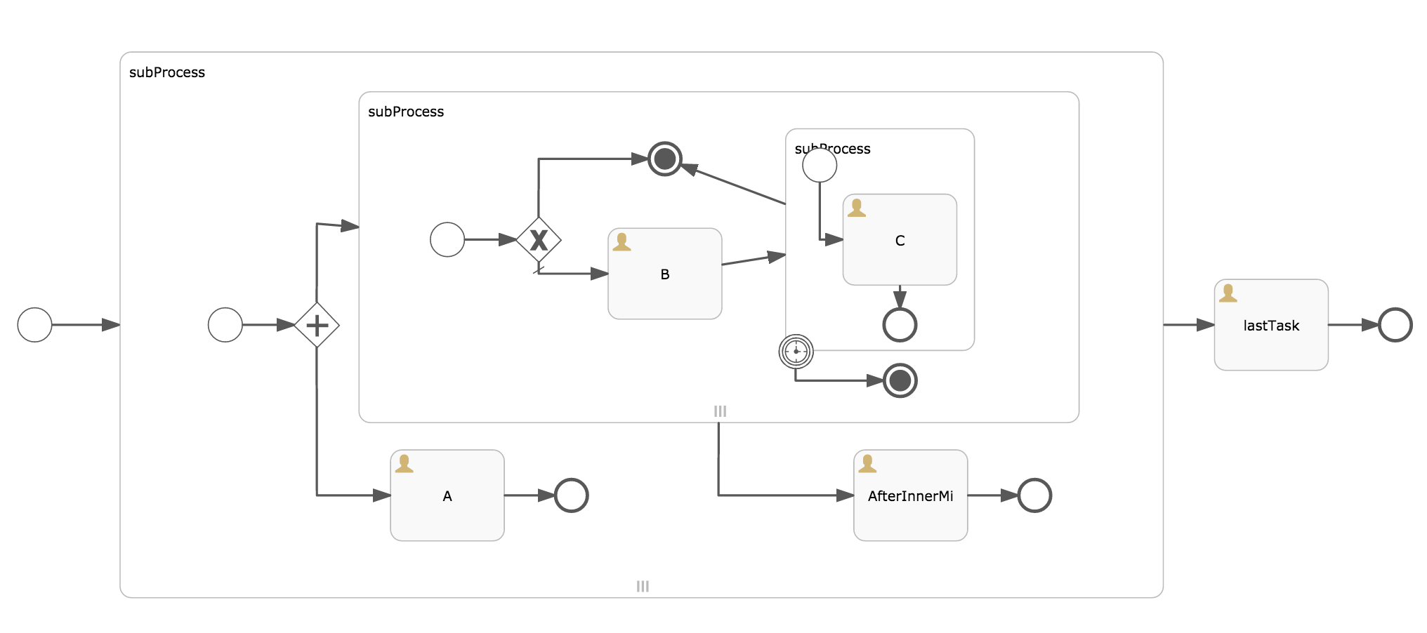
Terminate Multi Instance
72
12

Slide 31
Performance
One of the core focus areas of Beta3
Memory usage similar to v5
Clearer execution tree algorithm, but at the costs of more executions
More db rows ➔ more updates, more cleanup
Consolidated and consistent data services
Opens up paths to optimization

Slide 32
Current experiments
Execution tree fetching
When fetching one element of the execution tree, always fetch the whole thing
Roundtrip to db outweighs extra query time + data transfer
‘Counting’ executions
Cleanup of tree: check if related data exists (vars, jobs, tasks, …)
Keep a count on the execution itself. Only query if > 0
In v6 easy, as there is but one entry point when an execution is created/deleted
More areas yet uncharted
eg async history

Slide 33
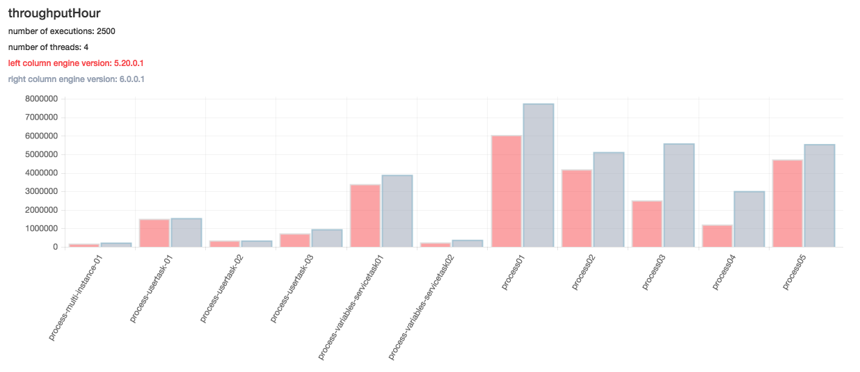
Some Results

Slide 34
<eof>
The programmer, like the poet,
works only slighty removed from pure thought-stuff.
He builds castles in the air.
~ Fred Brooks

