Slide 1

Externalizing permissions in Drools
Samuel Masué
Software developer at CERN

Slide 2
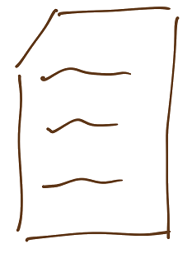
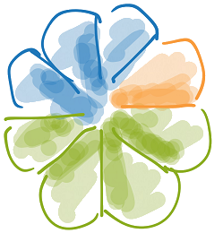
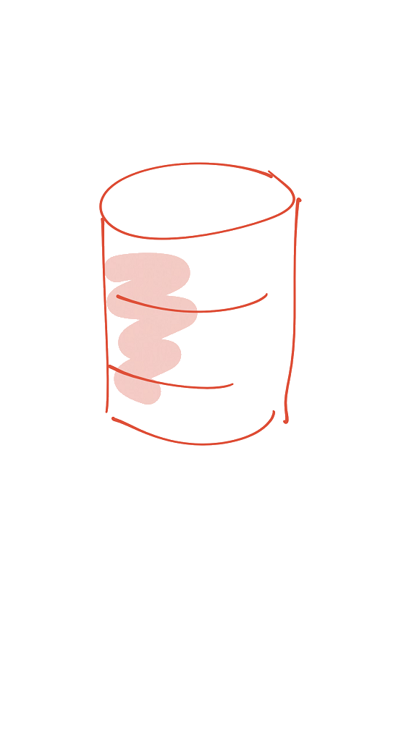
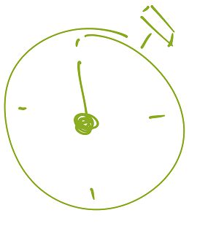
document level
meta-data
external
refreshed

Slide 3
document level
meta-data
external
refreshed

Slide 4
behaviour
permission service

Slide 5
behaviour
permission service
webscript
node service
dynamic
authorities

Slide 6
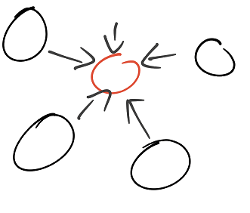
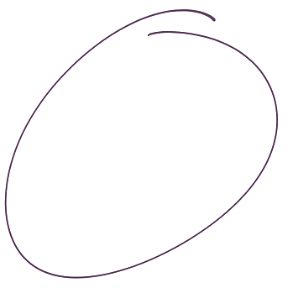
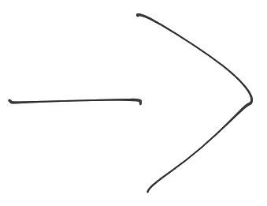
rules engine
centralized

Slide 7



centralized

Slide 8
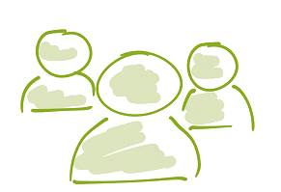
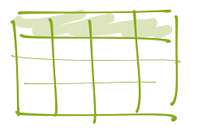
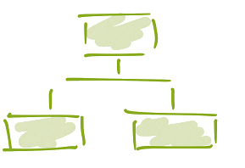
facts

Slide 9
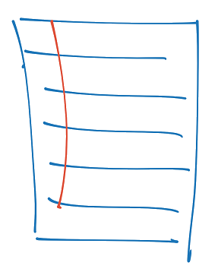
rules
facts

Slide 10
Get document’s ACL
document
ACL
rules
user
Get user’s authorities
authorities
user + doc
reason
Why can I see this document?
facts

Slide 11
Get document’s ACL
document
ACL
rules
user
Get user’s authorities
authorities
user + doc
reason
Why can I see this document?
facts

Slide 12
Parameter table (Drools facts)
who?
what?
of whom?
permission
group(HR)
CV
all
read
role(supervisor)
contract
supervisee
read
alf(creator)
ID card
all
delete

Slide 13
Parameter table (Drools facts)
who?
what?
of whom?
permission
group(HR)
CV
all
read
role(supervisor)
contract
supervisee
read
alf(creator)
ID card
all
delete

Slide 14




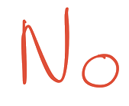
Integration with Alfresco
creation
access
update

Slide 15

creation
one single behaviour
node service
permission service
get node properties
generate document ACL
set permission

Slide 16
creation
one single behaviour
node service
permission service
get node properties
generate document ACL
set permission

Slide 17
access
permission service
get ACL
get authorities

Slide 18

access
override get authorities
authority service
smart override
get authorities
get custom authorities

Slide 19
access
override get authorities
authority service
smart override
get authorities
get custom authorities

Slide 20
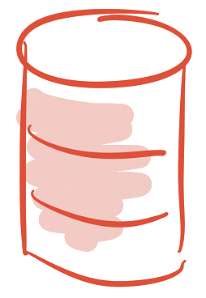

update
scheduled job
who?
what?
…
permission service
get last changes
select impacted
nodes
update permission

Slide 21
update
scheduled job
who?
what?
…
permission service
get last changes
select impacted
nodes
update permission

Slide 22

Externalizing permissions in Drools
Samuel Masué
Software developer at CERN

