Slide 1
Load Testing Your Alfresco Add-ons
Michael Suzuki
Software Engineer

Slide 2
Introduction
Alfresco Benchmark
Love Match Add-on
Benchmark Goals
Demo
Additional Information
Source Code

Slide 3
Alfresco Benchmark
Benchmark is made of 2 components, the drivers and a server.
Benchmark server manages configuration.
Benchmark drivers performs the actions.

Slide 4
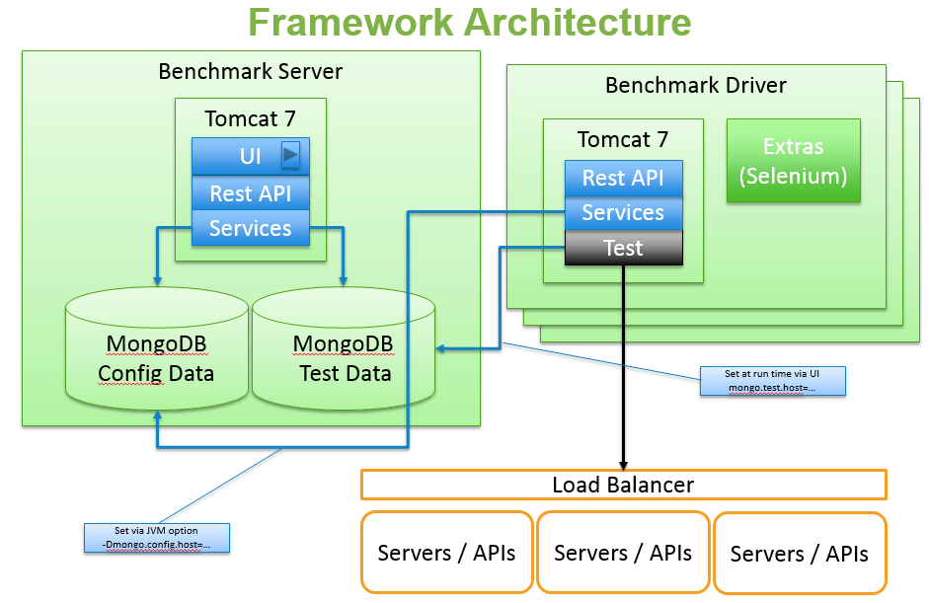

Slide 5
Love Match Add-on
An Alfresco Add-on, built with the latest Alfresco SDK.
An endpoint that returns a JSON message.
An app that randomly picks 2 users from Alfresco and calculates their compatibility.

Slide 6
Benchmark goals
Response time of 300 requests with 4 users.
Response time of 300 requests with 1000 users.

Slide 7
Demo

Slide 8
Additional Information
Benchmark Framework 2.0
Creating Benchmark Drivers
Benchmark Testing With Alfresco
Using Alfresco Benchmark Toolkit for Load and Scalability Testing
Alfresco SDK Demo Setup

Slide 9
Source Code
Love Match Sample AMP
Love Match Benchmark Driver
Benchmark Framework 2.0
Benchmark Drivers

Slide 10


@suzukimichael
github.com/AlfrescoBenchmark
github.com/michaelsuzukisagi

Slide 11
Thank you
Michael Suzuki
Software Engineer

