Slide 1

NBA Analytics 2020 -2021
Alicia Fazzone
cs 688

Slide 2


Analyze the top players shooting percentages for the Boston Celtics
Compare the Celtics Offense, Defense, and Penalties vs their rival the Lakers
Overall analysis of points, rebounds, and assists across the entire league per aggregate team position

Slide 3
Offensive Data Points
Field Goals Made
Threes Made
Free Throws Made
Offensive Rebounds
Assists
Field Goals Attempted
Threes Attempted
Free Throws Attempted
Total Points

Slide 4
Defensive Data Points
Steals
Blocks
Total Rebounds

Slide 5
Penalty Data Points
Turnovers
Personal Fouls
Ejections

Slide 6
Other Data Points
Team
Position
Games Started
Games Played
Total Minutes Played

Slide 7





Celtics Shooting Percentages

Slide 8
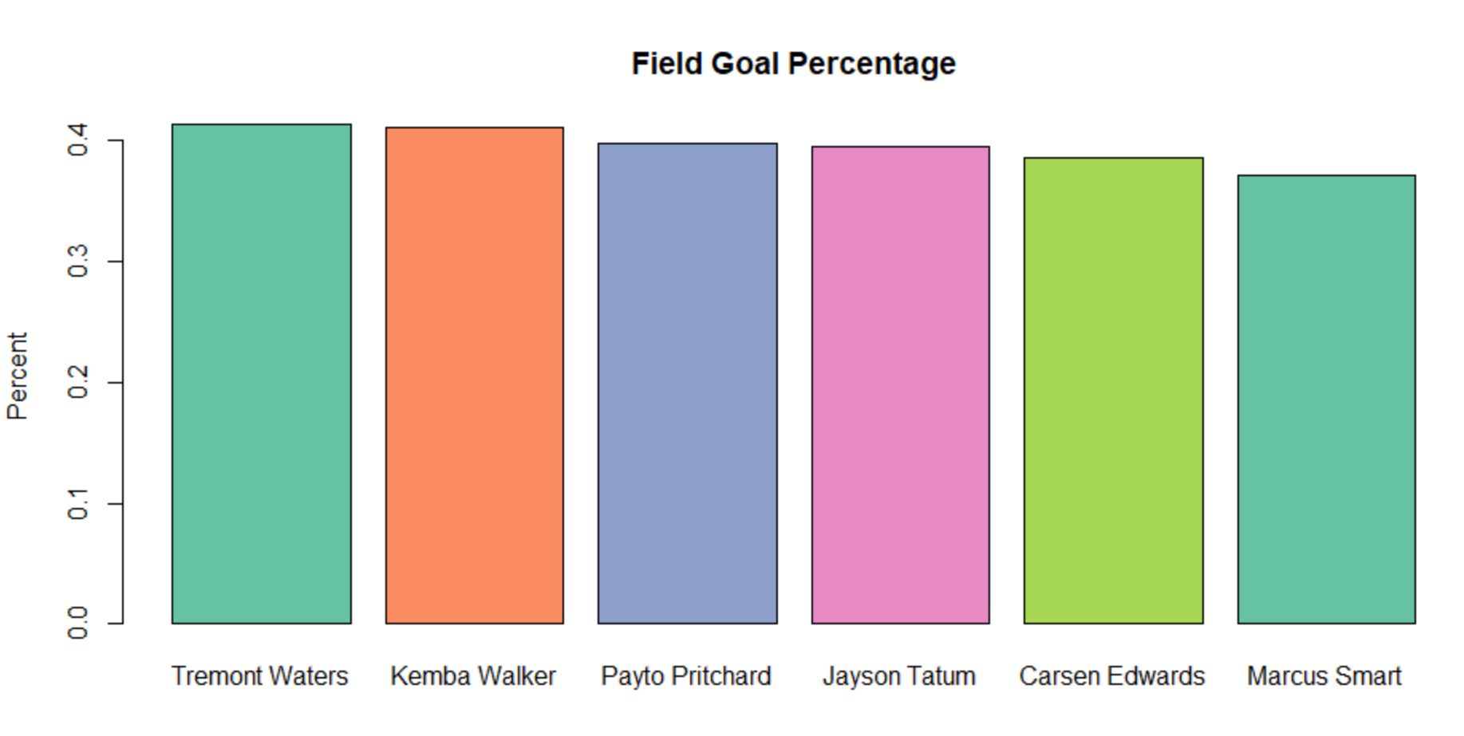

Slide 9
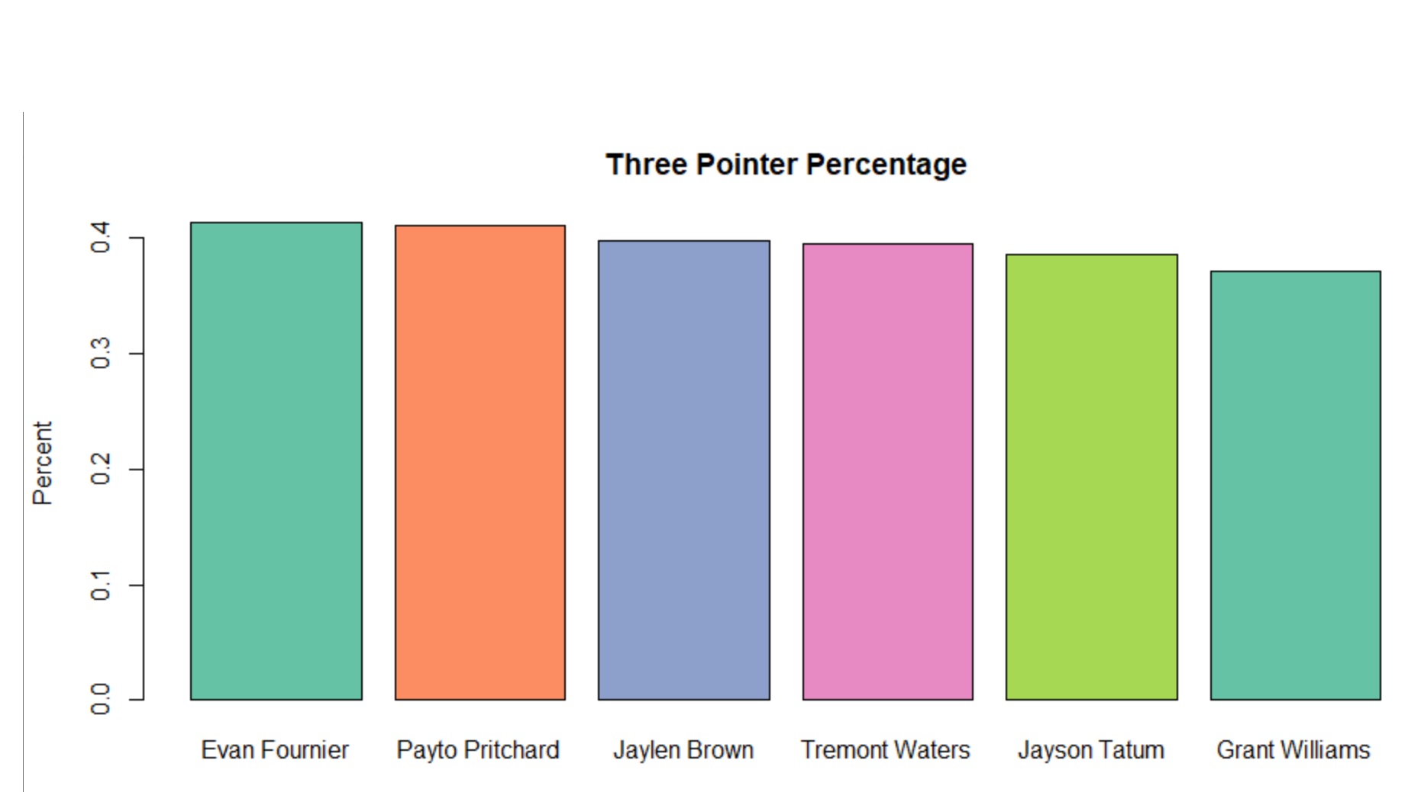

Slide 10
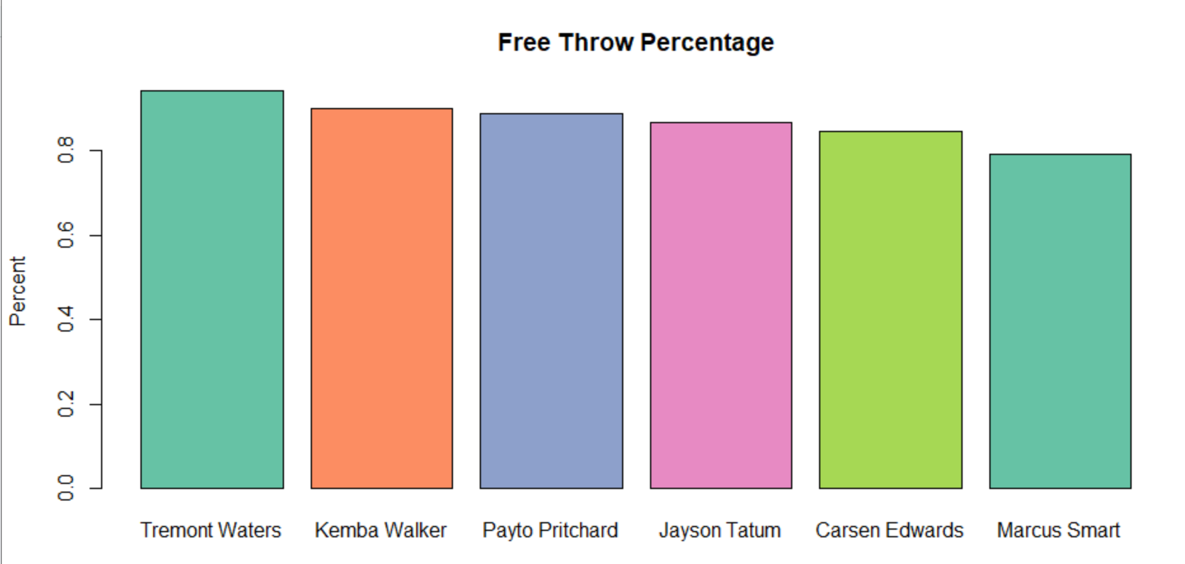

Slide 11
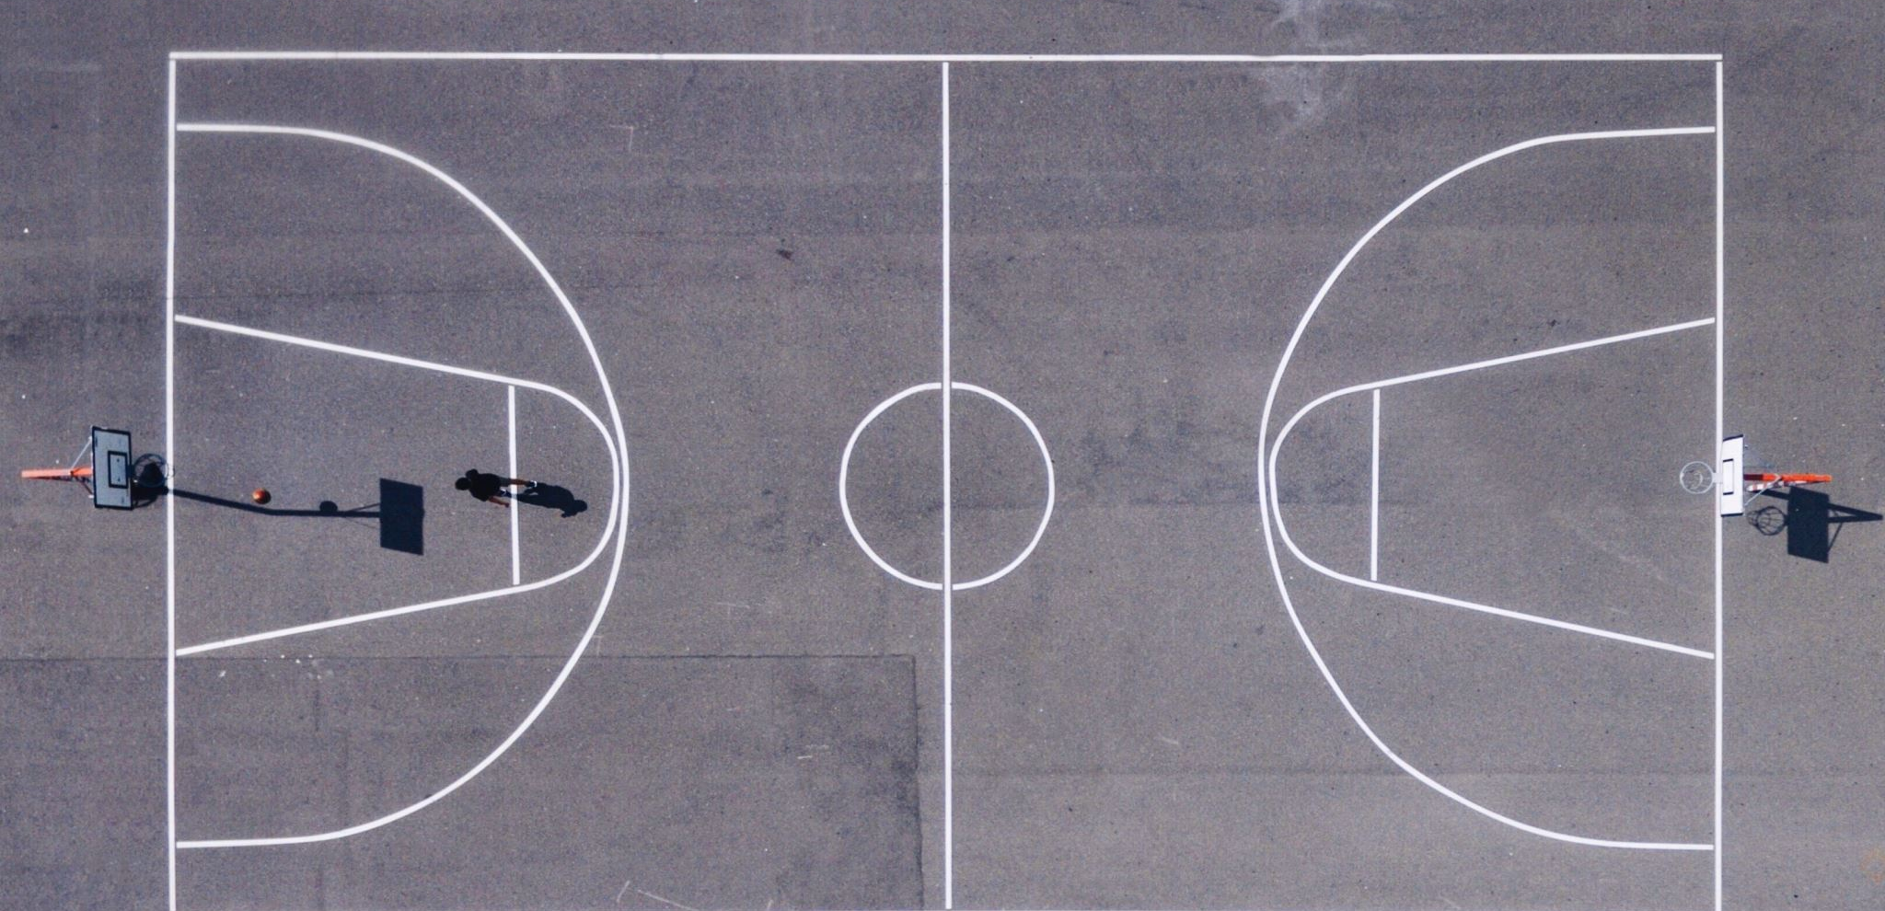
Celtics vs Lakers

Slide 12
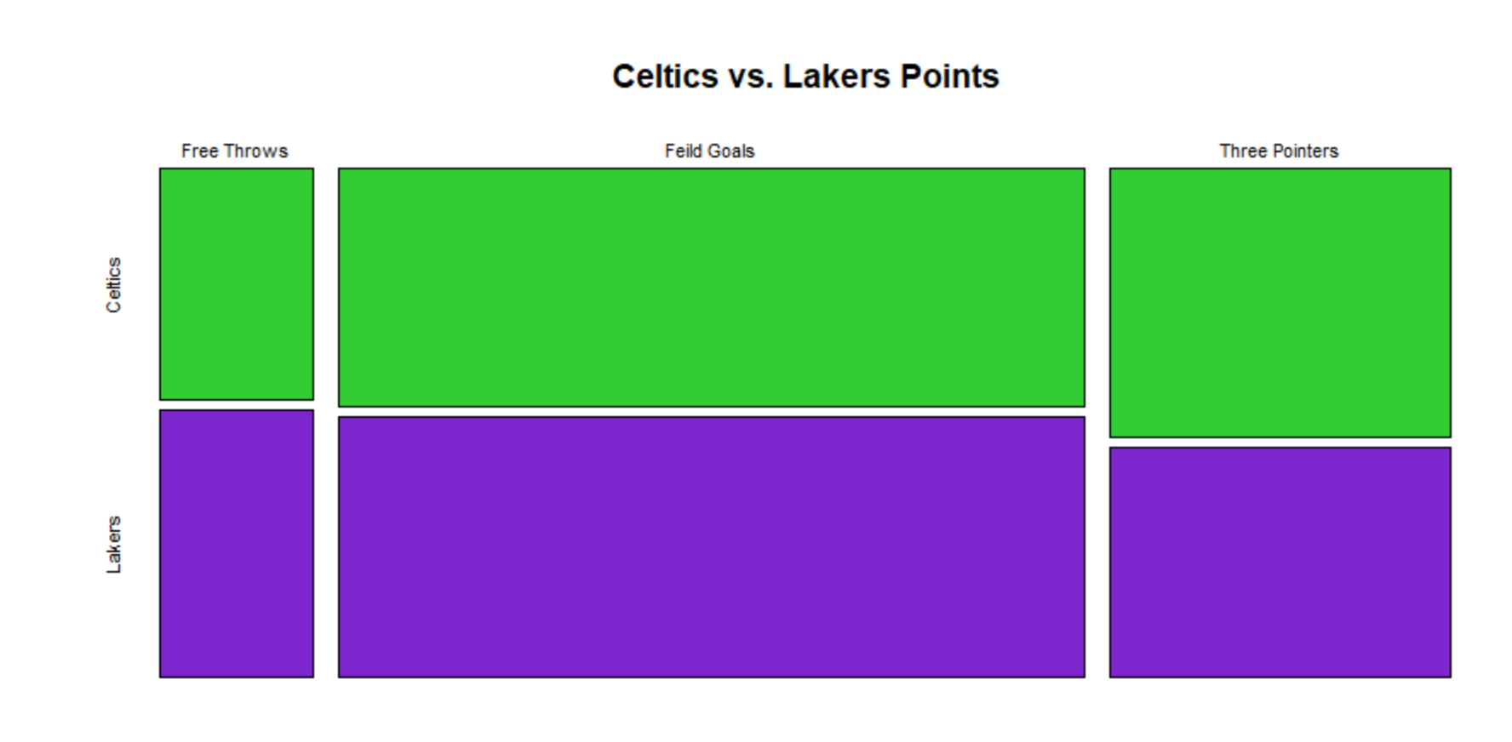

Slide 13
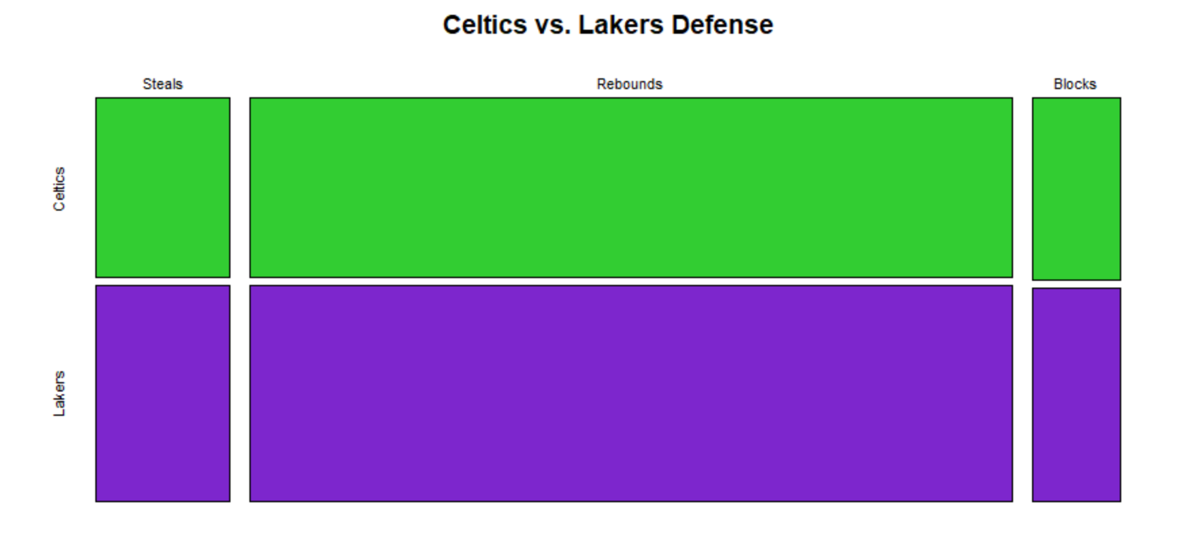

Slide 14
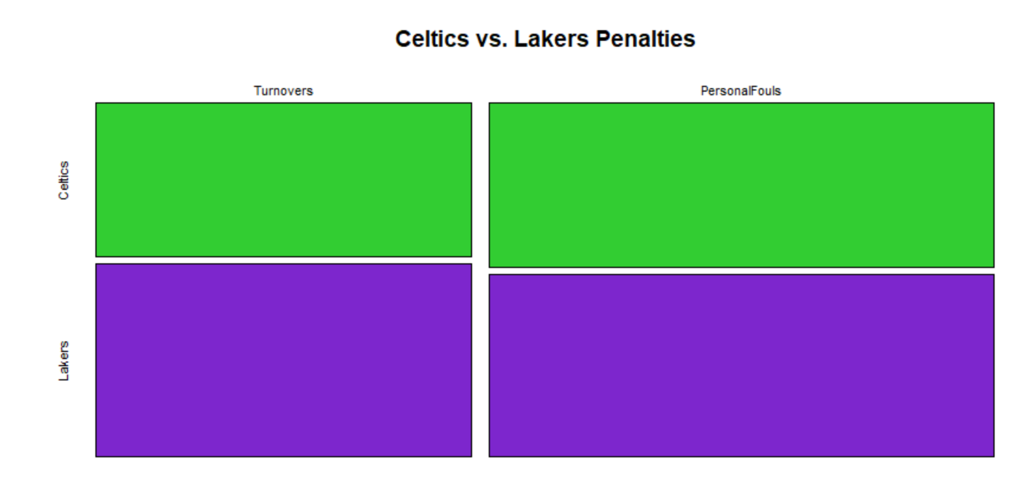

Slide 15

Aggregate NBA stats by Player Position

Slide 16
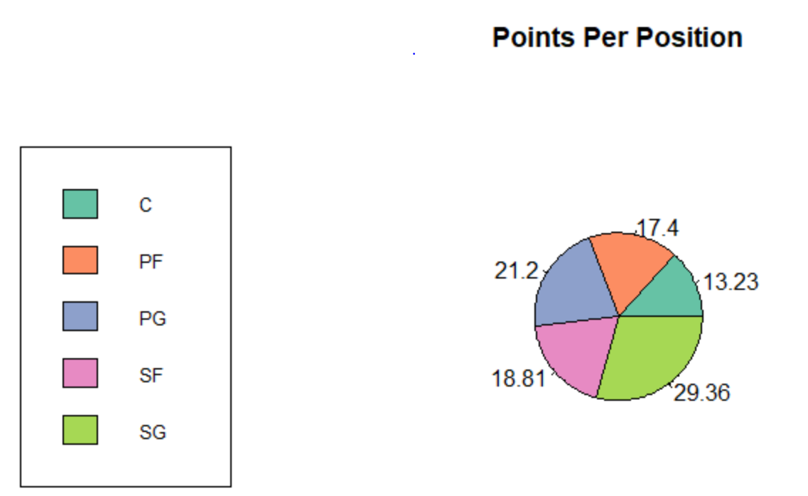

Slide 17
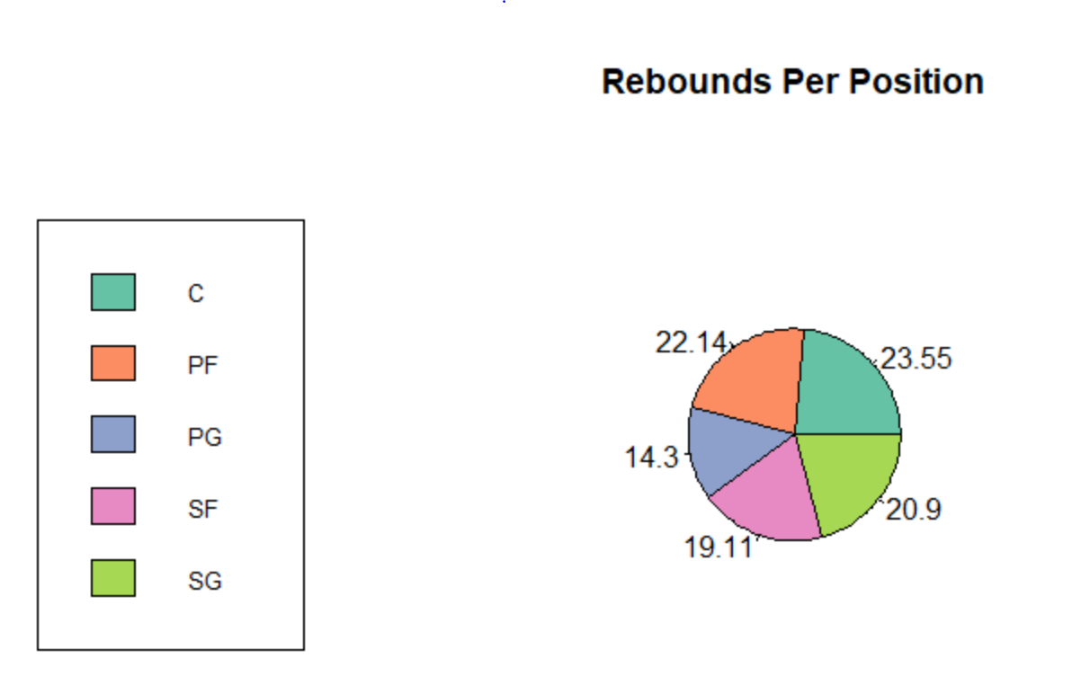

Slide 18
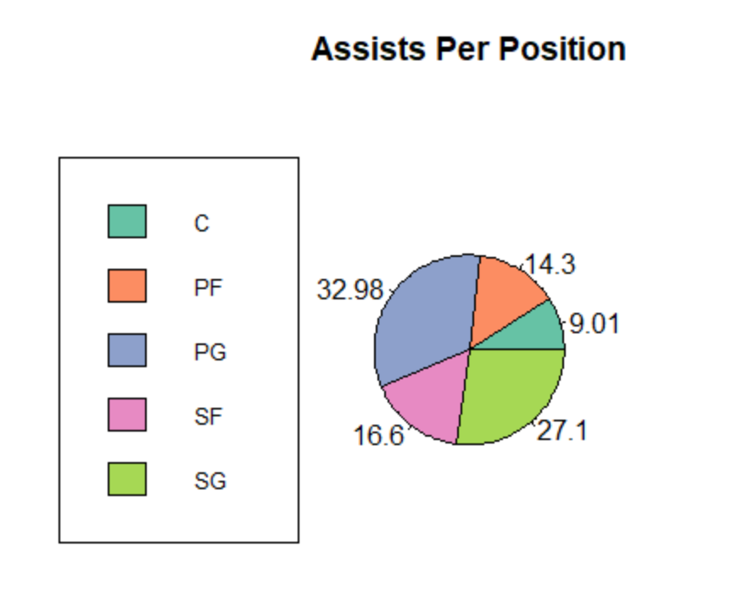

Slide 19

Conclusion
Celtics top shooters are 40% for threes and field goals, 80% for free throws
Celtics have more three pointers and less turnovers than the Lakers
Across the NBA, Shooting Guards score the most points, Centers have the most rebounds, and Point Guards have the most assists

