Slide 1
Prophet for Forecasting
Andrew Fraijo

Slide 2
Prophet
Prophet is a forecasting tool, created and released by Facebook, available for both R and Python. It is a powerful tool for automatically forecasting time-series. It also allows an analyst to be explicit about various parameters thus tailoring the process when prior information is available.

Slide 3
What makes Prophet different?
Other automatic forecasting functions in R (such as auto.arima() and ets()) assume structure between the observations of a time series
An ARIMA model, for example, assumes specific structure between the observations, i.e. auto-regression and a moving average
The model Prophet uses does not make that assumption. Instead, Prophet models what is essentially a Bayesian Generalized Additive Model (GAM), fitting curves to the trend and various seasonality levels, and then uses STAN to find the posterior

Slide 4
Benefits of Prophet
No need for regularly spaced observations!
Fast model building! This allows analysts to continually update the models based on new information
Flexibility, including specificying multiple levels of seasonality (yearly, quarterly, weekly, daily, etc.)

Slide 5
Cool, but how do I use it?
Prophet can be very simple to use. Below we fit a model on the daily electricity demand in Victoria, Australia from 2012-1-1 to 2014-12-31. Prophet simply asks for a data frame with a date (or date-time) column, called ds, and an observation column, called y. That’s it:
library(prophet) Elect_auto <- prophet(Elect_dem) future <- make_future_dataframe(Elect_auto, periods = 31, freq = 'day') Elect_auto_fcast <- predict(Elect_auto, future)

Slide 6
Cool, but how do I use it? Pt 2
Prophet will then let us look at the fit of the components (trend and seasonality) in a ggplot object
prophet_plot_components(Elect_auto,Elect_auto_fcast)

Slide 7
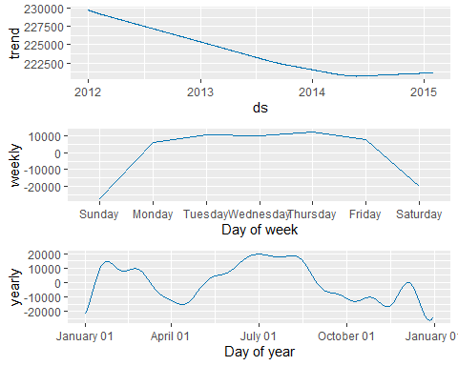

Slide 8
Cool, but how do I use it? Pt 3
Finally, we can plot the forecast and see how well it fits
plot(Elect_auto,Elect_auto_fcast, xlabel = "Date-Time", ylabel = "Daily Demand (kW)") + labs(title = "Hourly Electricity Demand In Victoria, Australia", subtitle = "With Auto-generated Forecast")

Slide 9
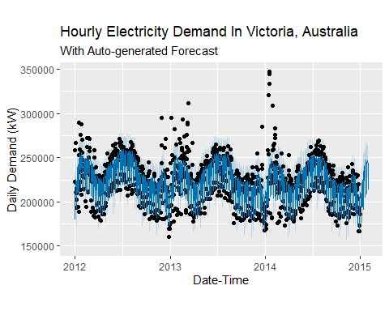

Slide 10
Holidays!
Holidays often distort time-series. Prophet can account for holidays in two separate ways. First, a column can be added to the data frame explicitly listing when a day is a holiday. Second, is a function that adds known national holidays to the model. Here we use the latter option while being more verbose in the modeling statement.
Elect_1 <- prophet(growth = "linear", yearly.seasonality = 'auto', weekly.seasonality = 'auto', daily.seasonality = FALSE) Elect_1 <- add_country_holidays(Elect_1, country_name = "AU") Elect_1 <- fit.prophet(Elect_1, Elect_dem) Elect_1_fcast <- predict(Elect_1, future)

Slide 11
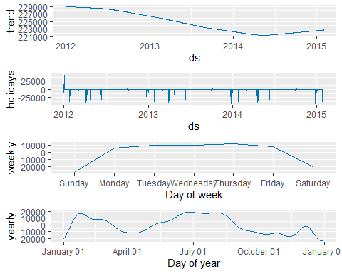
Holidays! Pt 2

Slide 12
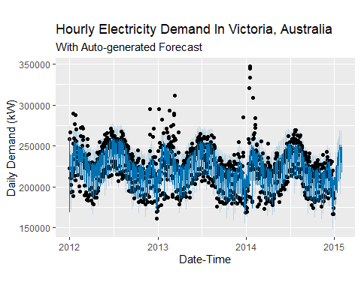
Holidays! Pt 3

Slide 13
Seasonality type
Prophet’s default assumption is that seasonlity is additive. However, that can be changed to multiplicative
Elect_2 <- prophet(growth = "linear", yearly.seasonality = 'auto', weekly.seasonality = 'auto', daily.seasonality = FALSE, seasonality.mode = 'multiplicative') Elect_2 <- add_country_holidays(Elect_2, country_name = "AU") Elect_2 <- fit.prophet(Elect_2, Elect_dem) Elect_2_fcast <- predict(Elect_2, future)

Slide 14
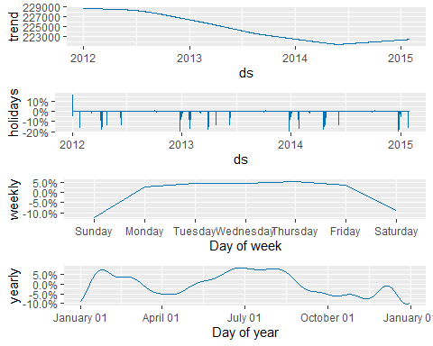
Seasonality Type Pt 2

Slide 15

Seasonality Type Pt 3

Slide 16
Full Bayesian
The default option in Prophet is to use maximum a posteriori (MAP) estimation to determine the posterior for the forecast. This allows for approximating the uncertaintity in trend and noise but not in the seasonality. To do that the user must explicitly call for MCMC sampling to do a full Bayesian estimation. In general the number of samples should be at least 1000, which may take some time to perform. For this example a smaller number is used.

Slide 17
Full Bayesian Pt 2
The interval.width variable defaults to 0.8 and determines the width of error bar of the forecast -The uncertainty.samples tells Prophet how many simulations to perform to calculate the forecast uncertainty and defaults to 1000. Lowering this number increases the uncertainty in the prediction while speeding up the calculation
Elect_3 <- prophet(growth = "linear", yearly.seasonality = 'auto', weekly.seasonality = 'auto', daily.seasonality = FALSE, seasonality.mode = 'multiplicative', mcmc.samples = 500, interval.width = .9, uncertainty.samples = 1000) Elect_3 <- add_country_holidays(Elect_3, country_name = "AU") Elect_3 <- fit.prophet(Elect_3, Elect_dem) Elect_3_fcast <- predict(Elect_3, future)

Slide 18
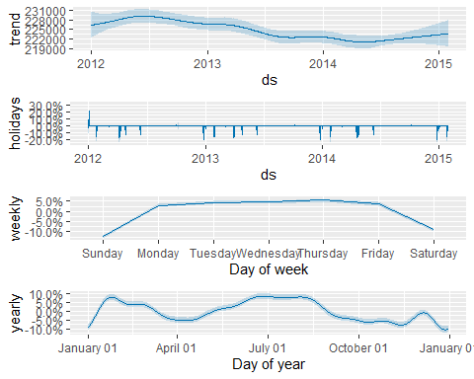
Full Bayesian Pt 3

Slide 19
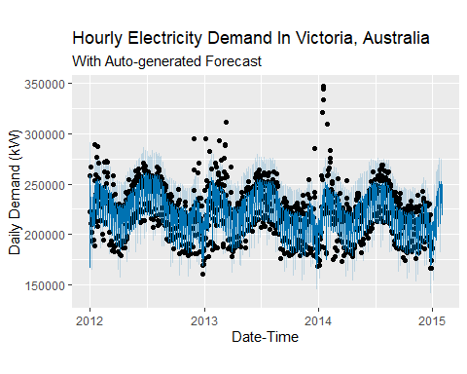
Full Bayesian Pt 4

Slide 20
What has not been covered
Using a logistic growth model. This is particularly useful when there is a clear cap on how large, or small, a series can grow
Monthly, Daily, and Subdaily seasonality
User-defined holidays
Change points
Additional regressors
User-defined Priors
Diagnostics using Cross-validation and performance_metrics function

Slide 21
More information
Prophet Homepage: https://facebook.github.io/prophet/
Using Prophet with Fable tidy time-series analysis: https://github.com/mitchelloharawild/fable.prophet
Gist containing the code from this presentation: https://gist.github.com/AFraijo/b8f4c05baa693f2ae9b1a159651cf754

