Slide 1
Cultural Memory, the media and ¿Us?
Disarming the Euclidean Rhythms and
Arming traditional rhythms with Euclidean analysis and notation
Alejandro Franco Briones
Today I will be talking about the concept of traditional rhythms generated via Euclidean algorithms (Euclidean Rhythms) and what does it imply to used them in technology-driven performative practice such as live coding. I will apply this knowledge to a mambo music piece by the composer Pérez Prado expecting to shade some light on ideas of memory and embodiment.

Slide 2
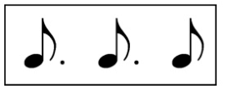
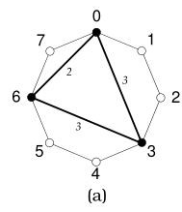
Cuban Tresillo
Score Notation
Euclidean Notation: (3,8)
Tablature Notation
X O O X O O X O
Geometric Notation

Slide 3
What live coding means to me
Zapatismo on the role of science and arts:
“[For our people not directly involved in the battles:] “Not to die” was the only order that they had to follow.
The order that the soldiers had was: “Not to give up, not to sale out”
When we returned to the mountains and encountered again with our people, we merged both orders and turned them in only one: “fight to build our own freedom”
And we agreed upon doing it with every women (otras), every men (otros) and every person (otroas).
And we agreed that, if it was not possible to do it in this world, then we should create a new world, one that is bigger, better, one in which any imaginable world can fit in: the ones we already have and the ones that we have not conceived yet but already exist in the arts and the sciences.”

Slide 4
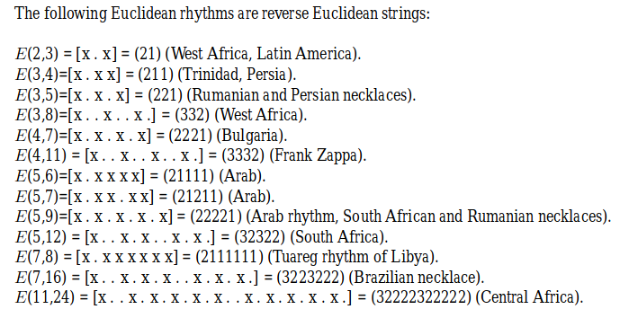
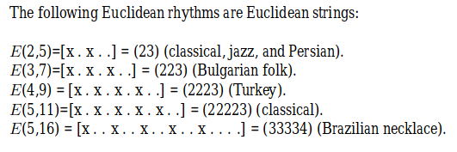
Big chunks of traditional knowledge reduced to an algorithm
“Euclidean algorithm may be used to generate, very efficiently, a large family of rhythms used as timelines (ostinatos), in sub-Saharan African music in particular, and world music in general”
Godfried Toussaint

Slide 5
Embodiment

