Slide 1
DREAM TD
Features Macro To Micro

Slide 2
Train
Core Feature

Slide 3
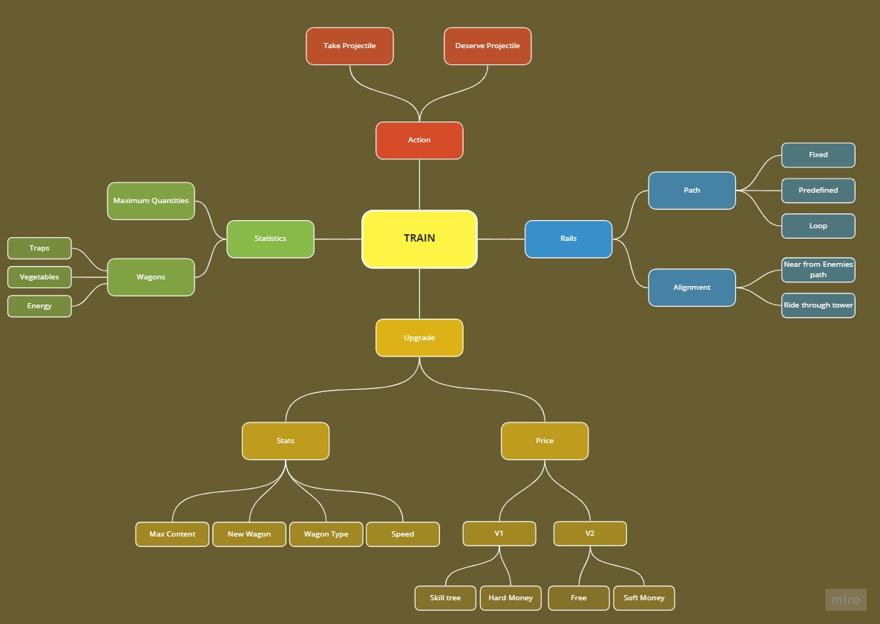
Train Feature – Basics

Slide 4
Train Feature – Basics
The Train is the bridge between factories and towers.
The train take factory’s projectiles to feed them at the wanted tower.
The train cannot be stopped, and it always move in the same direction.

Slide 5
Train Feature – Container

