Slide 1
Forecasting PM2.5 for Wanshouxigong District
Client: Darren Glosemeyer
Consultants: Team 8
Alex Funches, John Fetscher, Riya Dave, Yirui Luo, Yuxuan Zhang

Slide 2
Outline
01 INTRODUCTION & GOALS
02 DATA CLEANING & PREPROCESSING
03 DATA VISUALIZATION
04 RESULTS & INTERPRETATION
05 ALERT SYSTEM

Slide 3
INTRODUCTION & GOALS
01

Slide 4
Introduction
PM2.5 refers to atmospheric particulate matter (PM) that have a diameter of less than 2.5 micrometers
Major components of PM2.5
Sulfates
Nitrates
Ammonia
Sodium Chloride
Black Carbon
Mineral Dust
Water
Notes:
Sulfates
Nitrates Ammonia
Sodium Chloride
nitrates, ammonia, sodium chloride, black carbon, mineral dust, and water.

Slide 5
Introduction Part II
Long-term exposure to PM2.5 may be associated with increased rates of:
Chronic Bronchitis,
Reduced Lung Function
Increased Mortality from Lung Cancer
Heart Disease

Slide 6
Set Cut-off for PM 2.5 Severity
China’s Pollution Guidelines
Upper Annual Limit: ≤35 ug/m3
Upper Daily Limit: ≤75 ug/m3
World Health Organization Guidelines
Acceptable Annual Pollution: ≤35 ug/m3
Acceptable Daily Pollution: ≤75 ug/m3
Unacceptable Pollution: 150+ ug/m3

Slide 7
Objective and Methodology
Goals:
Determine variables that explain and accurately predict the PM 2.5 levels in Beijing’s Wanshouxigong District
Create an alert system that predicts the levels of the next day’s PM2.5 based on past and future data
Tools: R, Python, Tableau, Excel

Slide 8
DATA CLEANING & PREPROCESSING
02

Slide 9
Data Description
Dataset contains 35,064 observations (hourly data from the years 2013-2017) and 19 variables
16 numeric variables
11 continuous variables: PM2.5, PM10, SO2, NO2, CO, etc
5 discrete variables: No, year, month, day, hour
2 categorical variables: wind direction, station
1 character variable: timestamp
1 response variable PM 2.5

Slide 10
Description of Variables
CO: carbon monoxide (ug/m^3)
Day: the number of day (1-30 or 31)
DEWP: dew point (degree Celsius)
Hour: hour of the day (1-24)
Month: month of the year (1-12)
NO2: nitrogen dioxide (ug/m^3)
O3: ozone (ug/m^3)
PM10: particulate matter 10 with a diameter of 10 micrometers
PRES: pressure (hPa)
RAIN: rain (mm)
Season: season of the year
SO2: sulfur dioxide (ug/m^3)
Temp: temperature (Celcius)
Wd: wind direction (N, S, E, W)
Weekday: day of the week (1- sunday, 7, saturday)
WSPM: wind speed (m/s)
Notes:
Explain abbreviated variable names (pres, dewp, temp, wd, weekday, wspm)

Slide 11
Data Adjusting
Replaced missing values
Group data by day and compute daily average data
Added features: Season, Weekdays, Previous day’s PM2.5
Notes:
There are about 8% of missing values in the dataset, and we replace the missing values by taking the average for each variable in a certain day. For example, if there are missing values for PM2.5 in a certain day, we can replace the missing values by the average PM2.5 of this day. Also, since we want to use the previous day’s data to predict the PM2.5 for tomorrow, we group the data by day and compute daily average data, which makes it more convenient for us to analyze the data and run different regression models on the data. In addition, we also add some new features to the dataset. We add season, weekdays and previous day’s PM2.5 cuz we want to use the previous day’s data to predict tomorrow PM2.5

Slide 12
DATA VISUALIZATION
03

Slide 13
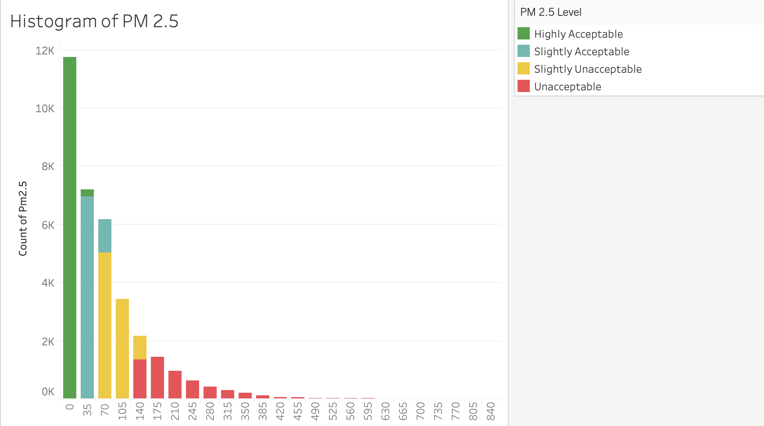
Notes:
This is a histogram that shows the amount of data points we have in every cutoff level. Since the histogram is skewed right, we can see that there are more acceptable levels than unacceptable levels in the data provided for this district. From this, we can conclude that overall, the PM 2.5 levels in the Beijing Wanshouxigong District are acceptable

Slide 14
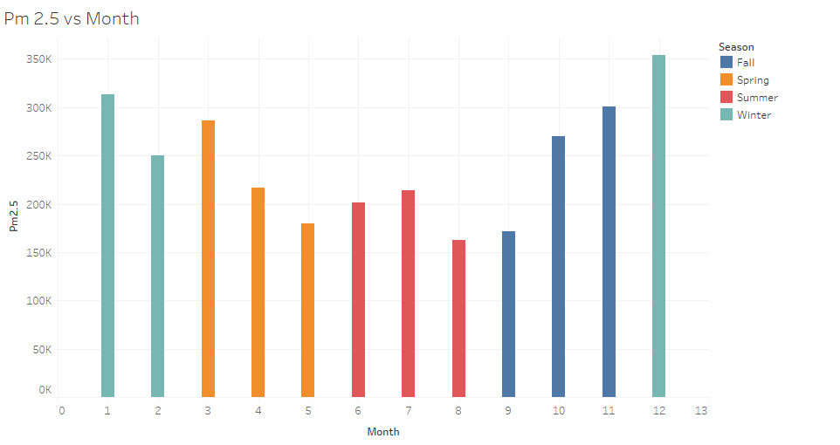
PM2.5 VS MONTH (higher pm2.5 in the winter, lower in the summer)
Pm2.5 vs Day (no significant trend)
Notes:
This visualization shows PM 2.5 values across the months of a year. While intially there seemed to be no pattern, after doing some research about the Beijing Wanshouxigong district, we split the months into different seasons. From this we are able to gather that PM 2.5 levels are generally lower in the warmer months (in spring and summer) and rise to higher levels as it gets cold (in fall and winter). Based on our research as to what causes PM 2.5, these trends make sense because as it gets colder, people are burning more coal and wood to generate heat in homes and other buildings which, along with other factors, increases the overall PM 2.5 levels in that time period. Similarly, as it gets hotter in the summer, the needs to generate heat lessen which also help in decreasing the overall PM 2.5 levels.

Slide 15
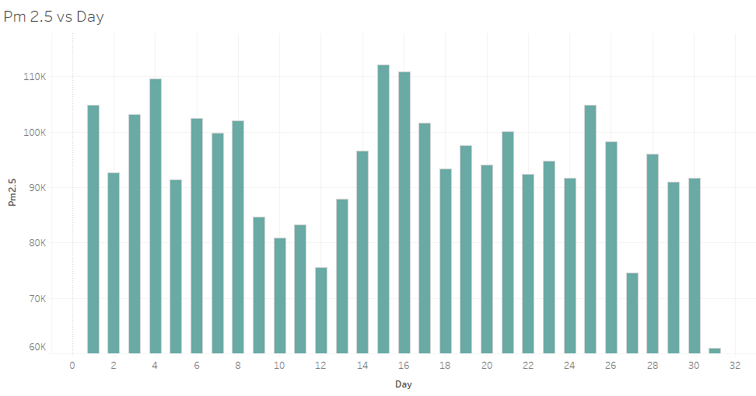
Notes:
Pm2.5 vs Day (no significant trend)

Slide 16
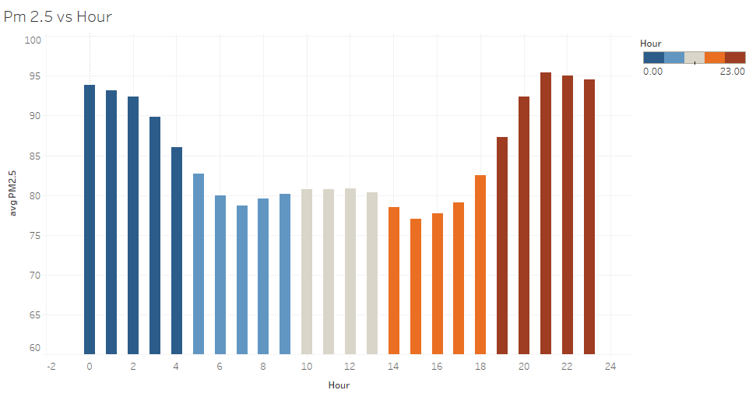
Notes:
The above visual describes PM 2.5 levels throughout the hours in a day. From this, we can see that overall, PM 2.5 levels tend to decrease during the middle of the day and rise as the day transitions into the evening and nighttime. Combining this visual with the research done for the sources of PM 2.5, we can reason that since people are working during the middle of the day, they are congregated at work places and at nighttime, most people are in their individual homes which is an increase in buildings that need heating and energy to make food. This could be a factor that explains these trends of increases and decreases of PM 2.5 levels during the day.

Slide 17
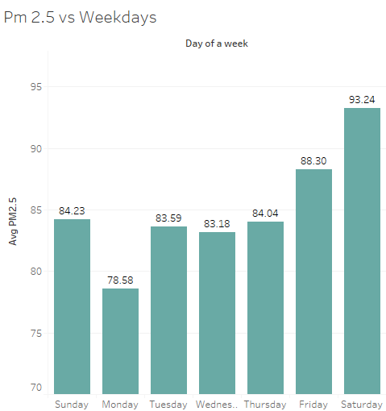
Notes:
if we look at PM 2.5 levels throughout the week, we can conclude that there is a general trend of increasing levels of 2.5 from the start of the week to the end of the week. We can see that generally weekdays have lower PM 2.5 levels than the weekend (starting with Friday). Combining this with the research done about the sources of PM 2.5, we can see that during the weekend, it is more likely that people are at home spending time with family or outside cooking which plays a role in increasing PM 2.5 levels in the area. Since people are usually home on the weekend, there are a lot more buildings burning fuels for cooking or lights than there are when people are working during the week day (since many people congregate in office buildings and work).

Slide 18
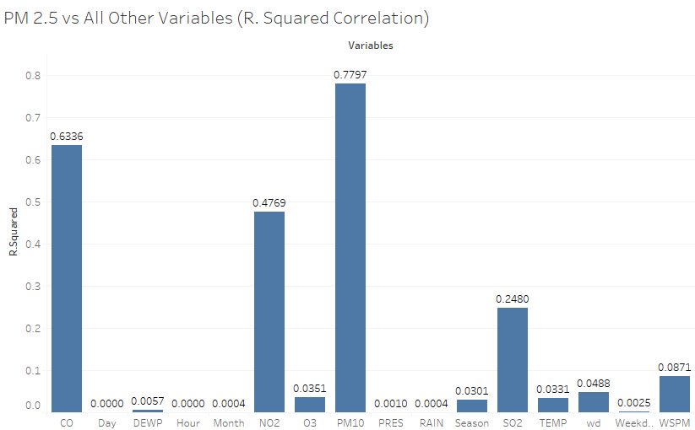
Correlations
Notes:
Factors with high correlation to PM 2.5:
Carbon monoxide
All of the toxic gases combined into one category
Factors with slight correlation to PM 2.5:
Nitrogen Dioxide
Sulfur Dioxide

Slide 19
REGRESSION RESULTS & INTERPRETATION
04
Notes:
We tried both the non-parametric models and linear models and we compared the results of each model. We used the Mean Squared Error as a metric to measure the model performance, and we will talk about what we got from these models.

Slide 20
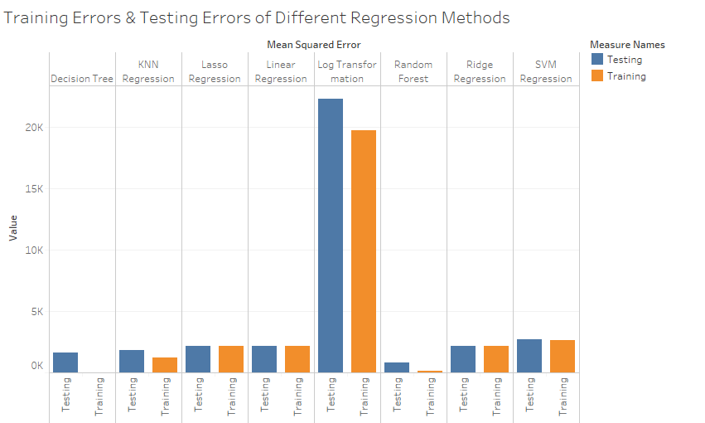
Model Comparison
Models | Training Errors | Testing Errors
Linear Regression | 2151.24 | 2137.84
Ridge Regression | 2151.24 | 2137.83
Lasso Regression | 2151.23 | 2137.83
Log Transformation | 19772.7 | 22281
Decision Tree | 0 | 1621.5
Random Forest | 104 | 779.69
KNN Regression | 1218.11 | 1821.07
SVM Regression | 2649.41 | 2706.91
Notes:
We found random forest is the optimal regression method with relatively lower training errors and testing errors than other methods

Slide 21
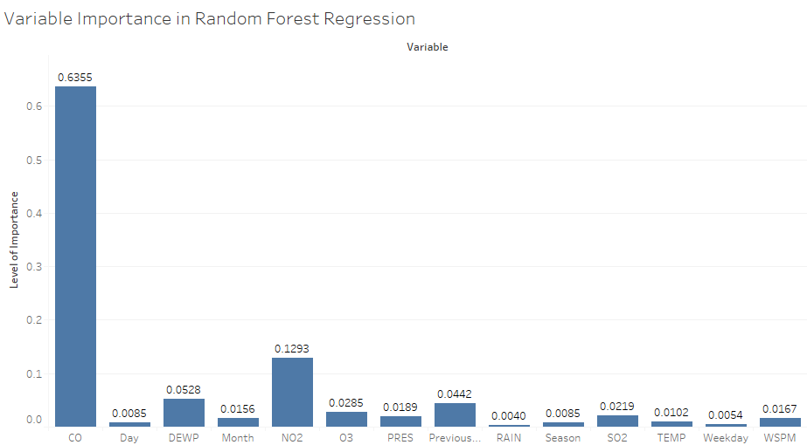
Variable Importance -- Random Forest
Notes:
We also compared the variable importance in random forest regression.

Slide 22
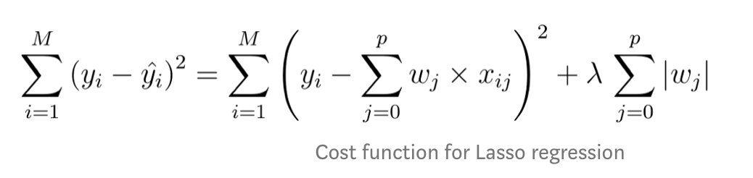
Lasso Regression
Dummy code categorical variable, month and weekday
Standardization
Distribution of features is skewed
Cross Validation
Prevent Overfitting
No p-value because the estimate is biased

Slide 23
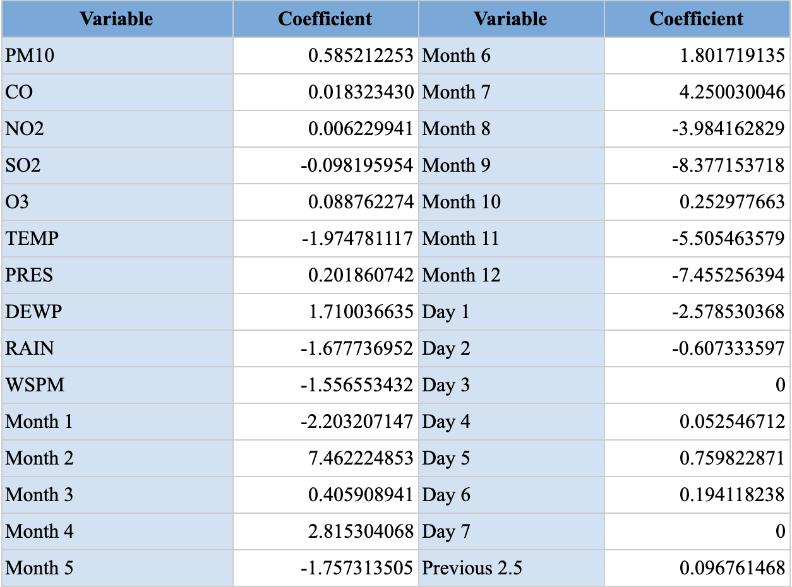
Coefficients Table - Lasso Regression
Notes:
These are the variables that we have deduced are effect PM2.5 values the most. Other than this, we can also conclude that if there is an increase in wind speed, SO2, Temperature, or rain, we can expect a gradual decrease in PM 2.5 levels. Similarly, we deduce that an increase in CO, NO2, PM 10, O3, Pressure, Dewpoint or in the previous day’s PM 2.5, also leads to an increase in the next day’s PM 2.5. We treat the weekday and month as a categorical variable (meaning it will either have a value of the coefficient when it is that day and that month or a 0 if it is not that day and month). As we saw in the trends for PM 2.5 throughout the week and throughout a year, we expect to see an increase in PM 2.5 values earlier in the year (February, March and April) and a decrease in PM 2.5 values in the later months of the year (August-December). A similar conclusion can be made for the days of the week. We see an increase as the week goes along.

Slide 24
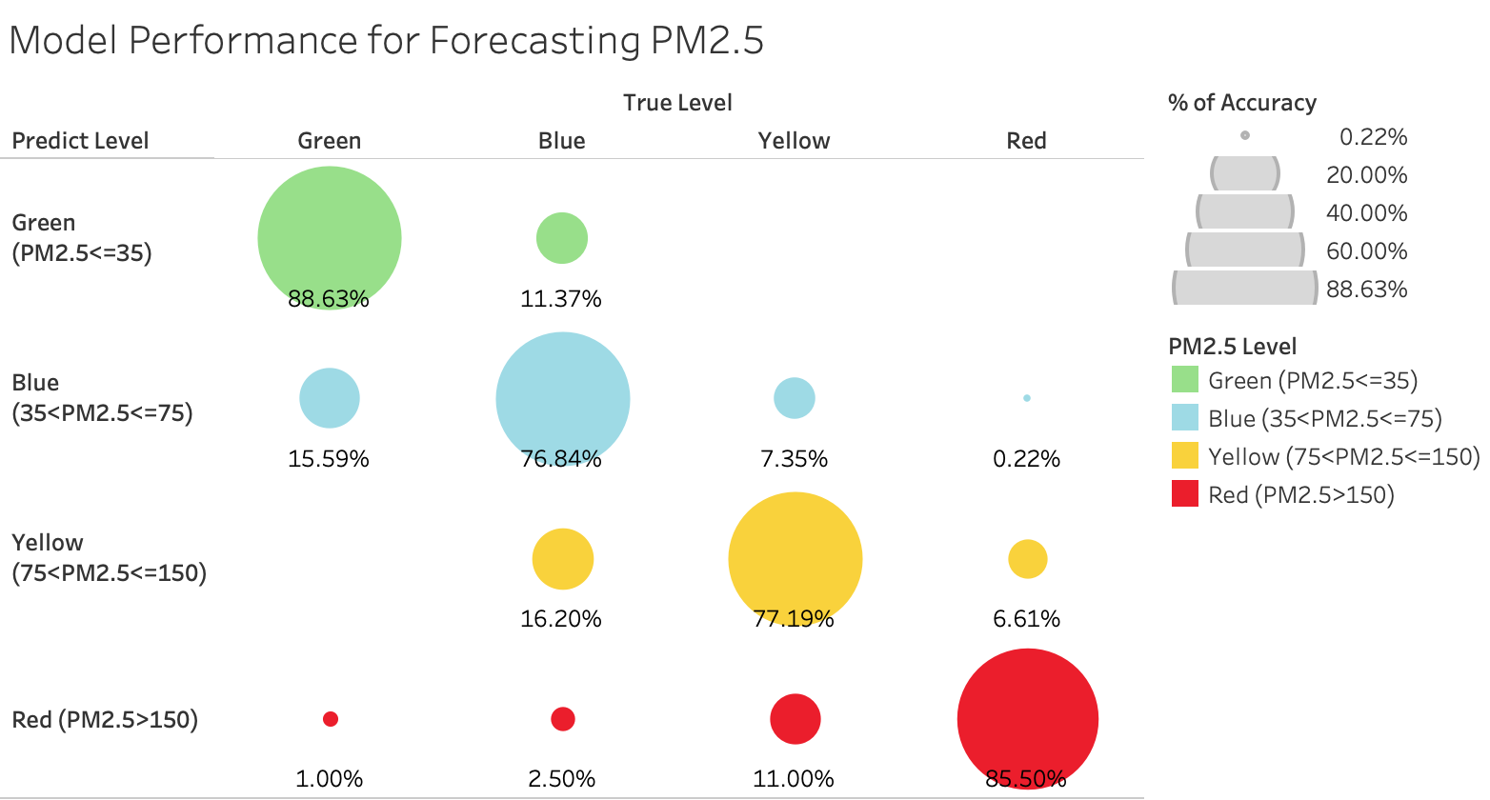
Notes:
This is just a visual to represent how well our model predicts the next day’s PM 2.5

Slide 25
ALERT SYSTEM
05

Slide 26
User Interface
PM 2.5 (Today) | PM 10 | SO2 | NO2 | CO | O3 | Temp | Pressure | Dew Point | Rain | Wind Speed | Month | Day
 |  |  |  |  | PM 2.5 (Tomorrow) | 0

Slide 27
Q&A?

