Slide 1

OpenCL based HMC Development Snapshot
Lars Zeidlewicz
Group Meeting – May 9, 2011
Institut für Theoretische Physik
Goethe-Universität Frankfurt

Slide 2
Outline
LOEWE-CSC
Our code: desired features
Code & project management
Code overview
Some words on OpenCL
2

Slide 3
LOEWE-CSC
Some numbers…
Top500 rank 22 (Nov 2010)
(285 Tflops, #2 in Germany)
Green500 rank 8
(741 Mflops/W, #4 in Germany)
About 800 nodes with
2 AMD Opteron 12 core
1 AMD ATI Radeon 5870 (Cypress)
3

Slide 4
LOEWE-CSC
Status
Testing phase
Monthly CSC-admin meetings
Current issues:
Queue: Large jobs vs. single-core
(Jobs wait for days and weeks)
Infiniband problems
2 week downtime starts on Friday
GPUs so-far unused
4

Slide 5
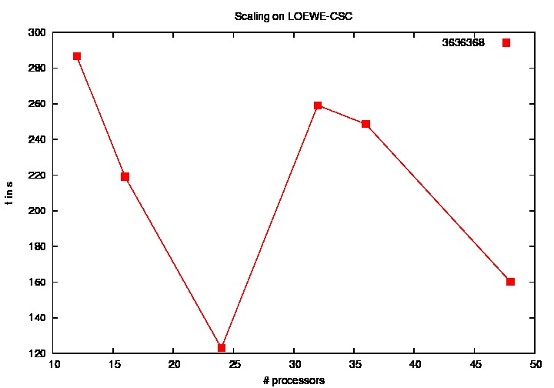
LOEWE-CSC
Status
Testing phase
Monthly CSC-admin meetings
Current issues:
Queue: Large jobs vs. single-core
(Jobs wait for days and weeks)
Infiniband problems
2 week downtime starts on Friday
GPUs so-far unused
[Christian]
5

Slide 6
LOEWE-CSC
SLURM
Admins hope to overcome queuing problems by switching to the SLURM scheduler
(https://computing.llnl.gov/linux/slurm/slurm.html)
Today: 29 nodes
After downtime: 100 nodes
OpenMPI tested (only!)
6

Slide 7
LOEWE-CSC
SLURM
Admins hope to overcome queuing problems by switching to the SLURM scheduler
(https://computing.llnl.gov/linux/slurm/slurm.html)
Today: 29 nodes
After downtime: 100 nodes
OpenMPI tested (only!)
How does that work for a "real" MPI program?
SLURM can be loaded as a module:
module load slurm
module show slurm
(sinfo, sqeue,…)
Working examples have been promised
#! /bin/sh
#
#SBATCH –-nodes=4
#SBATCH –-time=1
#SBATCH –-cpus-per-task=1
#SBATCH –-job-name=testjob
#
OMP_NUM_THREADS=1
Srun –ln4 –-mpi=none hostname
7

Slide 8
Code Features
Physics
SU(3) heatbath
Fermion inverter
(different actions)
Hybrid Monte-Carlo
Chemical potential
Smearing
…
8

Slide 9
Code Features
Programming
Hybrid structure
Within nodes
Beyond one node
OOP for host code
Large flexibility
Switches (single/double etc)
User defined types, access functions to faciliate changes
9

Slide 10
Code Features
GPUs
Today:
Memory Management
Benchmarking
Workgroup sizes
Future:
Several devices
[Matthias]
[Matthias]
10

Slide 11
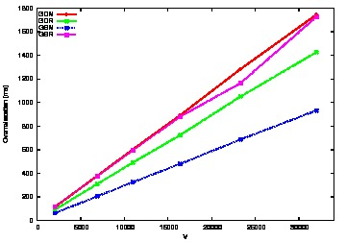
Code Features
GPUs
benchmark – gpu-dev
Benchmarks from Christopher
[Christopher]
11

Slide 12
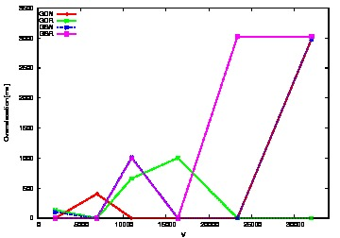
Code Features
GPUs
benchmark – loewe
Benchmarks from Christopher
[Christopher]
12

Slide 13
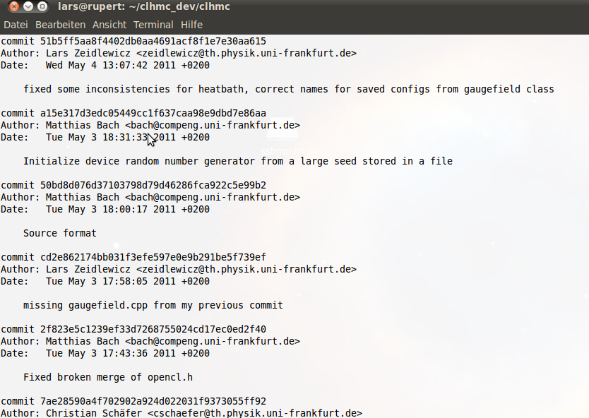
Code & Project Management
git
Code is subject to version management by git
13

Slide 14
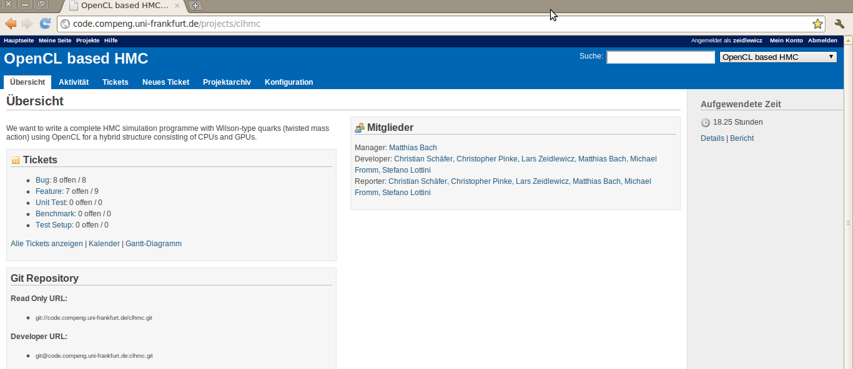
Code & Project Management
Online repository
http://code.compeng.uni-frankfurt.de/projects/clhmc
[Matthias]
14

Slide 15
Code & Project Management
Online repository
http://code.compeng.uni-frankfurt.de/projects/clhmc
[Matthias]
Side remark: The name?!?
OpenCL based HMC
OpTiMaL
15

Slide 16
Code & Project Management
Common style
Matthias has suggested to enforce a common coding style via
astyle --options=astylerc <FILENAME>
To be discussed…
[Matthias]
16

Slide 17
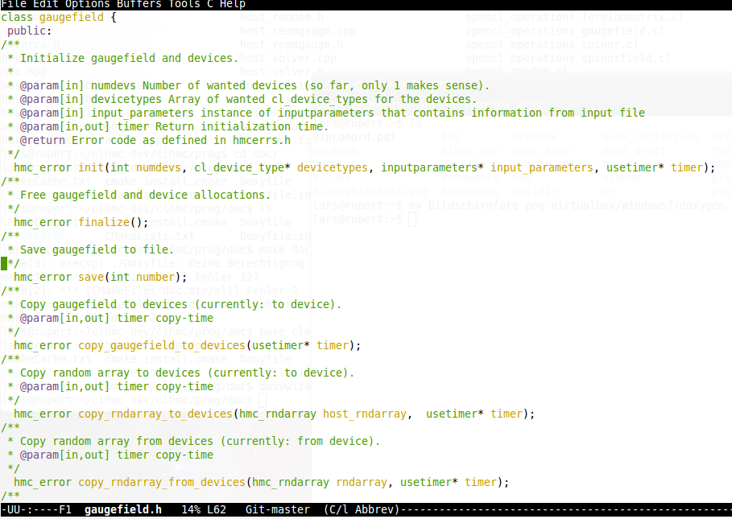
Code & Project Management
Doxygen
Doxygen
17

Slide 18
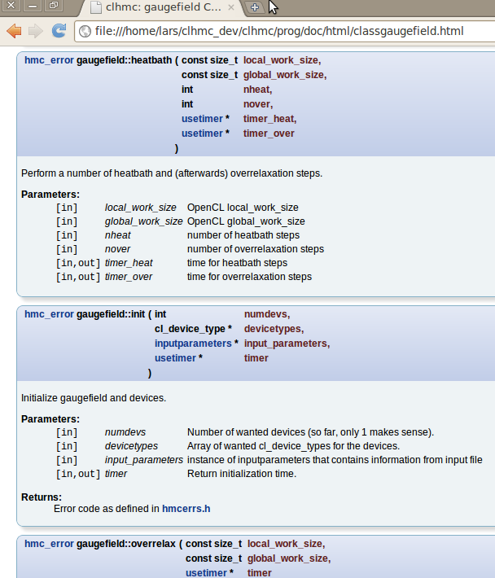
Code & Project Management
Doxygen
Use doxygen format for comments
18

Slide 19
Code & Project Management
cmake
Nice build-tool
Have a look at clhmc/prog/INSTALL
Creates Makefile:
make hmc
make heatbath
19

Slide 20
Code status
Overview
Three different types of code:
Host management code
(→ C++)
Host functional code
(deprecated?)
Device functional code
(→ OpenCL)
20

Slide 21
Code status
Heatbath
Based on Christopher‘s code
Check: Boyd et al.:
Nucl. Phys. B469 (1996) 419-444
Host and device versions
still to check device version with final status
Current improvement:
Implement an optimal projection to SU(3) [Christian]
21

Slide 22
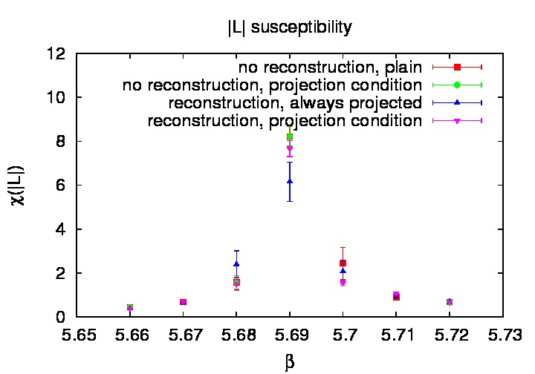
Code status
Heatbath
Based on Christopher‘s code
Check: Boyd et al.:
Nucl. Phys. B469 (1996) 419-444
Host and device versions
still to check device version
Current improvement:
Implement an optimal projection to SU(3) [Christian]
22

Slide 23
Code status
HMC & inverter
Work in progress
Host code inverter needs to be checked
So-far host code only
Molecular dynamics force?
[Christopher, Steo]
[Lars]
[Christopher]
23

Slide 24
Code status
Management
int main(){} in
hmc.cpp
(mixes all progs by compiler flags)
heatbath.cpp
…
Management in classes:
gaugefield
opencl
…
24

Slide 25
Code status
globaldefs.h
NC, NSPIN, NDIM,…
Right now: NT, NS
Right now: work_sizes
Derived constants (VOLSPACE…)
Available in all of the code
(sometimes useful:
kernel flag _INKERNEL_)
25

Slide 26
Code status
types.h
hmc_float
hmc_complex
hmc_su3matrix
…
Switches: INKERNEL, USEDOUBLEPREC, RECONSTRUCT_TWELVE
26

Slide 27
Code status
inputparameters
Class inputparameters
Reads input file
Look at method
set_defaults()
kappa=.125
mu=0.06
cgmax=1000
beta=6
#cgmax=3
prec=64
startcondition=cold
sourcefile=conf.save
thermalizationsteps=5
heatbathsteps=1000
27

Slide 28
Code status
gaugefield.h
ILDG storage format
Gauge field is really the central object:
hmc trajectories
heatbath
inversion
Gaugefield class: the place to manage inter-device communication
28

Slide 29
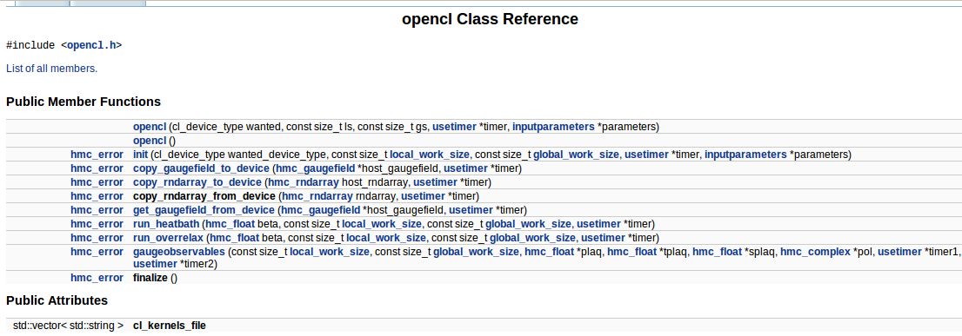
Code status
opencl.h
Wraps all device operations
class opencl
29

Slide 30
Code status
Random numbers
Random numbers on GPU are tricky; avoid cross correlations between threads
Vectorized, parallel RNG?!?
Right now: NR generator
Implement RanLux
[Matthias]
30

Slide 31
Code status
Operations
Implement operations for different types:
host_operations_complex
host_operations_fermionmatrix
host_operations_gaugefield
host_operations_spinor
host_operations_spinorfield
Maybe we can get that a bit more sorted?
[currently: Steo, Christian?]
31

Slide 32
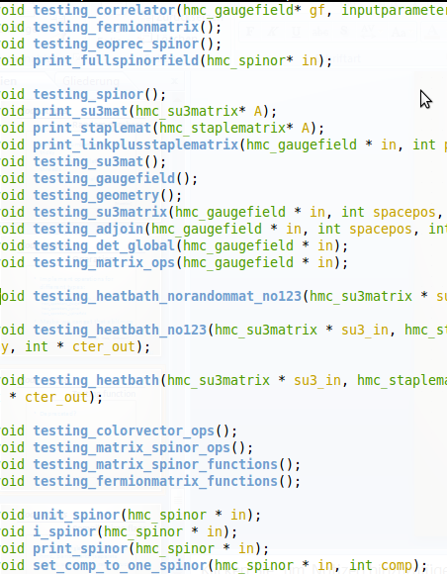
Code status
Testing function
Deprecated?
32

Slide 33
Code status
Compile time flags
USEDOUBLEPREC , USE_EOPREC
RECONSTRUCT_TWELVE
FERMIONS, HMC, BENCHMARKS
➔ Untangle into different programs
33

Slide 34


Code status
SU(3) reconstruct
M. Clark et al.
Comput. Phys. Commun., 181:1517-1528, 2010
hmc_complex reconstruct_su3(hmc_su3matrix *in, int j);
34

Slide 35
OpenCL
Device code
.cl files read in by opencl.cpp
Compilation at runtime
cl_kernelsfiles.cl for debug info
35

Slide 36
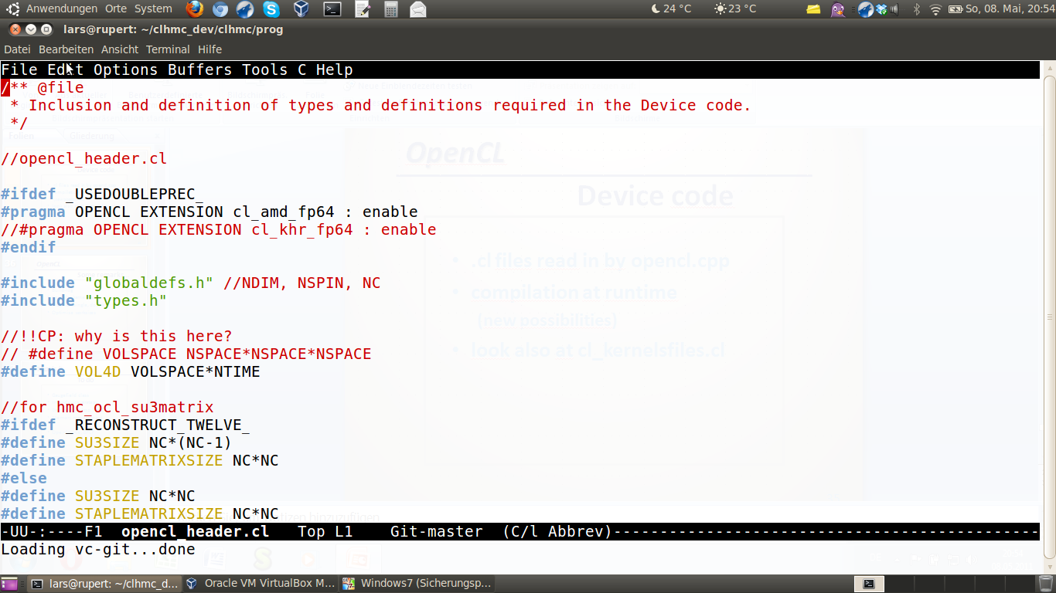
OpenCL
Device code
.cl files read in by opencl.cpp
compilation at runtime
(new possibilities)
look also at cl_kernelsfiles.cl
36

Slide 37
OpenCL
Some remarks…
Build-log
Kernels, kernel args
Pragmas (single, double)
Optimise worksizes
[Matthias…]
37

Slide 38
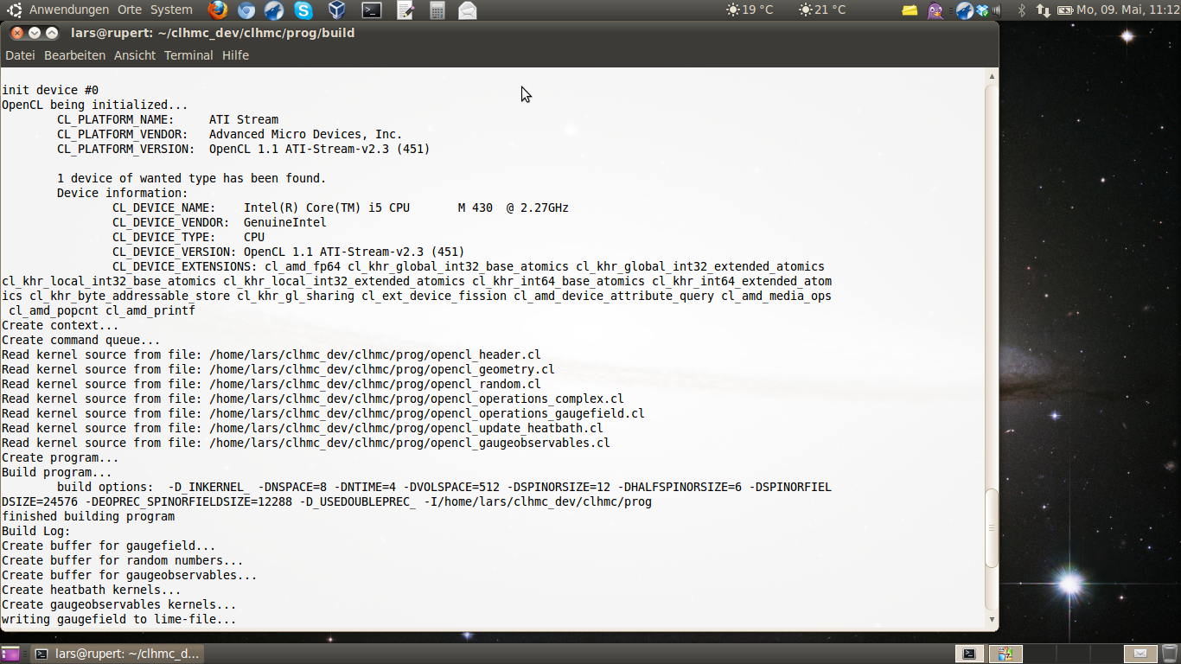
OpenCL
Some remarks…
Build-log
Kernels, kernel args
Pragmas (single, double)
Optimise worksizes
[Matthias…]
38

Slide 39
That‘s it
To do
Gaugefield class
Inter-device strategy
Device code (esp. hmc)
Memory management
OpenSource, GPL?
[Lars]
[Christopher]
[Matthias]
39

