Slide 1
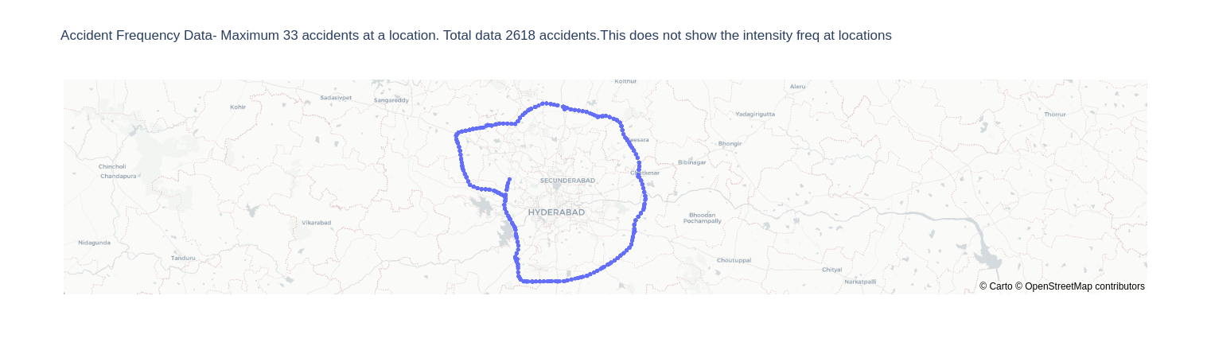
All accidents- 2618

Slide 2
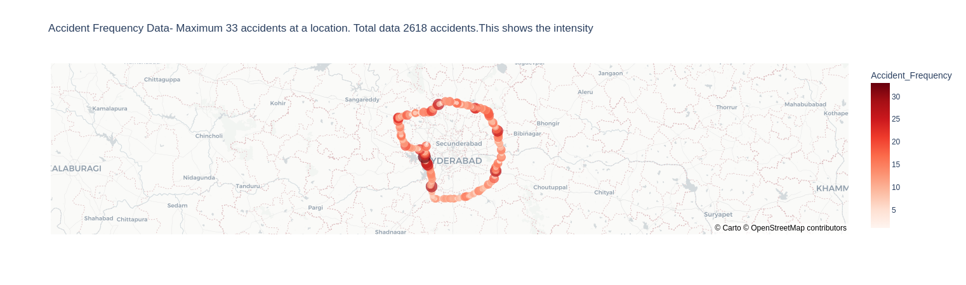
Accidents shown with intensity

Slide 3
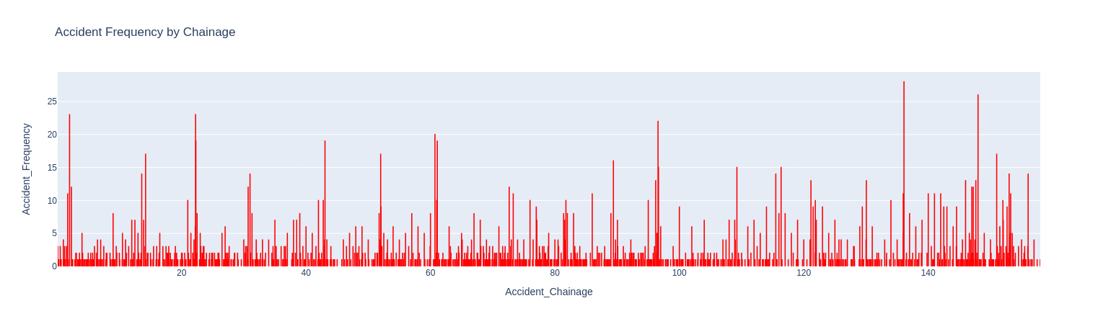
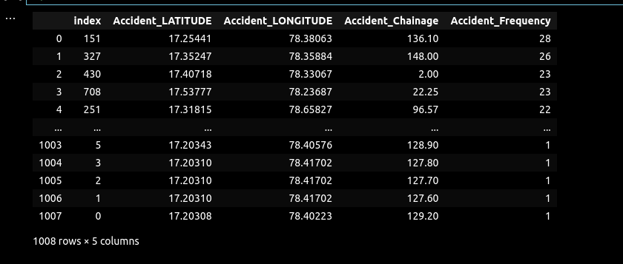
Countplot at chainage

Slide 4
Outliers
No outlier for 2*std dev.
Ideally- Total Acc.=Clustered Acc.
Using new data frame df_freq which has 1008 rows
df-2618
df_freq-1008

Slide 5
Clustering
Kmeans
DBSCAN
https://arxiv.org/abs/2108.03490- Reference Link

Slide 6
KMeans
Metrics used
1- Silhoutte Score- 0.75(max) at 25 Clusters
2-Davies-Bouldin Index- 0.2 (least) @ 27 clusters

Slide 7
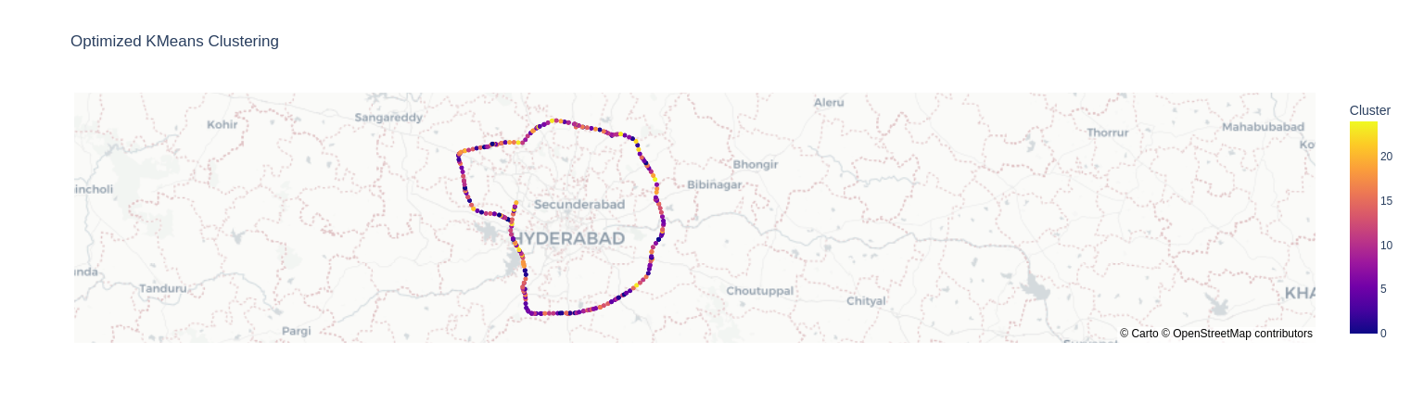
25 clusters based on (lat,lon,accident_freq) not useful since far spots clustered together- 1008 rows
Using only Lat,Lon for clustering on next slide

Slide 8
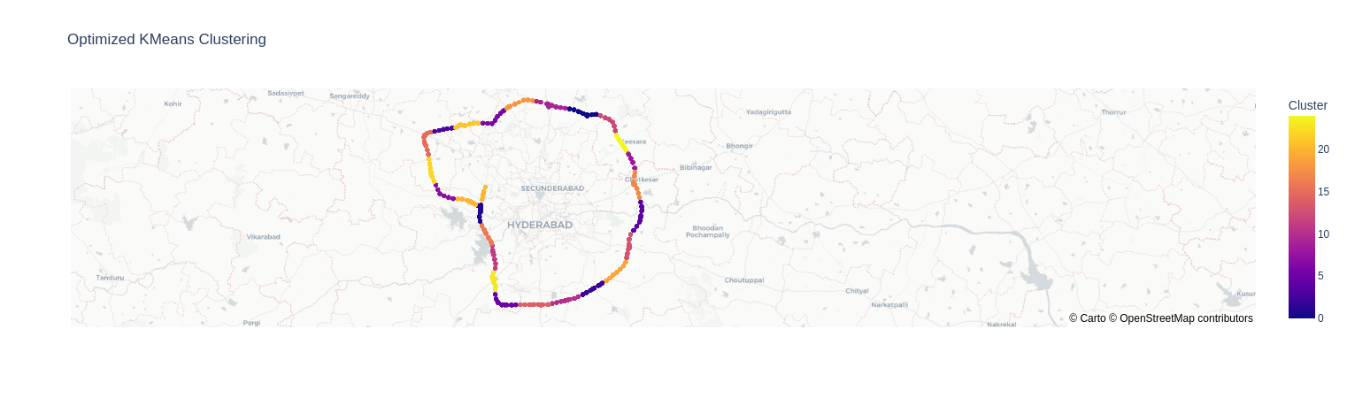
Selecting only Lat,Lon- 2618 rows- better clusters defined

Slide 9
DBSCAN
Metrics
1- Haversine used for distance on earth
2- epsilon- determined with K-distance plot

