Slide 1
Fuzzing processes for video games
Miruna Paduraru
Ciprian Paduraru
University of Bucharest

Slide 2
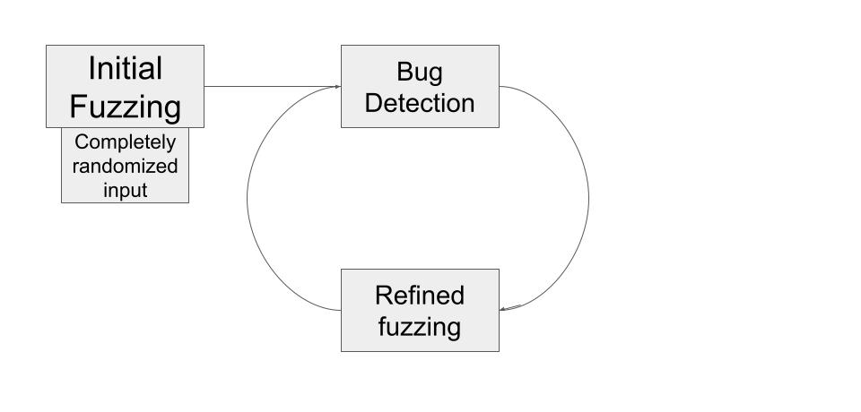
1. What is fuzzing in general ?
Fuzzing is the process of automatically testing the response of a piece of software against possible inputs
This allows the developer to converge on a set of test values, transitioning from a “see what sticks” style to a more precise method of testing or evaluation.

Slide 3
2. Fuzzing in video games:
To exploits various states of the games with different set of parameters, the fuzz testing method is known in literature as being one of the most powerful testing
Different strategies can be used to guide the fuzzing towards certain targets or areas of the game: e.g., test more physics or AI parts of the game.
As guided methods we can mention genetic algorithms, reinforcement learning, etc. – You can check the two author’s publications list to mention a few works in this direction,

Slide 4
3. Game testing use-case !
You can always ask your programmers to write tests…by they get bored usually, and even if they write unit / functional tests they will do it it for a limited set of values or states.
How about the army of designers, artists or animators that are modifying the content ? Many changes during iterations can break quality.
One of our main goals is to understand automatically the changes that designers/artists/animators/programmers do between iterations and generate tests on the fly without human effort.

Slide 5
Technically, the automated set of changes can be understood at different levels:
Have a process that watches for new / modified schematics (Frostbite terminology)/ blueprints (Unreal terminology), then generate tests based on those.
Have a process that evaluates the new classes added to the game and target the fuzzing processes around those more.

Slide 6
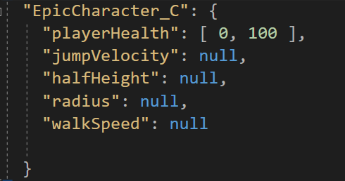
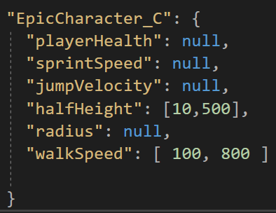
We use Unreal 4.27 as a playground for now, but if accepted, we’ll be happy to integrate the mechanisms in Frostbite engine too !
The current implementation uses as an optional guidance method a JSON file attached to a blueprints/set of variables/classes, that describes the ranges of values and type (numeric or string).
E.g:
B. walkSpeed can be be something between 100- 800, halfHeight of the collisionCapsule between 10-500, the rest could be anything.
A. playerHealth can be something between 0- 100, the rest could be anything.

Slide 7
Note: JSON guidance is optional ! If nothing is provided, the type declaration range is considered in the fuzzing process.
Demo: https://drive.google.com/file/d/1wYyX6MCHhnXEk54A7_GPidTne7QoP58T/view?usp=sharing

Slide 8
4. Finding different set of parameters
How can a designer quickly evaluate different ranges of parameters at gameplay ?
What if the designers observes at some point that the character gets blocked and needs to quickly iterate parameters changes ?
What if a designer wants to tune different difficulty levels ?

Slide 9
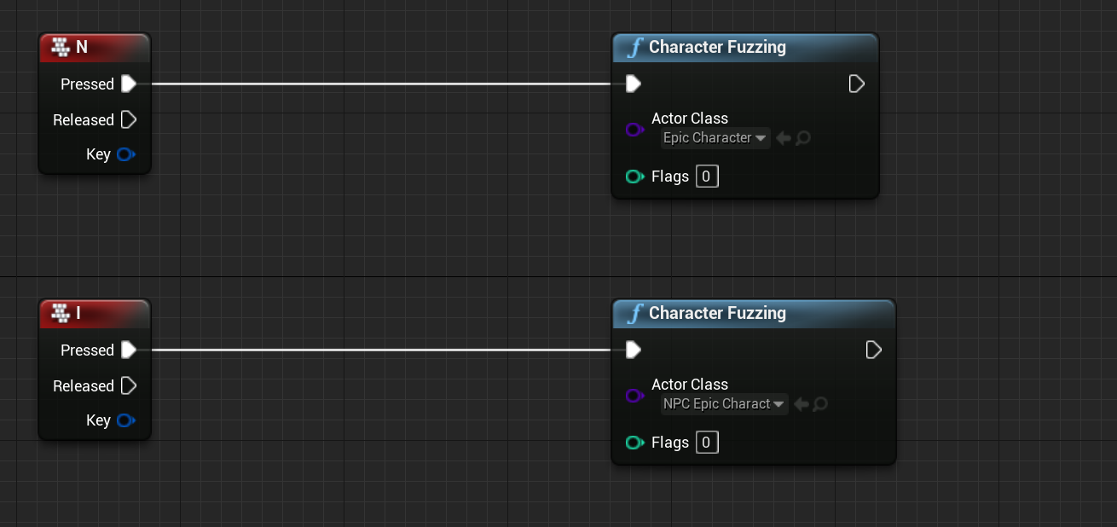
Idea: Manual triggering of fuzzing process using a guided JSON can be a quicker method than previous ones !
Think about having a shortcut that generates new values in ranges / categories specified. E.g.:
In our demo this triggers a new fuzz process for user-controlled character
In our demo this triggers a new fuzz process for an NPC character

Slide 10
Demo for user triggered fuzzing
https://drive.google.com/file/d/1tlbis6jDfHxqi3iDNy1vjRcbsNidHRBO/view?usp=sharing

Slide 11
5. Future work
Improve abstractization for automatic test generations
Prioritization tool for areas of the games that need to be tested, or maybe based on previous history of bugs that persist
Integrate our previous published papers on genetic algorithms and reinforcement learning for driving the fuzzing process.
Frostbite integration !

