Slide 1
Fuzzing processes for video games
Miruna Paduraru
Phd. Student at University of Bucharest
Conf. Univ. Dr. Ciprian Paduraru

Slide 2
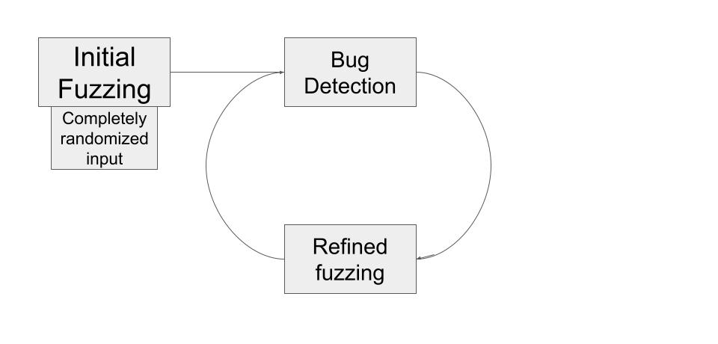
1. What is fuzzing in general?
Fuzzing is the process of automatically testing the response of a piece of software against possible inputs
This allows the developer to converge on a set of test values, transitioning from a “see what sticks” style to a more precise method of testing or evaluation.

Slide 3
2. Fuzzing in video games:
To exploit different states of the games with different set of parameters, the fuzz testing method is known in the literature as one of the most powerful testing methods.
Different strategies can be used to guide the fuzzing to specific goals or areas of the game: for example, test more physics or AI parts of the game.
As guided methods we can mention genetic algorithms, reinforcement learning, etc. - In the publication list of the two authors you can find some works in this direction.

Slide 4
3. Game testing use-case!
You can always ask your programmers to write tests... but this usually bores them, and even if they write unit/functional tests, they will do it only for a limited set of values or states.
What about the army of designers, artists, or animators who change the content? Many changes during iterations can affect the quality.
One of our main goals is to automatically understand the changes designers/artists/animators/programmers make between iterations and generate tests on the fly without human effort.

Slide 5
Technically, the automated set of changes can be understood at different levels:
Have a process that watches for new / modified schematics (Frostbite terminology)/ blueprints (Unreal terminology) and then generate tests based on those.
Have a process that evaluates the new classes that have been added to the game and aligns the fuzzing processes around those more.

Slide 6
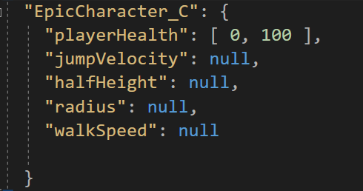
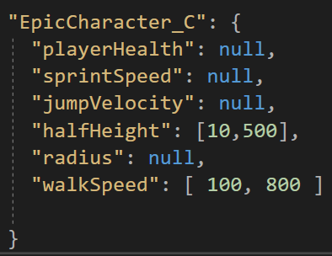
We are using Unreal 4.27 as a playground for now, but if it's accepted, we will be happy to integrate the mechanics into the Frostbite engine as well!
The current implementation uses as an optional guidance method a JSON file attached to a blueprint/set of variables/classes, that describes the ranges of values and type (numeric or string).
E.g:
B. walkSpeed can be be something between 100- 800, halfHeight of the collisionCapsule between 10-500, the rest could be anything.
A. playerHealth can be something between 0-100, the rest could be anything.

Slide 7
Note: The JSON guidance is optional! If nothing is provided, the type declaration range will be taken into account in the fuzzing process.
Demo: https://drive.google.com/file/d/1wYyX6MCHhnXEk54A7_GPidTne7QoP58T/view?usp=sharing

Slide 8
4. Finding different set of parameters
How can a designer quickly evaluate different ranges of parameters at gameplay level?
What if at a certain point the designer finds that the character is blocked and needs to quickly change parameters?
What if a designer wants to tune different difficulty levels?

Slide 9
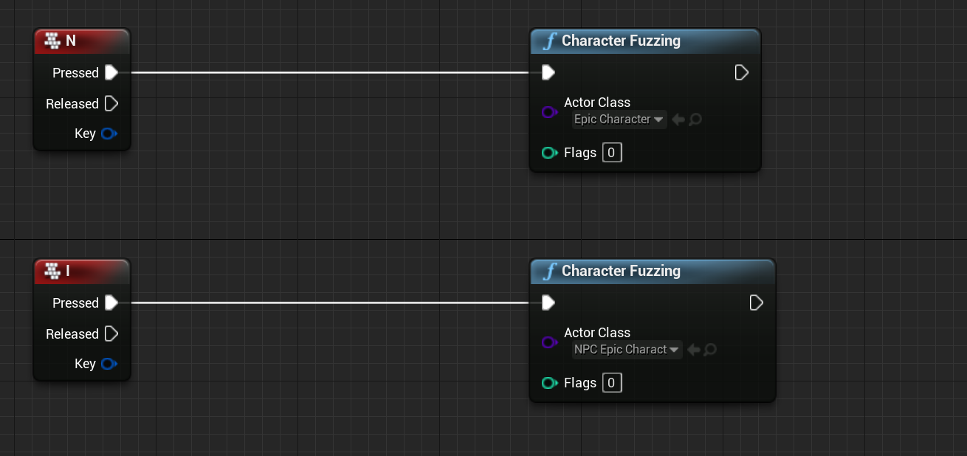
Idea: Manual triggering of fuzzing process using a guided JSON can be a quicker method than previous ones!
Think about having a shortcut that generates new values in ranges / categories specified. E.g.:
In our demo this triggers a new fuzz process for user-controlled character
In our demo this triggers a new fuzz process for an NPC character

Slide 10
Demo for user triggered fuzzing
https://drive.google.com/file/d/1tlbis6jDfHxqi3iDNy1vjRcbsNidHRBO/view?usp=sharing

Slide 11
5. Future work
Improved abstraction for automatic test generation
Prioritization tool for areas of the games that need to be tested, or perhaps based on previous history of bugs that continue to occur
Integration of our previously published work on genetic algorithms and reinforcement learning to guide the fuzzing process.
Frostbite integration! ☺

Slide 12
Thank you!

