Slide 1
NLP (Natural Language Processing) for Video Games
Miruna Paduraru
Phd Student at University of Bucharest

Slide 2
1. Motivation
Just a few use-cases where NLP could help :
Sentiment analysis use-case: User is playing with a companion NPC and he says – with voice or text - that the game is too easy / hard / boring. The difficulty or parameters can then be adjusted dynamically at runtime ! Or imagine what could happen after being too ‘vocal’ in a FIFA 23 game with the referee after a foul when you already have a yellow card !
Getting blocked/frustrated use-case: User can’t find the path to a certain location or objective. A companion NPC, physically spawned in the game or assistant can receive as voice/text commands a request and help the user by showing the path
Game mechanisms understand use-case: User wants to ask information at runtime for different contextual things in the game, design or mechanics that he doesn’t understand from beginning. E.g., how to heal and where to find potions, minimum required level for handling a weapon, etc.

Slide 3
2. Demos and source code
The code, installation and demos are available here: https://github.com/AGAPIA/NLPForVideoGames/
Since the project is developed with my supervisors from University of Bucharest, the engine behind needs to be open source. We use Unreal Engine 4 (latest stable version, 4.27, at the moment).
Personally, I don’t see any reasons why it wouldn’t work in Frostbite too and would be happy to bring it there too if you find it useful !

Slide 4
DEMOs:
Check the Presentation/Demo with audio commands.mp4 (with your sound opened please ☺ ) to see how we ask the NLPBotNPC to do several things, respond to our questions, etc.
At runtime, we press CTRL+R to start listening to the user voice in the local mic device, then, when a small pause is made in voice, we begin our inferences and perform the request.
Check the Presentation/Demo with text commands.mp4 to see different other things by inputting commands as text.
A small UIWidget is used to write text then after ENTER key is pressed we start the same processes as above

Slide 5
3. High-level technical aspects
Notes:
This is just a quick overview of the technical solutions that we use for the prototype. We’ll get in deeper details if the submission is accepted !
There are three state-of-the art external NLP models forked and extended for our needs in gaming:
- Joint Intention and slot fitting model https://arxiv.org/pdf/1902.10909.pdf
- Question Answering model: https://arxiv.org/pdf/1810.04805v2.pdf
- Speech recognition module https://arxiv.org/abs/2004.04099
To experiment quickly (e.g., swap models, retrain, test cycle), we run the three models currently on Flask instances and REST API.
Of course, in a production environment each of these models could be embedded in the C++ code as kernel functions. At the moment, we don’t have this men-power at University.

Slide 6
4. Game knowledge representation
The training data for Intention and slots filling model used come from csv files with the columns: text, intent and slots such that the model can understand the connection between actions, locations, and text.
For the Question Answering model , several texts describing objects in the game, i.e., where given. Then, BERT model was re-trained using the standard methodology used by chatbots in the industry / academic field. (Check QuestionAnswering, CONTEXT examples for more details about possible designers’ inputs).
Parts of the BERT model are used jointly by the two models such that they include the same base understanding/semantics.

Slide 7
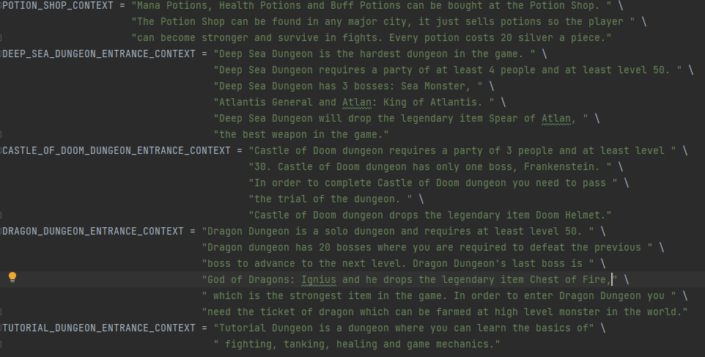
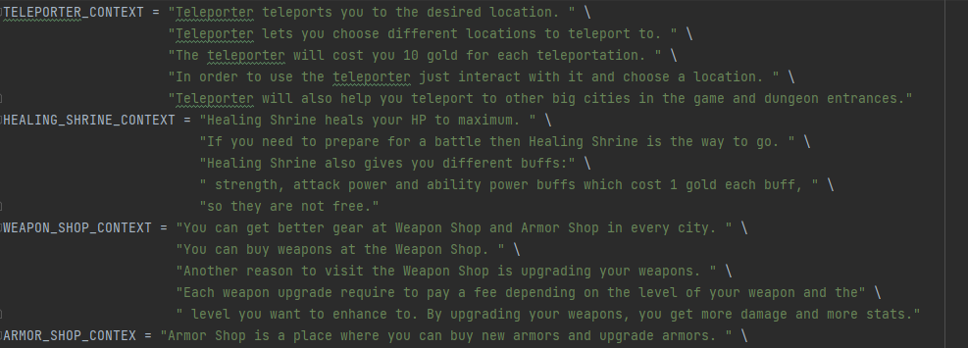
5. Methods used for NLP and game interaction
Question answering.
Bert model is re-trained on knowledge data texts provided by the designer/user. A few examples of knowledge data:

Slide 8
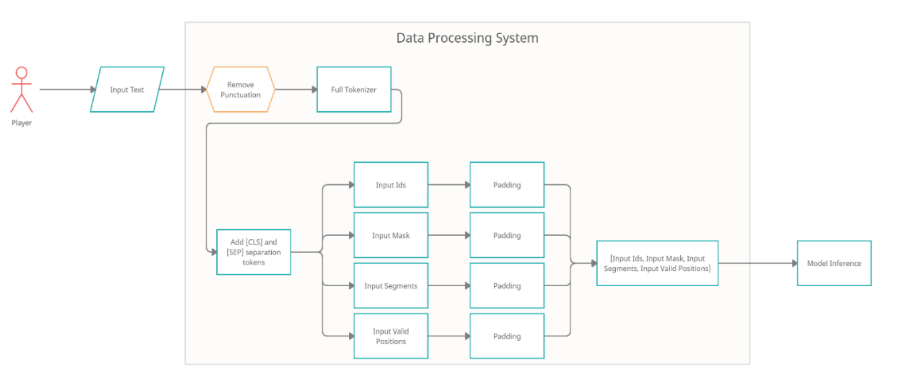
Note: more explanations will be given if accepted, about the flow description, data processing on input/output ends, etc.

Slide 9
B. Intent and slot filling usage
The input data is represented by a request, such as “Where can I heal myself?” or “Take me to healing shrine “
The output data is represented by two different types of data:
Intent – representing the intent of the player predicted by the model which can be either AnswerQuestion, FollowAction, SentimentAnalysis.
2. Slots – representing an array of tokens that show where in the text that particular information can be found

Slide 10
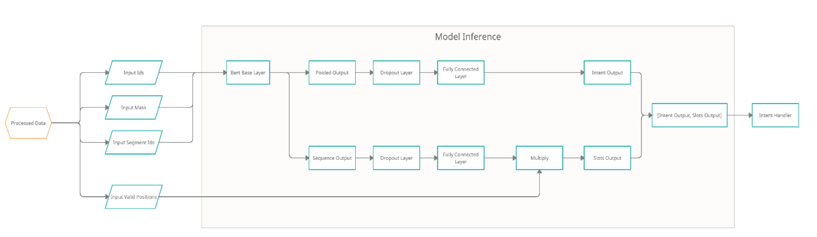
Note: more explanations will be given if accepted, about the flow description, data processing on input/output ends, etc.

Slide 11
Slots, and Input vs Output explanation
The used slots for extracting slots and using the attention model:
B-location – Beginning Location slot
I-location – Continuation of a location (a location can contain multiple words)
O – Empty slot (nothing of importance to the model)
E.g. 1:
For Input Text: “Get me to the teleporter”,
Model outputs:
Intent: “FollowAction”,
Slots: [O O O O B-location] - Text:
E.g. 2:
For Input text: “Take me to the healing shrine.”,
Model outputs:
Intent: “FollowAction”,
Slots: [O O O O Blocation I-location]

Slide 12
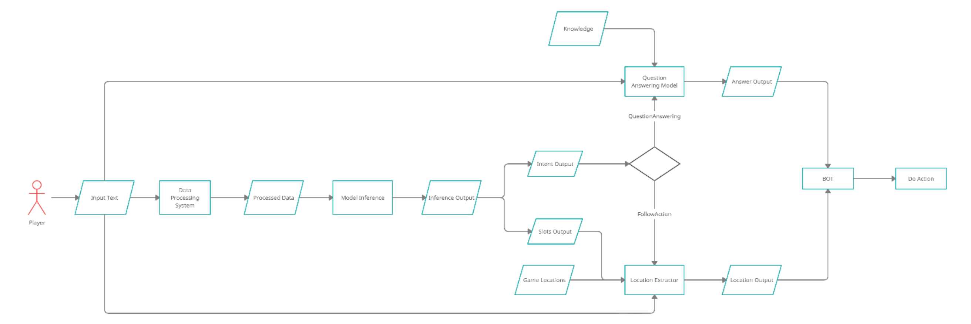
C. Complete example dataflow
Note: more explanations will be given if accepted, about the flow description, data processing on input/output ends, etc.

Slide 13
4. Future work
Provide a better abstraction for the categories of interaction between the NLP component and game knowledge
Tools for ease of use for representing game knowledge. Maybe more abstraction/reusability between games. E.g. something like Ontologies in the Web field maybe ?!
Frostbite integration !

