Slide 1
Natural Language Processing for Video Games
Miruna Paduraru
Phd. Student at University of Bucharest
Conf. Univ. Dr. Ciprian Paduraru

Slide 2
Content
Motivation
Demos and source code
High level technical aspects
Game knowledge representation
Methods used for NLP and game interaction
Future work

Slide 3
1. Motivation
Just a few use-cases where Natural Language Processing (NLP) could help :
Sentiment analysis use case: user plays with a companion NPC and says - via voice or text - that the game is too easy / hard / boring. The difficulty or parameters can then be dynamically adjusted at runtime! Or imagine what could happen if you are too vocal with the referee after a foul in a FIFA 23 game, even though you already have a yellow card!
Getting blocked/frustrated use case: the user can not find the path to a certain location or objective. An NPC companion that physically spawned in the game or an assistant can receive a request as a voice/text command and help the user by showing them the path.
Game mechanisms understand the use case: the user wants to ask information at runtime about various contextual things in the game, design, or mechanics that he does not understand from beginning. E.g. how to heal himself and where to find potions, what is the minimum level required to wield a weapon, etc.

Slide 4
2. Demos and source code
The code, installation and demos are available here: https://github.com/AGAPIA/NLPForVideoGames/
Since the project is developed together with my supervisors from the University of Bucharest, the engine behind it must be open source. We are using Unreal Engine 4 (the latest stable version, 4.27, at the moment).
Personally, I see no reason why it would not work in Frostbite too and would be happy to bring it there too if you find it useful!

Slide 5
2.1 DEMOS:
Check the Presentation/Demo with audio commands.mp4 (with sound opened please ☺ ) to see how we ask the NLPBotNPC to do various things, respond to our questions, etc.
At runtime, we press CTRL+R to listen to the user’s voice in the local mic device. Then, when there is a small pause in the voice, we begin our inferences and perform the request.
Check the Presentation/Demo with text commands.mp4 to see different other things by inputting commands as text.
A small UIWidget is used to write text. After pressing the ENTER key, we start the same processes as above.

Slide 6
3. High-level technical aspects
Notes:
This is just a quick overview of the technical solutions that we use for the prototype. We’ll get in deeper details if the submission is accepted!
There are three state-of-the art external NLP models forked and extended for our needs in gaming:
- Joint Intention and slot fitting model https://arxiv.org/pdf/1902.10909.pdf
- Question Answering model: https://arxiv.org/pdf/1810.04805v2.pdf
- Speech recognition module https://arxiv.org/abs/2004.04099
To experiment quickly (e.g., swap models, retrain, test cycle), we run the three models currently on Flask instances and REST API.
Of course, in a production environment each of these models could be embedded in the C++ code as kernel functions. At the moment, we don’t have this men-power at the University.

Slide 7
4. Game knowledge representation
The training data for Intention and slots filling model come from csv files with columns: Text, Intent and Slots such that the model can understand the connection between actions, locations, and text.
For the Question Answering model, several texts describing the objects in the game, i.e., where given. Then, the BERT model was re-trained with the standard methodology used by chatbots in industry / academic field. (Check QuestionAnswering, CONTEXT examples for more details about the possible designers’ inputs).
Parts of the BERT model are used jointly by the two models, so they share the same base understanding/semantics.

Slide 8
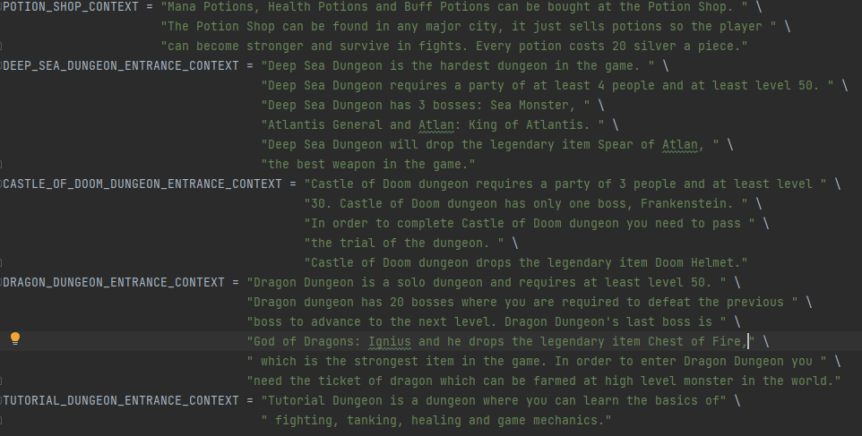
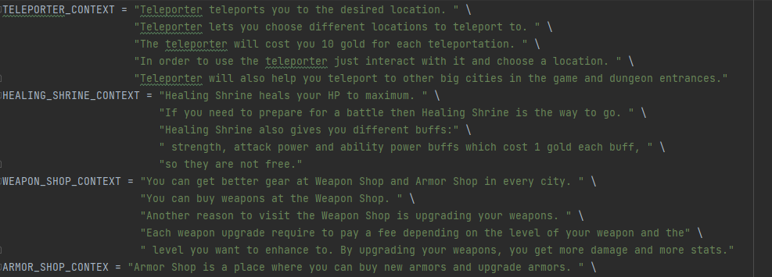
5. Methods used for NLP and game interaction
Question answering
Bert model is re-trained on knowledge data texts provided by the designer/user. A few examples of knowledge data:

Slide 9
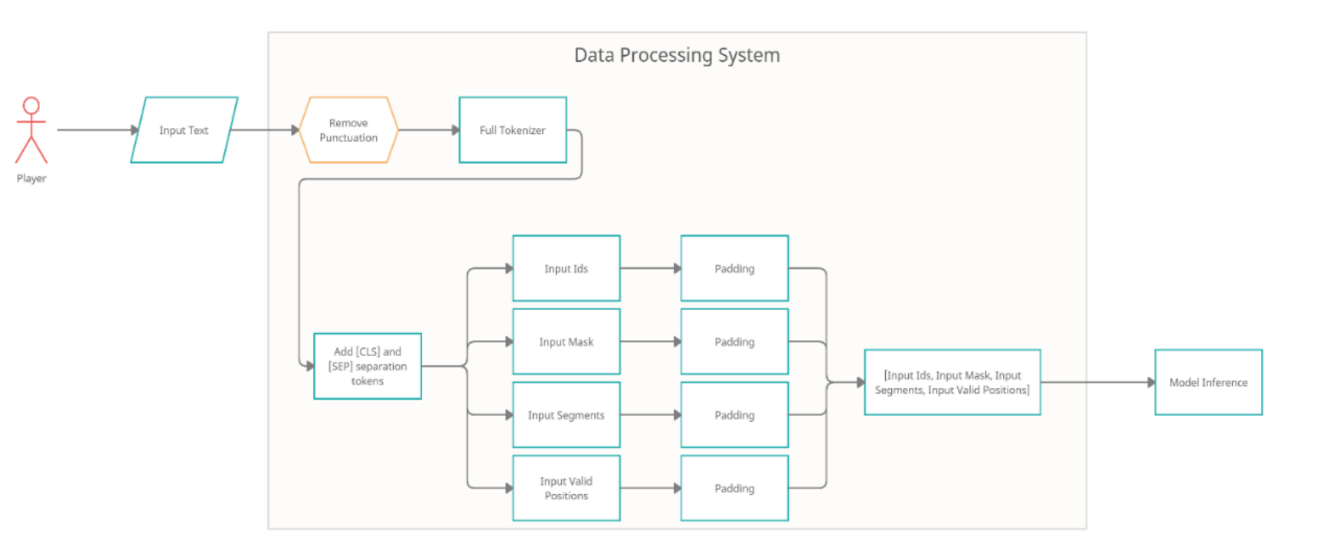
Note: more explanations will be given if accepted, about the flow description, data processing on input/output ends, etc.

Slide 10
B. Intent and slot filling usage
The input data is represented by a request, such as “Where can I heal myself?” or “Take me to healing shrine “
The output data is represented by two different types of data:
Intent – representing the intent of the player predicted by the model which can be either AnswerQuestion, FollowAction, SentimentAnalysis.
2. Slots – representing an array of tokens that show where in the text that particular information can be found

Slide 11
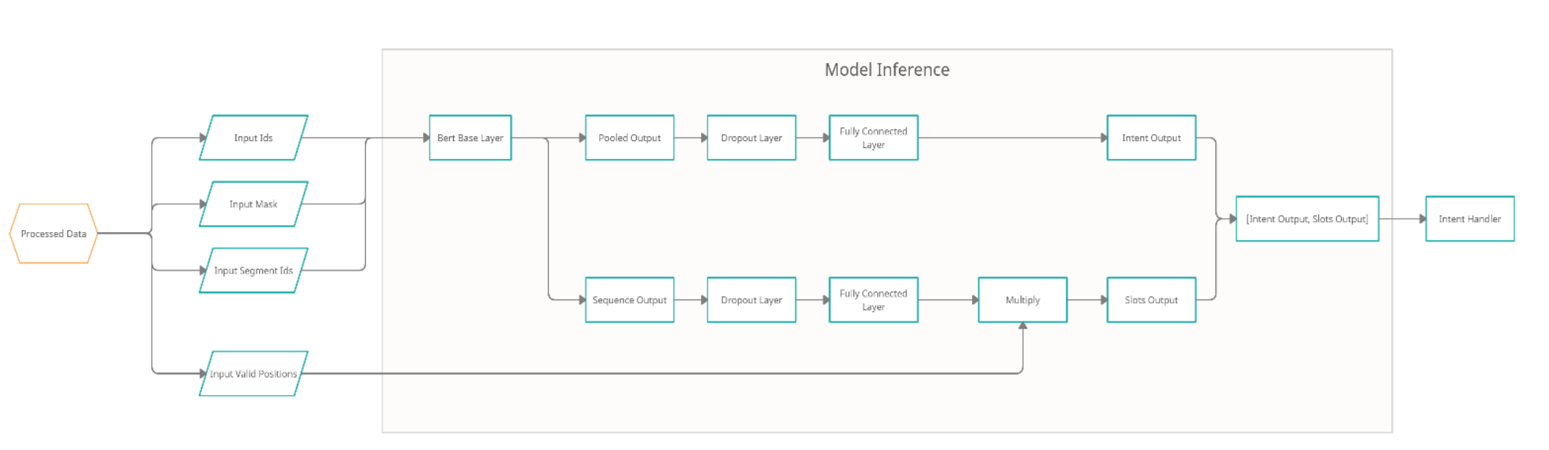
Note: more explanations will be given if accepted, about the flow description, data processing on input/output ends, etc.

Slide 12
Slots and Input vs Output explanation
The used slots for extracting slots and using the attention model:
B-location – Beginning Location slot
I-location – Continuation of a location (a location can contain multiple words)
O – Empty slot (nothing of importance to the model)
E.g. 1:
For Input Text: “Get me to the teleporter”,
Model outputs:
Intent: “FollowAction”,
Slots: [O O O O B-location] - Text:
E.g. 2:
For Input text: “Take me to the healing shrine.”,
Model outputs:
Intent: “FollowAction”,
Slots: [O O O O Blocation I-location]

Slide 13
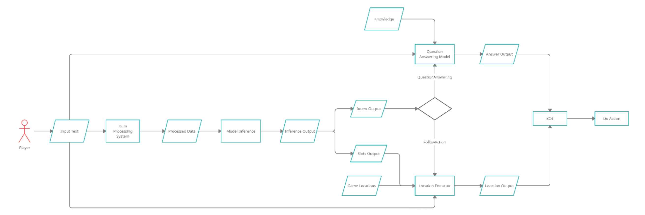
C. Complete example dataflow
Note: more explanations will be given if accepted, about the flow description, data processing on input/output ends, etc.

Slide 14
6. Future work
Provide a better abstraction for the categories of interaction between the NLP component and game knowledge
Tools for ease of use for representing game knowledge. Maybe more abstraction/reusability between games. E.g. something like Ontologies in the Web field maybe?!
Frostbite integration! ☺

Slide 15
Thank you!

