Slide 1
Real time map generation using Deep Reinforcement Learning
Stud. DOSPRA CRISTAIN-VASILE
Prof. coord. PĂDURARU CIPRIAN IONUȚ

Slide 2
What have we done?
Check out our github repo

Slide 3
Why have we done?

Slide 4
Urbanization
Gaming
Autonomous vehicles

Slide 5
How have we done?

Slide 6
Computer Vision Dataset processing
Lindenmayer Systems Content generation
Deep Reinforcement Learning Content generation

Slide 7
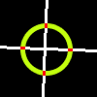
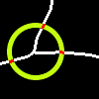


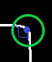
Approach -Lindenmayer Systems-
Finding intersections
Finding road ends
Finding road turns

Slide 8
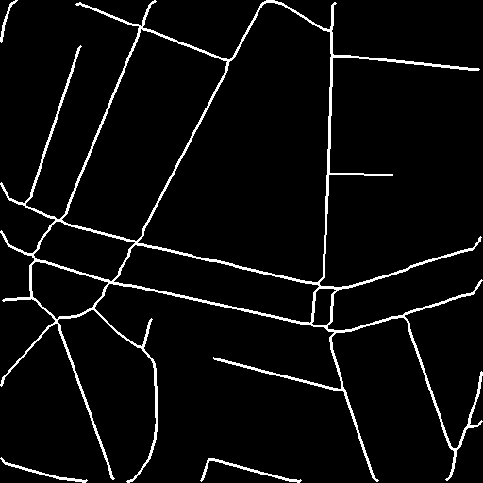
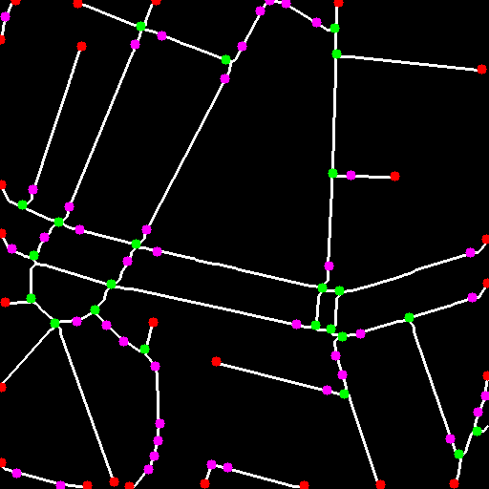
Approach (cont.) -Lindenmayer Systems-

Slide 9
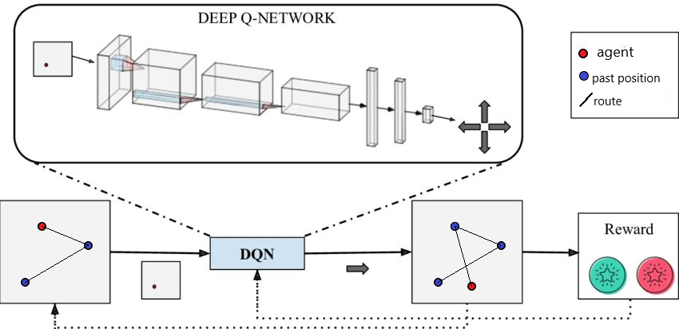
Approach (cont.) -Reinforcement Learning

Slide 10
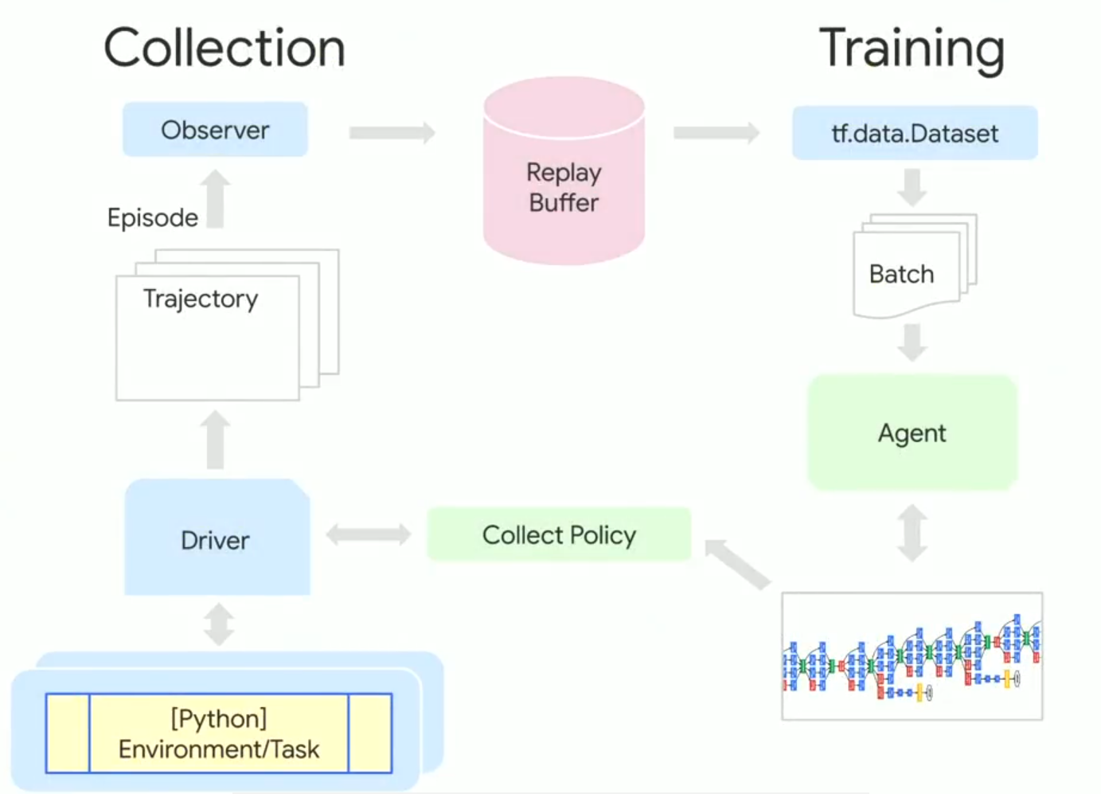

Approach (cont.) -Reinforcement Learning

Slide 11
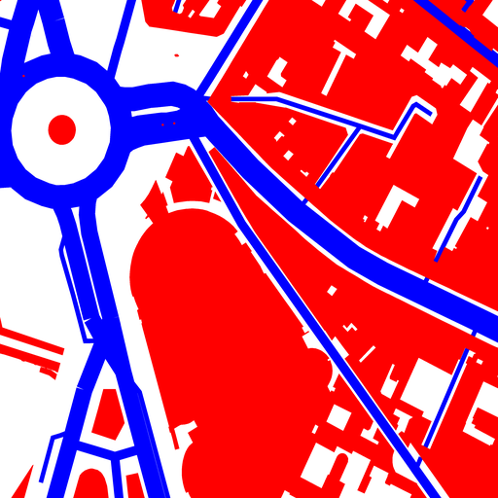



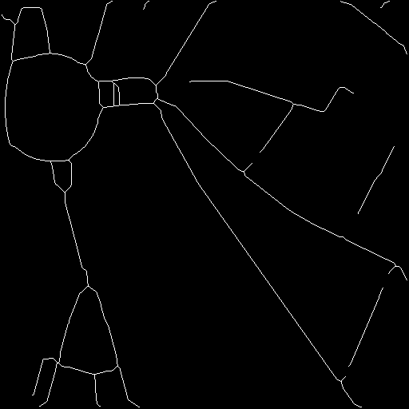

Results
Original
Road extraction
Closing
Erosion
Skeletonize
Binary dilation

Slide 12
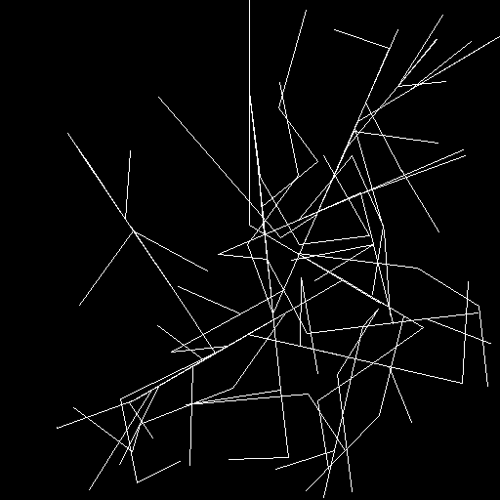
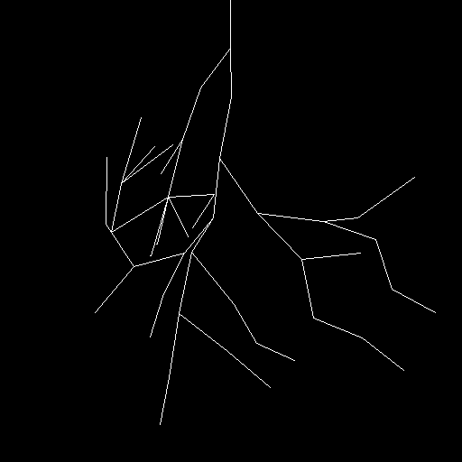
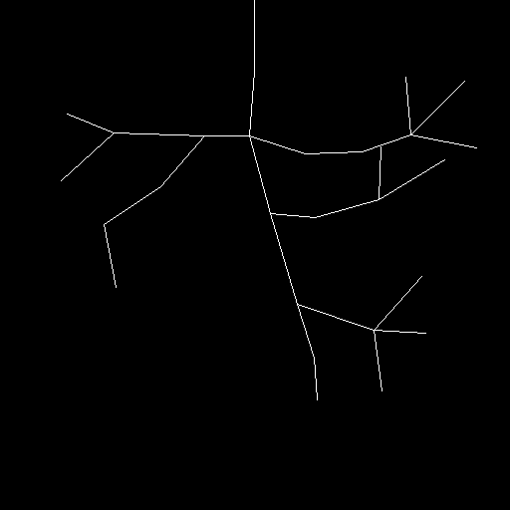
Results (cont.) -Lindenmayer Systems-
Phase 1
Phase 2
Phase 3

Slide 13
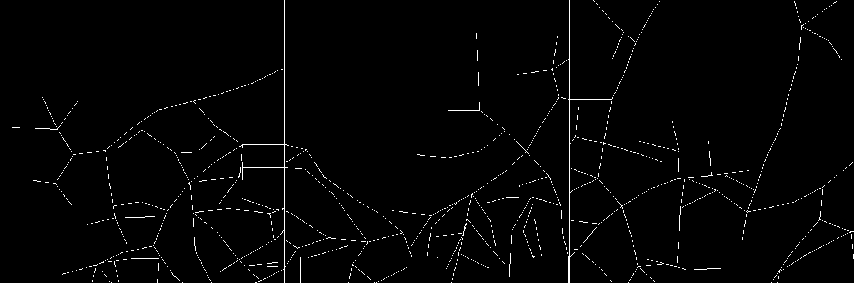
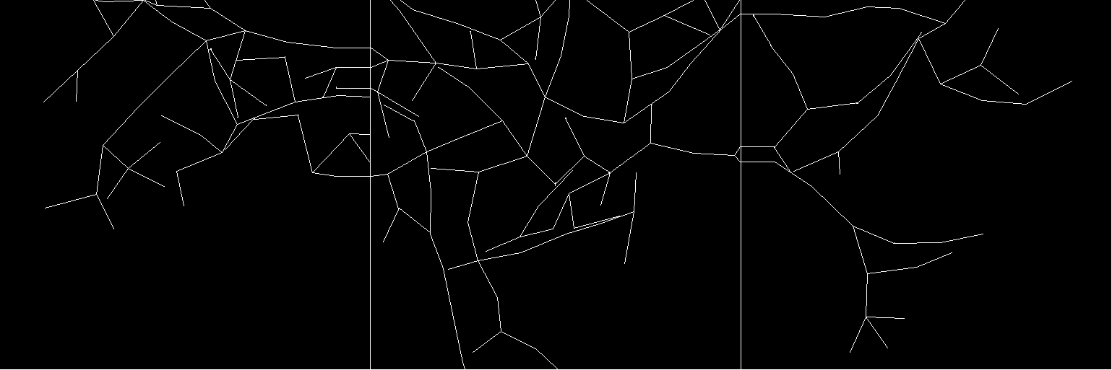
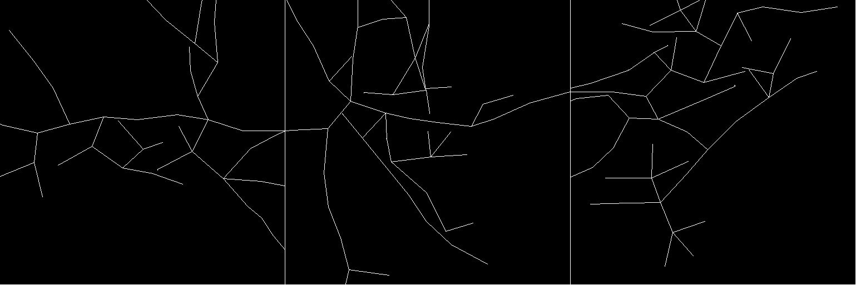
Results (cont.) -Lindenmayer Systems-

Slide 14

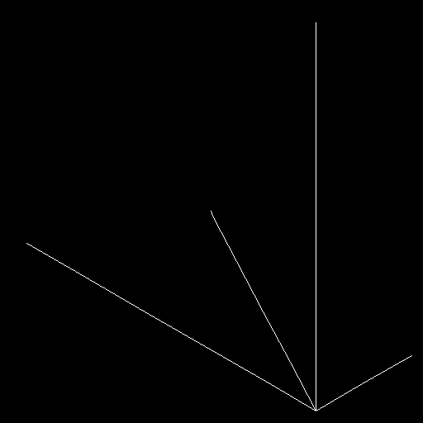
Results (cont.) -Deep Reinforcement Learning-
First attempts

Slide 15
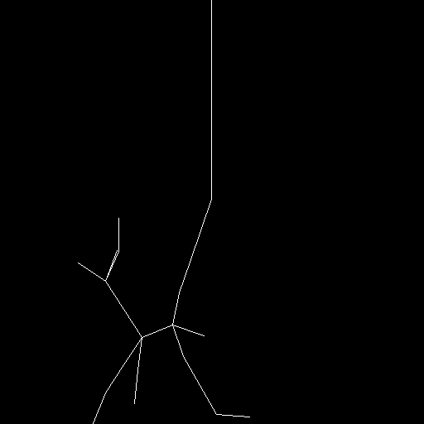
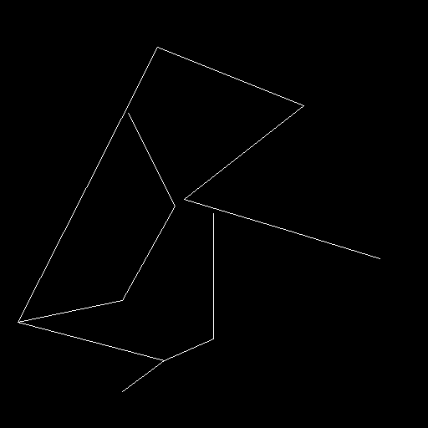
Results (cont.) -Deep Reinforcement Learning-
Final attempts

Slide 16
Conclusions
Showed the problem and it’s benefits
Analyzed the already existing similar approaches
Processed City dataset using Computer Vision
Extracted data and statistics which created our features
Came with a new approach for procedural content generation in terms of road maps
Made a parallel with Deep Reinforcement Learning model

Slide 17
THANK YOU!

