Slide 1
Waw app
Clasificador de emociones caninas con Machine Learning
The Bridge

Slide 2

¿Sabes si le pasa algo a tu perro?
(01)
(02)
(03)
(04)
Presentación
Arquitectura
Casos de uso
Futuras mejoras

Slide 3
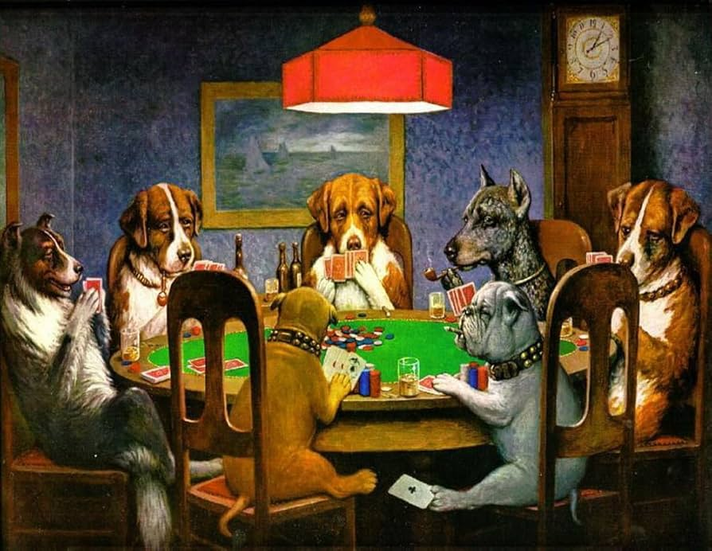
Una app para identificar las emociones de tu perro
Plataforma de Machine Learning que clasifica emociones caninas mediante el análisis de imágenes.
Compara modelos clásicos y Redes Neuronales para optimizar la precisión del diagnóstico emocional.

Slide 4
01
Business plan
Company name

Slide 5
Let’s have a look
Mercury is the closest planet to the Sun and the smallest one in the entire Solar System. This planet’s name has nothing to do with the liquid metal, since Mercury was named after the Roman messenger god. Despite being closer to the Sun than Venus, its temperatures aren't as terribly hot as that planet’s. Its surface is quite similar to that of Earth’s Moon, which means there are a lot of craters and plains. Speaking of craters, many of them were named after artists or authors who made significant contributions to their respective fields. Mercury takes a little more than 58 days to complete its rotation, so try to imagine how long days must be there!

Slide 6
Company description
From where we started to where we’re going
Provide a brief history of your company, including when it was founded and its evolution over time. Then, describe your company's vision for the future and its long-term objectives
Our management team leads with experience
Describe the key members of your team, their roles and responsibilities, and their relevant industry experience. Highlight any unique skills or qualifications that set your team apart from competitors to establish credibility with potential investors or partners

Slide 7
Market analysis
How we stand out in a competitive market
Analyze the competitive landscape for your industry, identify key competitors and their strengths and weaknesses. Then, you can explain how you plan to differentiate yourself and your business from them
Key trends shaping the industry
Who we’re targeting and why it matters
Provide a brief overview of your industry, including its size and growth trends. Identify key players in the market and any regulatory or technological changes that could impact your business or company
Describe your target customer segment(s) in detail, including demographics and psychographics, and explain why they represent an opportunity for your product or service

Slide 8
Marketing & sales strategy
Who we’re targeting and why
The value we offer to our customers
These are our key marketing channels
Identify your target audience, including demographics, psychographics, and
buyer personas
Clearly communicate the unique value that your product or service provides to customers compared
to competitors
Outline the channels you will use to reach your target market, such
as social media,
email marketing…
How we convert leads into customers
How we compare to our competitors
Key metrics and performance goals
Describe how you plan to convert leads into customers through your sales process
Analyze the strengths and weaknesses of your competitors in terms of their products/services, pricing strategy…
Define key performance indicators (KPIs) that measure the success of your marketing and sales efforts. Set specific goals

Slide 9
$4,498,300,000
Budget for the new products of the company
Company name

Slide 10
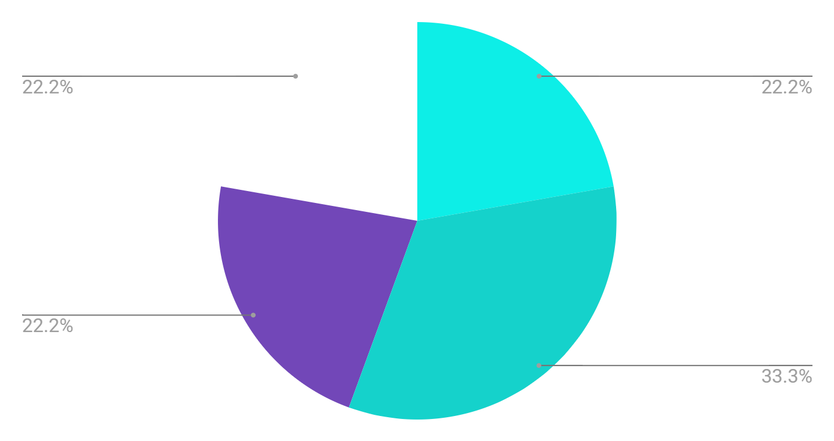
Budget for this quarter
 | Q1 | Q2 | Q3 | Q4 | Total
Research | $50,000 | $60,000 | $75,000 | $90,000 | $275,000
Product development | $20,000 | $24,000 | $30,000 | $36,000 | $110,000
Talent acquisition | $15,000 | $18,000 | $20,000 | $24,000 | $77,000
Marketing | $7,000 | $8,000 | $9,000 | $10,000 | $34,000
Understanding the numbers
Incorporating a graph in your business plan allows for the clear visualization and concise representation of data trends and comparisons, making complex information easier to understand
Follow the link in the graph to modify its data and then paste the new one here. For more info, click here

Slide 11
Business plan timeline
Step 01
Step 03
Step 05
Mercury is the closest planet
Earth is the third planet
Jupiter is the biggest planet
Step 02
Step 04
Step 06
Venus has a beautiful name
Mars is actually a cold place
Sun is the star at the center

Slide 12
My business strategy
Attractive business model
Growth and expansion strategy
Reorientation or abandonment strategy
High competitive strength
Low competitive strength
Maintenance and protection strategy
Reduction or elimination strategy
Unattractive business model

Slide 13
Market size infographic
$100 M
$100 M
"With the innovative approach and unique features, we aim to capture a significant portion of the $100 million"
$20 M
$20 M
"The research indicates that the market for [product/service] is projected to reach $20 million by next year"
$5 M
$5 M
"The market for [product/service] is currently valued at $5 million"

Slide 14
Thanks!
Do you have any questions?
youremail@freepik.com
+34 654 321 432
yourwebsite.com
Please keep this slide for attribution
Company name

Slide 15
Alternative resources
Did you like the resources used in this template? Get them on these websites:
Photos:
People working with ai operated devices I
People working with ai operated devices II
Gradient grainy texture
Round bubble spheres of northern lights background
Abstract northern lights background with defocused coloured shapes

Slide 16
Resources
Here’s an assortment of alternative resources whose style fits that of this template:
Abstract blue northern lights background
People working with ai operated devices

