Slide 1
Poisson Regression of Primary Care Access
Andrew Deighan

Slide 2
Primary Care Access and Insured Rate
Improved primary care access is strongly associated improved overall health outcomes and lower healthcare system costs
The uninsured rate has dropped from around 18% in 2013 to 9% in 2016
Are higher insured rates correlated with better primary care access?
Relationship between number of individuals with a personal doctor and insured rate

Slide 3
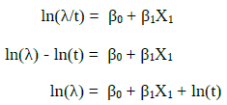
Personal Doctor Rate ~ Insured Rate
Use at statewide data
Regress count of individuals with a personal doctor on count of individuals with insurance
Standardize counts to rates per 100 individuals (percentage)
Use data from 2011 to 2015 Behavioral Risk Factor Surveillance System (BRFSS) annual surveys
Total of six models:
1 model for each year
1 model for five year averages

Slide 4
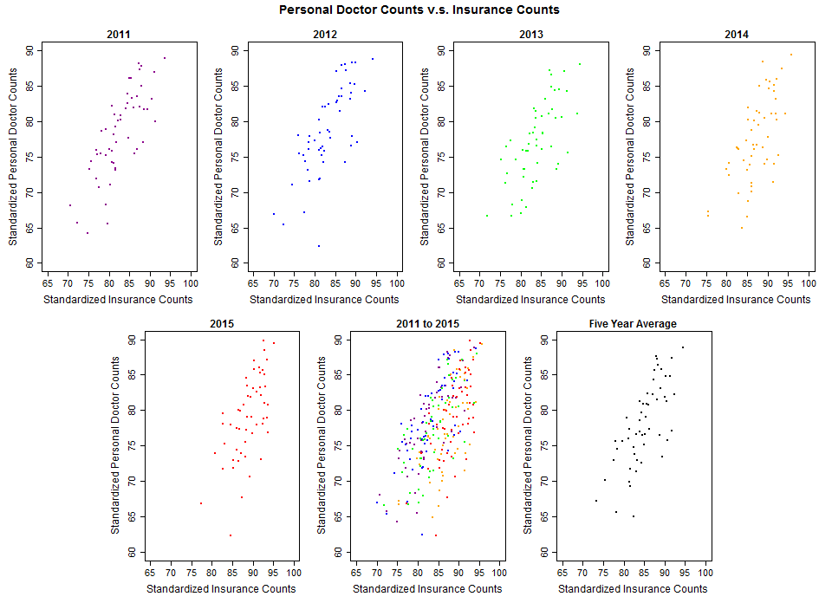

Slide 5
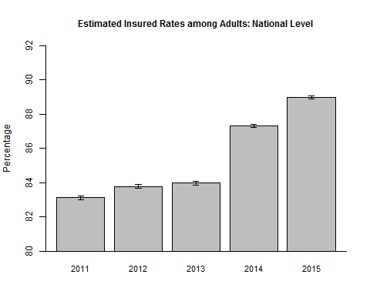
Change in Insured Rates
Insured rates increase from 2011 through 2012
Noticeable jump from 2013 to 2014
Period of time when most of the ACA reforms went into effect

Slide 6
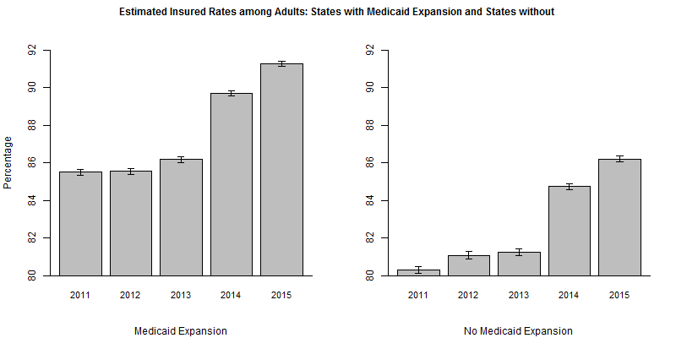
Medicaid Expansion Adoption

Slide 7
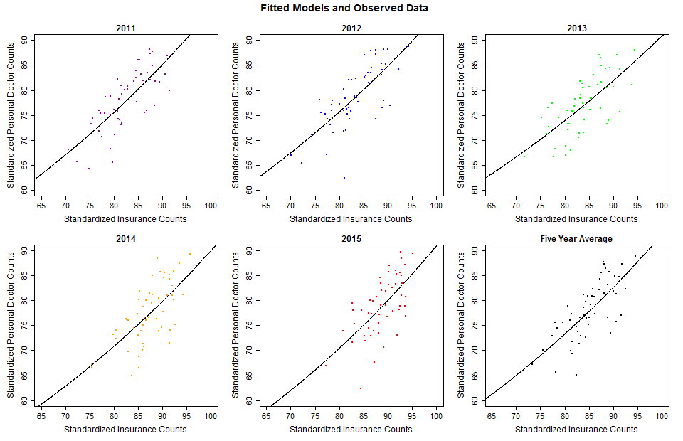
Fitted Models

Slide 8
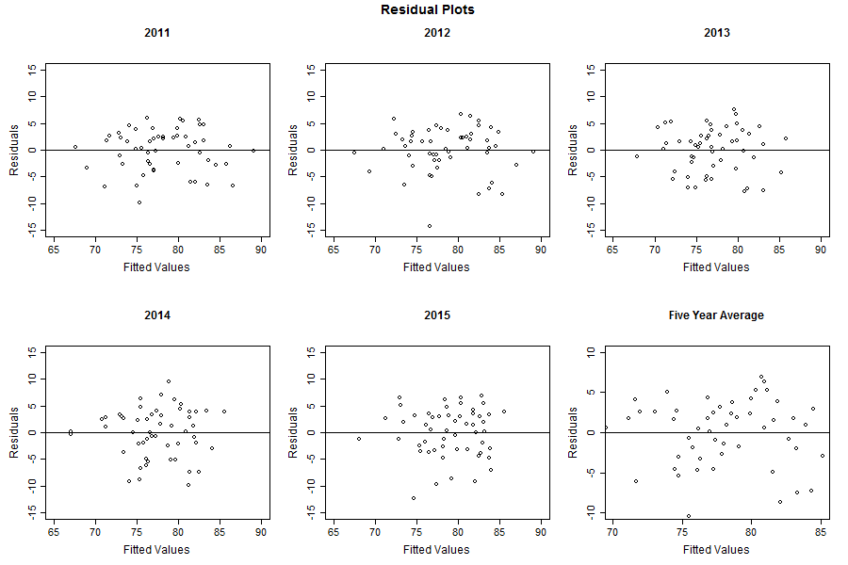
Residual Plots

Slide 9


Global Lack-of-Fit Tests
Null Hypothesis:
Model fits the data
Alternative Hypothesis:
Model does not fit the data (lack-of-fit)

Slide 10
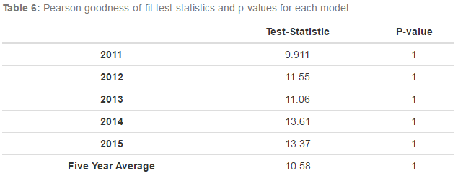
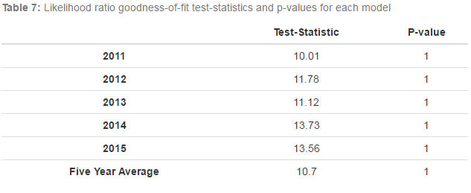
Global Fit Tests - continued

Slide 11

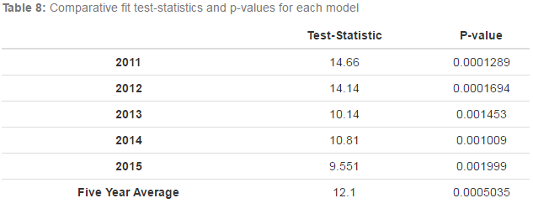
Comparative Fit Test: Deviance
Null Hypothesis:
Null model fits the data just as well as fitted model
Alternative Hypothesis:
Alternative model fits data better than null model

Slide 12

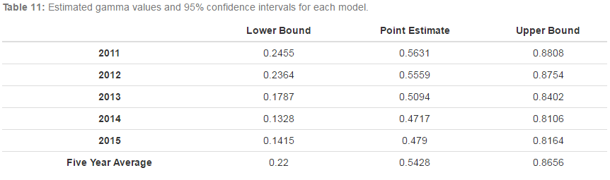
Predictive Power
None of the confidence intervals include 0

Slide 13
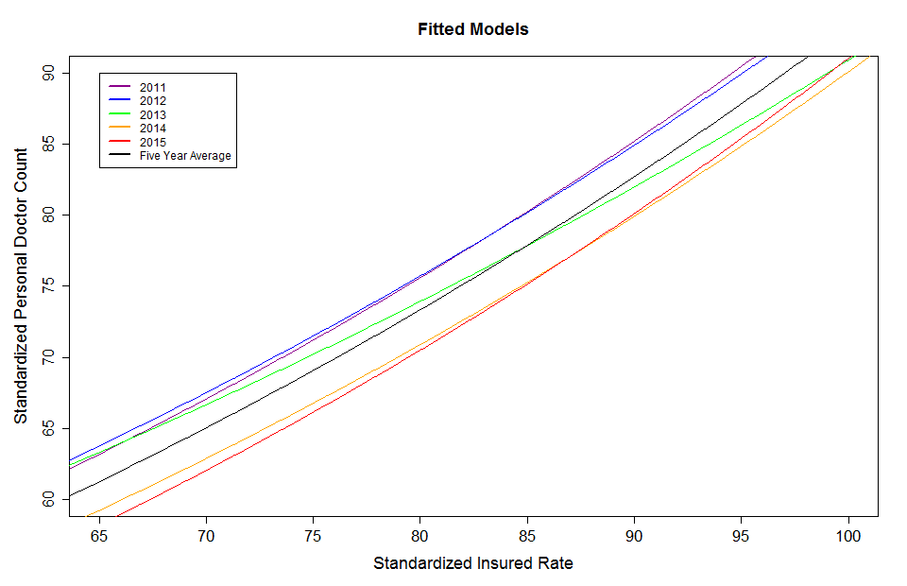

Slide 14
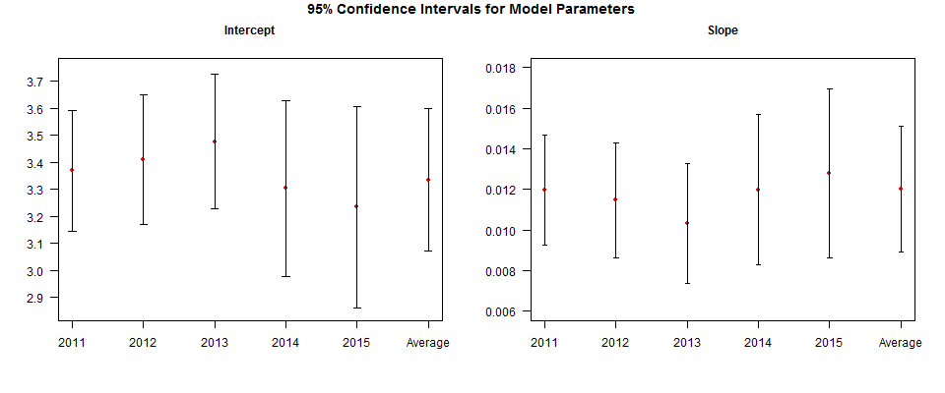

Slide 15
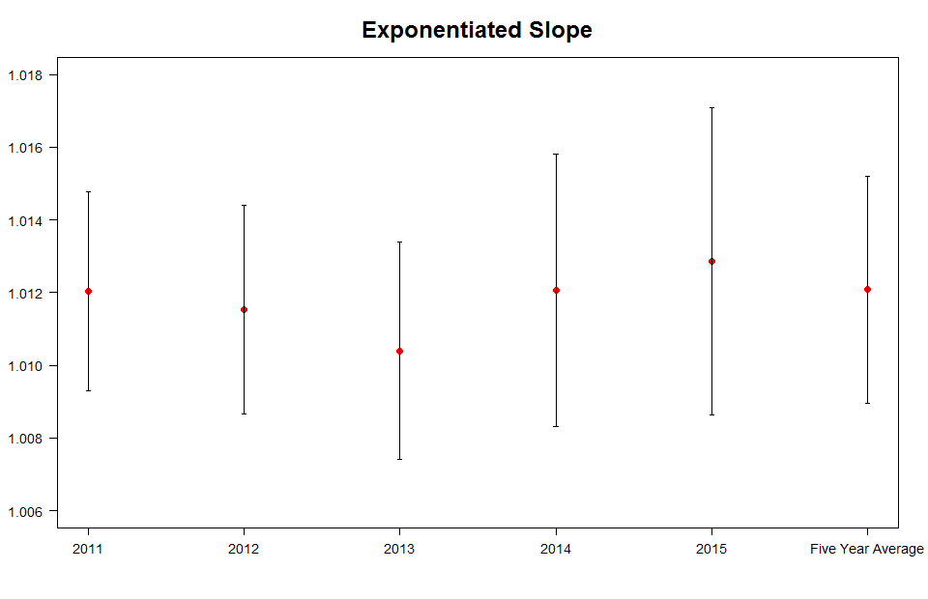
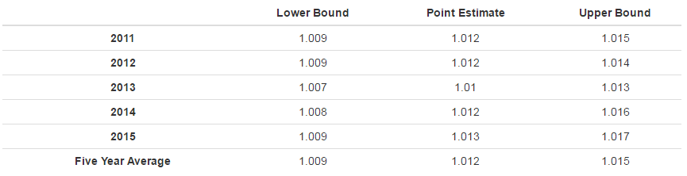
Using the five year average model we expect that for a 1 percentage increase in the insured rate that the percentage of individuals with a personal doctor should increase by 1.012 fold.
While this may seem like a small change, it can be quite large at the state level.

Slide 16



Interpreting a Poisson Model

Slide 17
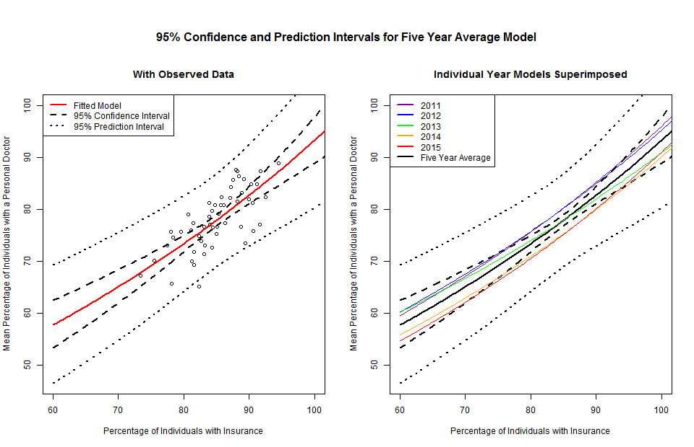

Slide 18
Conclusion
Insured rates have significantly increased in recent years
States that did not adopt the Medicaid expansion have significantly lower insured rates (~5%)
Higher insured rates in states are correlated with increased proportion of individuals with a personal doctor
For a 1 percentage increase in insured rate we expect the percentage of adults with a personal doctor to increase by about 1.012 fold.
Trend does not change significantly from year to year and can be expected to continue in a similar fashion
Increase in percentage of individuals indicates an increase in primary care access
Improvement in health outcomes
Decrease in healthcare system costs

