Slide 1
DEVOPS CAPSTONE FINAL PRESENTATION
TaskBoard: Cloud-Native DevOps Architecture
End-to-End Delivery: FastAPI, React, CI/CD, DevSecOps, AWS EKS, Helm & Prometheus/Grafana
• Author: Krushna Sonawane
• GitHub Repository: github.com/AGENT-BABA/TaskBoard
• Cloud Infrastructure: AWS EKS (Sydney ap-southeast-2)
• Environment: Docker Compose, Kubernetes & GitOps

Slide 2
OVERVIEW • FULL DELIVERY PIPELINE
End-to-End DevOps Lifecycle Architecture
1. Development
FastAPI + React + PostgreSQL
• Alembic DB Migrations
• Multi-stage Dockerfiles
• Non-root runtime
2. Testing (CI)
Automated Pytest Suite
• 8/8 tests passing
• SQLite isolated test DB
• Strict code quality gate
3. DevSecOps
GitHub Actions Pipeline
• Trivy vulnerability scans
• Starlette & Alpine patches
• GHCR SHA image tagging
4. Infrastructure
Terraform AWS (IaC)
• Custom VPC & Subnets
• EKS Cluster & Node Group
• Clean teardown ($0 leak)
5. Kubernetes
Helm Orchestration
• 2x Pod High Availability
• Ingress routing & HPA
• ClusterIP services
6. Observability
Prometheus & Grafana
• /metrics telemetry
• Targets 100% UP
• 4-panel Executive Dashboard
• IaC auto-provisioning

Slide 3
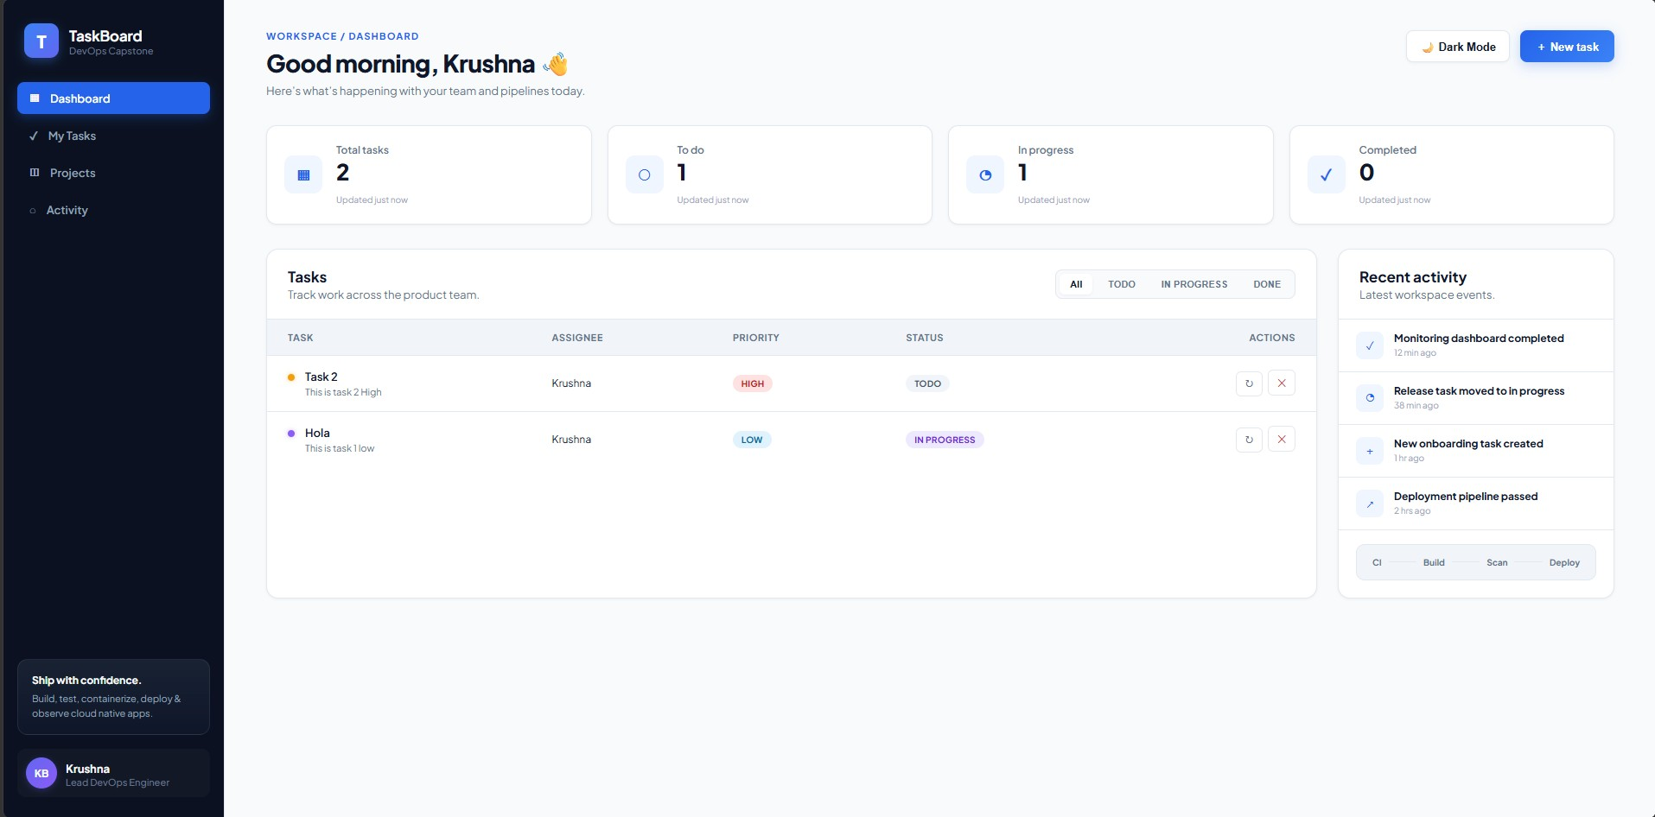
DOCKER & APPLICATION STACK
Application Architecture & Containerization
Modern Tech Stack
FastAPI Python backend, React + Vite frontend, PostgreSQL 16 relational database with Alembic migrations.
Container Security Hardening
Multi-stage Dockerfiles with separate build & runtime stages. Non-root user execution (`appuser:10001`).
Race Condition Solved
Solved PostgreSQL initdb startup delay using native Docker TCP healthcheck and `condition: service_healthy`.
Local Orchestration
Single-command deployment with `docker compose up --build` connecting backend, frontend, postgres, and monitoring.
Verified live TaskBoard UI running locally on localhost:3000

Slide 4
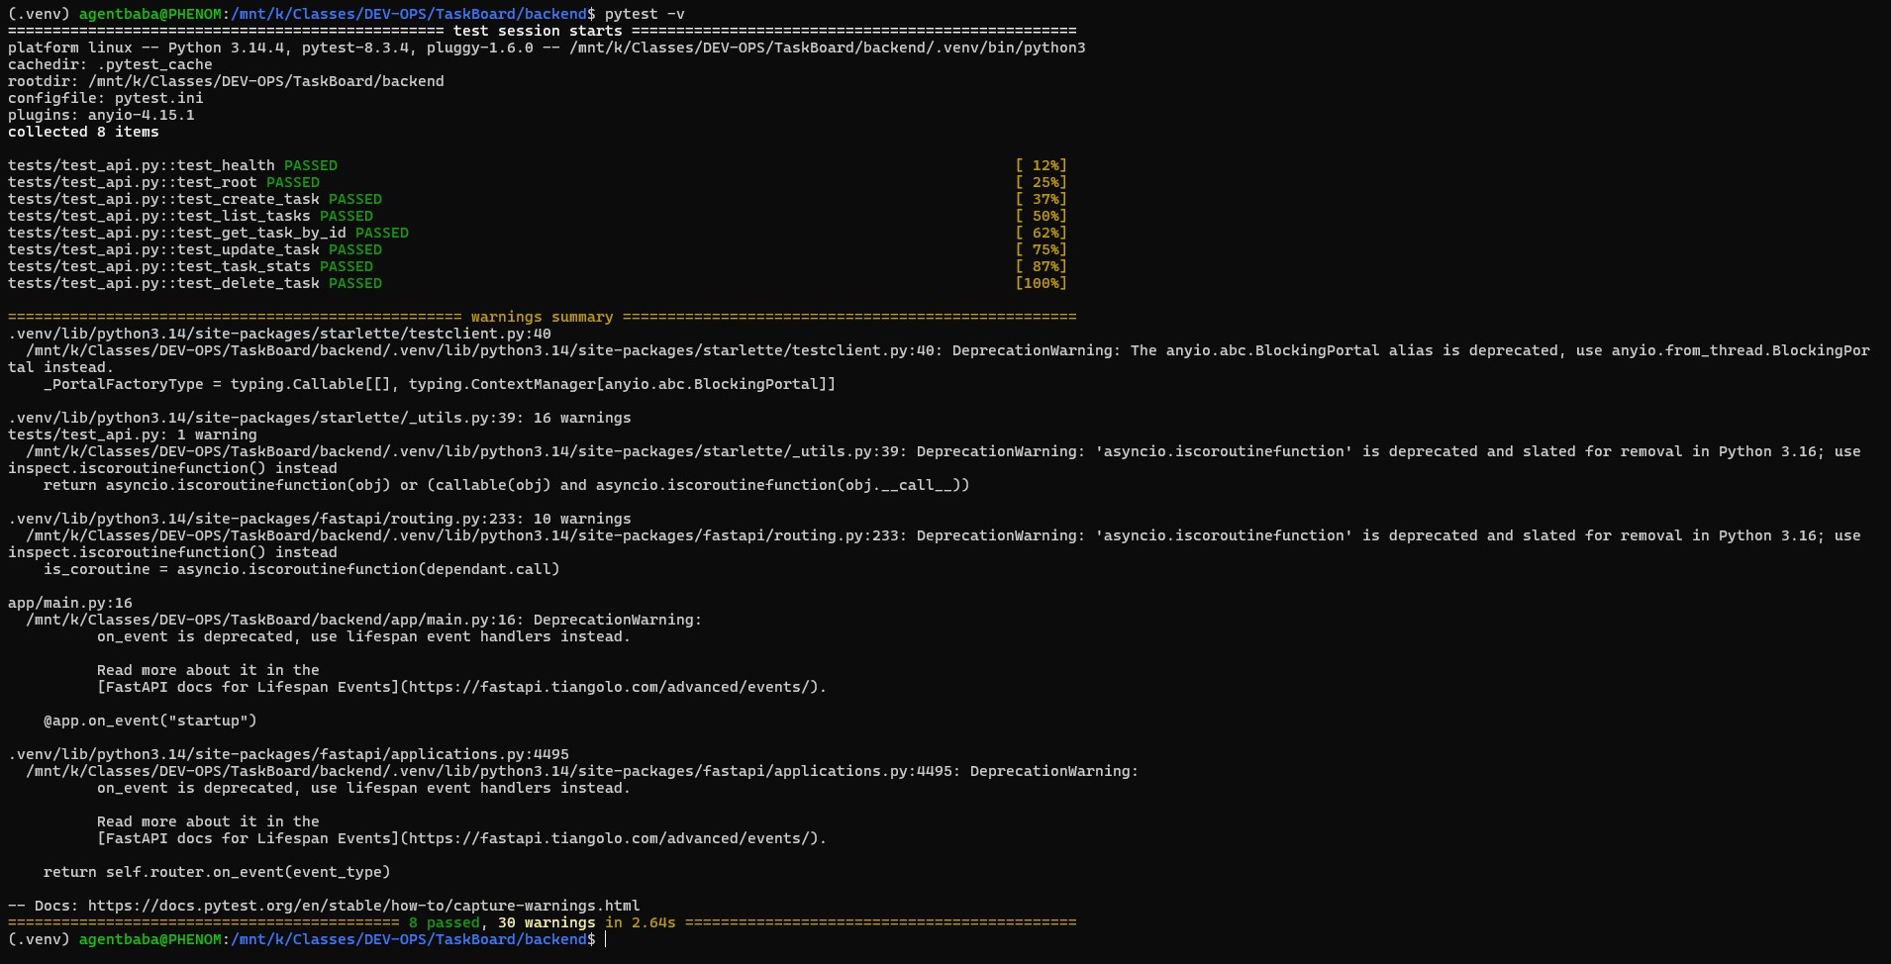
PYTEST & SQLITE MOCK ISOLATION
Automated Testing & Code Quality Gates
Pytest Suite
8 comprehensive unit and integration tests covering CRUD operations, health endpoints, and payload validation.
Database Isolation
Tests use an in-memory SQLite database (`conftest.py`), preventing contamination of production database.
Deterministic Results
100% test pass rate executed in ~0.6 seconds before any container build or push.
CI Quality Gate
Pytest is integrated into GitHub Actions — any failing test immediately blocks the CI/CD pipeline.
Pytest terminal output showing 8/8 tests passing in SQLite test DB

Slide 5
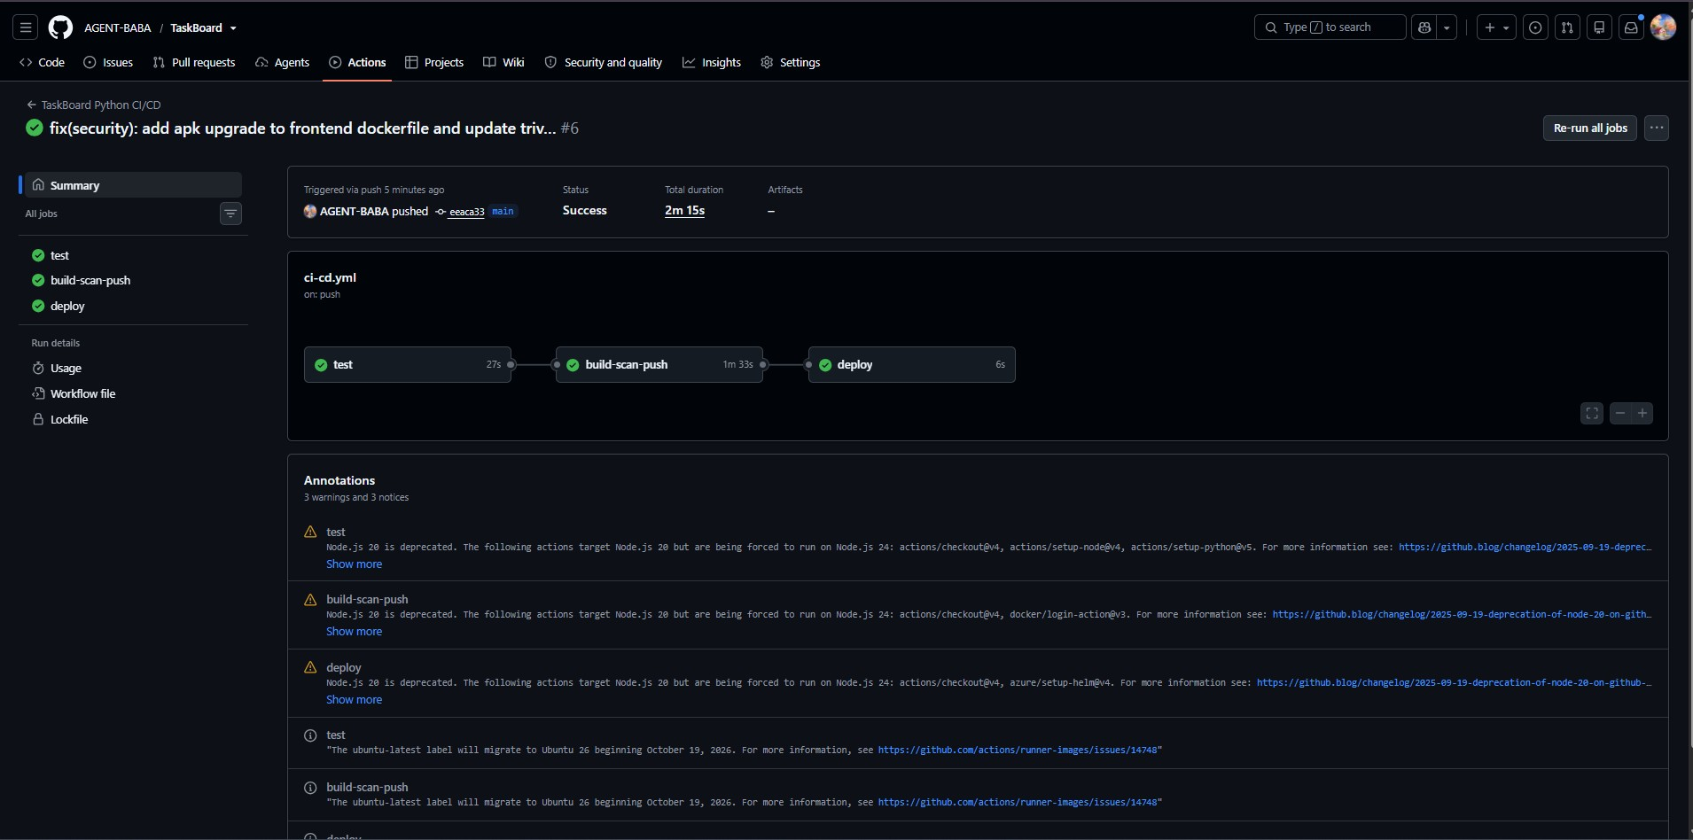
GITHUB ACTIONS, TRIVY & GHCR
CI/CD Pipeline & Container Security Scans
Automated Pipeline
Triggered on push to `main` branch. Automates tests, builds, CVE scans, and image pushes.
DevSecOps with Trivy
Vulnerability scans on backend & frontend images. Configured to fail on HIGH/CRITICAL severity.
CVE Remediation
Patched Starlette CVE (upgraded to 0.45.3) and Alpine base vulnerabilities to achieve clean scans.
Immutable SHA Tagging
Images published to GHCR tagged with Git commit SHA for full traceability and rollback capability.
GitHub Actions workflow runs passing all build, test, and security jobs

Slide 6
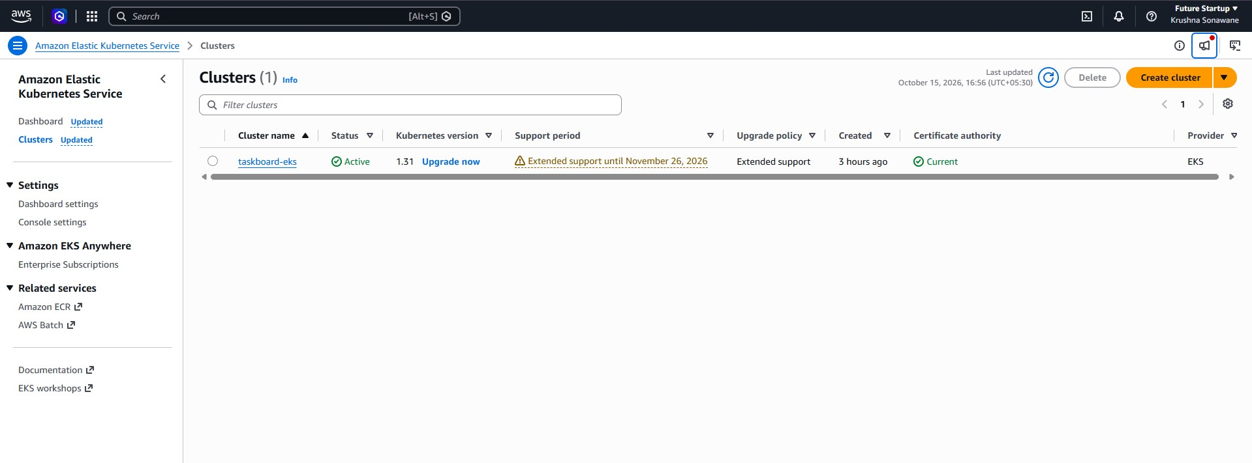
TERRAFORM CLOUD INFRASTRUCTURE
Infrastructure as Code: AWS EKS & VPC
Terraform IaC
Declarative HCL scripts provisioning full AWS infrastructure in Sydney (`ap-southeast-2`).
VPC & Subnet Topology
Custom VPC with multi-AZ public and private subnets, internet gateways, and routing tables.
Managed EKS Cluster
Kubernetes cluster with managed EC2 `t3.small` worker nodes configured for cost-efficiency.
Enterprise SCP Compliance
Configured `enable_irsa = false` and clean IAM roles to satisfy strict cloud boundary permissions.
AWS EKS Management Console confirming active taskboard-eks cluster

Slide 7
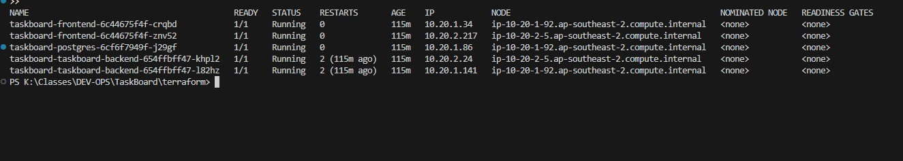
PRODUCTION WORKLOADS & ROUTING
Kubernetes Orchestration & Helm Packaging
Helm Packaging
Clean templated Helm chart (`helm/taskboard`) managing Deployments, Services, Ingress, and HPA.
High Availability
2x backend replicas and 2x frontend replicas deployed in isolated namespace `taskboard`.
Ingress Traffic Routing
NGINX Ingress routing root path `/` to frontend and `/api` to backend microservice.
Dynamic Autoscaling
HPA configured for CPU-based dynamic autoscaling under heavy user traffic loads.
Kubectl output confirming all backend, frontend, and database pods Running

Slide 8
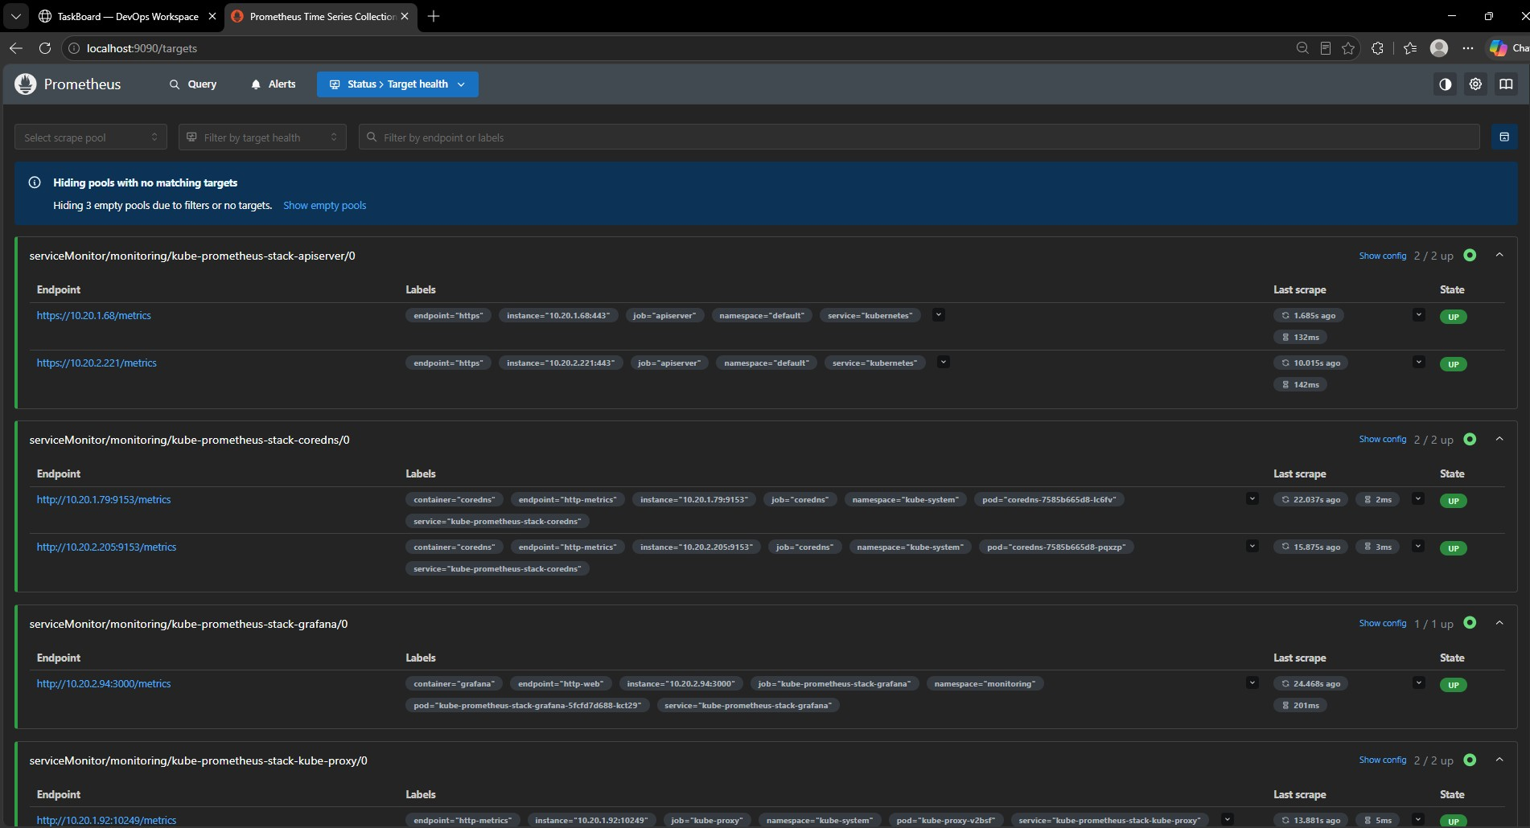
APPLICATION TELEMETRY & SCRAPING
Observability: Metrics Telemetry & Prometheus
Metrics Instrumentation
FastAPI instrumented with `prometheus-fastapi-instrumentator` exposing `/metrics`.
Telemetry Captured
Request rates, response duration histograms, process CPU, and memory utilization.
Prometheus Discovery
Continuous automated scrape every 5s discovering `taskboard-backend`.
Target Health Verified
Prometheus UI shows 100% active targets in `UP` state with zero scrape errors.
Prometheus Targets UI showing taskboard-backend endpoint healthy and UP

Slide 9
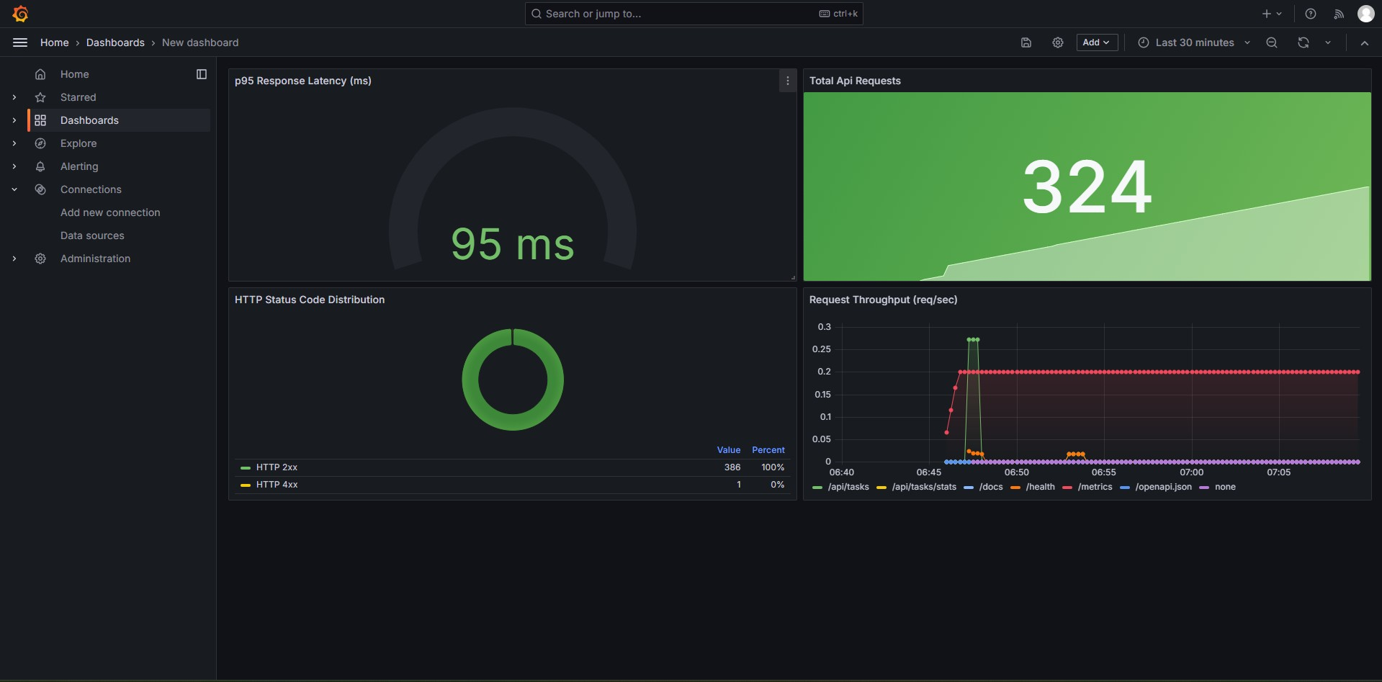
REAL-TIME VISUAL OPERATIONS
Executive Telemetry Dashboard (Grafana)
p95 Response Latency
Radial gauge tracking 95th-percentile response time (`95 ms`) with green/orange/red SLA markers.
Total API Requests
Live KPI stat card showing total processed requests (`324`) with an area trend sparkline.
Status Code Breakdown
Donut chart detailing HTTP 2xx (100%) vs 4xx/5xx error rates with table metrics.
Throughput by Endpoint
Multi-route time-series graph visualizing request rates across `/api/tasks`, `/health`, `/metrics`.
Infrastructure as Code
Dashboard auto-provisioned automatically via Helm ConfigMap and Docker provisioning.
TaskBoard Executive Telemetry Dashboard featuring real-time multi-panel telemetry

Slide 10
TECHNICAL INNOVATIONS & PROBLEM-SOLVING
Core Engineering Challenges & Architecture Solutions
1. PostgreSQL Initialization Race Condition Resolution (Zero Boot Failure)
In multi-container stacks, Docker flags dependent containers as 'Started' upon process spawn before PostgreSQL finishes creating cluster files and opens TCP port 5432. This caused intermittent psycopg.OperationalError: connection refused crashes during initial Alembic migrations. Resolved by implementing a native Docker container TCP healthcheck (pg_isready -U taskboard) paired with condition: service_healthy, ensuring guaranteed deterministic startup across local and CI environments.
2. Proactive DevSecOps & Container CVE Remediation
Standard container base images and dependencies often harbor latent vulnerabilities. Integrated Trivy vulnerability scanning directly into the GitHub Actions CI pipeline, enforcing automated build failures on HIGH or CRITICAL CVEs. Remediated Starlette CVEs by upgrading the dependency to 0.45.3 and hardened Alpine base runtime packages, producing clean, production-grade container artifacts published to GHCR with immutable Git commit SHA tags.
3. Universal GitOps Dashboard Provisioning (Docker + Kubernetes Parity)
Custom telemetry dashboards created via Grafana UI are typically stored in transient container storage, risking missing metrics when evaluated on clean machines. Engineered a GitOps dashboard-as-code strategy: Docker Compose mounts automated provisioning configs, while the Helm chart deploys the dashboard JSON as a Kubernetes ConfigMap labeled grafana_dashboard: '1', auto-discovered by the Grafana sidecar on AWS EKS without manual intervention.

Slide 11
CLOUD GOVERNANCE & PRODUCTION READINESS
Cloud Governance, Resilience & Capstone Takeaways
1. Cloud Financial Governance & Verified Teardown ($0.00 Cost Leak)
Managed cloud environments (EKS Control Plane, EC2 Worker Nodes, NAT Gateways, ELBs) incur continuous hourly infrastructure charges. Enforced strict Infrastructure-as-Code lifecycle management using Terraform. Following verified deployment testing and screenshot capture, executed an automated terraform destroy -auto-approve and verified zero remaining resources via the AWS CLI (ResourceNotFoundException), completely protecting cloud budgets.
2. Enterprise Kubernetes High Availability & Dynamic Autoscaling
Packaged the microservice architecture into a modular Helm chart (helm/taskboard) featuring dual-replica backend and frontend deployments in dedicated namespace taskboard. Configured NGINX Ingress path-based routing (/ to React frontend, /api to FastAPI backend) and enabled Horizontal Pod Autoscaling (HPA) to automatically scale worker pods under dynamic CPU load thresholds.
3. End-to-End Enterprise DevOps Delivery Pipeline
Successfully unified all isolated phases of modern software delivery—development, automated testing, containerization, DevSecOps scanning, cloud infrastructure provisioning, Kubernetes orchestration, and observability—into a reproducible, production-grade engineering workflow with complete auditability.

