Slide 1

VARDHAMAN COLLEGE OF ENGINEERING, HYDERABAD Autonomous institute affiliated to JNTUH DEPARTMENT OF COMPUTER SCIENCE & ENGINEERING
Title: PREDICTION USING SENTIMENT ANALYSIS
BATCH ID : 08
S. No | Roll. No | Student Name
1 | 19881A0504 | AKHIL KUMAR.S
2 | 19881A0515 | DAGAM MYTHILI
3 | 19881A0518 | GANDHAM SRI NITHYA
4 | 19881A0553 | VAMALA ANKITHA
5 | 19881A0555 | VARUVALA SRI KARAN REDDY
6 | 19881A0557 | VASAMSETTI RAMYA SRI SUSHMA
Guide Details
Mr. Shrawan Kumar
Assistant Professor
Department of CSE

Slide 2
PR Project Outlines
What is Sentiment Analysis ?
Why Do we perform Sentiment Analysis ?
Types of Sentiment Analysis
How does Sentiment Analysis work?
Applications
Process Model
Design Phase
Architecture Diagram
Challenges of Sentiment Analysis

Slide 3
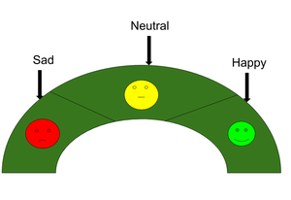
What is Sentiment Analysis ?
Recurrent neural networks or RNNs are the go-to method for sequential data.
Recurrent neural networks have a memory of their own and remember the input that was given to each node.
In a normal feed forward neural network data or information given in the form of input moves forward and never moves backward in any nodes, from the input layer to the hidden layer and out from the output layer.
Because these kinds of networks have no memory they do not remember the last input or predict the next input.

Slide 4
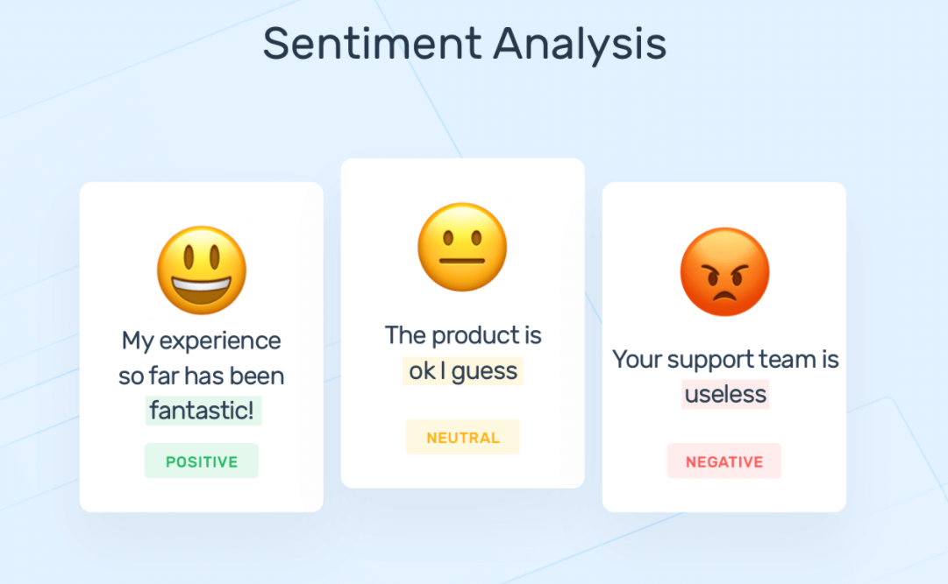
Why Do we perform Sentiment Analysis ?
According to the survey,80% of the world’s data is unstructured.
The data needs to be analyzed and be in a structured manner whether it is in the form of emails, texts, documents, articles, and many more.
Sentiment Analysis is required as it stores data in an efficient, cost-friendly.
Sentiment analysis solves real-time issues and can help you solve all the real-time scenarios.

Slide 5
Types of Sentiment Analysis
Types of Sentiment Analysis: -
Fine-grained sentiment analysis: This depends on the polarity based. This category can be designed as very positive, positive, neutral, negative, very negative. The rating is done on the scale 1 to 5. If the rating is 5 then it is very positive, 2 then negative and 3 then neutral.
Emotion detection: The sentiment happy, sad, anger, upset, jolly, pleasant, and so on come under emotion detection. It is also known as a lexicon method of sentiment analysis.
Aspect based sentiment analysis: It focuses on a particular aspect like for instance, if a person wants to check the feature of the cell phone then it checks the aspect such as battery, screen, camera quality then aspect based is used.
Multilingual sentiment analysis: Multilingual consists of different languages where the classification needs to be done as positive, negative, and neutral. This is highly challenging and comparatively difficult.

Slide 6
How does Sentiment Analysis work?
There are three approaches used :-
Rule-based approach: Over here, the lexicon method, tokenization, parsing comes in the rule-based. The approach is that counts the number of positive and negative words in the given dataset. If the number of positive words is greater than the negative words then the sentiment is positive else vice-versa.
Automatic Approach: This approach works on the machine learning technique. Firstly, the datasets are trained and predictive analysis is done. The next process is the extraction of words from the text is done. This text extraction can be done using different techniques such as Naive Bayes, Linear Regression, Support Vector, Deep Learning like this machine learning techniques are used.
Hybrid Approach: It is the combination of both the above approaches i.e. rule-based and automatic approach. The surplus is that the accuracy is high compared to the other two approaches.

Slide 7



APPLICATIONS
Sentiment Analysis has a wide range of applications as:
Social Media: If for instance the comments on social media side as Instagram, over here all the reviews are analyzed and categorized as positive, negative, and neutral.
Customer Service: In the play store, all the comments in the form of 1 to 5 are done with the help of sentiment analysis approaches.
Marketing Sector: In the marketing area where a particular product needs to be reviewed as good or bad.
Reviewer side: All the reviewers will have a look at the comments and will check and give the overall review of the product.

Slide 8
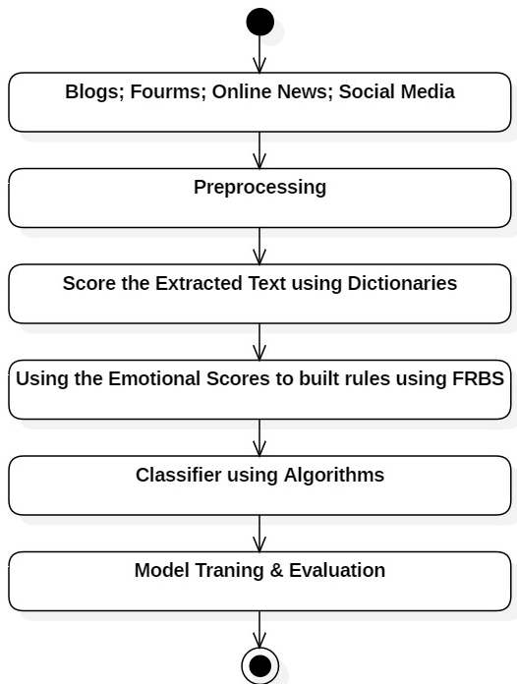
Process Model
Working Process of Sentiment Analysis: -

Slide 9
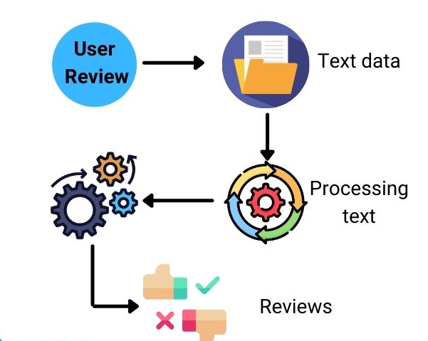
Design Phase
Diagram representation of Sentiment Analysis: -

Slide 10
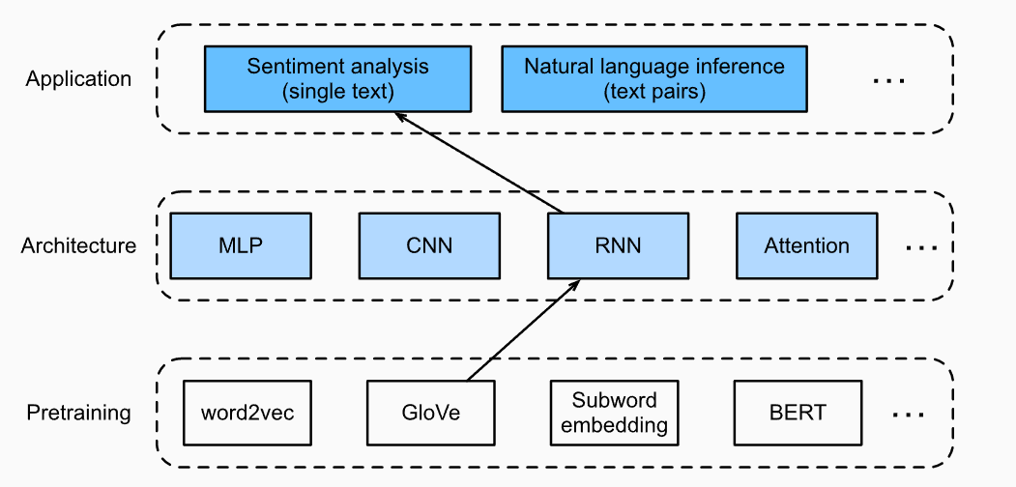
Architecture Diagram
Architecture representation of Sentiment Analysis: -
This section feeds pretrained GloVe to an RNN-based architecture for sentiment analysis.

Slide 11
Challenges of Sentiment Analysis
There are major challenges in sentiment analysis approach:
If the data is in the form of a tone, then it becomes really difficult to detect whether the comment is pessimist or optimist.
If the data is in the form of emoji, then you need to detect whether it is good or bad.
Even the ironic, sarcastic, comparing comments detection is really hard.
Comparing a neutral statement is a big task.

Slide 12
Thank You

