Slide 1


Slide 2
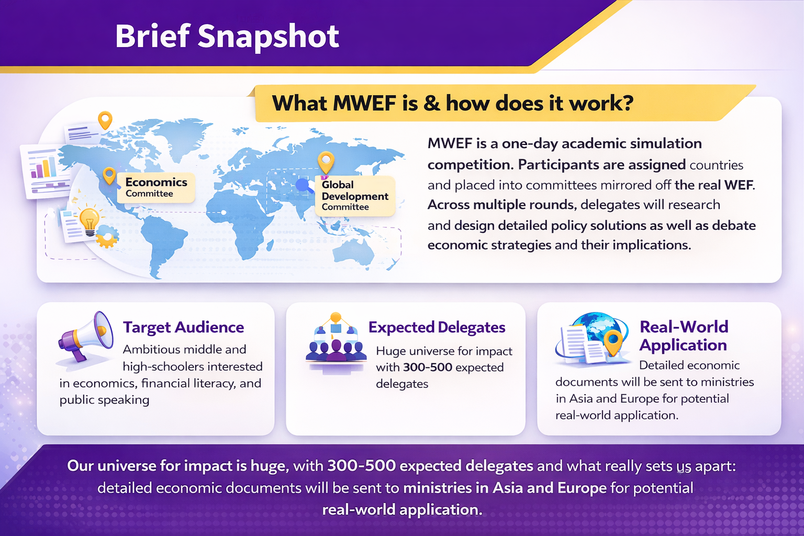

Slide 3
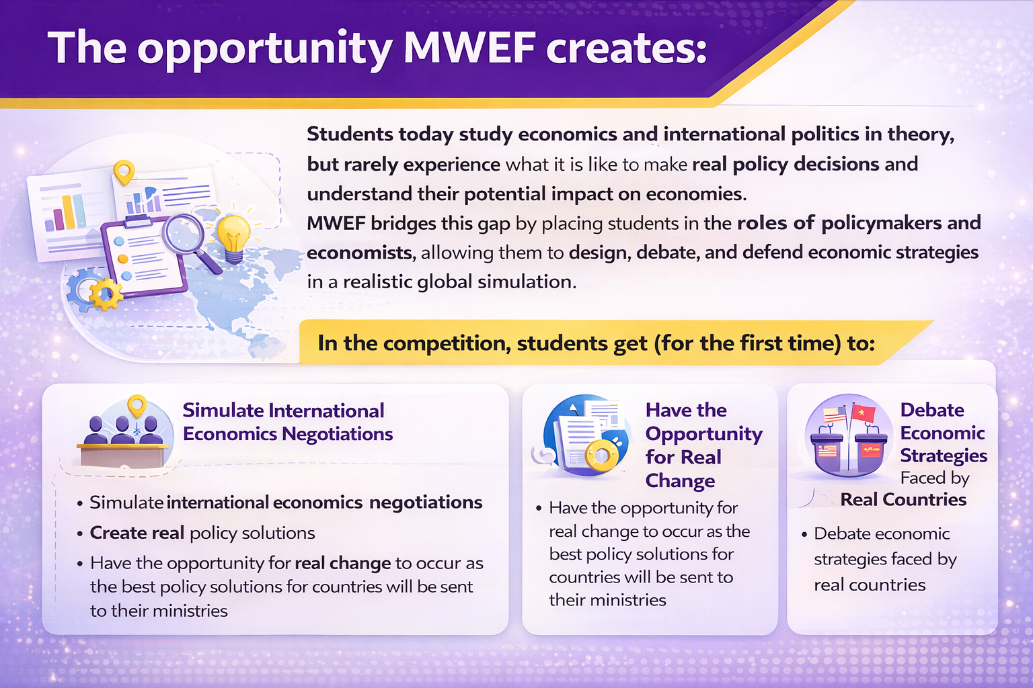

Slide 4
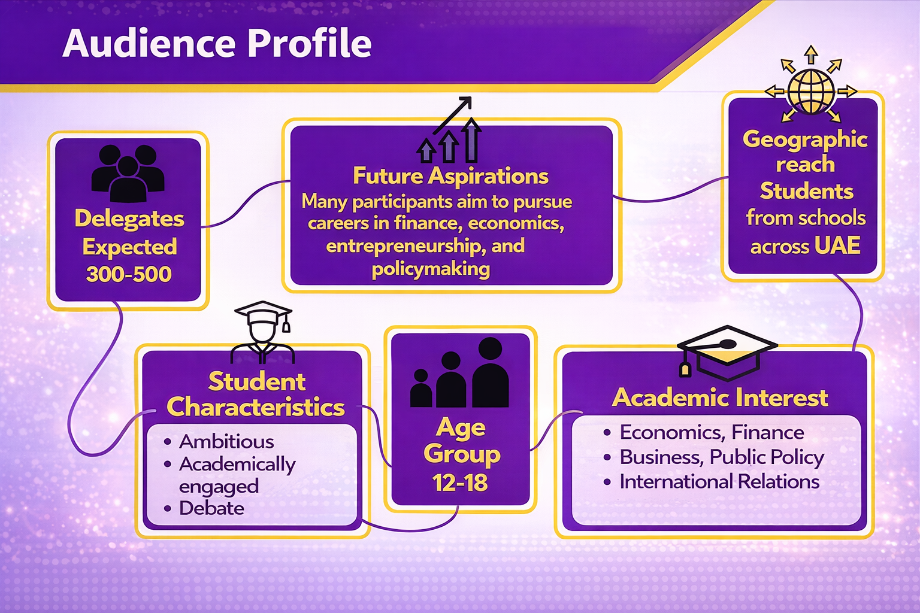

Slide 5
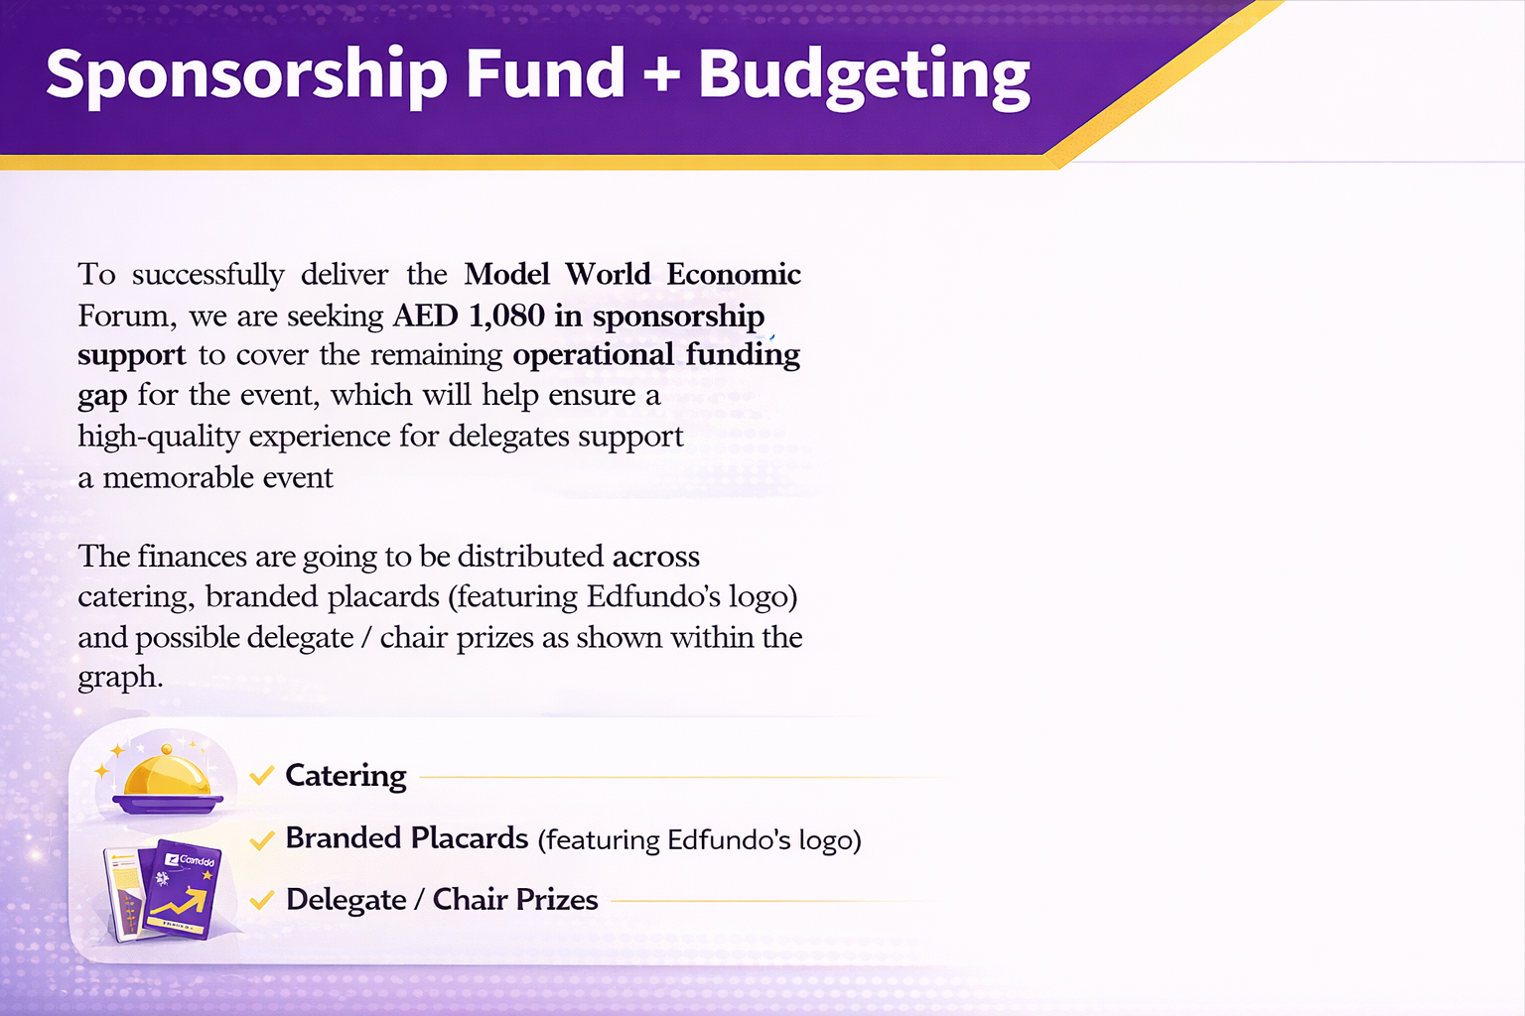
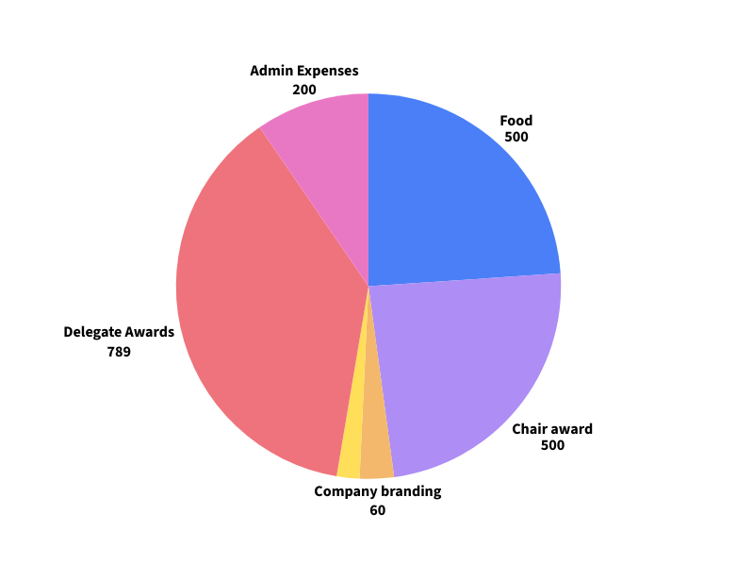

(featuring YOUR logo)
Detailed Financials Breakdown
Google sheets

Slide 6
What’s in it for You?
Named partner plaques on all 500 desks where people can see your logo alongside a QR code about the app or a download link
Mentioning of your companyconstantly and availability for a speaker to have a section advertising you for any length of choice to 500 delegates!
Availability to have a dedicated stall to your company with advertising up the entire day!
The target audience as mentioned in the above slide, ambitious and impressionable high school and middle schoolers who aim to pursue careers in finance, economics, and international relations.
Branding of your company to be present on flyers advertising
the event, on event days, and instagram posts on our page dedicated to the partnership (100K+ impressions total)
CSR opportunity in supporting kids explore their economic passions that can be posted on Instagram.

