Slide 1
Scripting Part II – Input
AGGP 101c
Introduction to Game Design and
Creation with Programming
Notes:
Presentations
Headings: Calibri Bold 44 in Maroon
Subheadings: Calibri 32 in Gray
Text: Calibri 18 in Black

Slide 2
Input
Types of Inputs:
Keyboard
Mouse
Controllers
Joysticks
Touch Screens
Voice
Motion
Camera

Slide 3
Unity’s Input Systems
Input (Legacy)
Key Codes & Mouse Buttons
Basic Keyboard and Mouse input is very easy
Hard coded input system
Bound Axis and Buttons
Project Based Binds
Doesn’t support multi players and controllers well
Different controller brands have different binds
Input Manager (New)
New System that supports multiple gamepads
Streamlined support for multiple controller typess
Have gotten 22 controllers recognized on one PC
New Systems to create controller profiles
Has to be enabled when you make your project.

Slide 4
Keyboard Input
bool result = Input.anyKey();
bool result = Input.anyKeyDown()
bool result = Input.GetKey(KeyCode key);
bool result = Input.GetKeyDown(KeyCode key);
bool result = Input.GetKeyUp(KeyCode key);

Slide 5
KeyCode Class
KeyCode is a predefine class built for you to reference all of the keys on a keyboard easily.
A standard keyboard has over 100 different keys on it.
Examples:
KeyCode.A KeyCode.Z KeyCode.F1
KeyCode.Alpha2 KeyCode.UpArrow KeyCode.At
KeyCode.Escape KeyCode.Keypad5 KeyCode.LeftAlt

Slide 6
Mouse Input
bool result =
Input.GetMouseButton(int button);
bool result =
Input.GetMouseButtonDown(int button);
bool result =
Input.GetMouseButtonUp(int button);
Vector2 mLoc = Input.mousePosition;
Vector2 mSWD = Input.mouseScrollDelta;

Slide 7
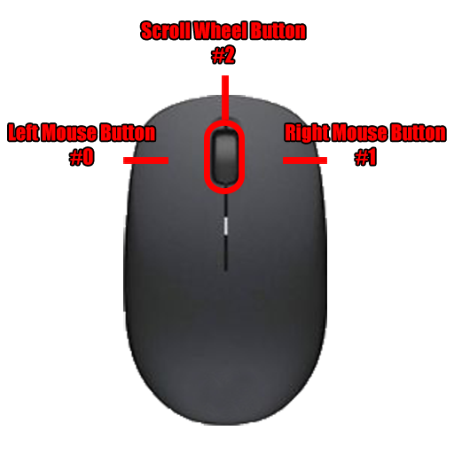
Button Numbers

