Slide 1
Vectors vs Transform
AGGP 101c
Introduction to Game Design and
Creation with Programming
Notes:
Presentations
Headings: Calibri Bold 44 in Maroon
Subheadings: Calibri 32 in Gray
Text: Calibri 18 in Black

Slide 2
Axis Colors
Red is the X Axis
Green is the Y Axis
Blue is the Z Axis
These colors are standard across most applications.

Slide 3
Vector3 vs transform
Both Vector3\Vector2 and Transform has built in properties to help you determine direction. How they work differ greatly.
Vector3 has properties that are give directions aligned to the global axis.
Use the static members of the Vector3 Class to get these members.
Transform has properties that are aligned to the local axis as it is rotated in the global space.
Use an instance of a Transform to get these properties.

Slide 4
Unity’s Axis Directions
Y is Up
Z is forward
X is Right

Slide 5
Vector3 Properties
Property Axis Vector
.Left -X (-1,0,0)
.Right +X (1,0,0)
.Up +Y (0,1,0)
.Down -Y (0,-1,0)
.Forward +Z (0,0,1)
.Back -Z (0,0,-1)

Slide 6
Transform Properties
Property Axis
.Right Local X Axis (red arrow)
rotated in world space
.Up Local Y Axis (green arrow) )
rotated in world space
.Forward Local Z Axis (blue arrow) )
rotated in world space

Slide 7
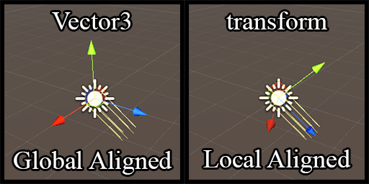

Slide 8
Which way am I facing?
To determine the forward facing vector of a gameObject based on its rotation, use…
(GameObject Reference)
.transform.forward;

