Slide 1
Containers
AGGP 101c
Introduction to Game Design and
Creation with Programming
Notes:
Presentations
Headings: Calibri Bold 44 in Maroon
Subheadings: Calibri 32 in Gray
Text: Calibri 18 in Black

Slide 2
Containers
Containers is the generic term for an object and\or data structure that holds multiple values or reference of a specific type.
There are several types of Containers. The two you’ll use most often in C#:
Array
List

Slide 3
Arrays
To declare an array:
type[] arrayName;
Arrays are containers of a fixed size.
The size of an array is called its length
Arrays of Primitives and structures are Value Type Arrays.
The array will be initialized with the default value of the type
Arrays of Objects are Reference type Arrays
The Array will be initialized with null in all array locations.

Slide 4
Lists
To declare a list:
List<type> listName;
Lists are constrainers of a variable size.
Can Easily Add, Remove, and Clear them.
The size of a list is called its count
By Default, a list starts with nothing in it.

Slide 5
Public Arrays and Lists Initialized in the Unity Editor
Any Array or List made a public member of a class is editable in the editor
public int[] IntArray;
public GameObject[] GameObjectArray; public List<GameObject> GameObjectList;

Slide 6
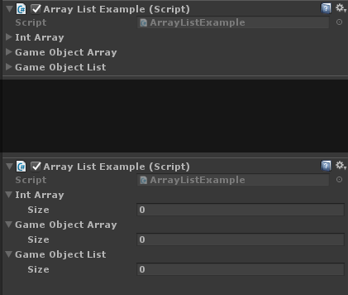
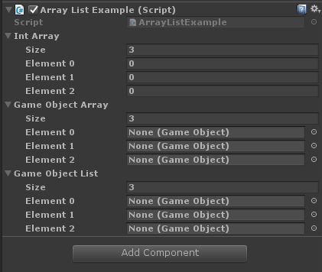
Public Arrays and Lists Initialized in the Unity Editor

Slide 7
Accessing Elements
An Element is a singular part of an Array of List.
We use Array Notation using the hard brackets ‘[‘ and ‘]’ to access an element in an array or List.
containerName[index]
We can get the information and set the information this was as you can with any other variable.
containerName[index] = value;
variable = containerName[index];

Slide 8
Accessing Elements
void ShowNameAtFirstElement()
{
Debug.Log("First in GameObjectArray : "
+ GameObjectArray[0].name);
Debug.Log("First in GameObjectList : "
+ GameObjectList[0].name);
}

Slide 9
Container Size
void ShowLengths()
{
Debug.Log("IntArray : " + IntArray.Length);
Debug.Log("GameObjectArray : "
+ GameObjectArray.Length);
Debug.Log("GameObjectList : "
+ GameObjectList.Count);
}

Slide 10
Private Arrays and Lists
YOU ARE RESPONSIBLE FOR INITALIZING
When an Array or List is declared
private
protected
local in a method

Slide 11
List Operations
List Declare List<type> listName;
List Initiation listName = new List<type>();
Add item listName.Add(itemToAdd);
Remove item listName.Remove(itemToRemove);
Remove item at listName.RemoveAt(indexToRemove);
Is item in List listName.Contains(item);
Clear List listName.Clear();
List Size listName.Count;

Slide 12
Arrays Initialization Examples
Initiation with default values
int[] intArray = new int[5];
string[] stringArray = new string[6];
Int Array values {0,0,0,0,0}
String Array values {“”, “”, “”, “”, “”, “”,}

Slide 13
Arrays Initialization Examples
Initiation with default values
int[] intArray = new int[5];
string[] stringArray = new string[6];
Int Array values {0,0,0,0,0}
String Array values {“”, “”, “”, “”, “”, “”,}

