Slide 1
Spawning & Destroying
AGGP 101c
Introduction to Game Design and
Creation with Programming
Notes:
Presentations
Headings: Calibri Bold 44 in Maroon
Subheadings: Calibri 32 in Gray
Text: Calibri 18 in Black

Slide 2
Instantiate
Instantiate AKA SPAWN PREFAB
To spawn a new prefab, you will need to know
Original Prefab to Spawn
Where to Spawn
Rotation to Spawn
In some cases you’ll provide a Parent to Spawn to.

Slide 3
Destroy
Destroy removes something from the world.
Can be any Game Object
Can be a Component
Using “this” refers to the current script
You can give an optional parameter to set a time for destruction
This value determines the time from after the destroy call is made

Slide 4
Unity Tutorials Videos
https://unity3d.com/learn/tutorials/topics/scripting/instantiate
https://unity3d.com/learn/tutorials/topics/scripting/destroy

Slide 5
Unity API Documents
https://docs.unity3d.com/ScriptReference/Object.Instantiate.html
https://docs.unity3d.com/ScriptReference/Object.Destroy.html

Slide 6
Factories
Factories refers to classes and objects that handle the creation of other objects.
Use of the term Factory was heavily used by Epic in the development of Unreal Tournment.
As we get more complex with the object that we are spawning, we will require additional code to handle different tasks.
This can be for object creation or object spawning.

Slide 7
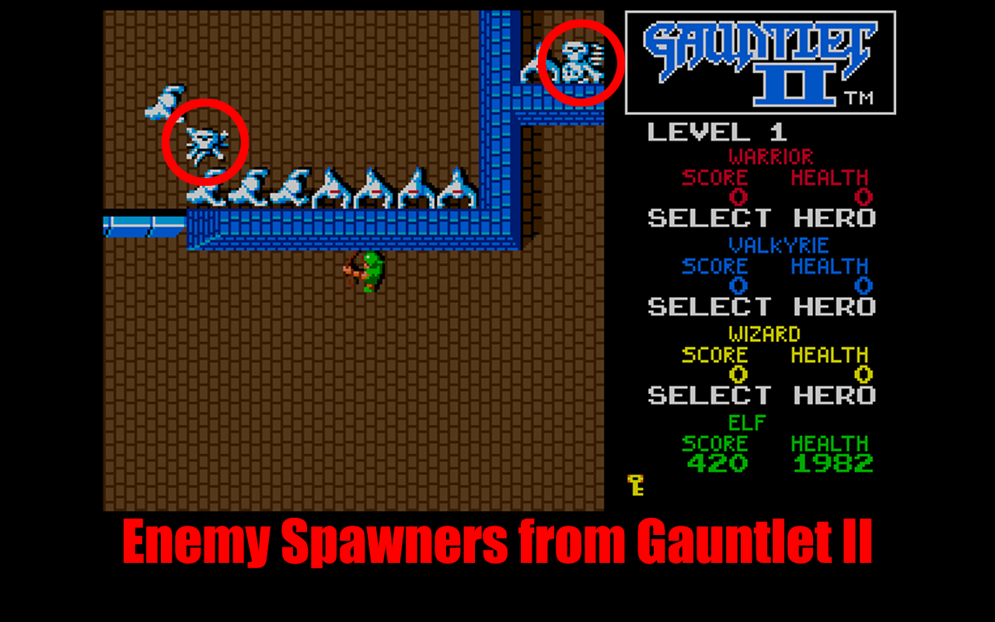
Factory Example

