Slide 1
Scripting Part II – Input
AGGP 101c
Introduction to Game Design and
Creation with Programming
Notes:
Presentations
Headings: Calibri Bold 44 in Maroon
Subheadings: Calibri 32 in Gray
Text: Calibri 18 in Black

Slide 2
Input
Types of Inputs:
Keyboard
Mouse
Controllers
Joysticks
Touch Screens
Voice
Motion
Camera

Slide 3
Keyboard Input
bool result = Input.anyKey;
bool result = Input.anyKeyDown
bool result = Input.GetKey(KeyCode key);
bool result = Input.GetKeyDown(KeyCode key);
bool result = Input.GetKeyUp(KeyCode key);

Slide 4
KeyCode Class
KeyCode is a predefine class built for you to reference all of the keys on a keyboard easily.
A standard keyboard has over 100 different keys on it.
Examples:
KeyCode.A KeyCode.Z KeyCode.F1
KeyCode.Alpha2 KeyCode.UpArrow KeyCode.At
KeyCode.Escape KeyCode.Keypad5 KeyCode.LeftAlt

Slide 5
Mouse Input
bool result =
Input.GetMouseButton(int button);
bool result =
Input.GetMouseButtonDown(int button);
bool result =
Input.GetMouseButtonUp(int button);
Vector3 mLoc = Input.mousePosition;
Vector2 mSWD = Input.mouseScrollDelta;

Slide 6
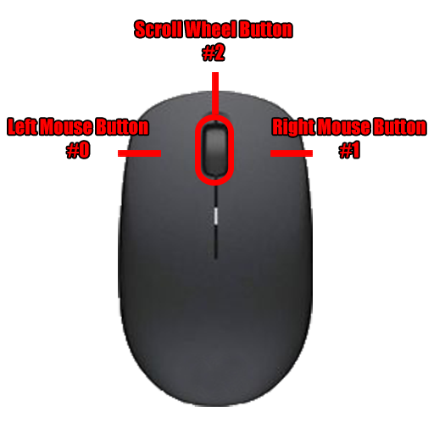
Button Numbers

