Slide 1
Scripting Vectors
AGGP 101c
Introduction to Game Design and
Creation with Programming
Notes:
Presentations
Headings: Calibri Bold 44 in Maroon
Subheadings: Calibri 32 in Gray
Text: Calibri 18 in Black

Slide 2
Vectors
Vectors are objects with multiple float components
Vector2 X,Y 2D positions and directions
Vector3 X,Y,Z 3D positions and directions
Vector4 X,Y,Z,W mesh tangents,
parameters for shaders
Flux Capacitor Calculations

Slide 3
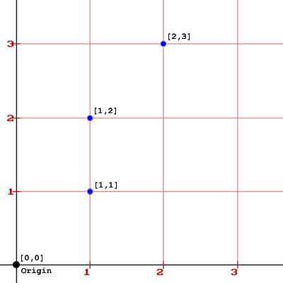
Vectors as Positions
Positions On Plot:
[0,0] - The Origin
[1,1]
[1,2]
[2,3]
Vector positions are relative to an origin point

Slide 4
Vectors as Lines
Thinking of a Vectors as lines is a useful way to visualize them.
A line is formed by two points.

Slide 5
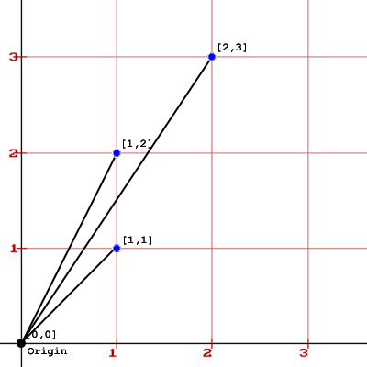
Vectors as Lines
A line is formed by two points.
On this plot, each line is from the Origin and the vector point.

Slide 6
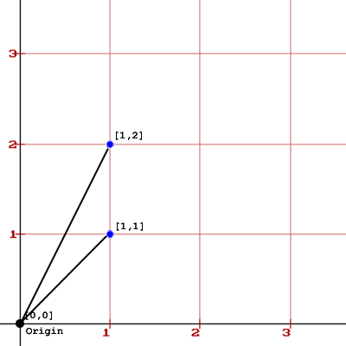
Vectors Addition
Two Vectors to add
[1,1] and [1,2]

Slide 7
Math: Vector Add and Subtract
When Adding two vectors we add each component (x’s with x’s and y’s with y’s) to generate a new vector
Given two Vector2 Va and Vb :
Va + Vb = [ ( Va.x + Vb.x) , ( Va.y + Vb.y) ]
We can also Subtraction
Given two Vector2 Va and Vb :
Va - Vb = [ ( Va.x - Vb.x) , ( Va.y - Vb.y) ]

Slide 8
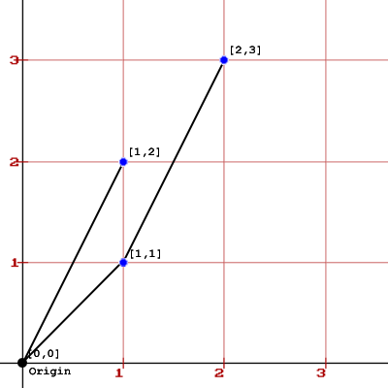
Vectors Addition
Vector [1,2] Moved Vector to start at [1,1]
The Result is [2,3]

Slide 9
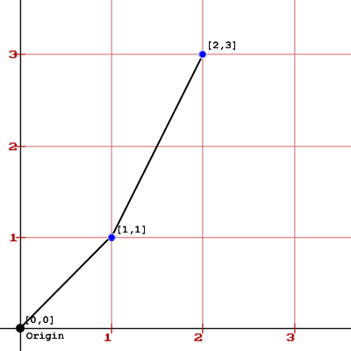
Vectors Addition Result
The Result [2,3]
by seeing Vector [1,2] moved to start at Vector [1,1]
The mathematical term for this move is called “Transpose”

Slide 10
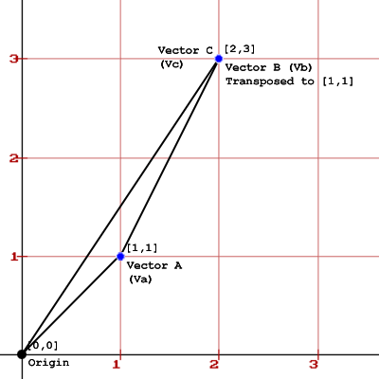
Vectors Addition Result
The Resulting Vector [2,3]
with Vector [1,2] transposed to start of Vector [1,1] shown.

Slide 11
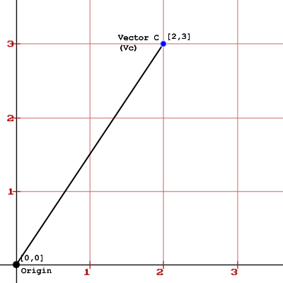
Vectors Addition Result
The Final Result of the Addition

Slide 12
Code Example: Addition
void ShowAddExample() {
Vector2 VectorA = Vector2.zero;
Vector2 VectorB = Vector2.zero;
VectorA.Set(1, 1);
VectorB.Set(2, 3);
Vector2 VectorC = VectorA + VectorB;
Debug.Log("Vector C Result : " + VectorC.ToString());
}

Slide 13
Properties of a Vector
Two properties of a Vector
Direction
Length

Slide 14
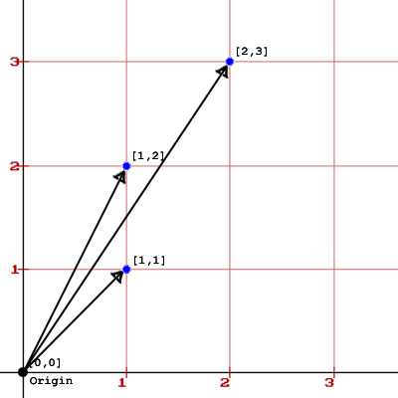
Vectors as a Direction
Direction of the line is defined by:
The Origin is the start point.
Vector Data is the end point.

Slide 15
Which Way Are We Going?
Vector Subtraction is used to determine a direction from one point to another point.
Given two Vector2 Va and Vb,
Va is current location
Vb is location we want to head towards
Vector of Direction = Vb - Va
ORDER OF SUBTRACTION IS IMPORTANT!
You get this reversed, you’ll head in the opposite direction you want.

Slide 16
Vector Heading
At [1,1]
Heading to [2,3]

Slide 17
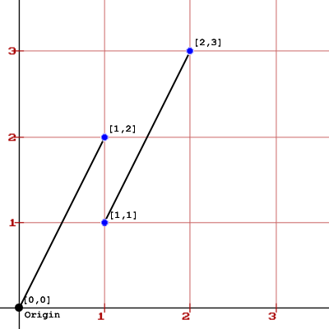
Vector Heading
[1,2] is the resulting vector of [2,3] – [1,1]

Slide 18
Vectors as a Length
Vector have a length (or distance)
This is called magnitude
[1,1] 1.413214
[1,2] 2.236069
[2,3] 3.605551

Slide 19
Code Example: Magnitude
void ShowMagnitudeExample ()
{
Vector2 exampleVector = Vector2.zero;
exampleVector.Set(1, 1);
Debug.Log("[1,1] - Distance: " + exampleVector.magnitude);
exampleVector.Set(1, 2);
Debug.Log("[1,2] - Distance: " + exampleVector.magnitude);
exampleVector.Set(2, 3);
Debug.Log("[2,3] - Distance: " + exampleVector.magnitude);
}

Slide 20
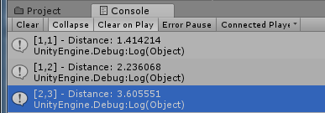
Code Result: Magnitude

Slide 21
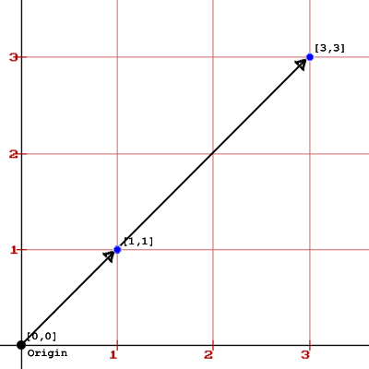
Vector Scale
[1,1] * 3 = [3,3]
[3,3] / 3 = [1,1]
The length of the vectors are different, but have the same direction.

Slide 22
Math: Scale
To scale a vector: multiply or divide each component by a float value to create a new vector.
Given Vector2 V and Float F:
V * F = [ ( V.x * F ) , (V.y * F) ]
V / F = [ ( V.x / F ) , (V.y / F) ]

Slide 23
Code Example: Scale
void ShowScaleExample() {
Vector2 exampleVector = Vector2.zero;
exampleVector.Set(1, 1);
Debug.Log(exampleVector.ToString()
+ " - Distance: " + exampleVector.magnitude);
exampleVector = exampleVector * 3;
Debug.Log(exampleVector.ToString()
+ " - Distance: " + exampleVector.magnitude);
exampleVector = exampleVector / 3;
Debug.Log(exampleVector.ToString()
+ " - Distance: " + exampleVector.magnitude);
}

Slide 24
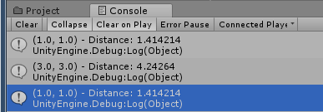
Code Result: Scale

Slide 25
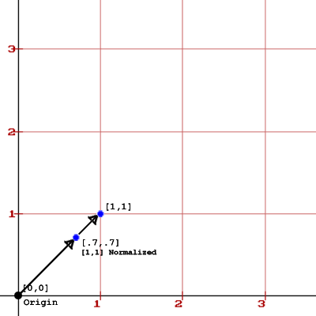
Vector Normalize
[1,1] * 3 = [3,3]
[3,3] / 3 = [1,1]
The length of the vectors are different, but have the same direction.

Slide 26
Math: Normalize
To Normalize a vector: Divide each component by it’s magnitude to create a new vector of with a length of 1.
Given Vector2 V with magnitude not 0:
Normalized Vector = [ (V.x / V.magnitude) , (V.y / V.magnitude) ]
Exception: Vector [0,0] normalized is [0,0]
There is code already written for us in the Vector Classes!

Slide 27
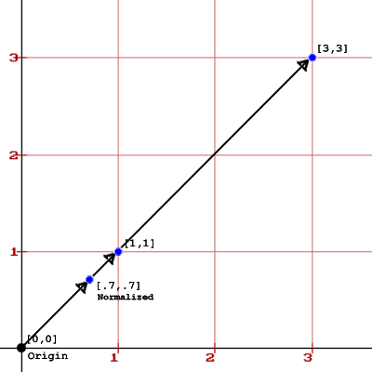
Vector Normalize
[1,1] * 3 = [3,3]
[3,3] / 3 = [1,1]
The length of the vectors are different, but have the same direction.

Slide 28
Code Example: Normalize
void ShowNormalizeExample () {
Vector2 exampleVector = Vector2.zero;
exampleVector.Set(1, 1);
Debug.Log("[1,1] - Distance: " + exampleVector.magnitude);
exampleVector = exampleVector.normalized;
Debug.Log("[1,1] - Normalized Distance: "
+ exampleVector.magnitude);
Debug.Log("[1,1] - Normalized : "
+ exampleVector.ToString());
}

Slide 29
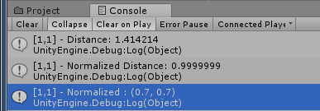
Code Result: Normalize
Note: .9999999 is pretty much a value of 1 for our uses

Slide 30
Why Normalize
The sole reason to normalize a vector is to isolate the direction of the vector with a length of 1.
Now that the length is 1, we can scale is as we want.
Example:
Direction Vector * Movement Speed = Change in Position
Remember it’s your actual speed,
that is (Movement Speed* Time.deltaTime)

