Slide 1
Object Representation
AGGP 101c
Introduction to Game Design and
Creation with Programming
Notes:
Presentations
Headings: Calibri Bold 44 in Maroon
Subheadings: Calibri 32 in Gray
Text: Calibri 18 in Black

Slide 2
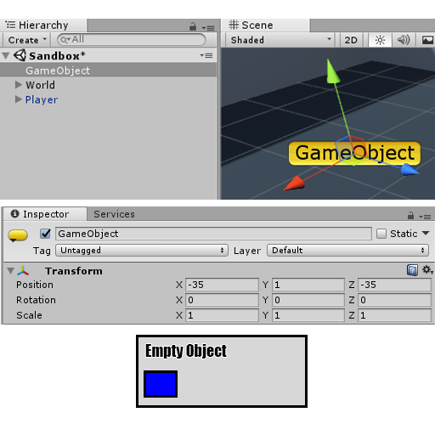
Empty Game Object
A New Empty Game Object created,
Note: Every Game Object has a transform component.

Slide 3
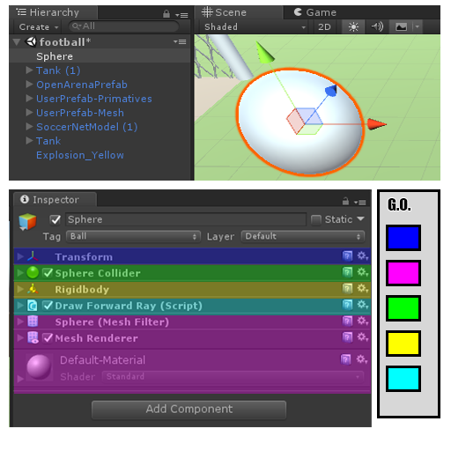
Single Object Example
The Inspector Tab is shown in this example with color overlays added.
Purple contains all visual and rendering components

Slide 4
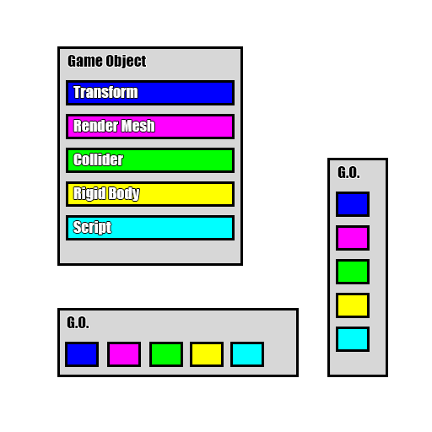
Game Object & Component Representation
These diagrams are a visual way to see an object hierarchy’s with its components.

Slide 5
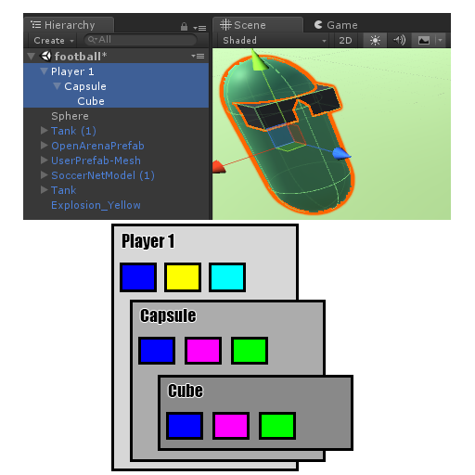
Capsule Character Example
In this case, the object “Player 1” started as an empty object. An rigid body and a script was added.
The all collision and visual aspects are child objects.

