Slide 1
Scripting Part III – Functions
AGGP 101c
Introduction to Game Design and
Creation with Programming
Notes:
Presentations
Headings: Calibri Bold 44 in Maroon
Subheadings: Calibri 32 in Gray
Text: Calibri 18 in Black

Slide 2
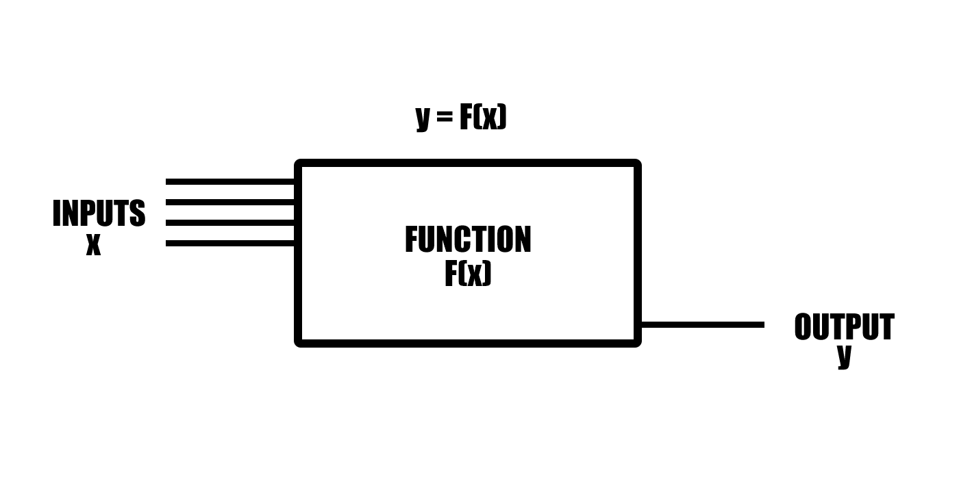
Functions (as seen by Math)

Slide 3
Functions (Example from Mathmatics)

Slide 4
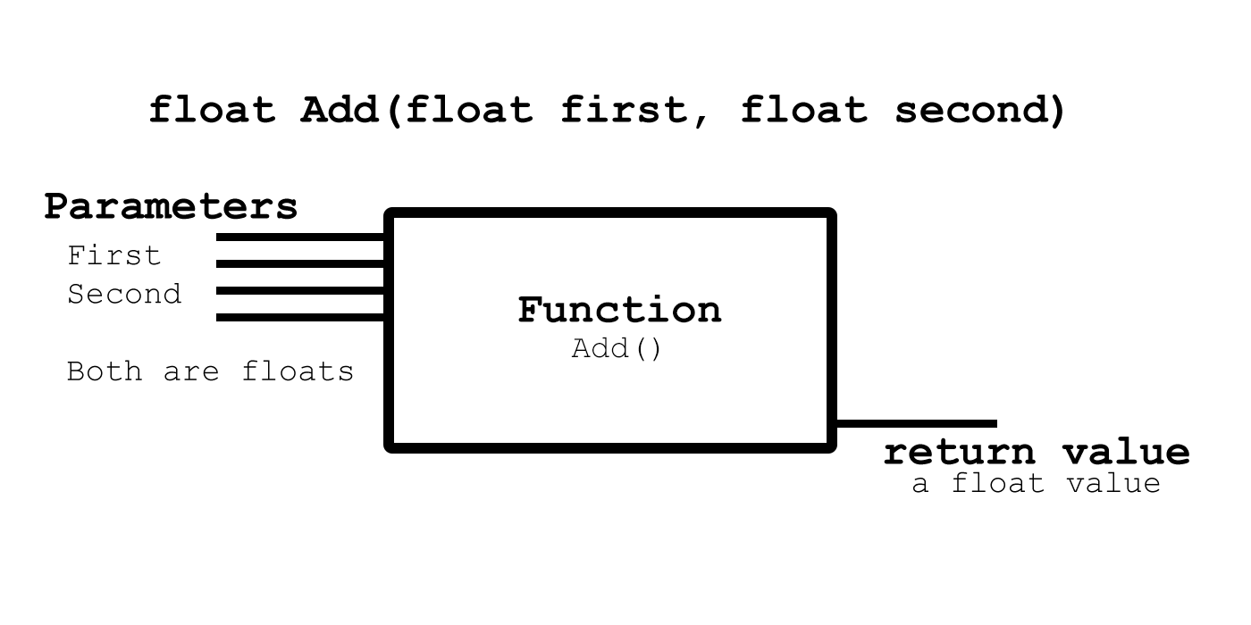
Functions (Example from C#)

Slide 5
Parts of a Function
Accessibility Level
Return type
Name
(Parameters)
{Code Block}

Slide 6
Writing Functions
int Difference (int Avalue, int Bvalue)
{
int value;
value = Bvalue - Avalue;
return value;
}

Slide 7
Functions with No Parameters
float GiveMeOnePointFive()
{
return 1.5f;
}

Slide 8
Void Functions (or Functions with no return type)
void PrintMeAMessage()
{
Debug.Log("Okay. Here is a Message.");
}
void PrintThisMessage(String message)
{
Debug.Log(message);
}

Slide 9
Return
Use one return statement in your function
Unless you are using return to end the function early
Or shown otherwise by a specific programming technique.

Slide 10
Early Function Ending
void Update ()
{
if (!trans){
return;
}
Vector3 location = trans.position;
location += MovementDirection
* movementSpeed * Time.deltaTime;
trans.position = location;
}

