Slide 1
Object 2 Object
AGGP 101c
Introduction to Game Design and
Creation with Programming
Notes:
Presentations
Headings: Calibri Bold 44 in Maroon
Subheadings: Calibri 32 in Gray
Text: Calibri 18 in Black

Slide 2
Public Methods
We already know that if a variable is made public, it can be edited in the Unity Editor.
If we have a reference to a script in C#, we can access all of it’s public members and methods via the dot operator.
Script names are C# object names. We can use them as a “type” of variable
Some you’ve used already are:
int, float, bool, GameObject, Transform, Vector3

Slide 3
Public Access Slide #1 of 2
using UnityEngine;
public class PublicAccess : MonoBehaviour
{
public int publicInt = 0;
int privateInt = -1;

Slide 4
Public Access Slide #2 of 2
public void ChangePrivateInt(int number)
{ privateInt = number; }
public void ShowNumbers()
{ Debug.Log("Public: " + publicInt);
Debug.Log("Private: " + privateInt);
}
}

Slide 5
User Script Slide #2 of 2
using UnityEngine;
public class UserScript : MonoBehaviour {
void Start () {
// Let's add the script to our game object.
PublicAccess paScript = gameObject.AddComponent<PublicAccess>();
paScript.publicInt = 100;
paScript.ChangePrivateInt(9001);
paScript.ShowNumbers();
} }

Slide 6
User Script Slide #2 of 2
// privateInt is private, not public
// So the below is not allowed,
// paScript.privateInt = 9001;
}
}

Slide 7
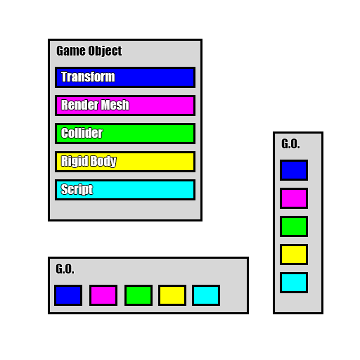
Game Object & Component Representation
These diagrams are a visual way to see an object hierarchy’s with its components.

Slide 8
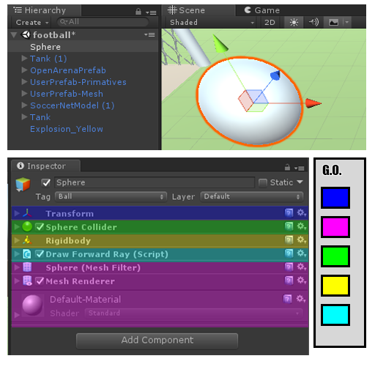
Single Object Example
The Inspector Tab is shown in this example with color overlays added.
Purple contains all visual and rendering components

Slide 9
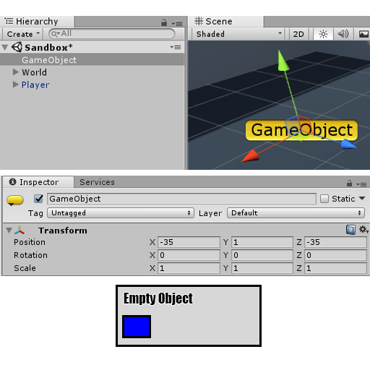
Empty Game Object
A New Empty Game Object created,
Note: Every Game Object has a transform property.

Slide 10
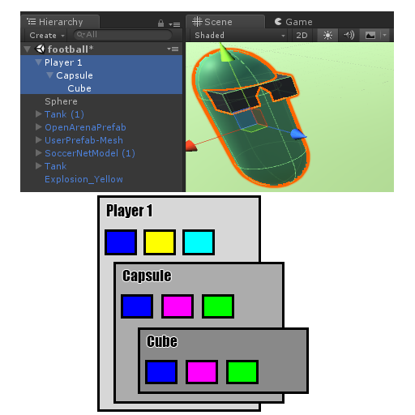
Capsule Character Example
In this case, the object “Player 1” started as an empty object. An rigid body and a script was added.
The all collision and visual aspects are child objects.

Slide 11
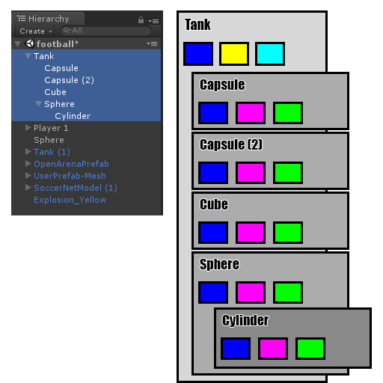
Tank Object
Another Example of an object consisting of multiple game objects.
Note: All collision components are in the child objects.

Slide 12
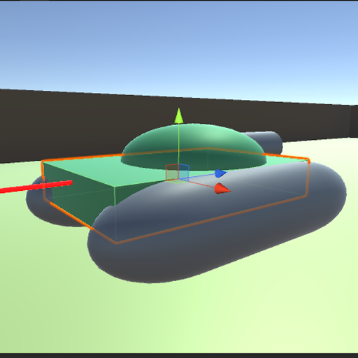
Multiple Object Example
Ray Cast Visualized
In this case, the ray has hit the Cube Collider of the tank

Slide 13
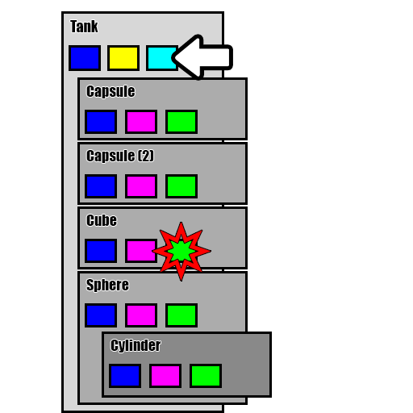
Multiple Object Example
The hit test returned back a collider reference.
We need to access the script in a different game object.

Slide 14
Unity API Links
https://docs.unity3d.com/ScriptReference/GameObject.html
https://docs.unity3d.com/ScriptReference/Transform.html

Slide 15
Transform.parent
The Transform component has a parent property.
If the object has no parent, then its value will be null

Slide 16
GetComponentIn…
GetComponentInChildren
Returns the component of Type type in the GameObject or any of its children using depth first search.
GetComponentInParent
Returns the component of Type type in the GameObject or any of its parents.
BOTH RETURN a single Component

Slide 17
GetComponentsIn…
GetComponentsInChildren
Returns all components of Type type in the GameObject or any of its children.
GetComponentsInParent
Returns all components of Type type in the GameObject or any of its parents.
BOTH RETURN an Array of Components (Component[])

Slide 18
Messages
SendMessage
Calls the method named methodName on every MonoBehaviour in this game object.
BroadcastMessage
Calls the method named methodName on every MonoBehaviour in this game object or any of its children.
SendMessageUpwards
Calls the method named methodName on every MonoBehaviour in this game object and on every ancestor of the behaviour.

Slide 19
Find
Game Object has several static methods you can use to find objects.
Find
Finds a GameObject by name and returns it.
Recommended that you read the documentation on Find, as it supports several different methods of using it.
https://docs.unity3d.com/ScriptReference/GameObject.Find.html

Slide 20
Find With Tag
FindWithTag
Returns one active GameObject tagged tag. Returns null if no GameObject was found.
FindGameObjectsWithTag
Returns a list of active GameObjects tagged tag. Returns empty array if no GameObject was found.

Slide 21
Find By Type
FindObjectOfType
Returns the first active loaded object of Type type.
FindObjectsOfType
Returns a list of all active loaded objects of Type type.

