Slide 1

Virtual reality – Part 2
Application development and software prototyping, week 9

Slide 2

Week 9 topics
Direct Interactor
Player Movement
XR Interaction Toolkit Debugger
Interaction Layer Masks

Slide 3
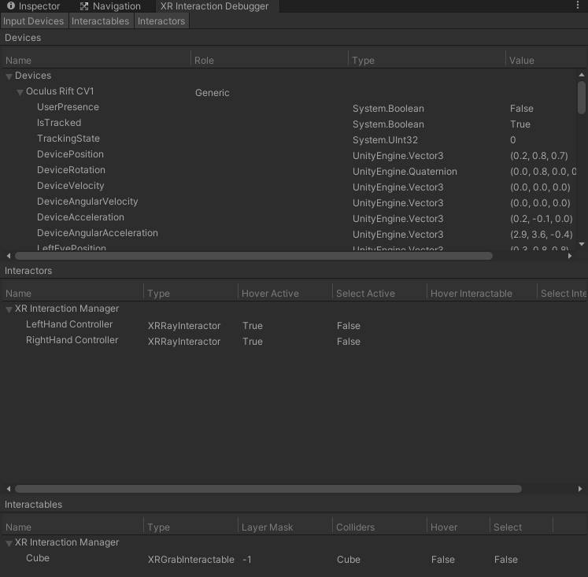
XR Interaction toolkit debugger
Window > Analysis > XR Interaction Debugger
DEVICE
INTERACTORS
INTERACTABLES
Notes:
Top Level View, also displays Relationships between each other

Slide 4
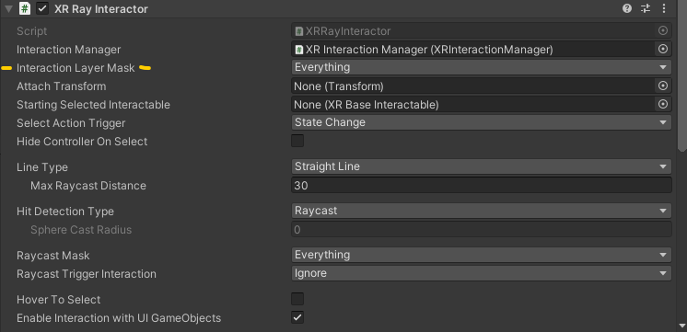
Interaction layer mask
Notes:
“The InteractionLayerMask is a mechanism for filtering which interactors can act upon which interactables.”
“Mask comparisons do not consider the layer on an interactor's or interactable's gameobject.”
“Comparisons only consider the InteractionLayerMasks on the interactor and interactable.”

Slide 5
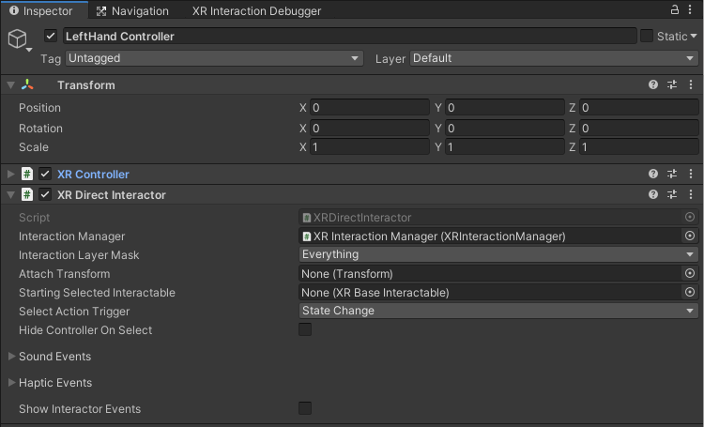
Direct interactor
REMEMBER:
NEEDS a Controller
NEEDS an Interaction Manager
NEEDS a Collider
Check the Show Interactor Events box to expose event list
Hover
Select

Slide 6
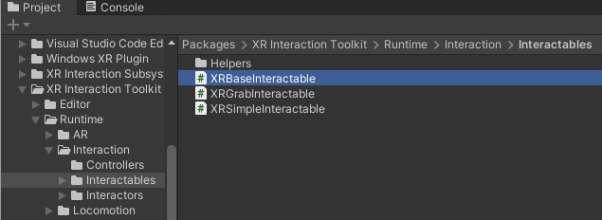
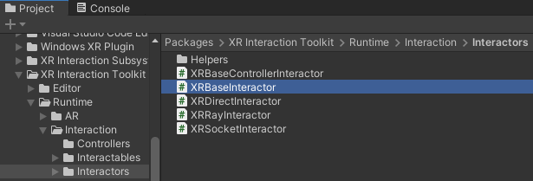
Base Events
Events in XR Base Interactable Script
On First Hover Enter
On Hover Enter/Exit
On Select Enter/Exit
On Activate/Deactivate
Events in XR Base Interactor Script
On Hover Enter/Exit
On Select Enter/Exit

Slide 7
Demo Direct interaction
Demo Direct Interaction

Slide 8
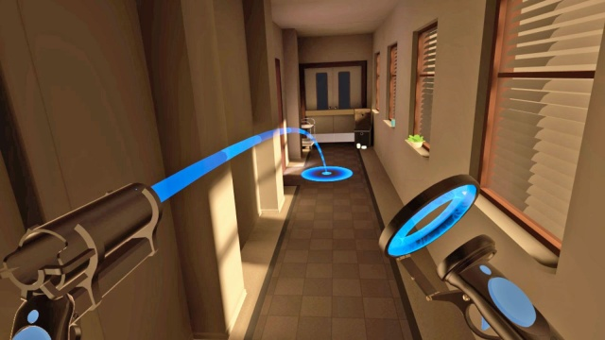
Player movement

Slide 9
Player movement – Locomotion system
Locomotion System
Teleportation
Locomotion Provider
Snap Turn
XR RIG
Notes:
Locomotion System – MonoBehaviour that controls which Locomotion Provider can move the Rig
Locomotion Provider – Base class for various locomotion implementations

Slide 10
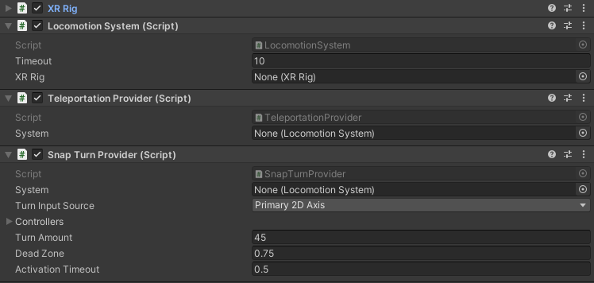
Player movement – Locomotion components

Slide 11
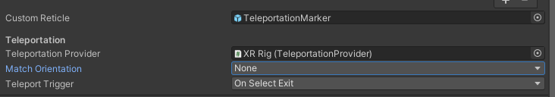
Player movement – Teleportation area
Teleportation Area/Anchor is an Interactable
Events (hover, select, etc.)
Interaction Layer Masks
Can Take a Custom Reticle
Can Match Orientation
Teleport Trigger
On Select Exit/Enter (button press/release)

Slide 12
Player movement - demo
Demo Player Movement

Slide 13

Thank You
pjohnstone@ccsnh.edu

