Slide 1
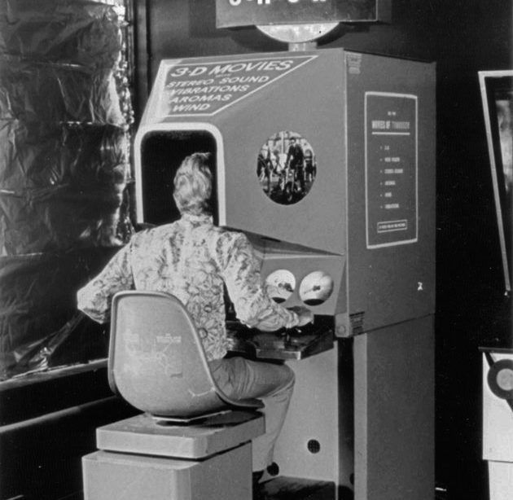
WEEK 1
AGGP 231C
Application Development and Software Prototyping

Slide 2
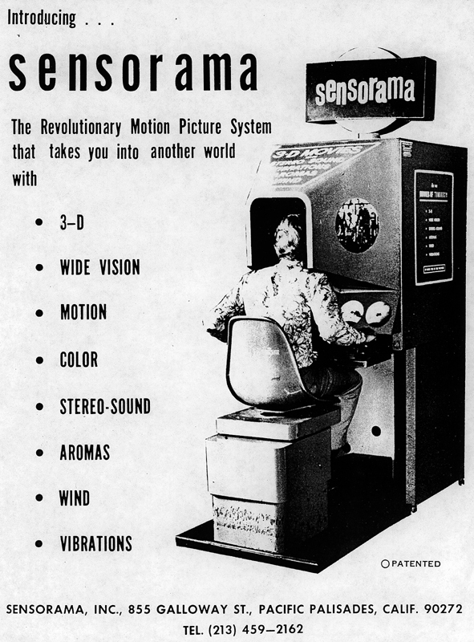
Back in 1957…
Popularly considered the birthplace of VR.

Slide 3

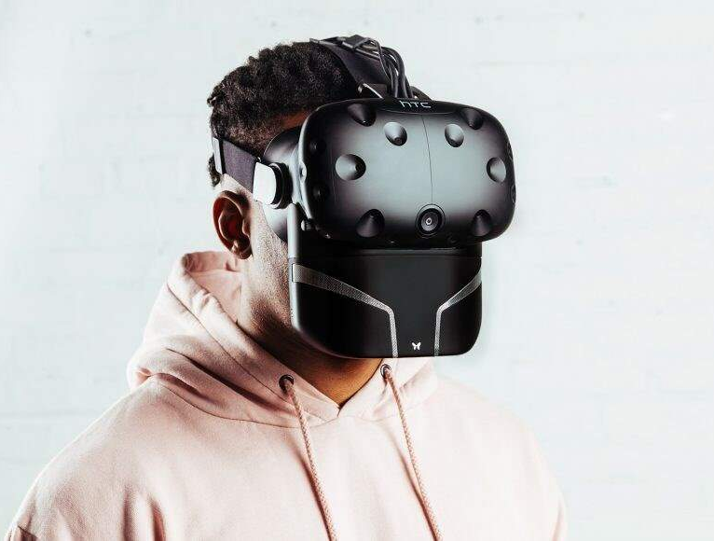

…50+ years later
How far has Mixed Reality technology come since the Sensorama (and smell-o-vision)?
The Void
[1][2] Feelreal.com

Slide 4
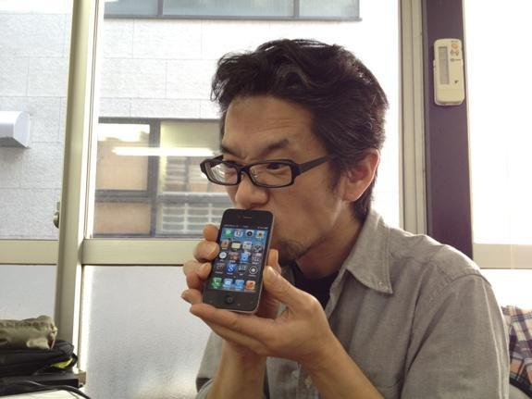
AR Mario
[3] ubergizmo.com

Slide 5
COURSE OVERVIEW
ANDROID DEVELOPMENT
ASSIGNMENT

Slide 6

COURSE OVERVIEW
August
September
October
November
December
1
2
3
4
5
6
7
8
9
10
11
12
13
14
15
FINAL
Augmented Reality
Virtual Reality
Presentation
4 Weeks of Topic, Lecture, Lab, and Assignment
3 Weeks for a Project
Assignments are due at the beginning of next Lecture

Slide 7

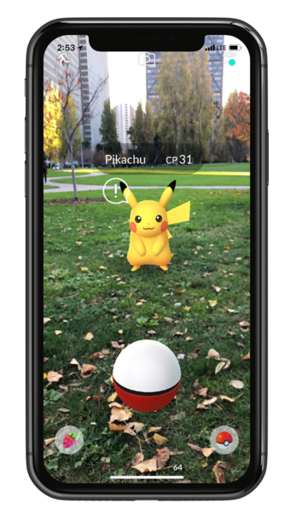

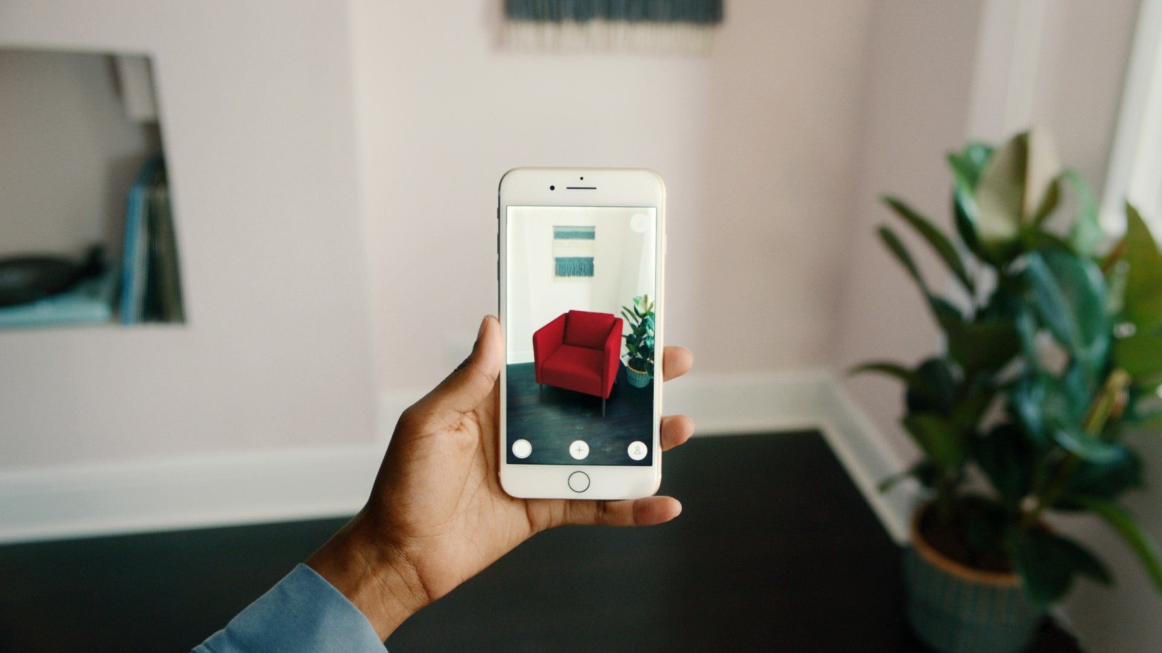
MOBILE AR
[4] PokemonGO [5] IndoorNav [6] IkeaPlace

Slide 8
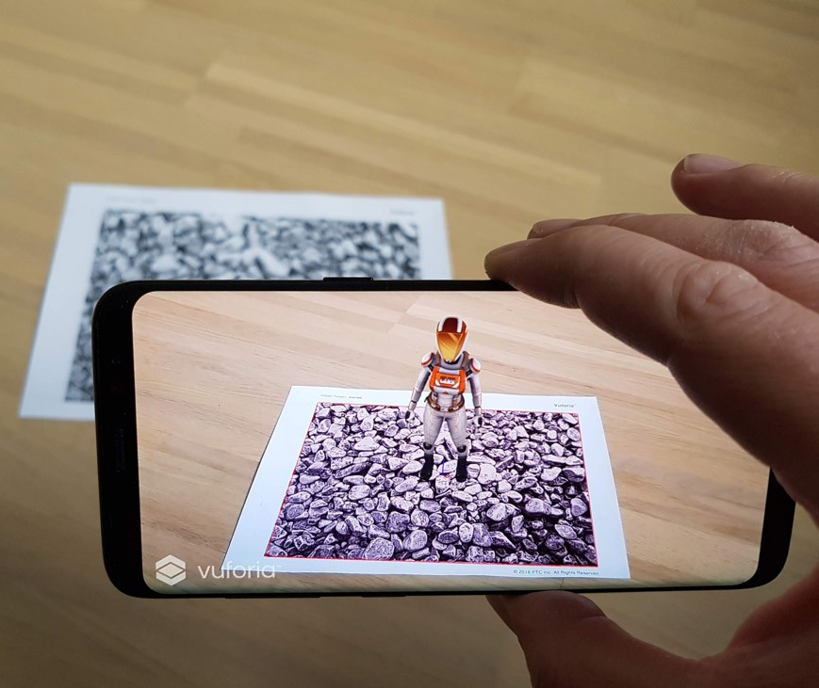

MOBILE AR
Image Tracking
Surface Tracking
[7] Vuforia.com [8] ARCore

Slide 9
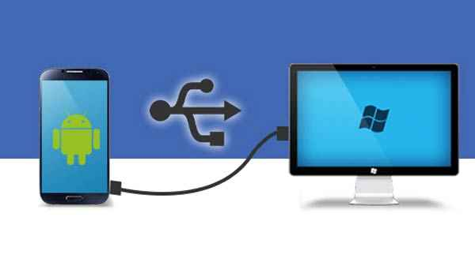
ANDROID DEVELOPMENT
Week01_Setup.docx
Assignments folder, Course Repository
[9] Android to PC

Slide 10
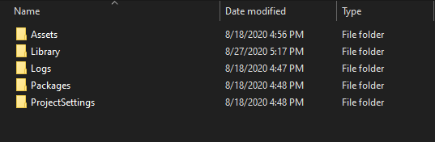
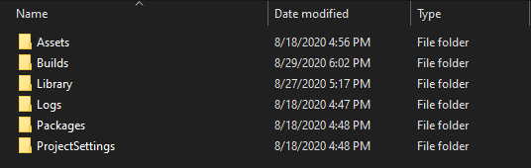
ANDROID DEVELOPMENT
Add a “Builds” folder to the Root Directory for

Slide 11
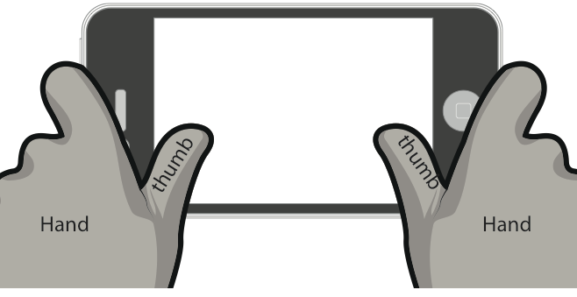

UI/UX Best Practices (Games)
Finger-Sized Elements
Avoid Clutter
Swipe Space
[10] TouchSwipe

Slide 12

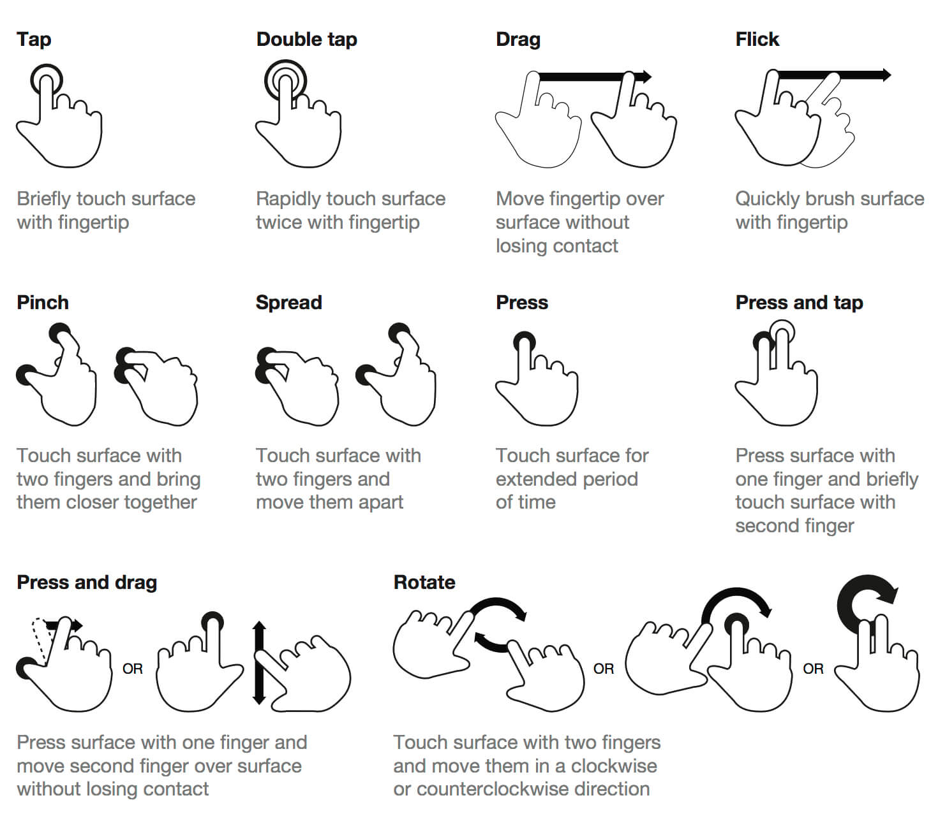

Touchscreen Interactions
[11] Touch Gestures [12] JoystickPack

Slide 13
Touchscreen API
Touch API: https://docs.unity3d.com/ScriptReference/Touch.html
Touch Phase API: https://docs.unity3d.com/ScriptReference/TouchPhase.html
Began | A finger touched the screen.
Moved | A finger moved on the screen.
Stationary | A finger is touching the screen but hasn't moved.
Ended | A finger was lifted from the screen. This is the final phase of a touch.
Canceled | The system cancelled tracking for the touch.

Slide 14
ASSIGNMENT
Purpose of this assignment is to get you up and running with Android Development
Create and Build 2 Scenes to an Android device
Touch Gesture
Virtual Joystick
Record a demonstration of each Scene on the device
Talk about what you did and a brief Post Mortem
More information can be found in the assignment document (in the repository and on Canvas)

