Slide 1

Virtual reality
Application development and software prototyping, week 8

Slide 2

Setting up devices
Mixed Reality Portal (Odyssey)
Oculus App (Rift, Quest 1 & 2)
SteamVR (Vive, Index)

Slide 3
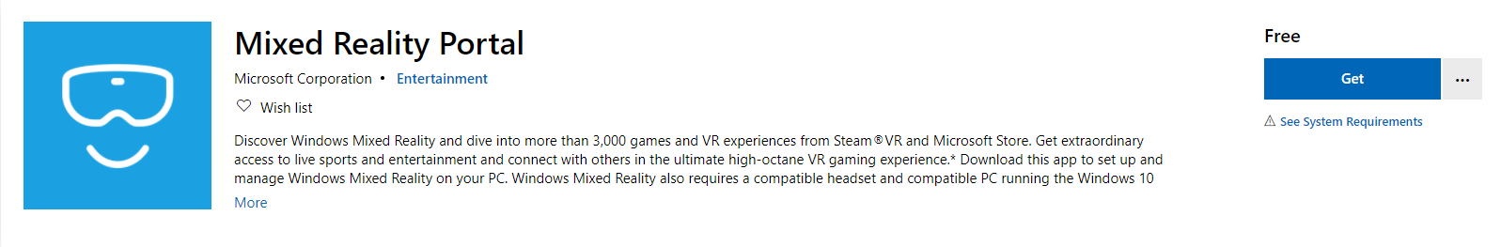
HMD ODyssey
Download Mixed Reality Portal

Slide 4

Rift, Rift s, Quest, quest 2
Download Oculus App

Slide 5
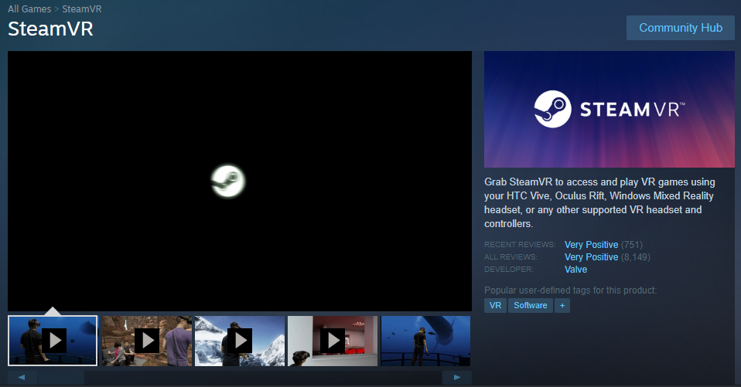
Vive, index
Download SteamVR
Probably Need Valve’s Open VR

Slide 6
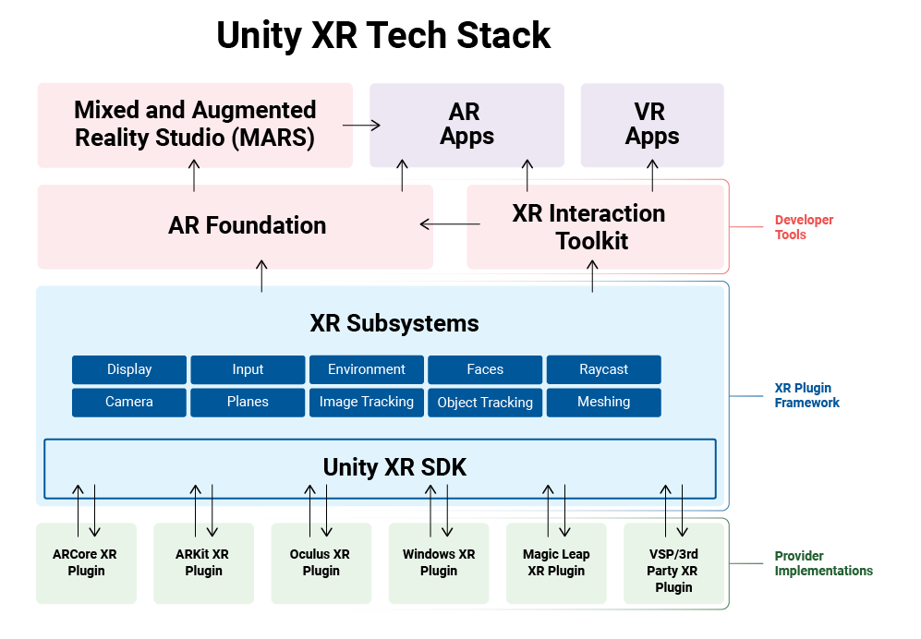

Slide 7
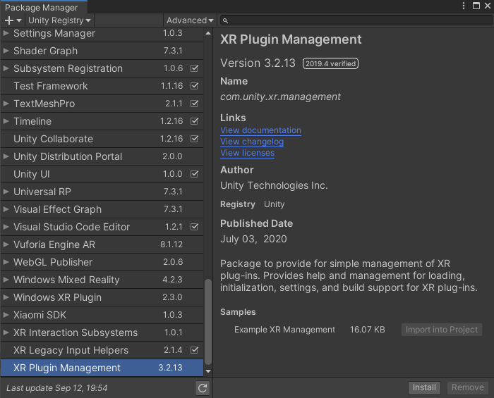
XR Plugin Management
INSTALLATION
Window > Package Manager

Slide 8
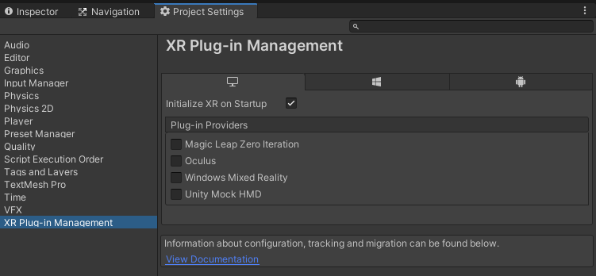
XR Plugin Management
INSTALLATION
Edit > Project Settings

Slide 9
XR Interaction toolkit
XR INTERACTION TOOLKIT
Link: XR Interaction Toolkit
INTERACTION MANAGER
Interactor
Interactable
Notes:
“…Set of base Interactor and Interactable components, and an Interaction Manager that ties these two types of components together.”
Cross-platform XR Controller Input
Basic Object hover, select and grab
Haptic feedback
Visual feedback
Basic canvas UI interaction with XR Controllers
A VR camera rig for handling stationary and room-scale VR experiences

Slide 10
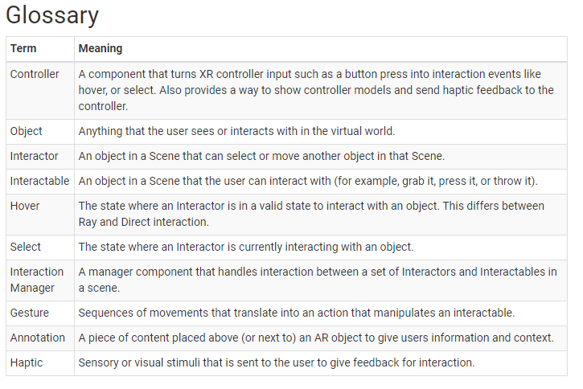
XR Interaction toolkit

Slide 11
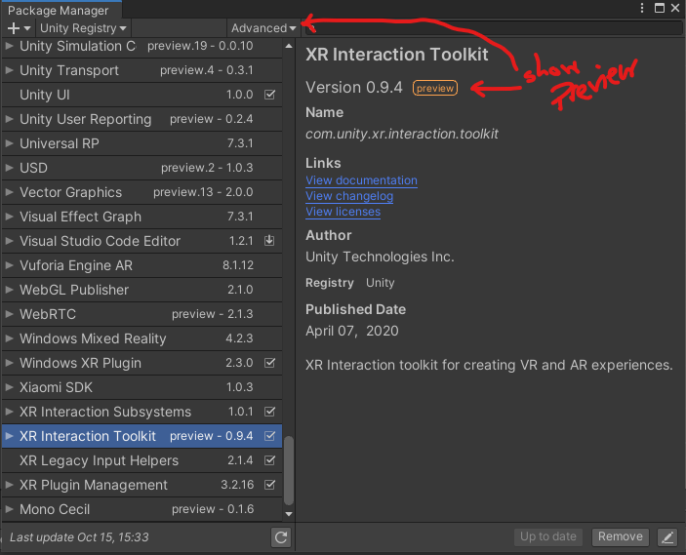
XR Interaction toolkit
XR INTERACTION TOOLKIT
Window > Package Manager

Slide 12
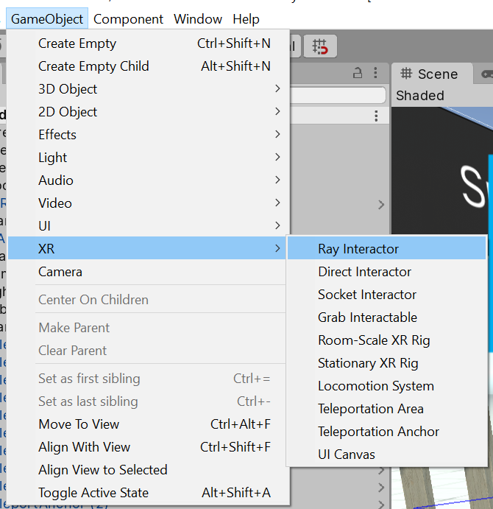
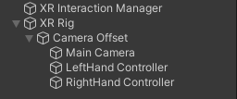
XR Interaction toolkit
UNITY: XR SCENE
Notes:
Every Scene that uses the XR Interaction Toolkit needs at least one Interaction Manager to facilitate interaction between Interactors and Interactables. By default, Interactors and Interactables reference the first Interaction Manager they find in the Scene if you don’t specify one. You can also break up larger Scenes with multiple Managers or turn specific ones on and off to enable sets of interaction.

Slide 13

Thank You
pjohnstone@ccsnh.edu

