Slide 1
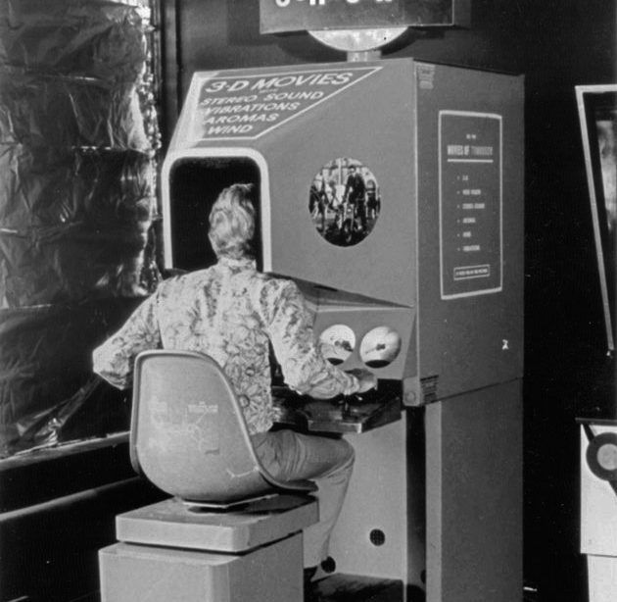
WEEK 1
AGGP 231C
Application Development and Software Prototyping

Slide 2



50+ years later…
How far has Mixed Reality technology come since the Sensorama (and smell-o-vision)?
[1][2] Feelreal.com

Slide 3
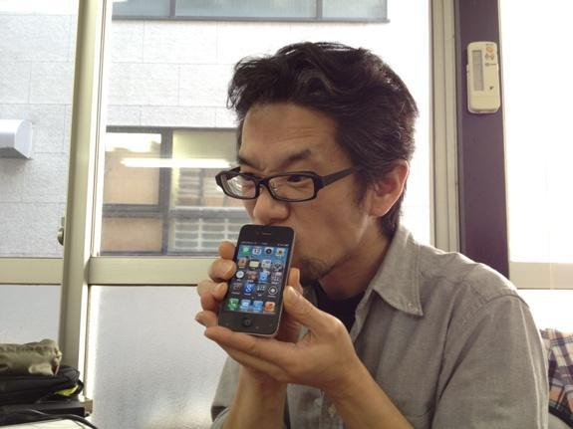
The Void AR Mario
[3] ubergizmo.com

Slide 4
COURSE OVERVIEW
ANDROID DEVELOPMENT
ASSIGNMENT

Slide 5

COURSE OVERVIEW
August
September
October
November
December
1
2
3
4
5
6
7
8
9
10
11
12
13
14
15
FINAL
Augmented Reality
Virtual Reality
Presentation
4 Weeks of Topic, Lecture, Lab, and Assignment
3 Weeks for a Project
Assignments are due at the beginning of next Lecture

Slide 6

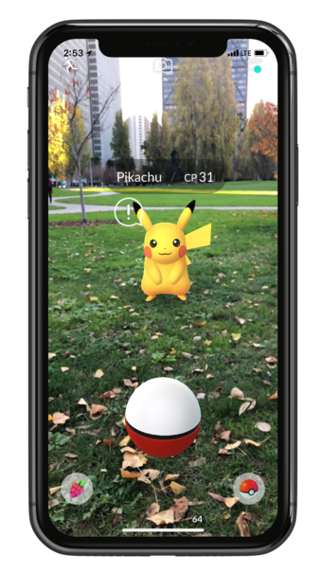

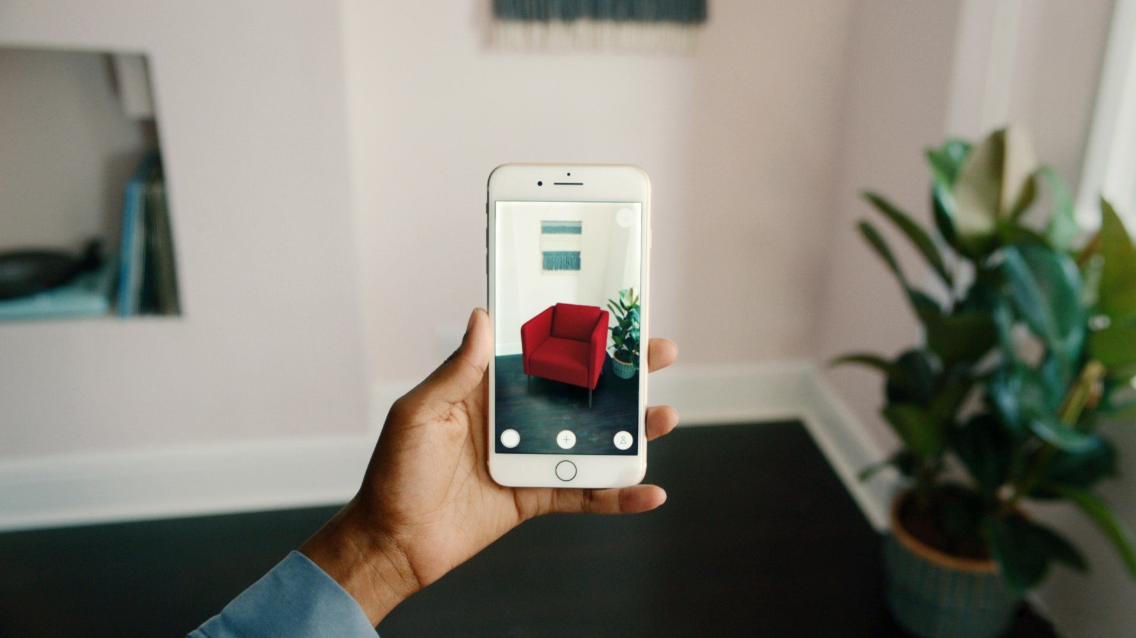
ANDROID DEVELOPMENT
[4] PokemonGO [5] IndoorNav [6] IkeaPlace

Slide 7
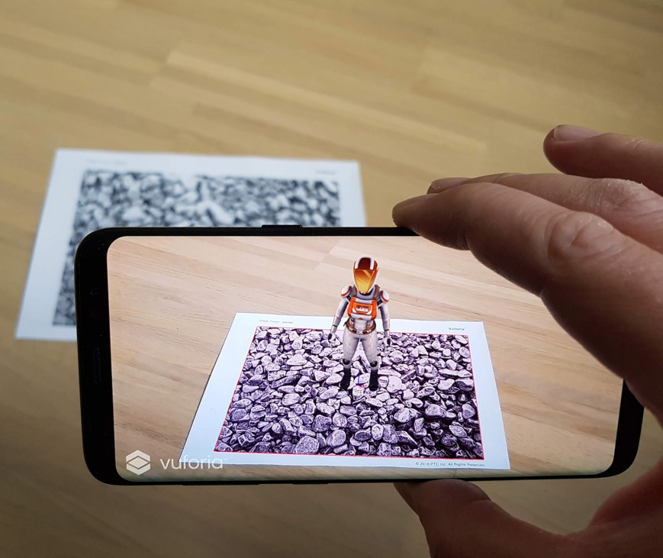

ANDROID DEVELOPMENT
Image Tracking
Surface Tracking
[7] Vuforia.com [8] ARCore

Slide 8
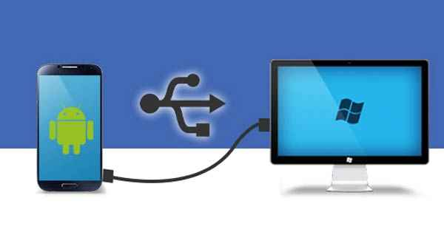
ANDROID DEVELOPMENT
Week01_Setup.docx
(under Assignments folder)
[9] Android to PC

Slide 9

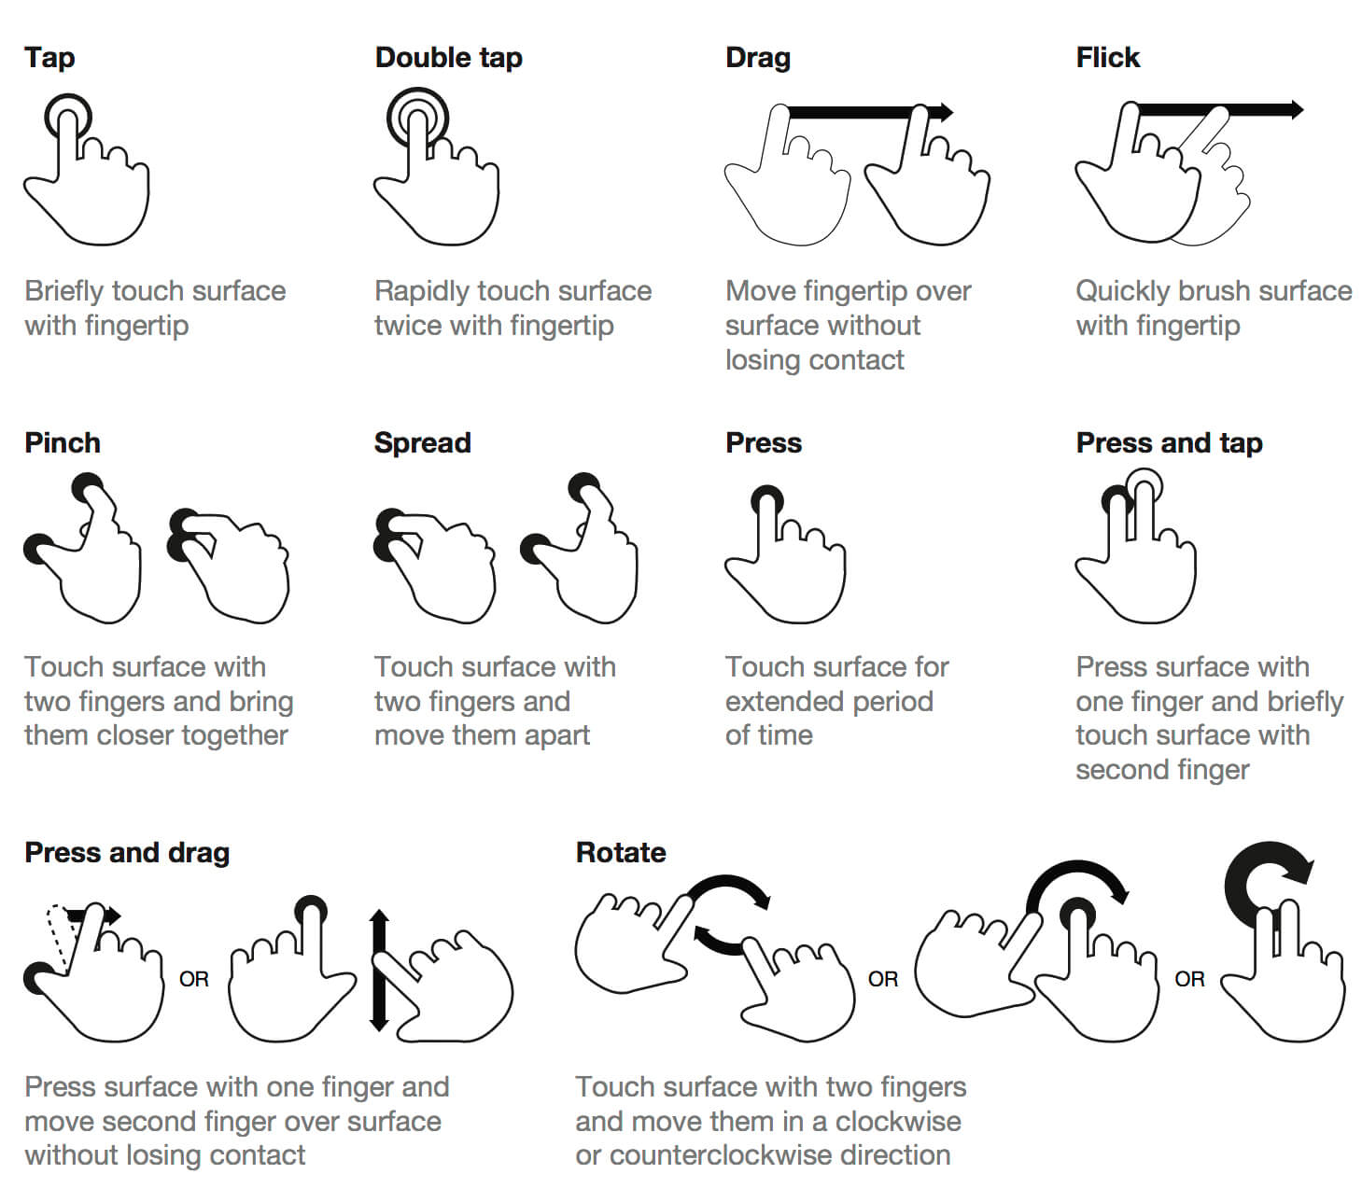

ASSIGNMENT
[10] Touch Gestures [11] JoystickPack

Slide 10
ASSIGNMENT
Create and Build 2 Scenes to an Android device
Touch Gesture
Virtual Joystick
Record a demonstration of each Scene on the device
Talk about what you did and a brief Post Mortem

