Slide 1
The Trigonometric Functions

Slide 2
Geometry
  Mathematics of points, lines, shapes, and solids.
Trigonometry
  Mathematics of triangles and the trigonometric functions.

Slide 3
Angle
Formed by two ‘rays’ with a common endpoint (vertex)
The arrow between the rays show direction of the angle.
C
A
θ
Terminal Side
Initial Side
B
Vertex

Slide 4
Angles
Angle: amount of rotation.
Common symbols:
    θ theta
    φ phi
    α Alpha
    β Beta
    A or any capital letter

Slide 5
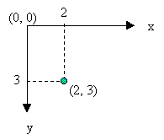
Cartesian
Coordinate
System
Computer Screen
Coordinate
System
x-axis
y-axis
+ θ
(2, 3)
3
x-axis
+ θ
y-axis
(0,0)
2
Up is positive y direction
Right is positive x direction
Counterclockwise rotation positive
Down is positive y direction
Right is positive x direction
Clockwise rotation positive

Slide 6
Measuring Angles - Degree
Degree:
  One full rotation is 360º.
  One degree is 1/360 ^{th} of a complete rotation.

Slide 7
Measuring Angles - Radian
Radian:
Related to the length of circle arc, s.
Angle formed when the arc length is divided by the radius, θ = s/r.
  When r=1, θ = s/1 = s. The angle is equal to the arc length.
One full rotation = circumference of a circle = 2π
s
θ
r
r

Slide 8
Conversion between Degrees and Radians
Full Rotation: 2π radians = 360º
or
π radians = 180º
Convert to radians:
radians = degrees * Math.PI/180
Convert to degrees:
degrees = radians * 180/Math.PI
Flash: Math functions use radians.

Slide 9
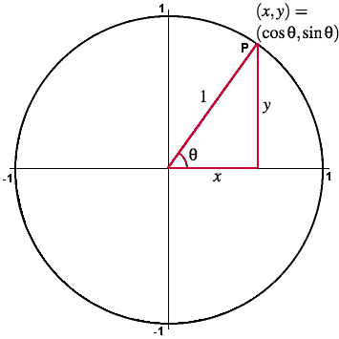
r
s

Slide 10
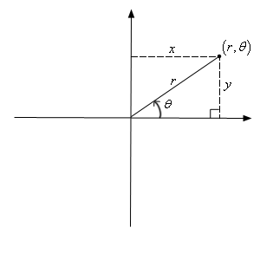
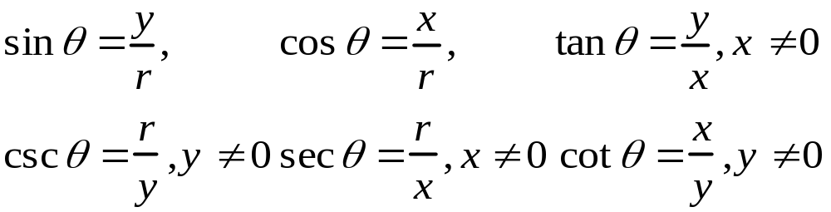
Trigonometric Functions
x

Slide 11
Right Triangle Trigonometry
Hypotenuse
Side opposite θ.
θ
Side adjacent to θ.

Slide 12
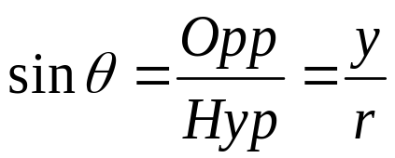
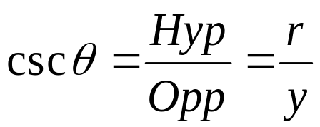
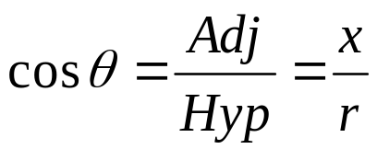
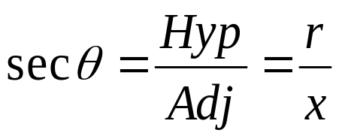
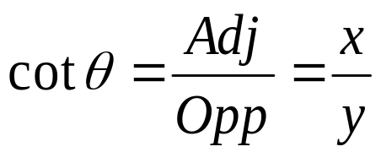
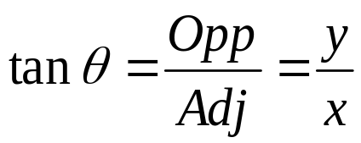
Right Triangle Definitions of Trigonometric Functions
Hyp
r
Opp
y
θ
Adj
x
SOH-CAH-TOA

Slide 13
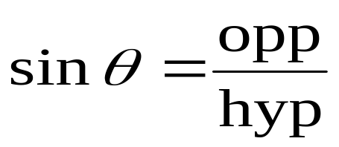
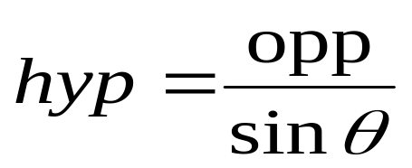
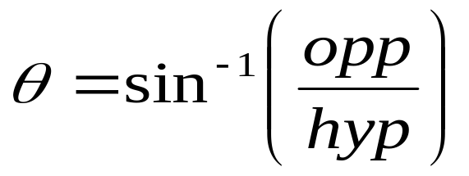
Inverse Trig Functions
Trigonometric Ratios:
Given: angle and one side
Find: other sides
Inverse Trigonometric Ratios:
Given: 2 sides
Find: angle
For example:

Slide 14
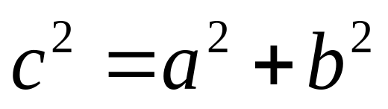
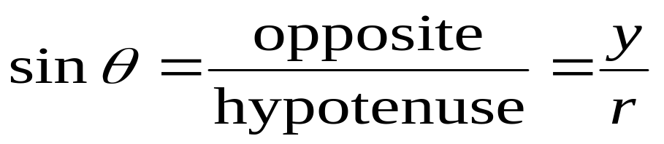
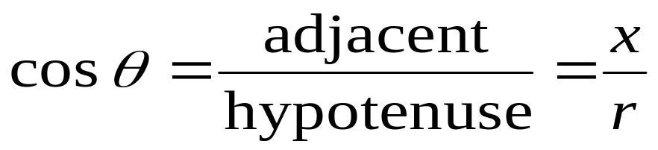
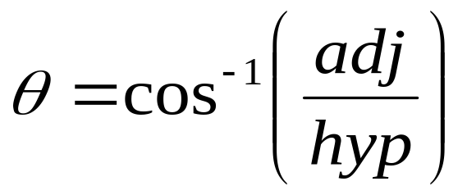
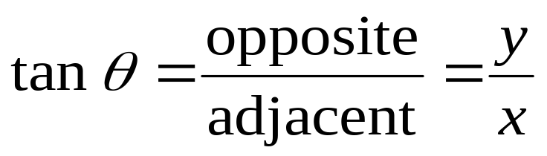
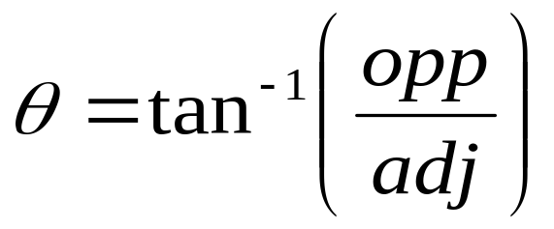
Pythagorean Theorem:
Trig Ratios: Inverse Trig Ratios:

Slide 15
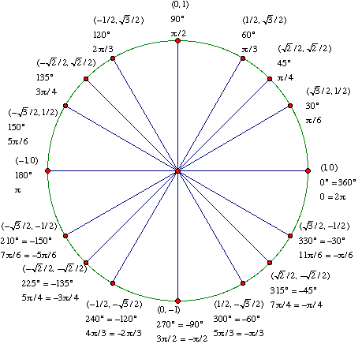
Unit Circle
circle.fla;

Slide 16
Trig Functions in Flash
MathHelper.sin(degrees*Math.PI/180)
MathHelper.cos(degrees*Math.PI/180)
MathHelper.tan(degrees*Math.PI/180)
MathHelper.asin((opp/hyp)*180/Math.PI)
MathHelper.acos((adj/hyp)*180/Math.PI)
MathHelper.atan((opp/adj)*180/Math.PI)
MathHelper.atan2((y,x)*180/Math.PI)

Slide 17
Graphs of Sine and Cosine Functions
Any equation with two variables may be graphed using points.
*
This includes equations with sine and cosine.
y = sinx
y = cosx
**
For these equations, x is the angle.
y is the ratio of the right triangle.

Slide 18
The Graph of y = sinx
y
1
π
π
π
˝
x
3 π
2 π
6
3
2
2
-1
Period: 2π

Slide 19
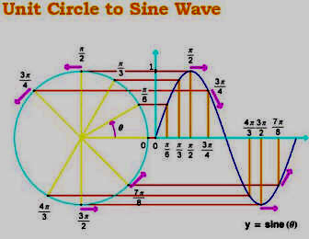

Slide 20
Amplitude, A y = A sinx
y
y = Asinx
x
Amplitude: | A|
*
|A| is the maximum height, y, of the graph.
-|A| is the minimum y value.
**
When ‘A’ is negative in the equation, the graph is inverted (flipped).
Period: 2π

Slide 21
y
1
y = sin x
y = 1/2sinx
x
˝
-1
y = -sin x

Slide 22
y
Period, B
y = sinBx
y = sinBx
x
Period: 2π/B
‘B’ is the length of one cycle, or the period.
The period of the sine curve y = sin(x) is 2.
The period of the sine curve y = sin Bx is 2/B.
B stretches or shrinks the curve in the x direction.
  B > 1, the period will shrink.
  B < 1, the period will stretch.

Slide 23
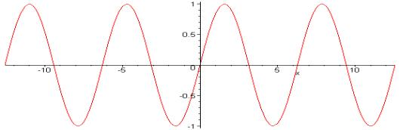
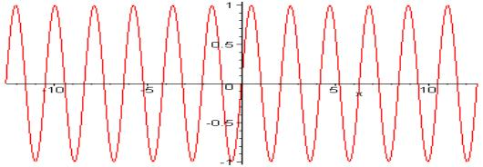
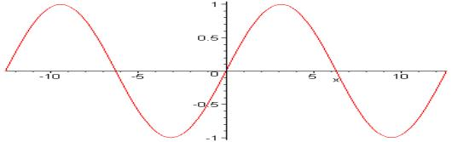


Slide 24
Shift, C y = sin(x+C)
*
‘C’ is the phase shift, the amount the graph shifts to the left or to the right.
+ C shifts left
- C shifts right
If B ≠ 1, shift is equal to C/B

Slide 25
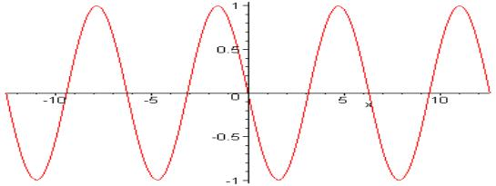

Slide 26
The Graph of y = cosx
.
y
1
x
^{-3π} /2
-π
^{-π}/2
^{π}/2
π
^{3π}/2
2π
^{5π}/2
-1
Period: 2π

Slide 27
The Graph of y = Asin(Bx - C)
The A-B-C’s of the Sine Curve
“A” controls the amplitude.
“B” controls the period.
“C” controls the phase shift.

