Slide 1
Out For A Walk
By: Miranda, Jeremy, and Joe
(add last names and ppt theme later!)

Slide 2
Key Features:
2 Player
Fight Enemies
Role Swapping
Annoyance Simulator

Slide 3
The Team
Miranda:
Art
Some Enemy AI programming
Joe:
Music
Some Enemy AI Programming
Map Layout
Jeremy:
Main programmer

Slide 4
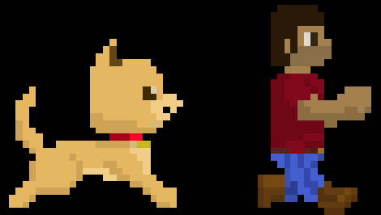
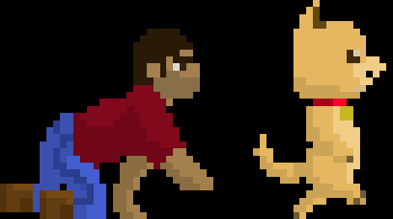

Role Swapping

Slide 5
Annoyance Simulator
Aid your friend… Or push them into enemies’ attacks
Drag your partner across the map

Slide 6
EULA Disclaimer
“not responsible for injuries to yourself or the other player”
(LOOK UP FAKE LEGAL FIRM NAMES
example: ACME Injury Legal Firm)

