Slide 1
研究方向由研究者掌握
有来源、有版本、可人工介入的视觉工作流
仅为合成软件示例，不是科研实验结果
1 | ILLUSTRATIVE | Synthetic interface fixture
Notes:
Timing: 35 seconds
Introduce the software demonstration. No scientific result or user-study outcome is claimed.
Claims
[demo] illustrative: These values illustrate the interface only.
Sources
data: Synthetic interface fixture; SHA256 f8b24b0e6ba7b387d44efbfc30fc2e248704b27f216fa8306a6547b4d863317d

Slide 2
原生图表保留给定数据
图表可编辑。
数据绑定 CSV 哈希。
2 | ILLUSTRATIVE | Synthetic interface fixture
Notes:
Timing: 60 seconds
Show that the native chart workbook retains each CSV value. The earlier figure separately shows supplied bounds.
Claims
[demo] illustrative: These values illustrate the interface only.
Sources
data: Synthetic interface fixture; SHA256 f8b24b0e6ba7b387d44efbfc30fc2e248704b27f216fa8306a6547b4d863317d

Slide 3
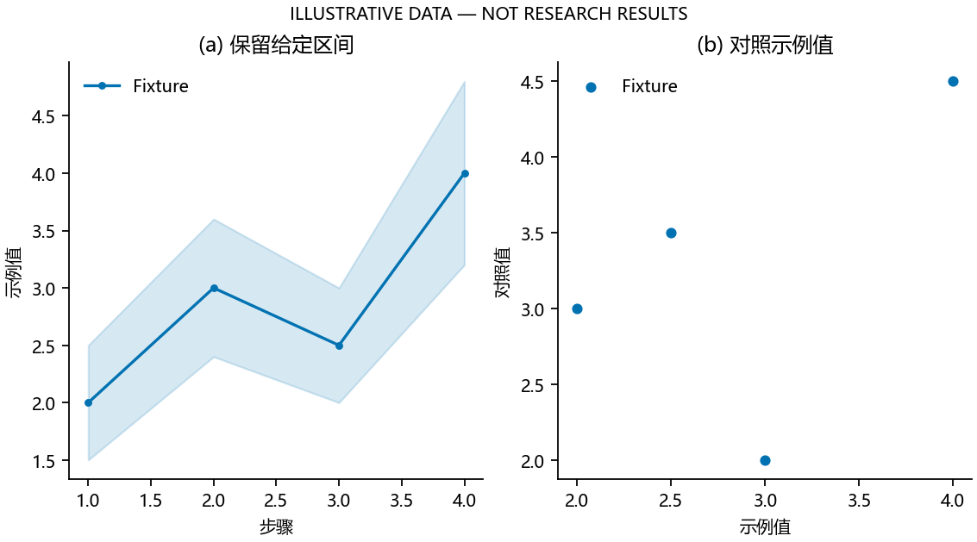
保留区间与中文标注
3 | ILLUSTRATIVE | Synthetic interval figure; Synthetic interface fixture
Notes:
Timing: 40 seconds
Explain the supplied bounds. They are not estimated confidence intervals. This is a software fixture.
Claims
[demo] illustrative: These values illustrate the interface only.
Sources
figure: Synthetic interval figure; SHA256 7ff19146978291568ab0feba0192336fd49ebfa111cdac68e11ae82ab677363d
data: Synthetic interface fixture; SHA256 f8b24b0e6ba7b387d44efbfc30fc2e248704b27f216fa8306a6547b4d863317d

Slide 4
区分机器检查与科研判断
机器检查
研究者判断
来源字节与文件结构
时长与对象边界
实际渲染结果
科学问题与证据强度
适当的强调与叙事
是否采用当前版本
4 | ILLUSTRATIVE | Synthetic interface fixture
Notes:
Timing: 55 seconds
Explain why technical success does not approve scientific meaning or visual taste.
Claims
[demo] illustrative: These values illustrate the interface only.
Sources
data: Synthetic interface fixture; SHA256 f8b24b0e6ba7b387d44efbfc30fc2e248704b27f216fa8306a6547b4d863317d

Slide 5
采用前，哪些内容需要修改？
核对方向、论断和证据。
提出修订、解释或停止要求。
只审阅当前产物版本。
5 | ILLUSTRATIVE | Synthetic interface fixture
Notes:
Timing: 45 seconds
Ask for actual feedback. The example does not synthesize approval.
Claims
[demo] illustrative: These values illustrate the interface only.
Sources
data: Synthetic interface fixture; SHA256 f8b24b0e6ba7b387d44efbfc30fc2e248704b27f216fa8306a6547b4d863317d

