Slide 1


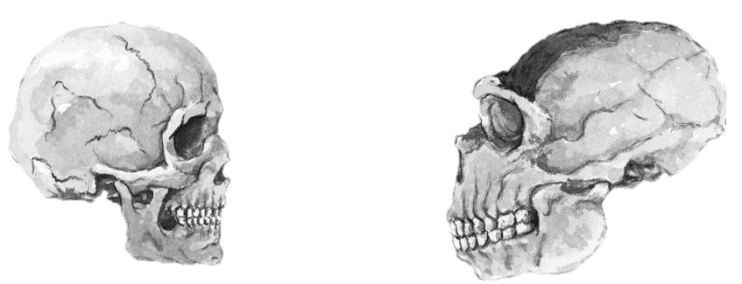
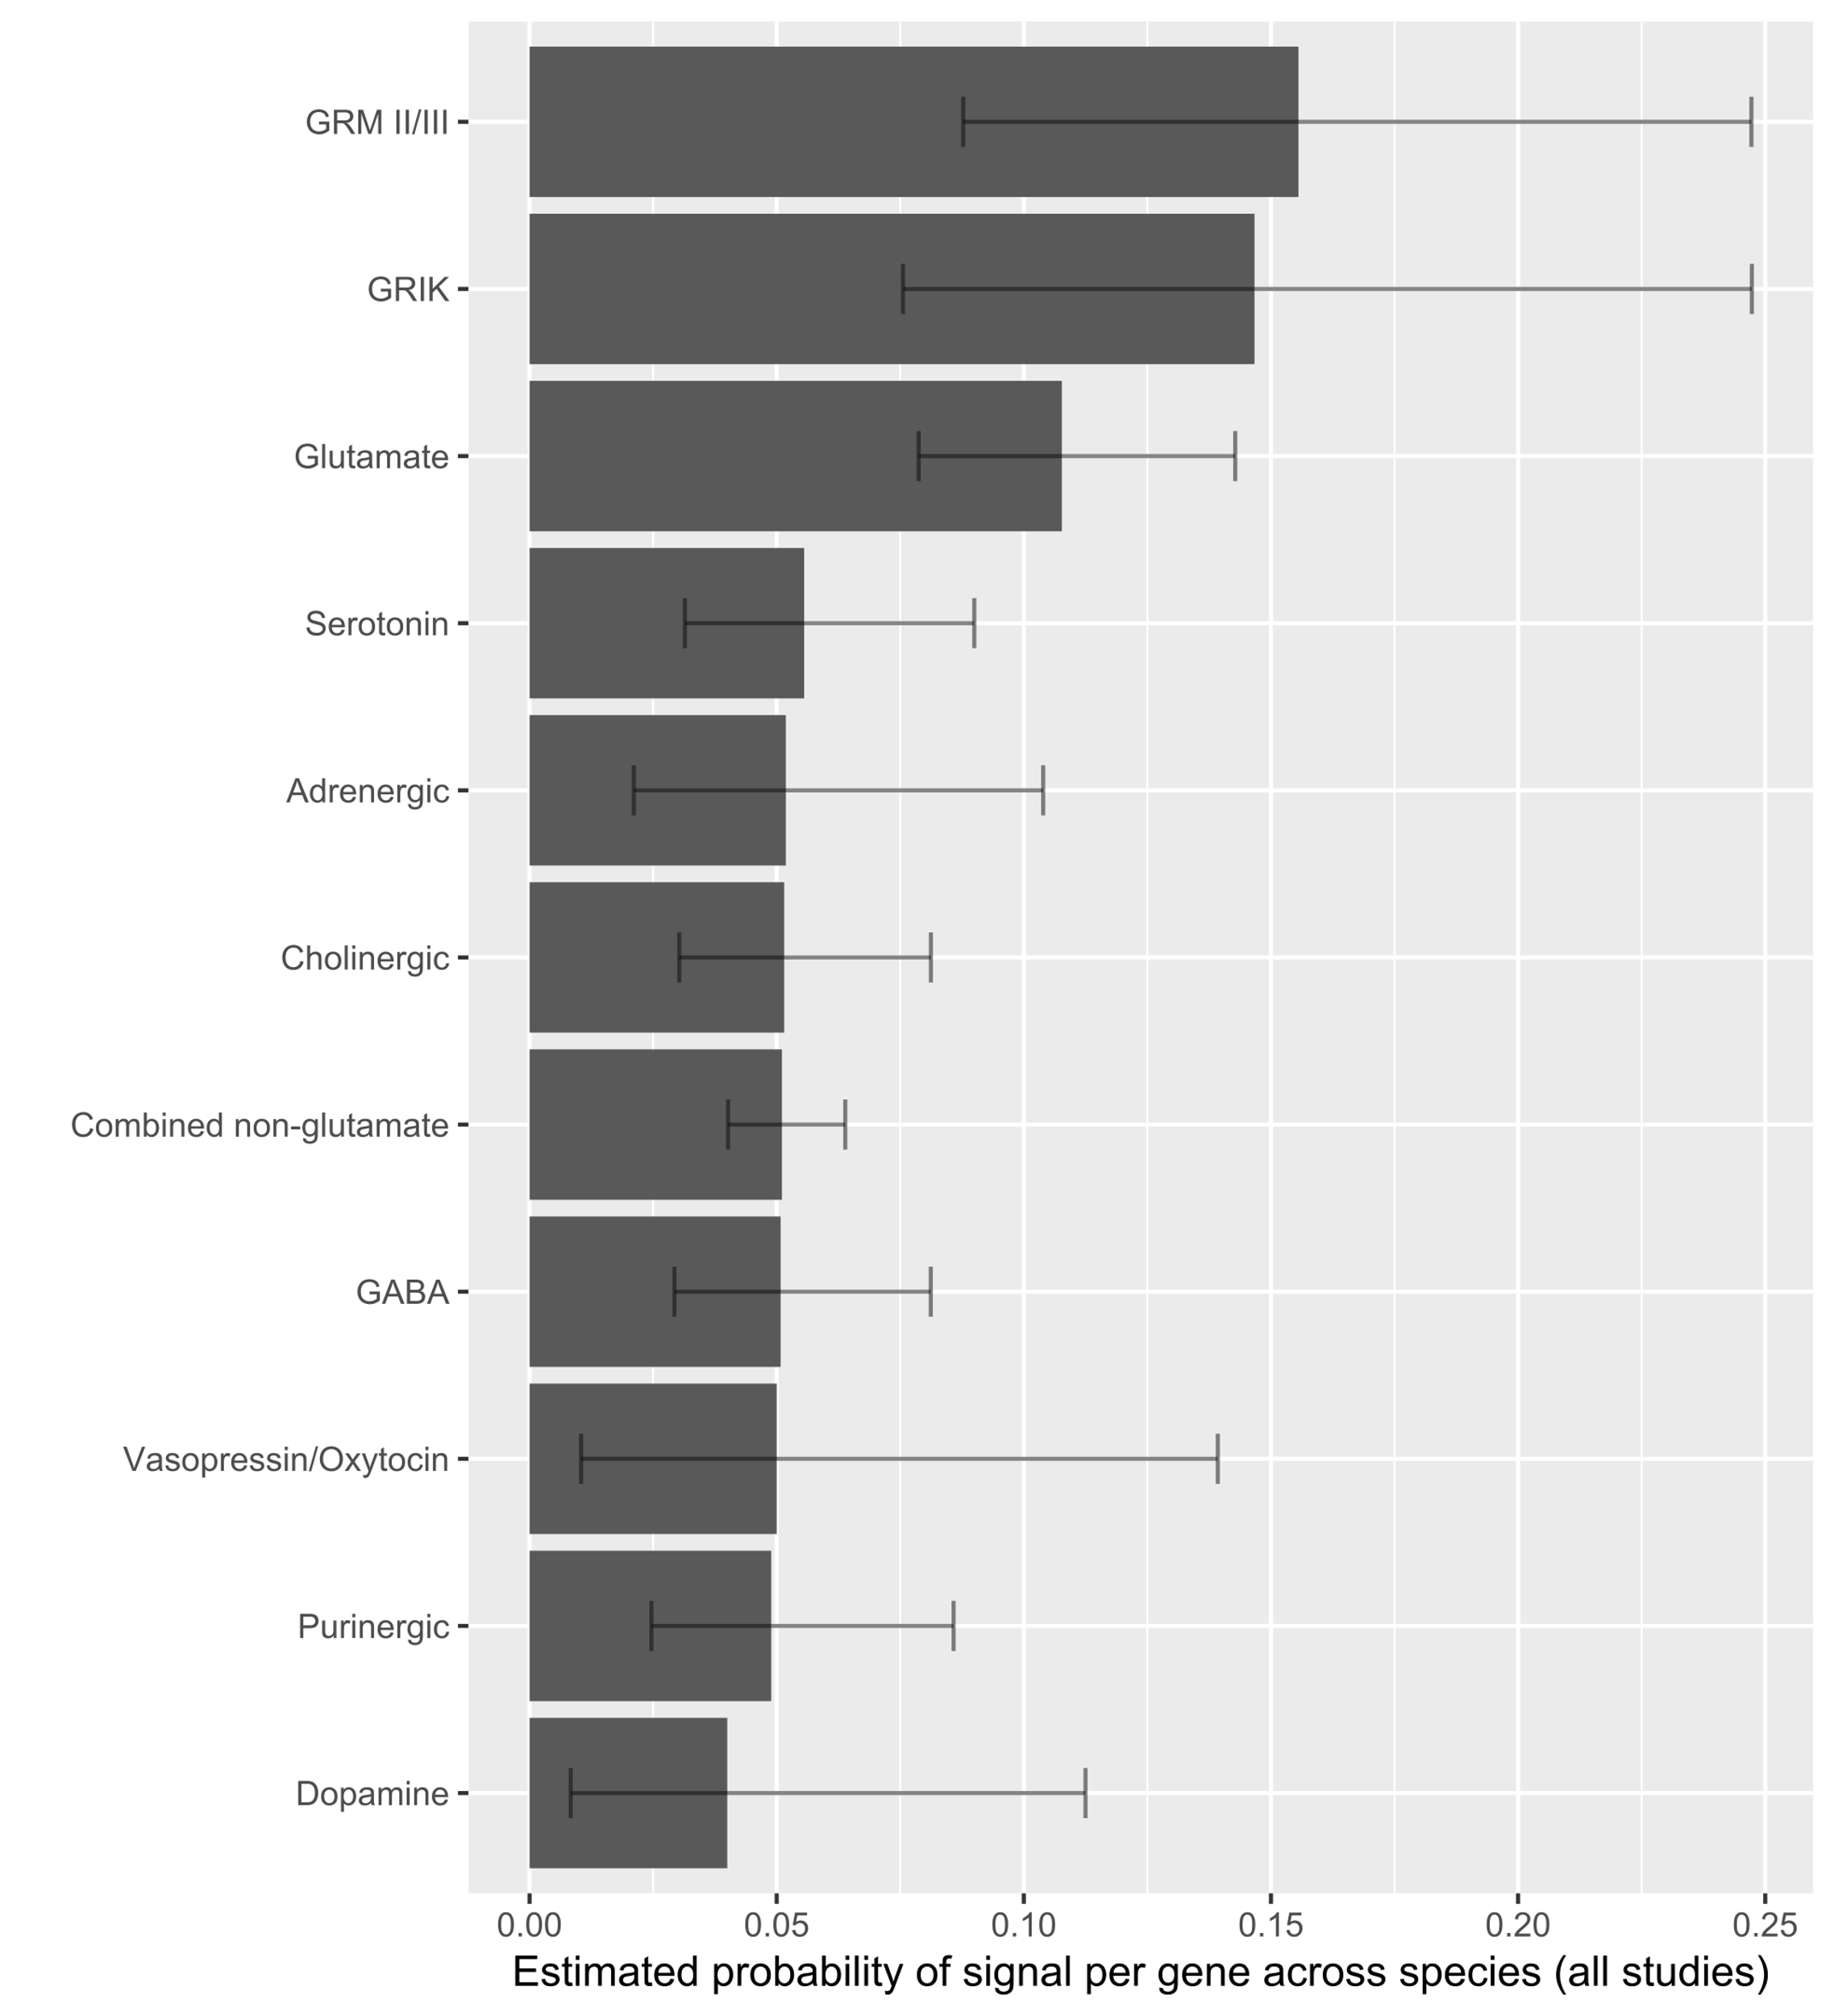
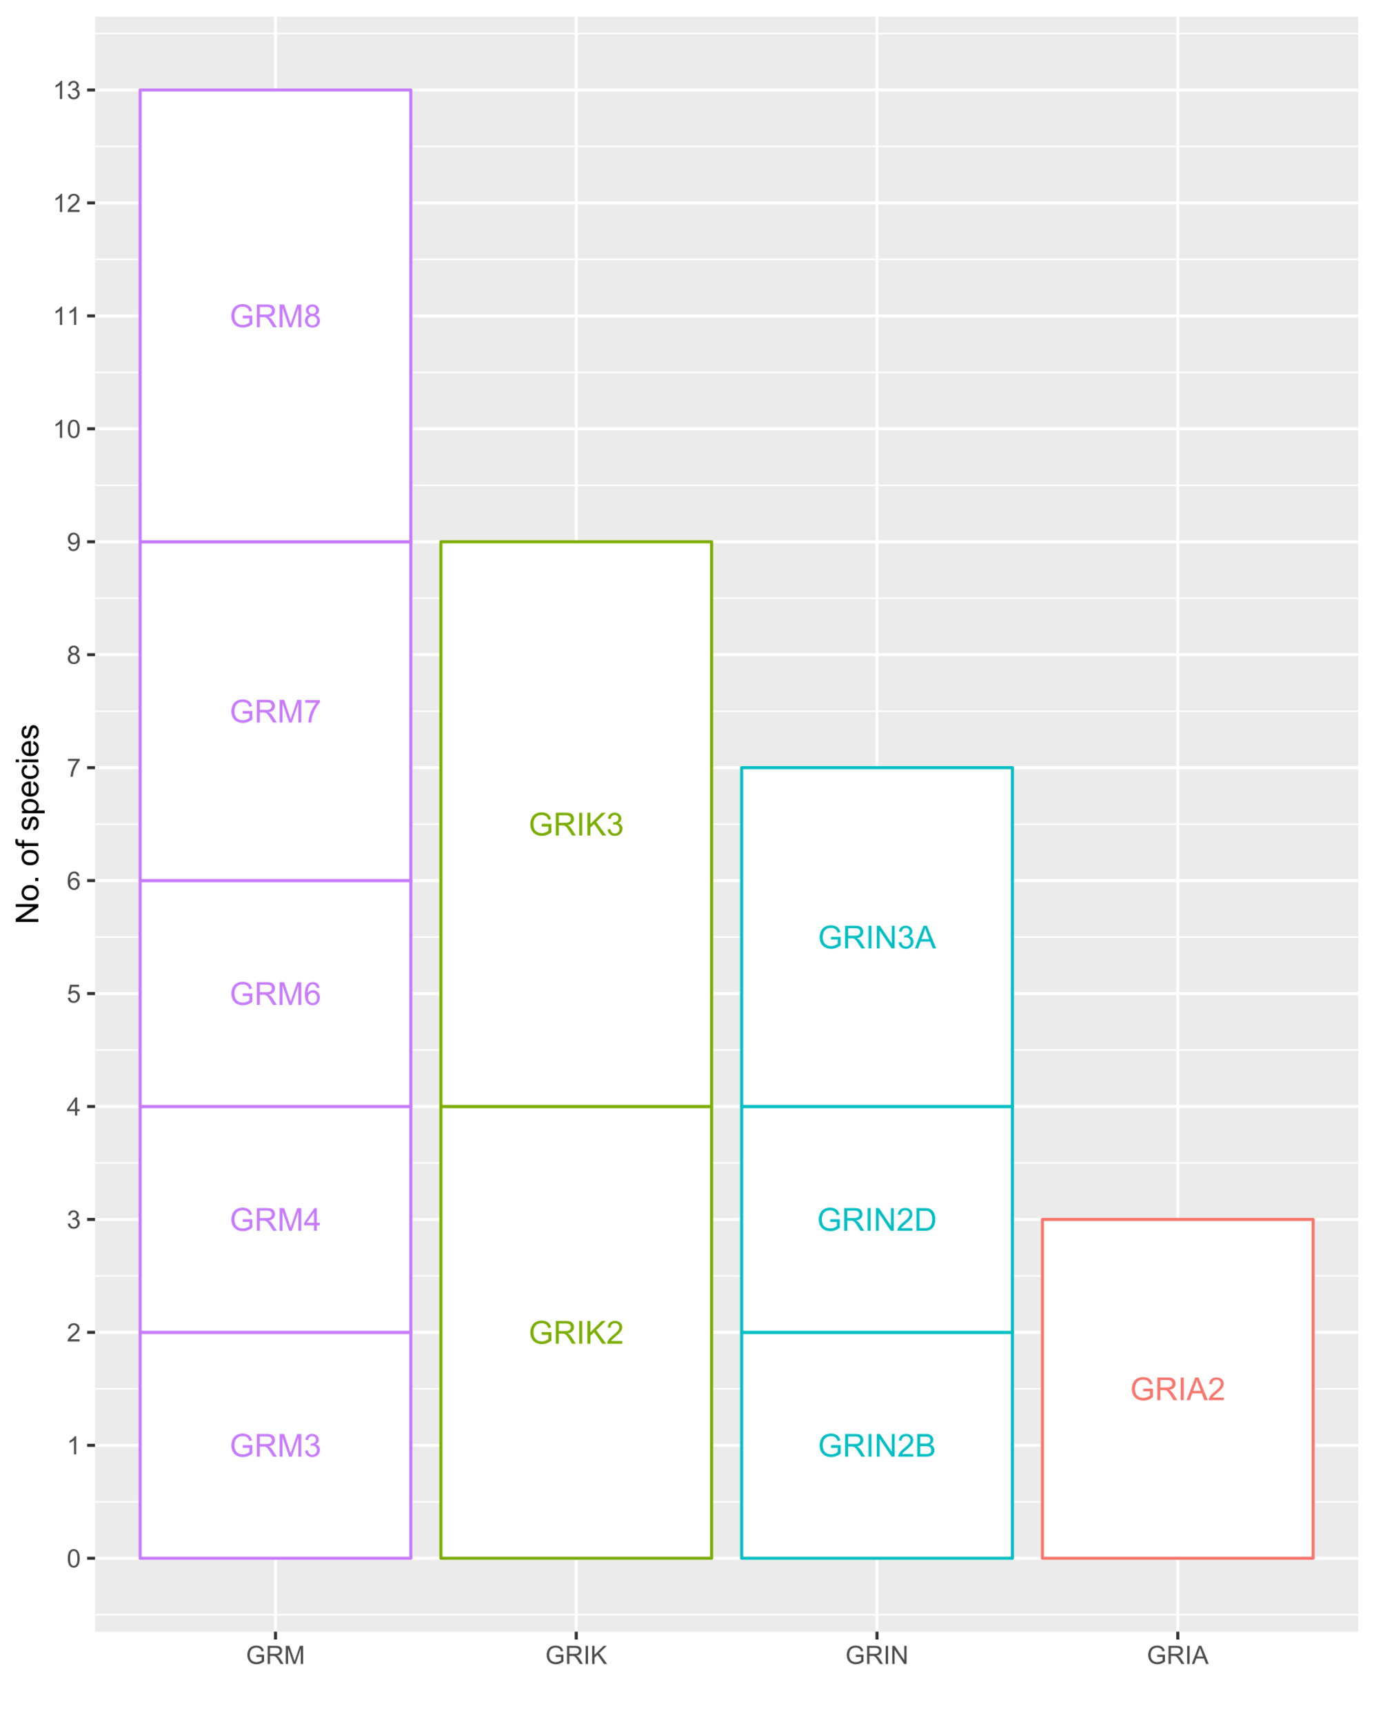
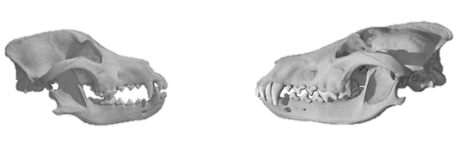
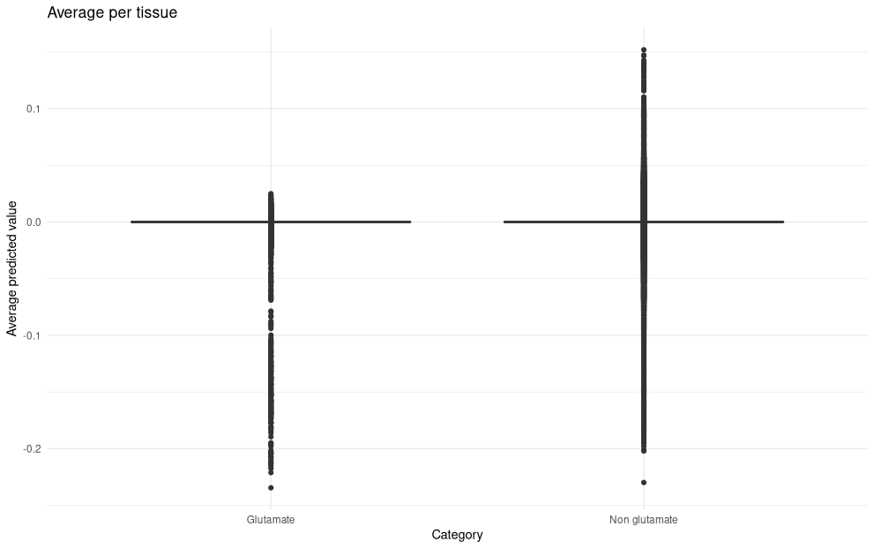
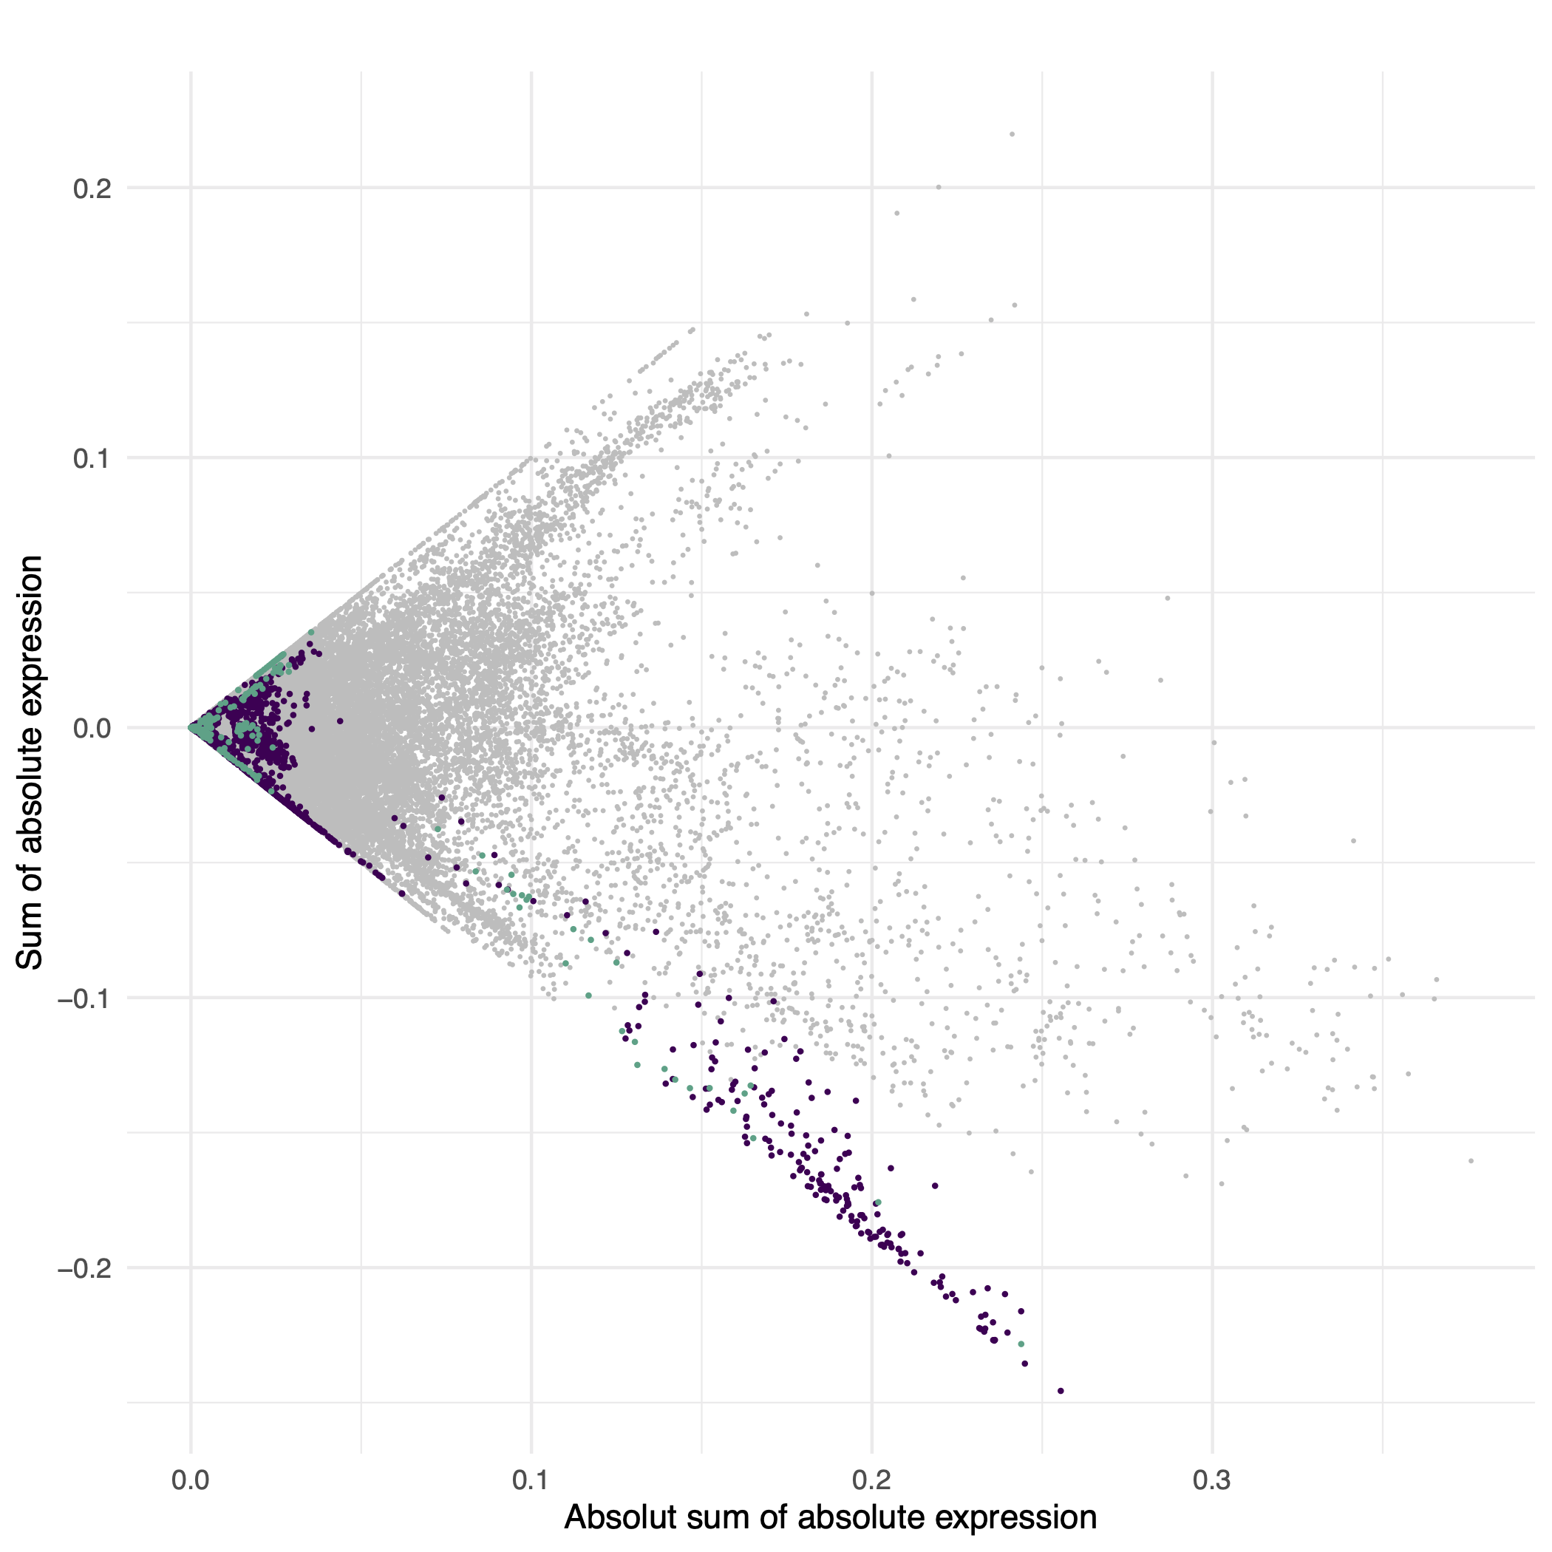
Gene expression under human self-domestication:
an in silico exploration of modern human high-frequency variants
Thomas O’Rourke¹✉, Pedro Tiago Martins^{1,2}, Alejandro Andirkó¹*
¹University of Barcelona, ²University of Ljubljana
Introduction
Hypothesis
Downregulated glutamatergic synaptic activity
Methods
Gene expression values per high-freq/fixed variant (ExPecto)
Genes in glut. signaling pathway (based on GO category 0098978)
Tissues: blabla out of 228 in ExPecto
Homo sapiens
Homo neanderthalensis
Canis lupus familiaris
Canis lupus lupus
(adapted from Theofanopoulou et al. 2017, PLoS ONE)
Differences:
Braincase shape & size, browridge, nasal bone, tooth size, jaw progession
(O’Rourke & Boeckx 2020, Neurosci. Biobehav. Rev.)
Results
✉ Correspondence: tomo.orourke@gmail.com | References, code & further info: https://github.com/AGMAndirko/CogSci

