Slide 1


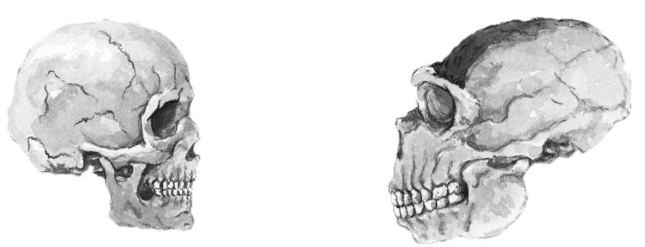
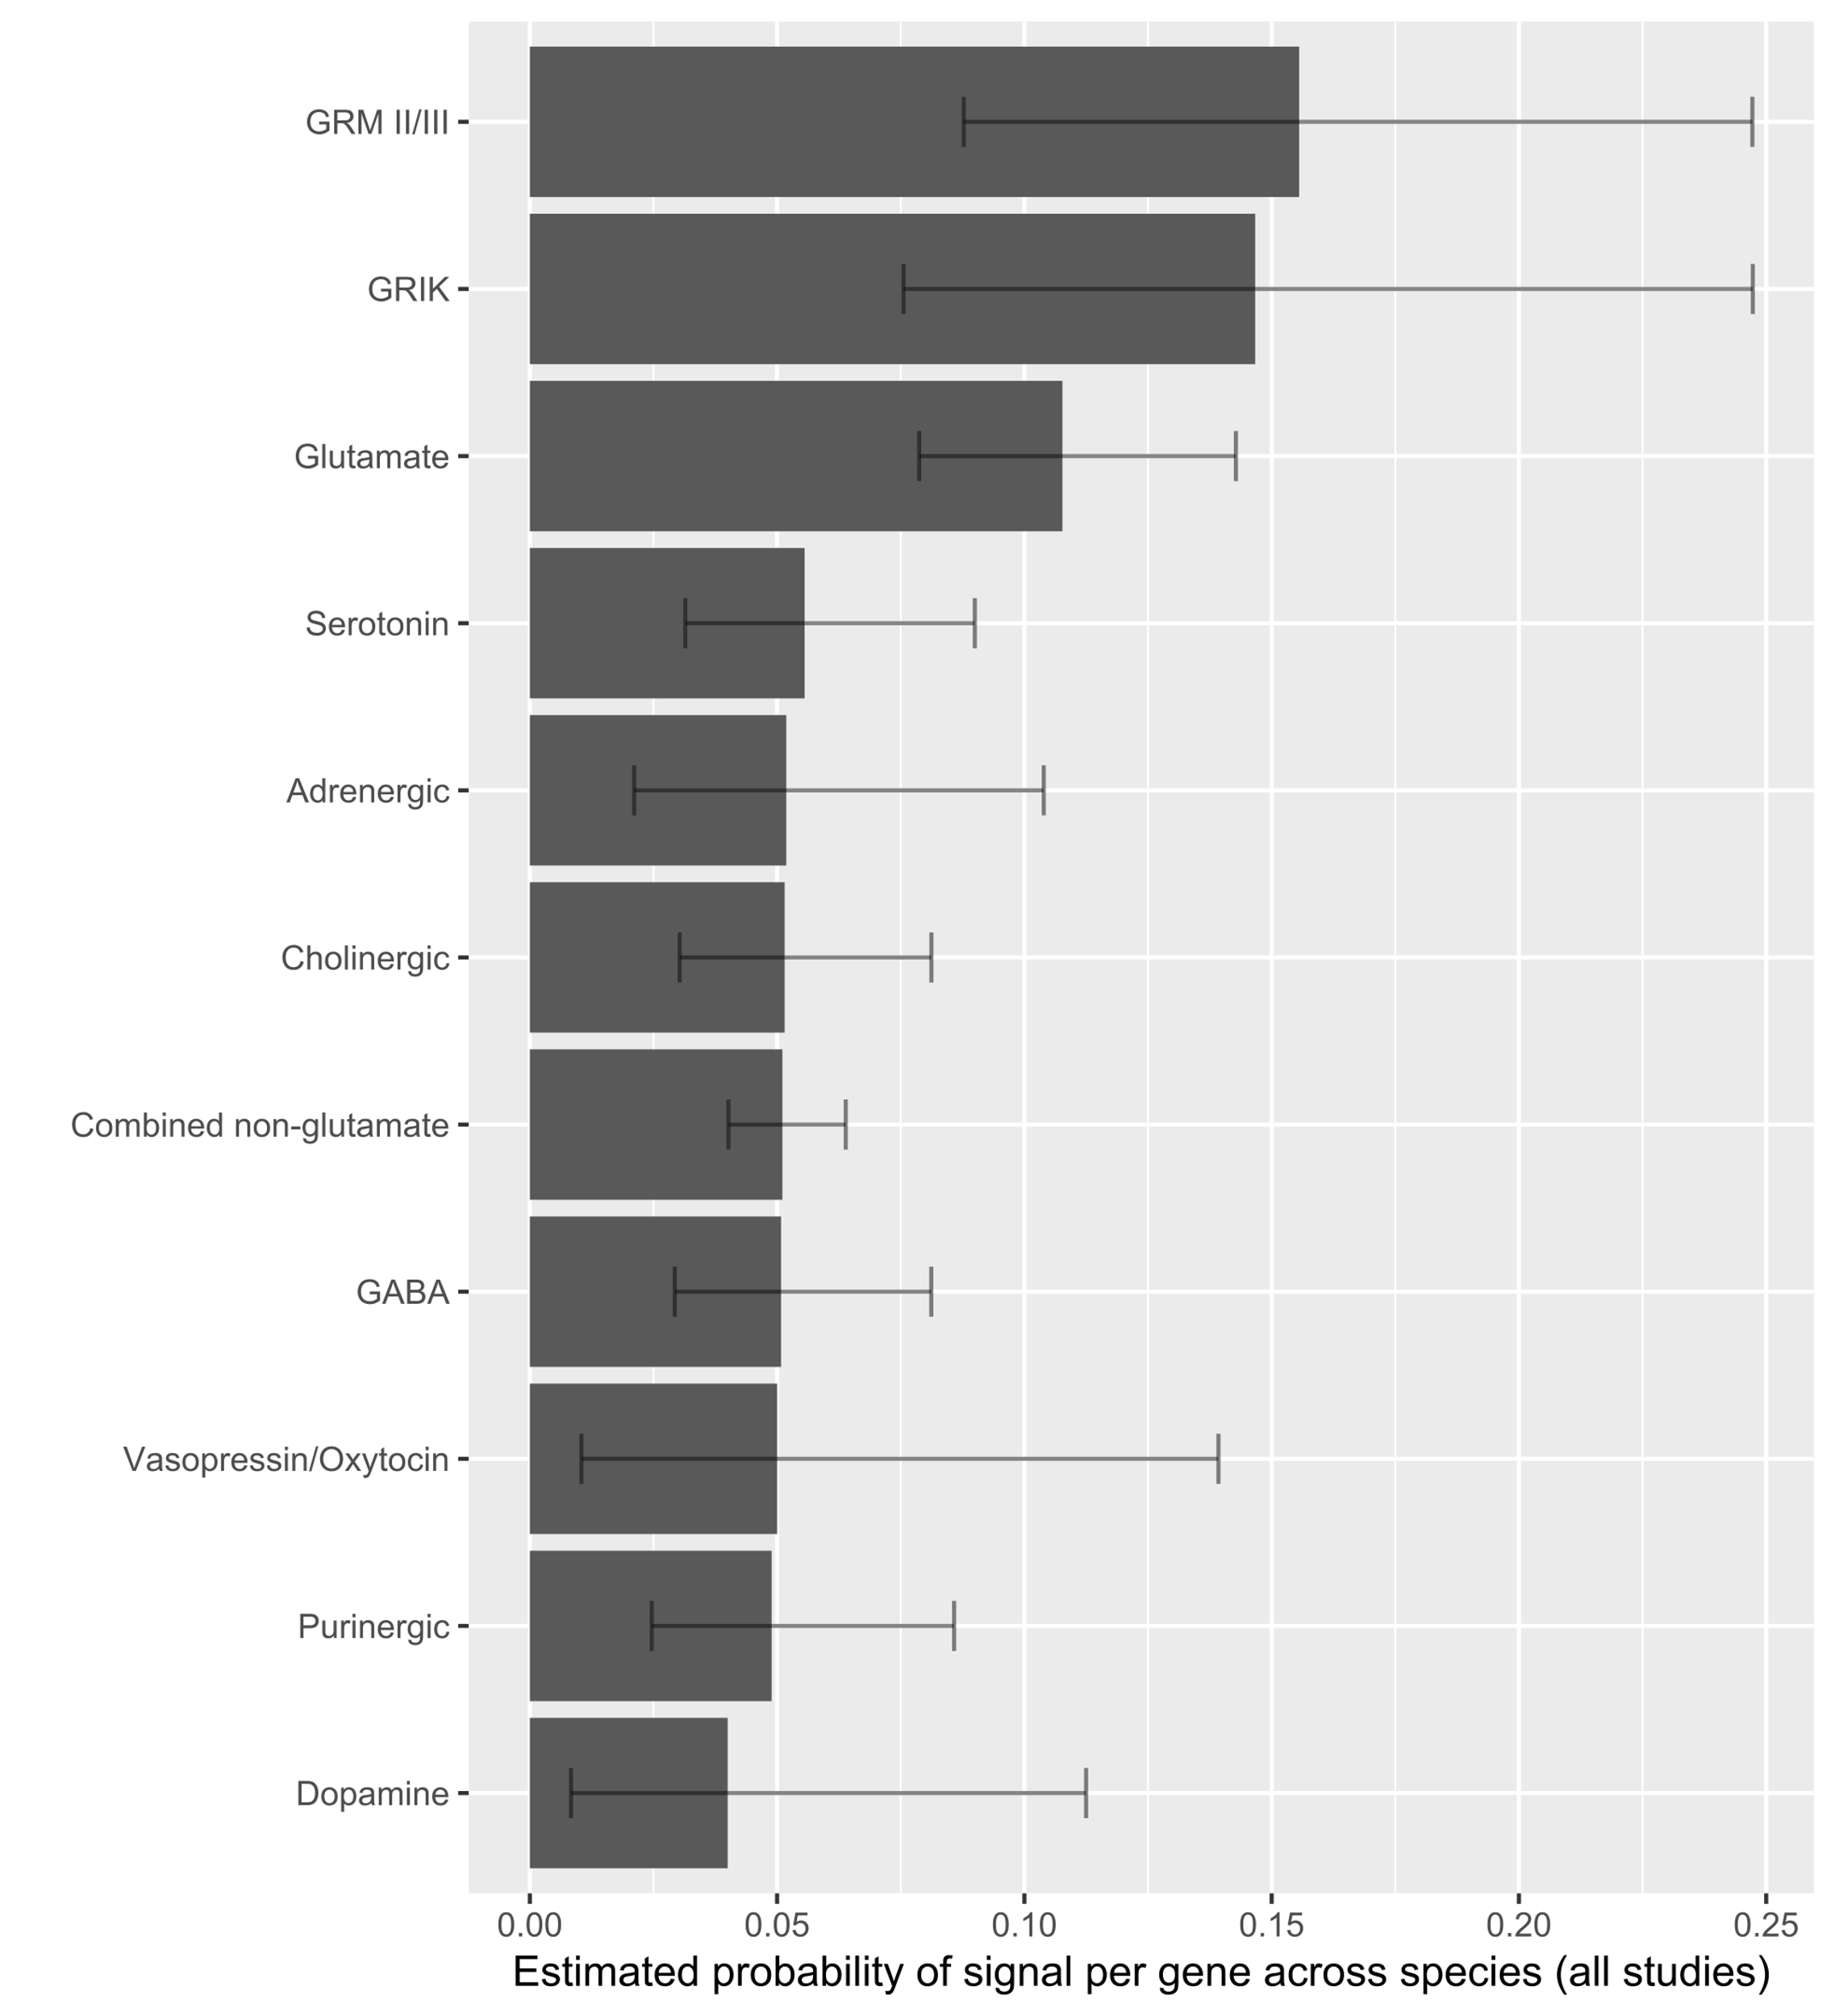
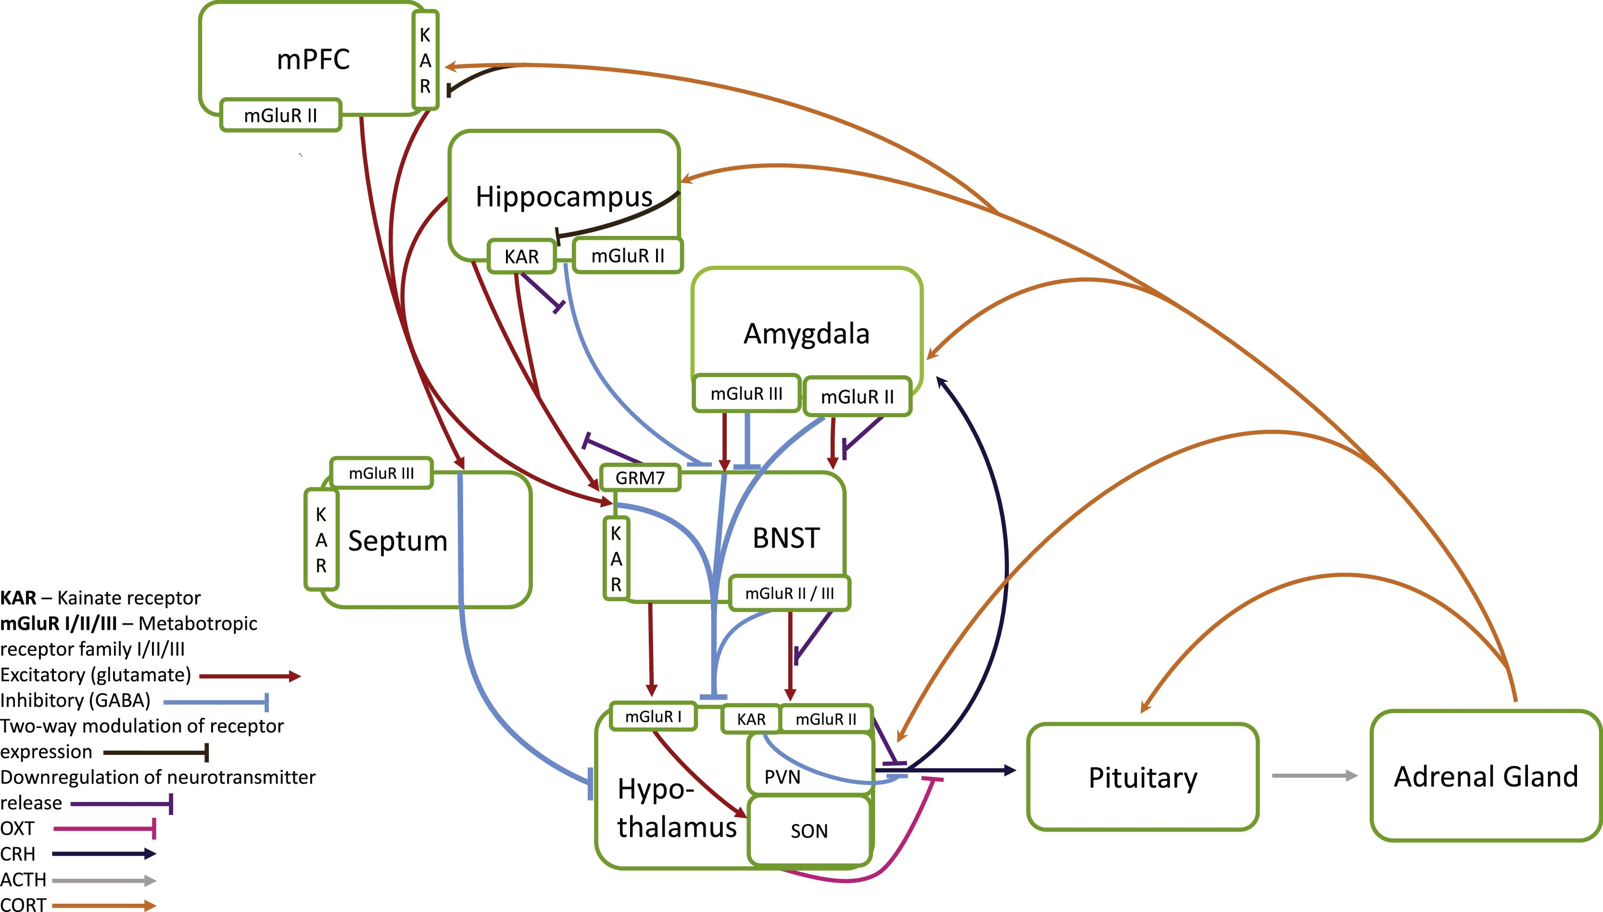
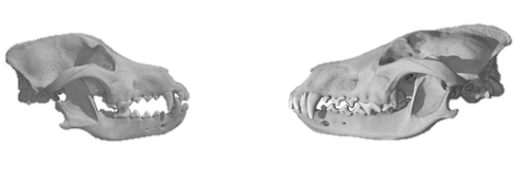
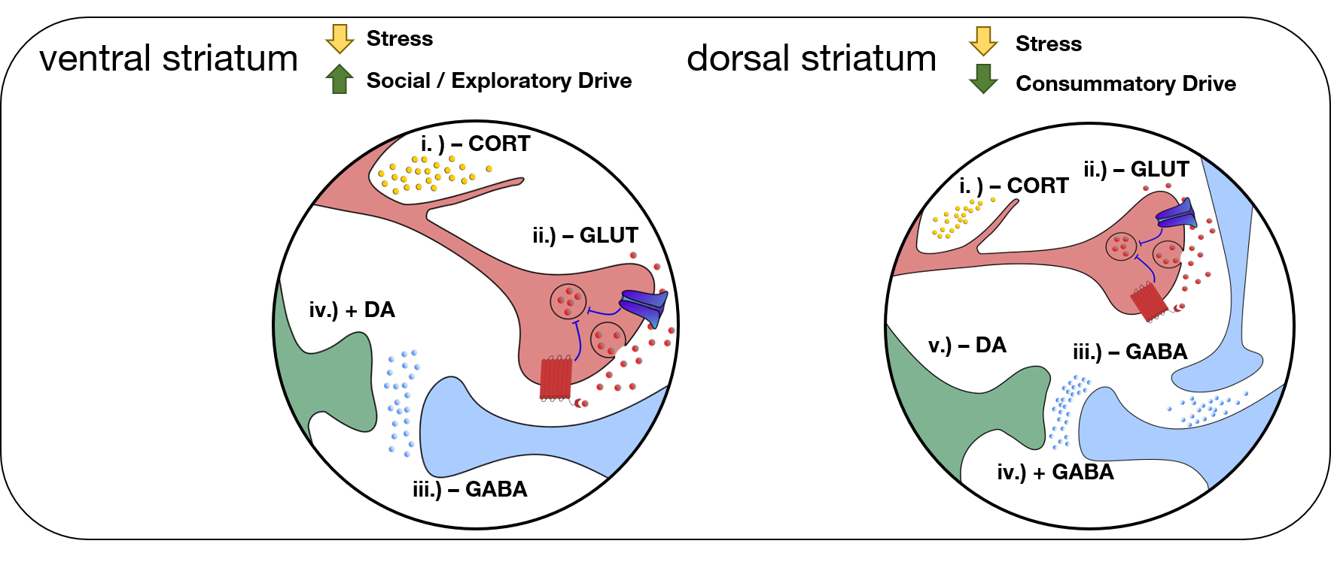
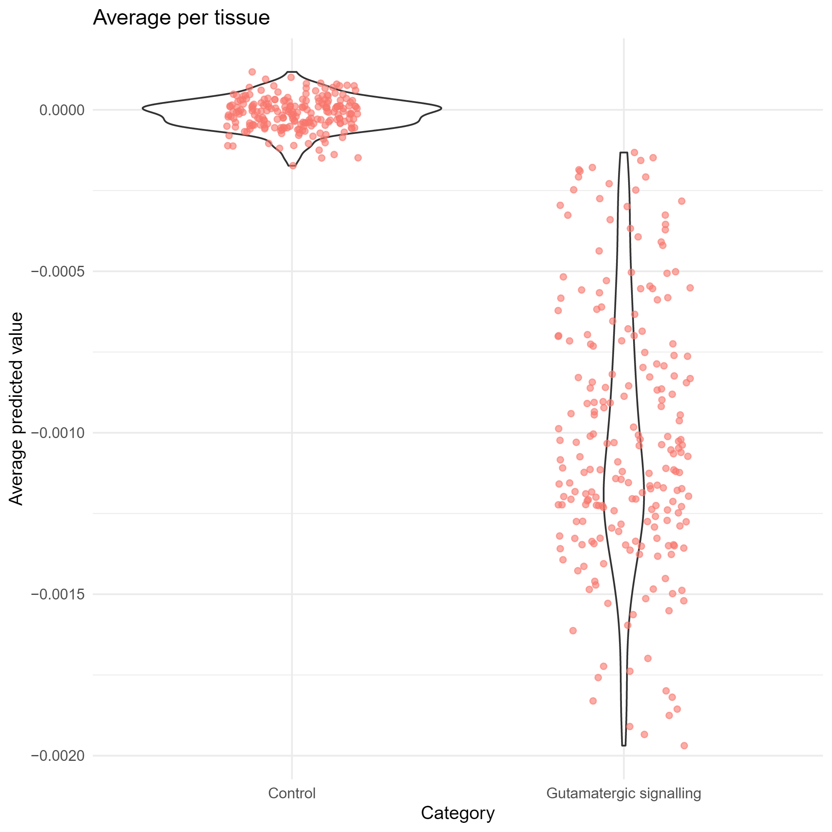
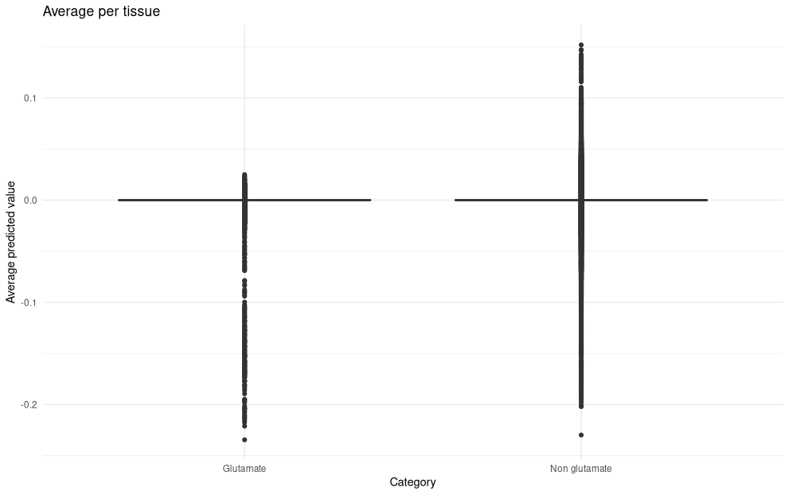
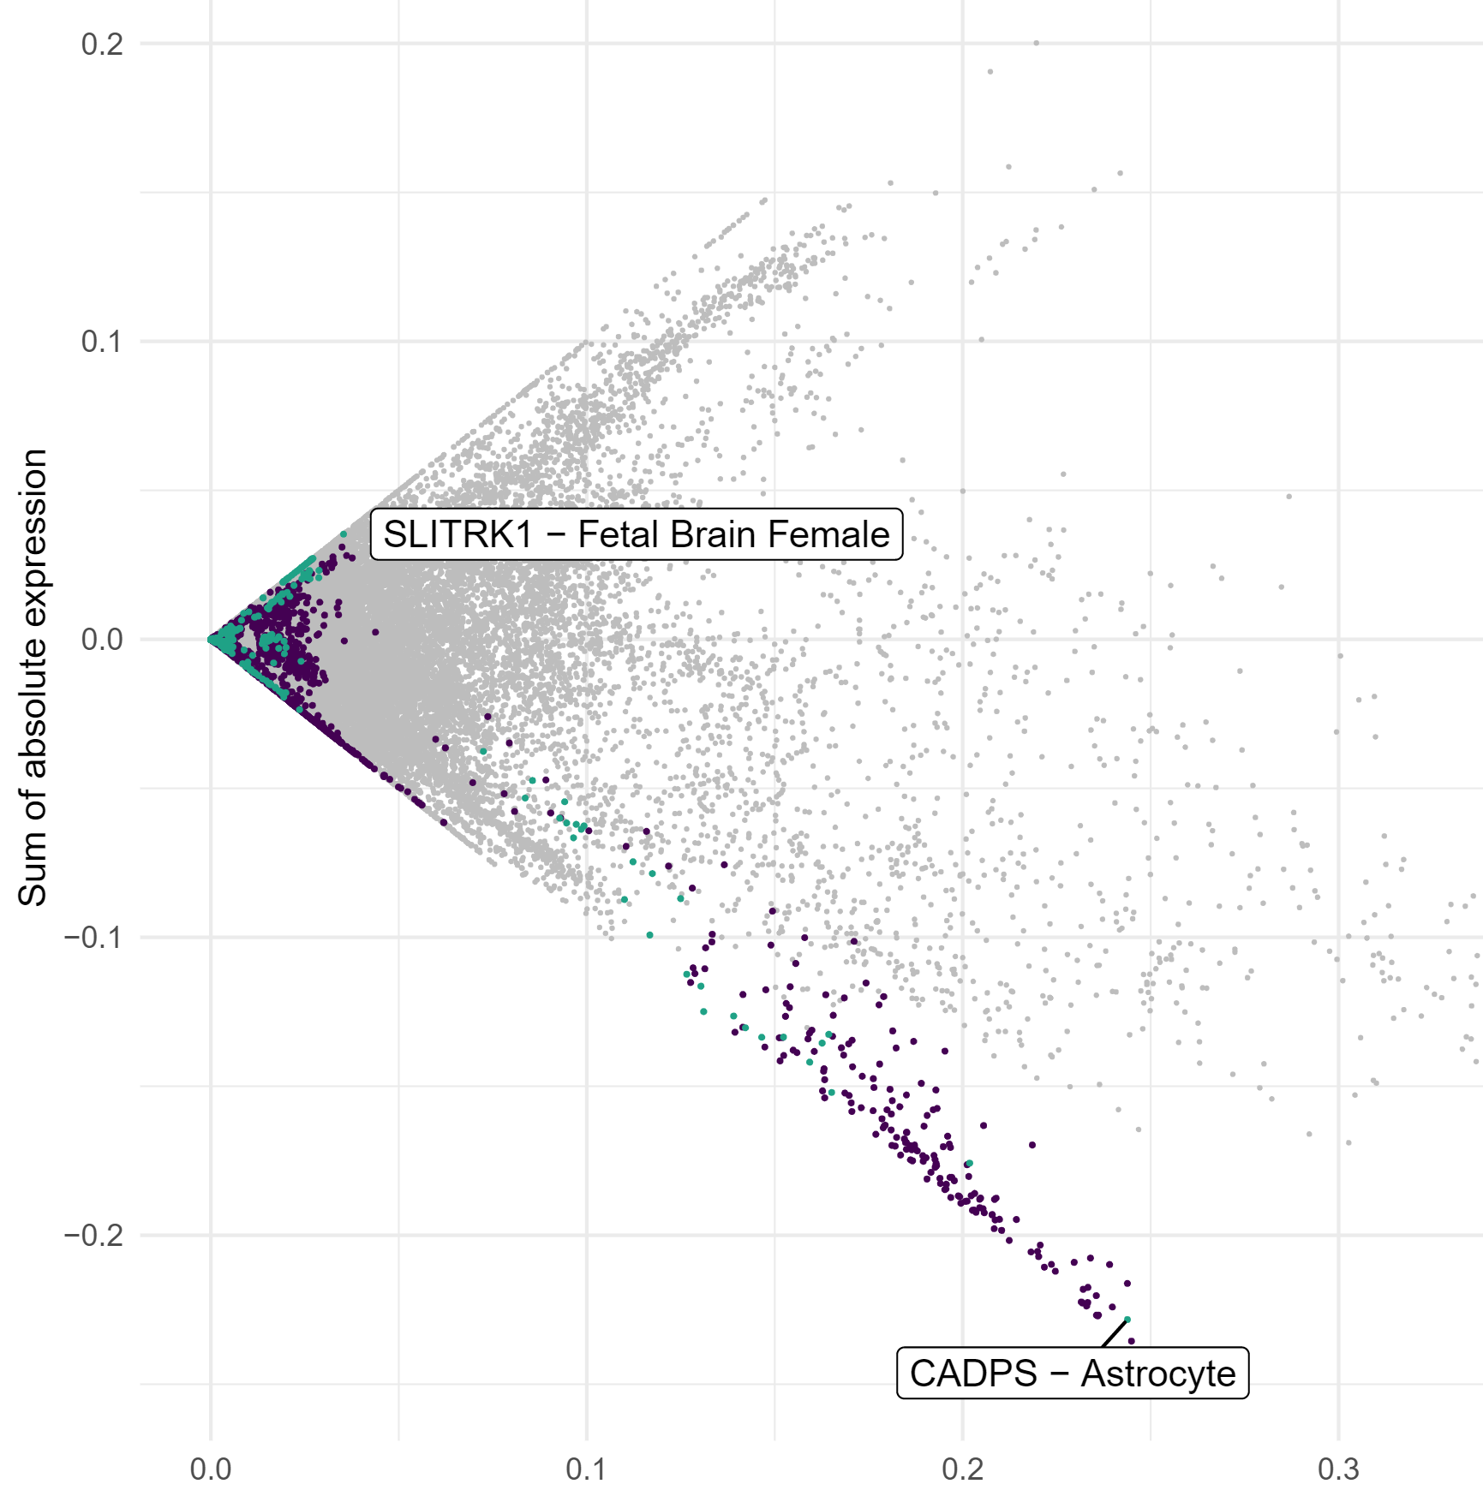
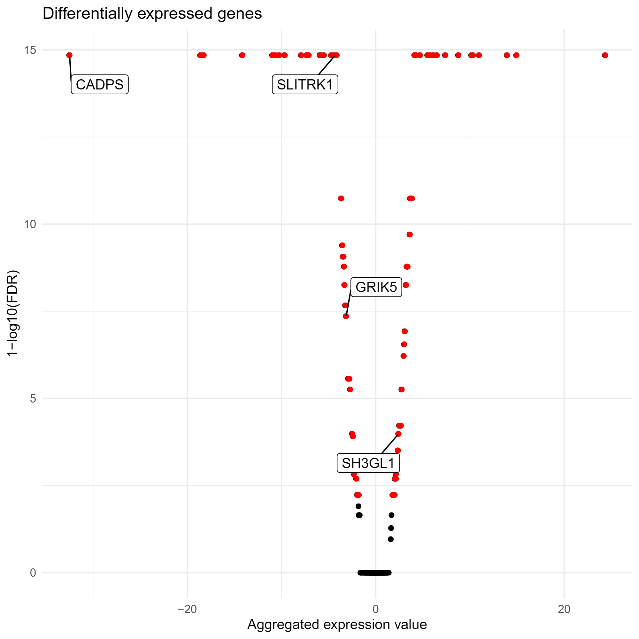
Gene expression under human self-domestication:
an in silico exploration of modern human high-frequency variants
Thomas O’Rourke¹✉, Pedro Tiago Martins^{1,2}, Alejandro Andirkó¹*
¹University of Barcelona, ²University of Ljubljana ✉ tomo.orourke@gmail.com
GitHub repo
Convergent human-domesticate evolution
Hypothesis
Downregulated glutamatergic synaptic activity as a result of positive selection in modern humans
Methods
Using ExPecto, we explored predicted expression resulting from high-frequency/fixed variants identified by Peyrègne et al. 2017
We generated ≈ 1 million predicted transcriptional reads across 218 human tissues
We compared genes enriched at the Glutamatergic Synapse (GO category 0098978) with other genes targeted in recent human evolution
a
b
c
d
Homo sapiens
Homo neanderthalensis
O’Rourke & Boeckx 2020, Neurosci. Biobehav. Rev.
Canis lupus familiaris
Canis lupus lupus
(adapted from Theofanopoulou et al. 2017, PLoS ONE)
Shared Differences: Craniofacial alterations, attenuated stress signaling, reduced reactive aggression, increased social exploration
O’Rourke & Boeckx 2020 Neurosci. Biobehav. Rev.
O’Rourke et al. 2021 Trends Cogn. Sci.
Results
e
f
g
h
e. Glutamatergic signaling gene variants are significantly downregulated (p < 0.01) compared to non-glutamatergic variants when averaged across tissues (red dots)
f: Range of up- and downregulated expression for individual glutamatergic signaling gene versus non-glutamatergic variants. Horizontal lines at zero denote no change in expression
g. Tendency towards downregulation of glutamatergic signaling genes across all tissues (purple) and in brain tissues (blue) versus other genes (grey)
h. Significantly differentially expressed genes (red, FDR < 0.01), including glutamatergic signaling genes (named). Genes left of the zero are downregulated

