Slide 1


ANALYSIS AND PREDICTION OF WEATHER PATTERNS USING SATELLITE OBSERVATIONS AND MACHINE LEARNING MODELS
SUBJECT NAME: PROJECT STAGE-II SEMESTER-8TH COURSE CODE :EC881 SESSION-2025-26
DEPARTMENT: ECE
YEAR: 4TH YEAR GROUP: 3
Under the Guidance of
Dr. Tuhina Halder
NAME CLASS ROLL UNIV ROLL NO
AGNIK GHOSH 29 12200322044
ABHRANIL CHAKRABORTY 09 12200322025
SANTANU MONDAL 37 12200322013
CRASIVA CHAUDHURY 16 12200322050

Slide 2
Problem Statement
Problem
Opportunity
Solution
High-end NWP models are computationally expensive and fail to capture localized monsoon volatility in Kolkata
Big data and advanced machine learning offer modern alternatives to capture intricate, non-linear atmospheric patterns.
We leverage NASA’s MERRA-2 and GPM satellite observations paired with a two-stage Gradient Boosting pipeline
Objectives
Analyse Local Weather Data
Dual-Stage GBM Architecture for predicating weather pattern
Feature Pipeline Engineering

Slide 3
Literature Review
Ref No. | Year | Authors | Paper | Research | Gaps
[1] | 2024 | D. Sharma, P. Rattan | Rainfall Prediction using Random Forest and XGBoost-A comparative study | Compared Random Forest (RF) and XGBoost using a 10-year NASA dataset (2012–2022) for the Jammu Region. RF performed slightly better on test data with a lower RMSE (3.799). | Significant overfitting noted (large gap between training and validation error).

Slide 4
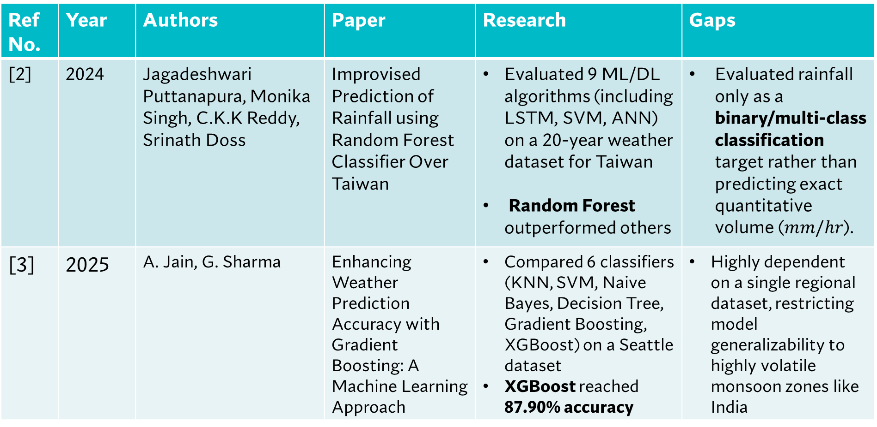
Ref No. | Year | Authors | Paper | Research | Gaps
[2] | 2024 | Jagadeshwari Puttanapura, Monika Singh, C.K.K Reddy, Srinath Doss | Improvised Prediction of Rainfall using Random Forest Classifier Over Taiwan | Evaluated 9 ML/DL algorithms (including LSTM, SVM, ANN) on a 20-year weather dataset for Taiwan Random Forest outperformed others | Evaluated rainfall only as a binary/multi-class classification target rather than predicting exact quantitative volume ($mm/hr$).
[3] | 2025 | A. Jain, G. Sharma | Enhancing Weather Prediction Accuracy with Gradient Boosting: A Machine Learning Approach | Compared 6 classifiers (KNN, SVM, Naive Bayes, Decision Tree, Gradient Boosting, XGBoost) on a Seattle dataset XGBoost reached 87.90% accuracy | Highly dependent on a single regional dataset, restricting model generalizability to highly volatile monsoon zones like India

Slide 5
Ref No. | Year | Authors | Paper | Research | Gaps
[4] | 2025 | P. Sahu, S. Kumar, R. K. Yadav, et al. | Explainable AI-Powered and Machine Learning Approach for Heavy Rainfall Prediction | Developed a hybrid Voting Classifier Ensemble Used SHAP and LIME for model transparency and feature importance tracking. | Complex ensemble approach requires high computational footprint and lacks real-time sequential multi-step timeline adjustments.
[5] | 2024 | S. P. S. Ibrahim, N. V. Harika, et al | Application of Machine Learning and Data Mining Techniques for Accurate Cloud Burst Prediction | Utilized Fuzzy Association Rule Mining Handled severe class imbalances to achieve a baseline 94% accuracy. | The data mining rules struggle when handling datasets with significantly high spatial or temporal density variances.
Table-1

Slide 6
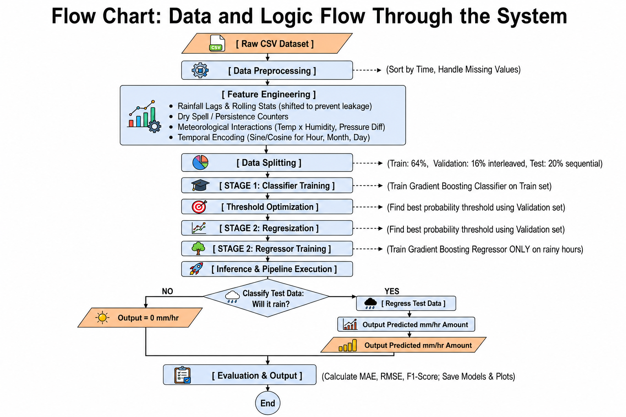
Figure-1

Slide 7
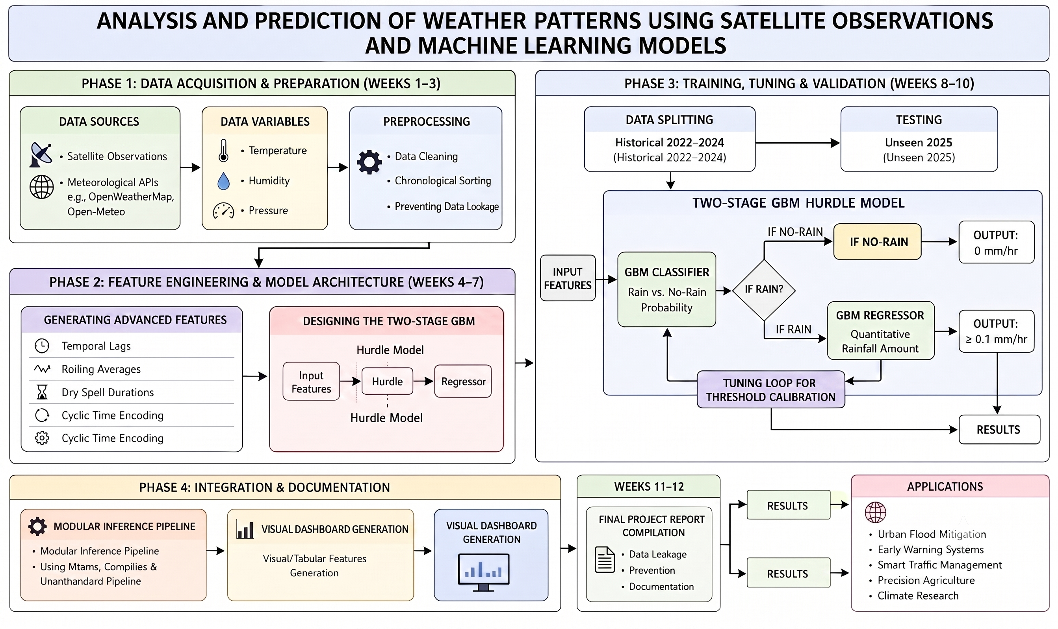
Block Diagram
Figure-2

Slide 8
Hardware & Software Details
Software
Streamlit
Plotly
Scikit-learn & Xgboost
Earthacess & Xarray
Joblib & Request
Numpy & Pandas
HARDWARE
NodeMCU ESP 8266
GY –SHT30-D Sensor
Output ML files
Trained Classification Model
Trained Regression Model
Metadata and optimized threshold values

Slide 9
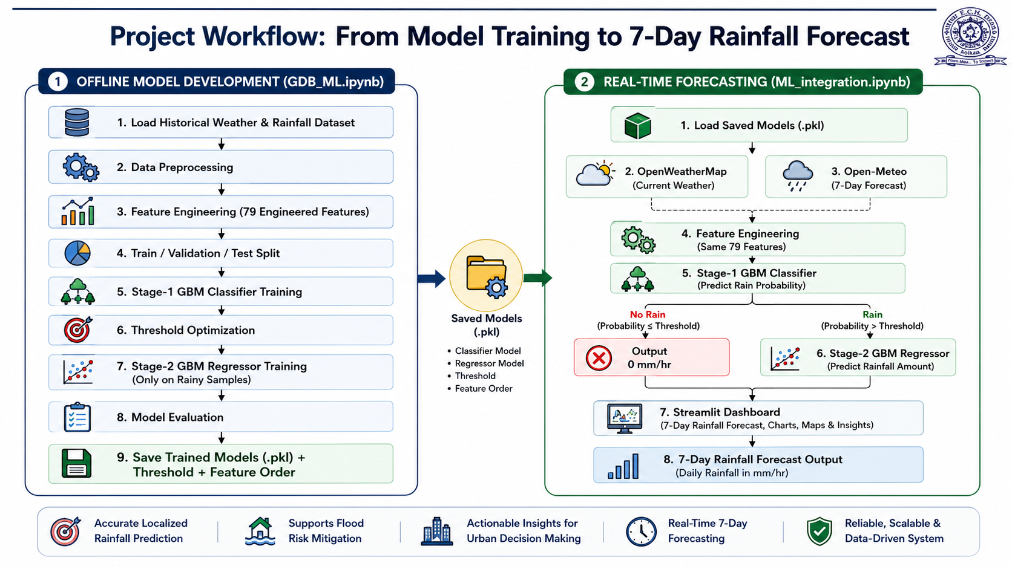
Explanation of the project

Slide 10
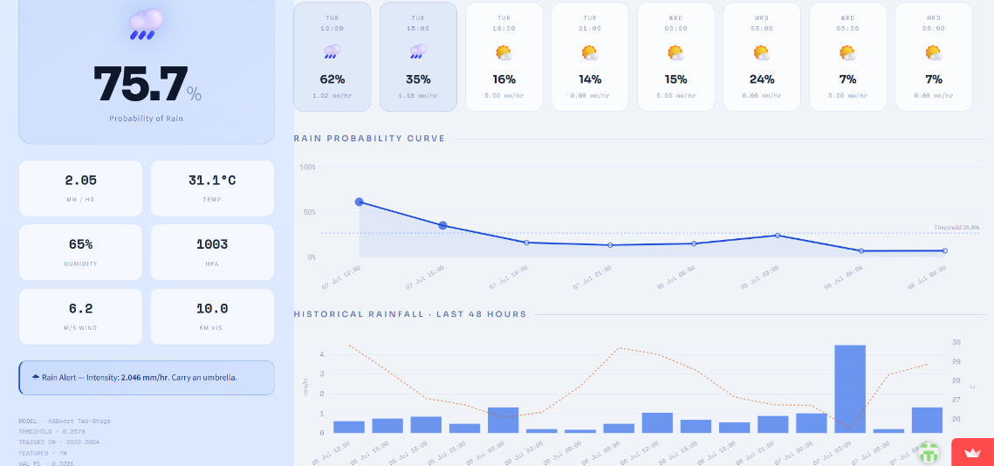
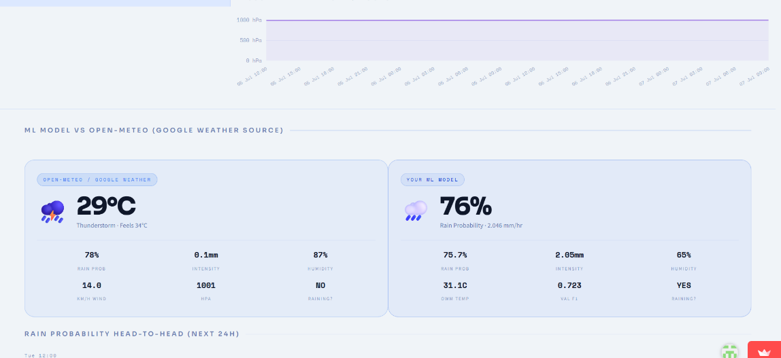
Pictures of the Prototype Model
Figure-3 Web Dashboard
Figure-4 ML-Model Vs Open Meteo

Slide 11
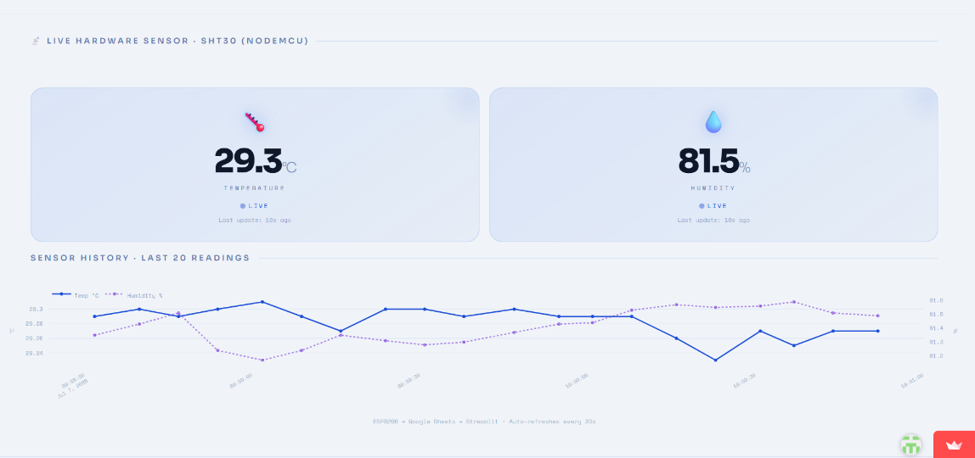
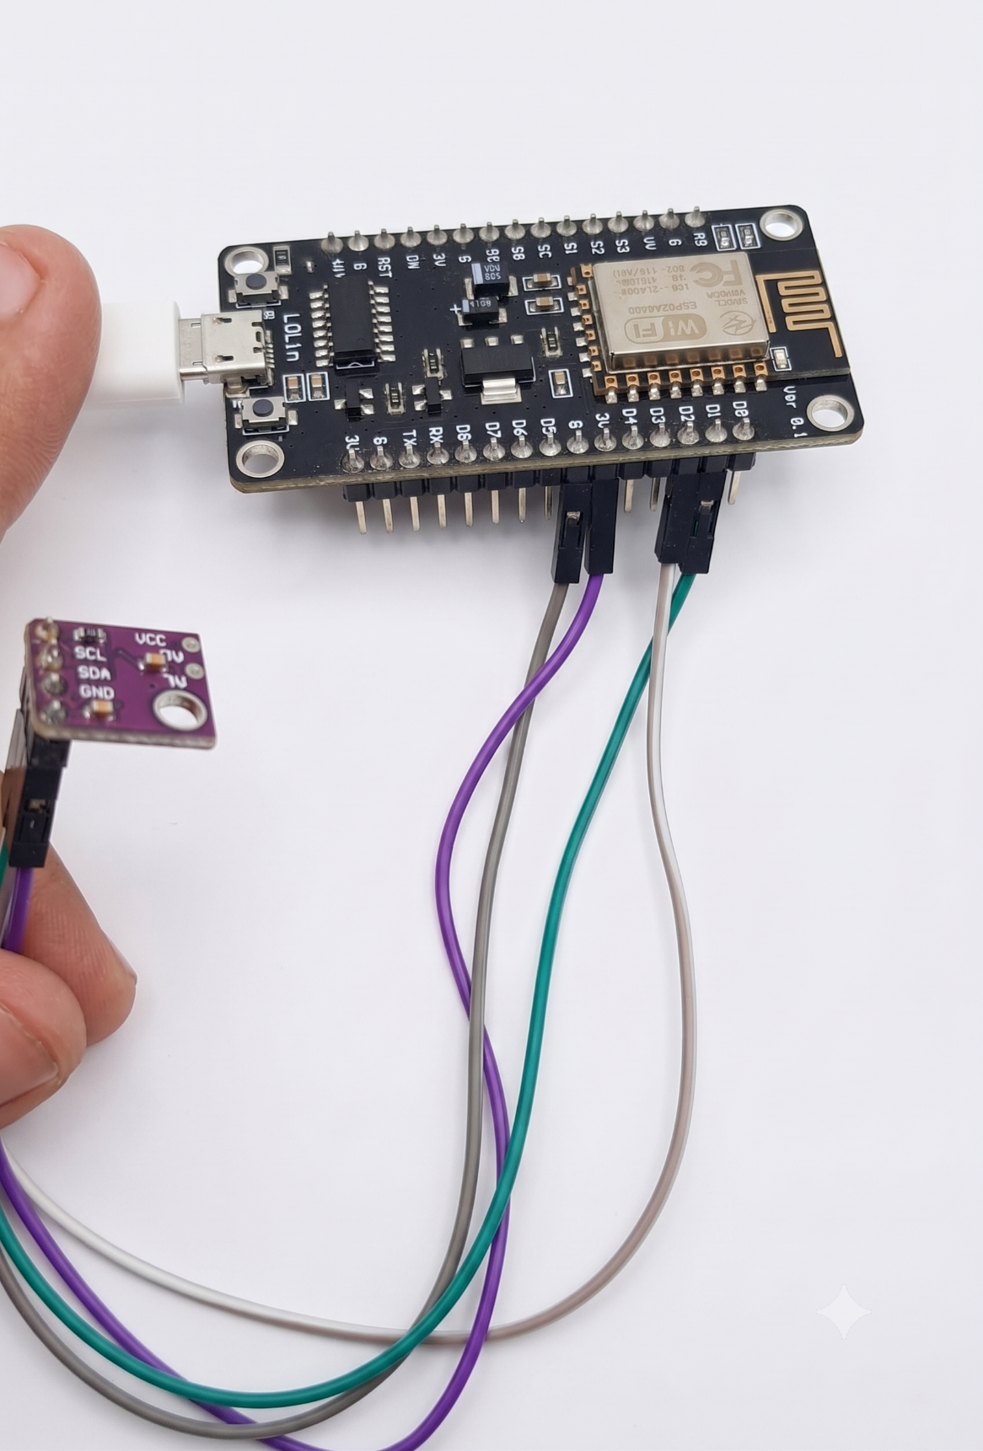
Figure-5 Hardware Sensor Reading
Figure-6 Hardware (ESP8266 &SHT30)

Slide 12
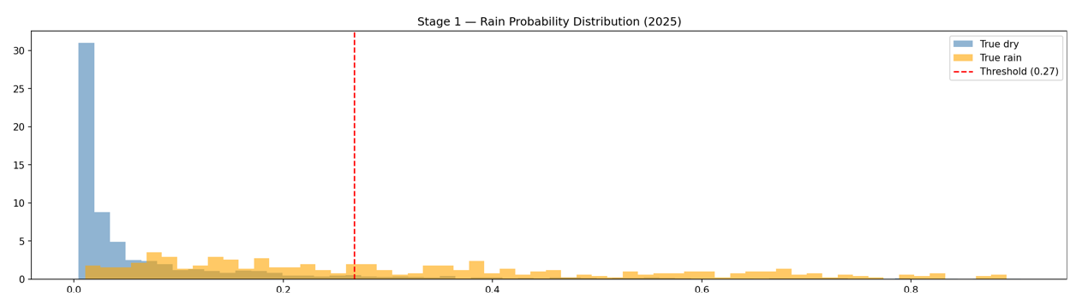
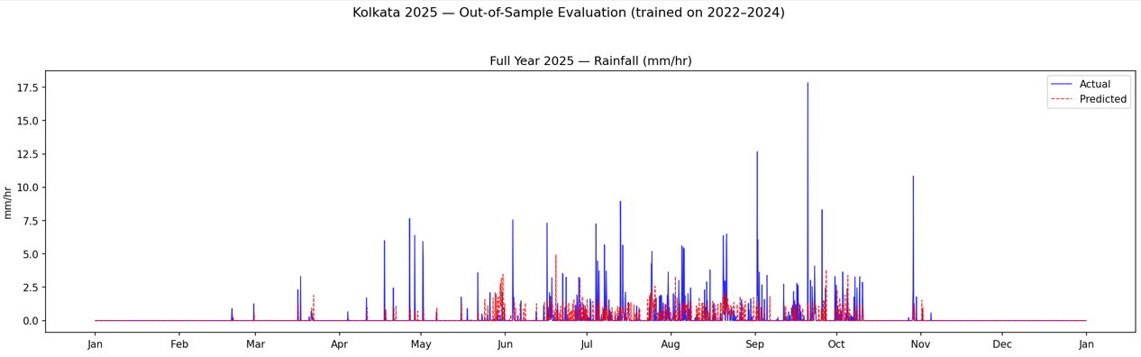
Experimental Result
Figure-7 Stage 1 Classifier Probability Threshold
Figure-8 Full ML predication of 2025 Unseen Test data

Slide 13
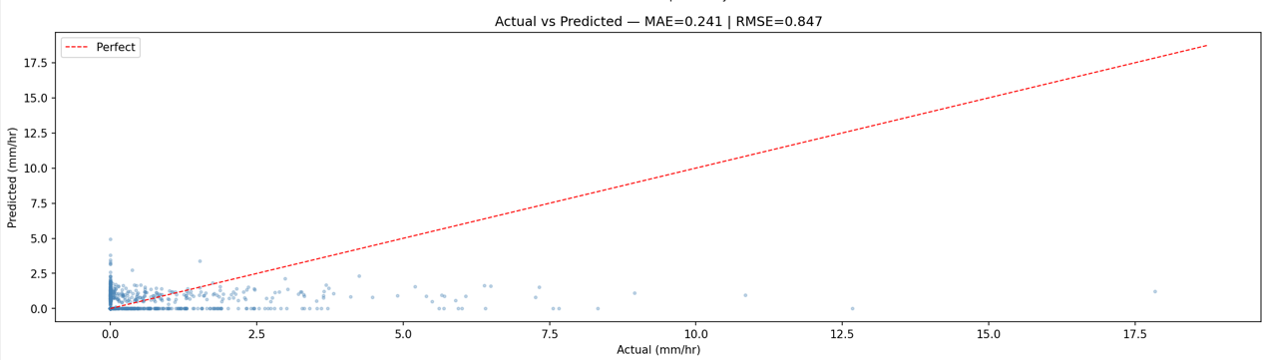
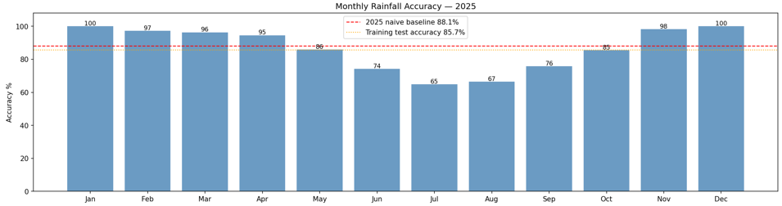
Figure-9 Actual Vs Predicated Scatter Plot
Figure-10 Monthly Accuracy Histogram

Slide 14
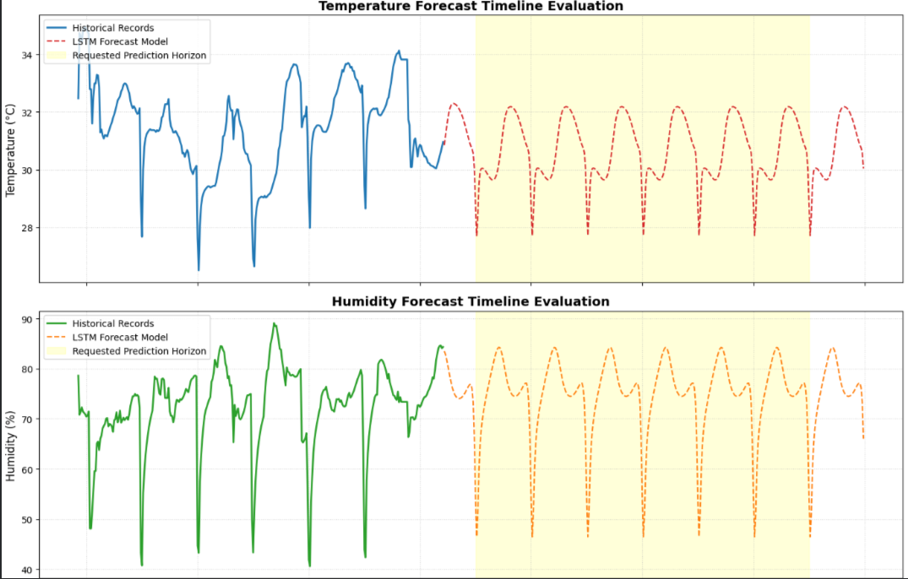
Figure-11 Hardware Statistical Performances

Slide 15
Analysis & Discussion of the results
ML MODEL STATS (predicting Rainfall intensity)
CATEGORY | EVALUATION METRIC | RESULT
Error Rates | MAE | 0.4170 mm/hr
 | RMSE | 1.2902 mm/hr
Accuracy | Accuracy | 81.58%
 | F1- Score | 0.716
Mean | Actual | 4.68 mm/hr
 | Predicted | 0.93 mm/hr
CATEGORY | EVALUATION METRIC | RESULT
Error Rates | MAE | 0.2388 mm/hr
 | RMSE | 0.8426 mm/hr
Accuracy | Accuracy | 86.54%
 | F1-Score | 0.696
Mean | Actual | 4.20 mm/hr
 | Predicted | 0.68 mm/hr
Table-2 Training Data Stats for the (GBM) ML Model
Table-3 Testing Stats of the (GBM) trained model

Slide 16
ML MODEL STATS (predicting Temperature and Humidity)
CATEGORY | EVALUATION METRIC | RESULT
Temperature | RMSE | 0.8395 °C
Humidity | RMSE | 8.8386 %
Table-4 Testing Data stats for the LSTM ML model

Slide 17
Deep Learning for Sequential Extraction: Future research must focus on optimizing advanced Deep Learning (DL) architectures, like Long Short-Term Memory (LSTM) networks or Temporal Convolutional Networks (TCNs
Hyper-Local Nowcasting: Leveraging real-time data from IoT weather sensors deployed across different municipal zones in Kolkata to develop hyper-local, real-time nowcasting (0-3 hours) for rainfall.
Extreme Event Extrapolation: Future work will focus on integrating Extreme Value Theory (EVT) to ensure the model remains robust during severe climatic anomalies.
Future Scope

Slide 18
Cost of the prototype
Category | Description | Estimated Cost
Data Acquisition | Utilization of Open-Meteo & OpenWeatherMap APIs (Free tiers) | ₹0
Software & Tools | Python, Scikit-learn, Pandas, Matplotlib (Open Source) | ₹0
Compute Resources | Local Workstation usage | ₹0
Hardware | Sensor Microconcontroller wire etc | ₹400 ~ ₹600
Misc | Printing, binding, and incidental research costs | Minimal
Total |  | ₹700-₹800 (approx.)
Table-5 Finance

Slide 19
Conclusion
Dual-stage Gradient Boosting Machine (GBM) architecture—utilizing a classifier to predict rain probability and a regressor for precipitation volume—effectively overcomes the overwhelming statistical bias of "no rain" hours.
Pairing wide-area remote sensing data from NASA’s MERRA-2 and GPM instruments with a cascading machine learning ensemble optimizes tropical weather forecasting.
Delivers accurate, localized downpour forecasts to support flood resilience, water resource management, traffic planning, and early disaster risk reduction in Kolkata

Slide 20
References
[1]Deepa Sharma and Punam Rattan, "Rainfall Prediction using Random Forest and XGBoost – A Comparative Study," Proceedings of the 5th International Conference on Data Intelligence and Cognitive Informatics (ICDICI), IEEE, 2024, doi: 10.1109/ICDICI62993.2024.10810907.
[2]Jagadeshwari Puttanapura, Monika Singh T., C. Kishor Kumar Reddy, and Srinath Doss, "Improvised Prediction of Rainfall using Random Forest Classifier Over Taiwan," Proceedings of the 4th International Conference on Soft Computing for Security Applications (ICSCSA), IEEE, 2024, doi: 10.1109/ICSCSA64454.2024.00031.
[3]Abhinav Jain and Gargi Sharma, "Enhancing Weather Prediction Accuracy with Gradient Boosting: A Machine Learning Approach," Proceedings of the 2nd International Conference on Computational Intelligence, Communication Technology and Networking (CICTN), IEEE, 2025, doi: 10.1109/CICTN64563.2025.10932431.
[4]Premananda Sahu, Rakesh Kumar Yadav, Lalita Kumari, Sunil Kumar, and Prakash Srivastava, "Explainable AI-Powered and Machine Learning Approach for Heavy Rainfall Prediction," Proceedings of the 12th International Conference on Reliability, Infocom Technologies and Optimization (ICRITO), IEEE, 2025, doi: 10.1109/ICRITO66076.2025.11241873.
[5]S. P. Siddique Ibrahim, N. Venkata Harika, N. Mohitha Reddy, K. Srija, P. Shiva Sahithi, and A. Kohima, "Application of Machine Learning and Data Mining Techniques for Accurate Cloud Burst Prediction," Proceedings of the International Conference on IoT Based Control Networks and Intelligent Systems (ICICNIS), IEEE, 2024, doi: 10.1109/ICICNIS64247.2024.10823388.

Slide 21
References
[6] I. Salehin, I. M. Talha, M. Mehedi Hasan, S. T. Dip, M. Saifuzzaman and N. N. Moon, “An Artificial Intelligence Based Rainfall Prediction Using LSTM and Neural Network,” 2020 IEEE International Women in Engineering (WIE) Conference on Electrical and Computer Engineering (WIECON-ECE), Bhubaneswar, India, 2020.
[7] Priya A Nandini, Bhargavi Meenavalli, Adarsha Puttamreddy, Jatoth Meghana,Nilima Kataria, Lalita Gupta “Prediction of Rainfall using Random Forest”,2022 IEEE International Students' Conference on Electrical, Electronics and Computer Science (SCEECS),2022
[8] A. Chand and R. Nand, “Rainfall prediction using Artificial Neural Network in the South Pacific region,” 2019 IEEE Asia-Pacific Conference on Computer Science and Data Engineering (CSDE), Melbourne, VIC, Australia, 2019.
[9] M. Patel and A. Shah, “Feature Importance in Machine Learning with Explainable Artificial Intelligence (XAI) for Rainfall Prediction,” in ITM Web of Conferences, EDP Sciences, vol. 65, p. 03007, 2024.
[10] Zhang, Yushan, Kun Wu, Jinglin Zhang, Feng Zhang, Haixia Xiao, Fuchang Wang, Jianyin Zhou, Yi Song, and Liang Peng, “Estimating Rainfall with Multi-Resource Data over East Asia Based on Machine Learning”, Remote Sensing, 2021.
[11] Yang, Huang., George, P., Petropoulos., Qifeng, Lu., Yanfeng, Huo., Fu, Wang. “Precipitation Estimation Using FY-4B/AGRI Satellite Data Based on Random Forest.” Remote sensing,2024

