Slide 1


Slide 2
INSTITUTION: MBARARA UNIVERSITY OF SCIENCE AND TECHNOLOGY.
FACULTY: COMPUTING AND INFORMATICS.
PROGRAM: BACHELOR OF COMPUTER SCIENCE
COURSE UNIT: DATABASE SYSTEMS.
COURSE CODE: CSC 1204.
PROJECT TITLE: ANIMAL HUSBANDRY DATABASE MANAGEMENT SYSTEM.
STUDENT NAME: AGONDEZE JOSHUA SAMUEL.
REG NO: 2025/BCS/010/PS
STUDENT NO: 2500602927 SUBMISSION DATE: 11/05/2026.
GROUP: 12

Slide 3
Introduction
Animal husbandry involves livestock care and management
Manual systems are inefficient
DBMS improves data handling

Slide 4
Problem Statement
Difficult to track animal records
Data redundancy and inconsistency
Poor decision-making

Slide 5
Objectives
Store livestock data efficiently
Track health and vaccination
Manage production and breeding
Improve reporting

Slide 6
System Overview
Centralized livestock database
Used by farmers and administrators
Includes tracking and monitoring features

Slide 7
Business Case
a. Application Domain
These are the operations supported by the project.
Animal Records Management : Registration of new animals, tracking breed, gender, DOB, and health status.
Shelter Management : Monitoring shelter capacity and animal allocation.
Feed Inventory Control : Recording feed types, stock levels, cost per unit.
Feeding Operations : Logging daily feeding activities per animal, quantity used, and employee responsible.
Manager tasks : Managing employee data for herdsmen.

Slide 8
Database Design
Relational database
Uses MySQL/PostgreSQL
Tables with defined relationships

Slide 9
Entities
Animal
Feed
Employee
Shelter
Animal_feeding

Slide 10
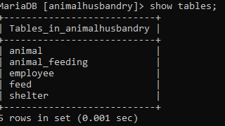

Slide 11
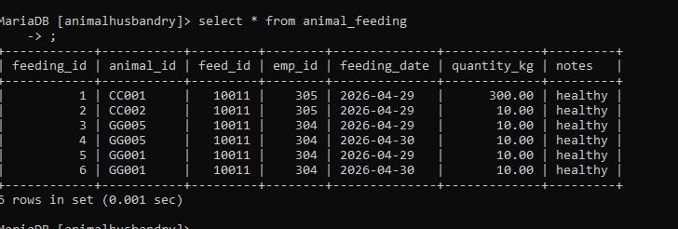

Slide 12
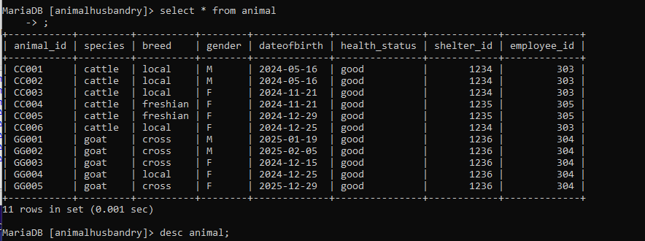

Slide 13
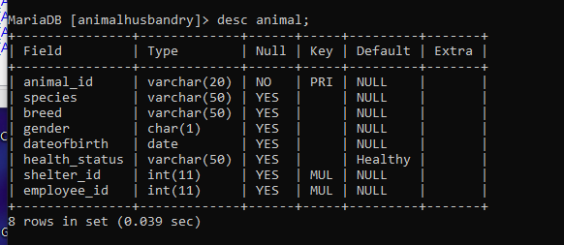

Slide 14
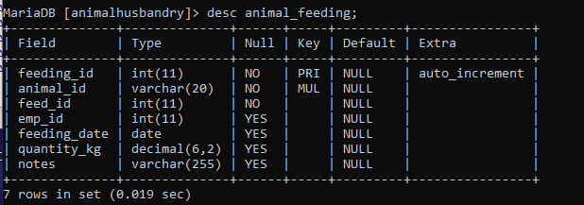

Slide 15
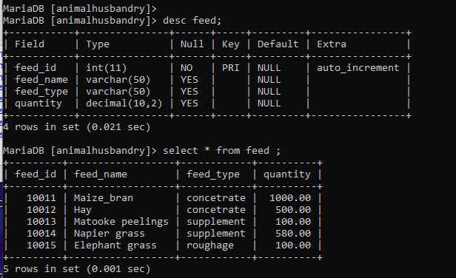

Slide 16
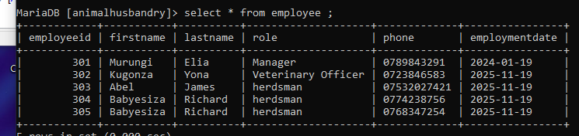

Slide 17
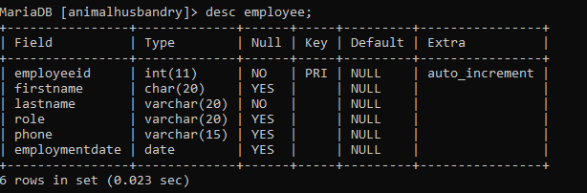

Slide 18
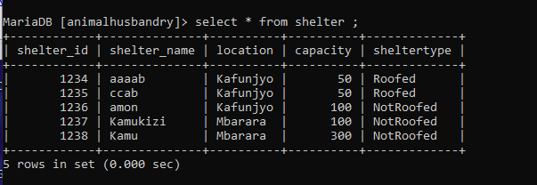

Slide 19
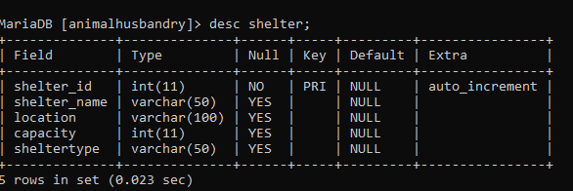

Slide 20
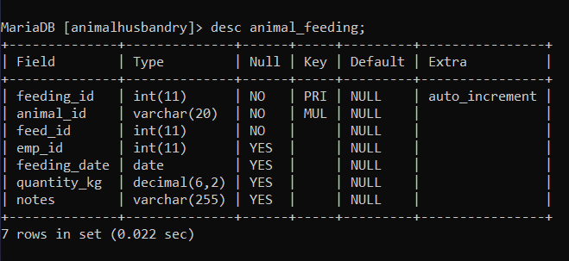

Slide 21
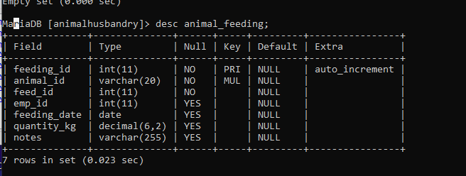

Slide 22
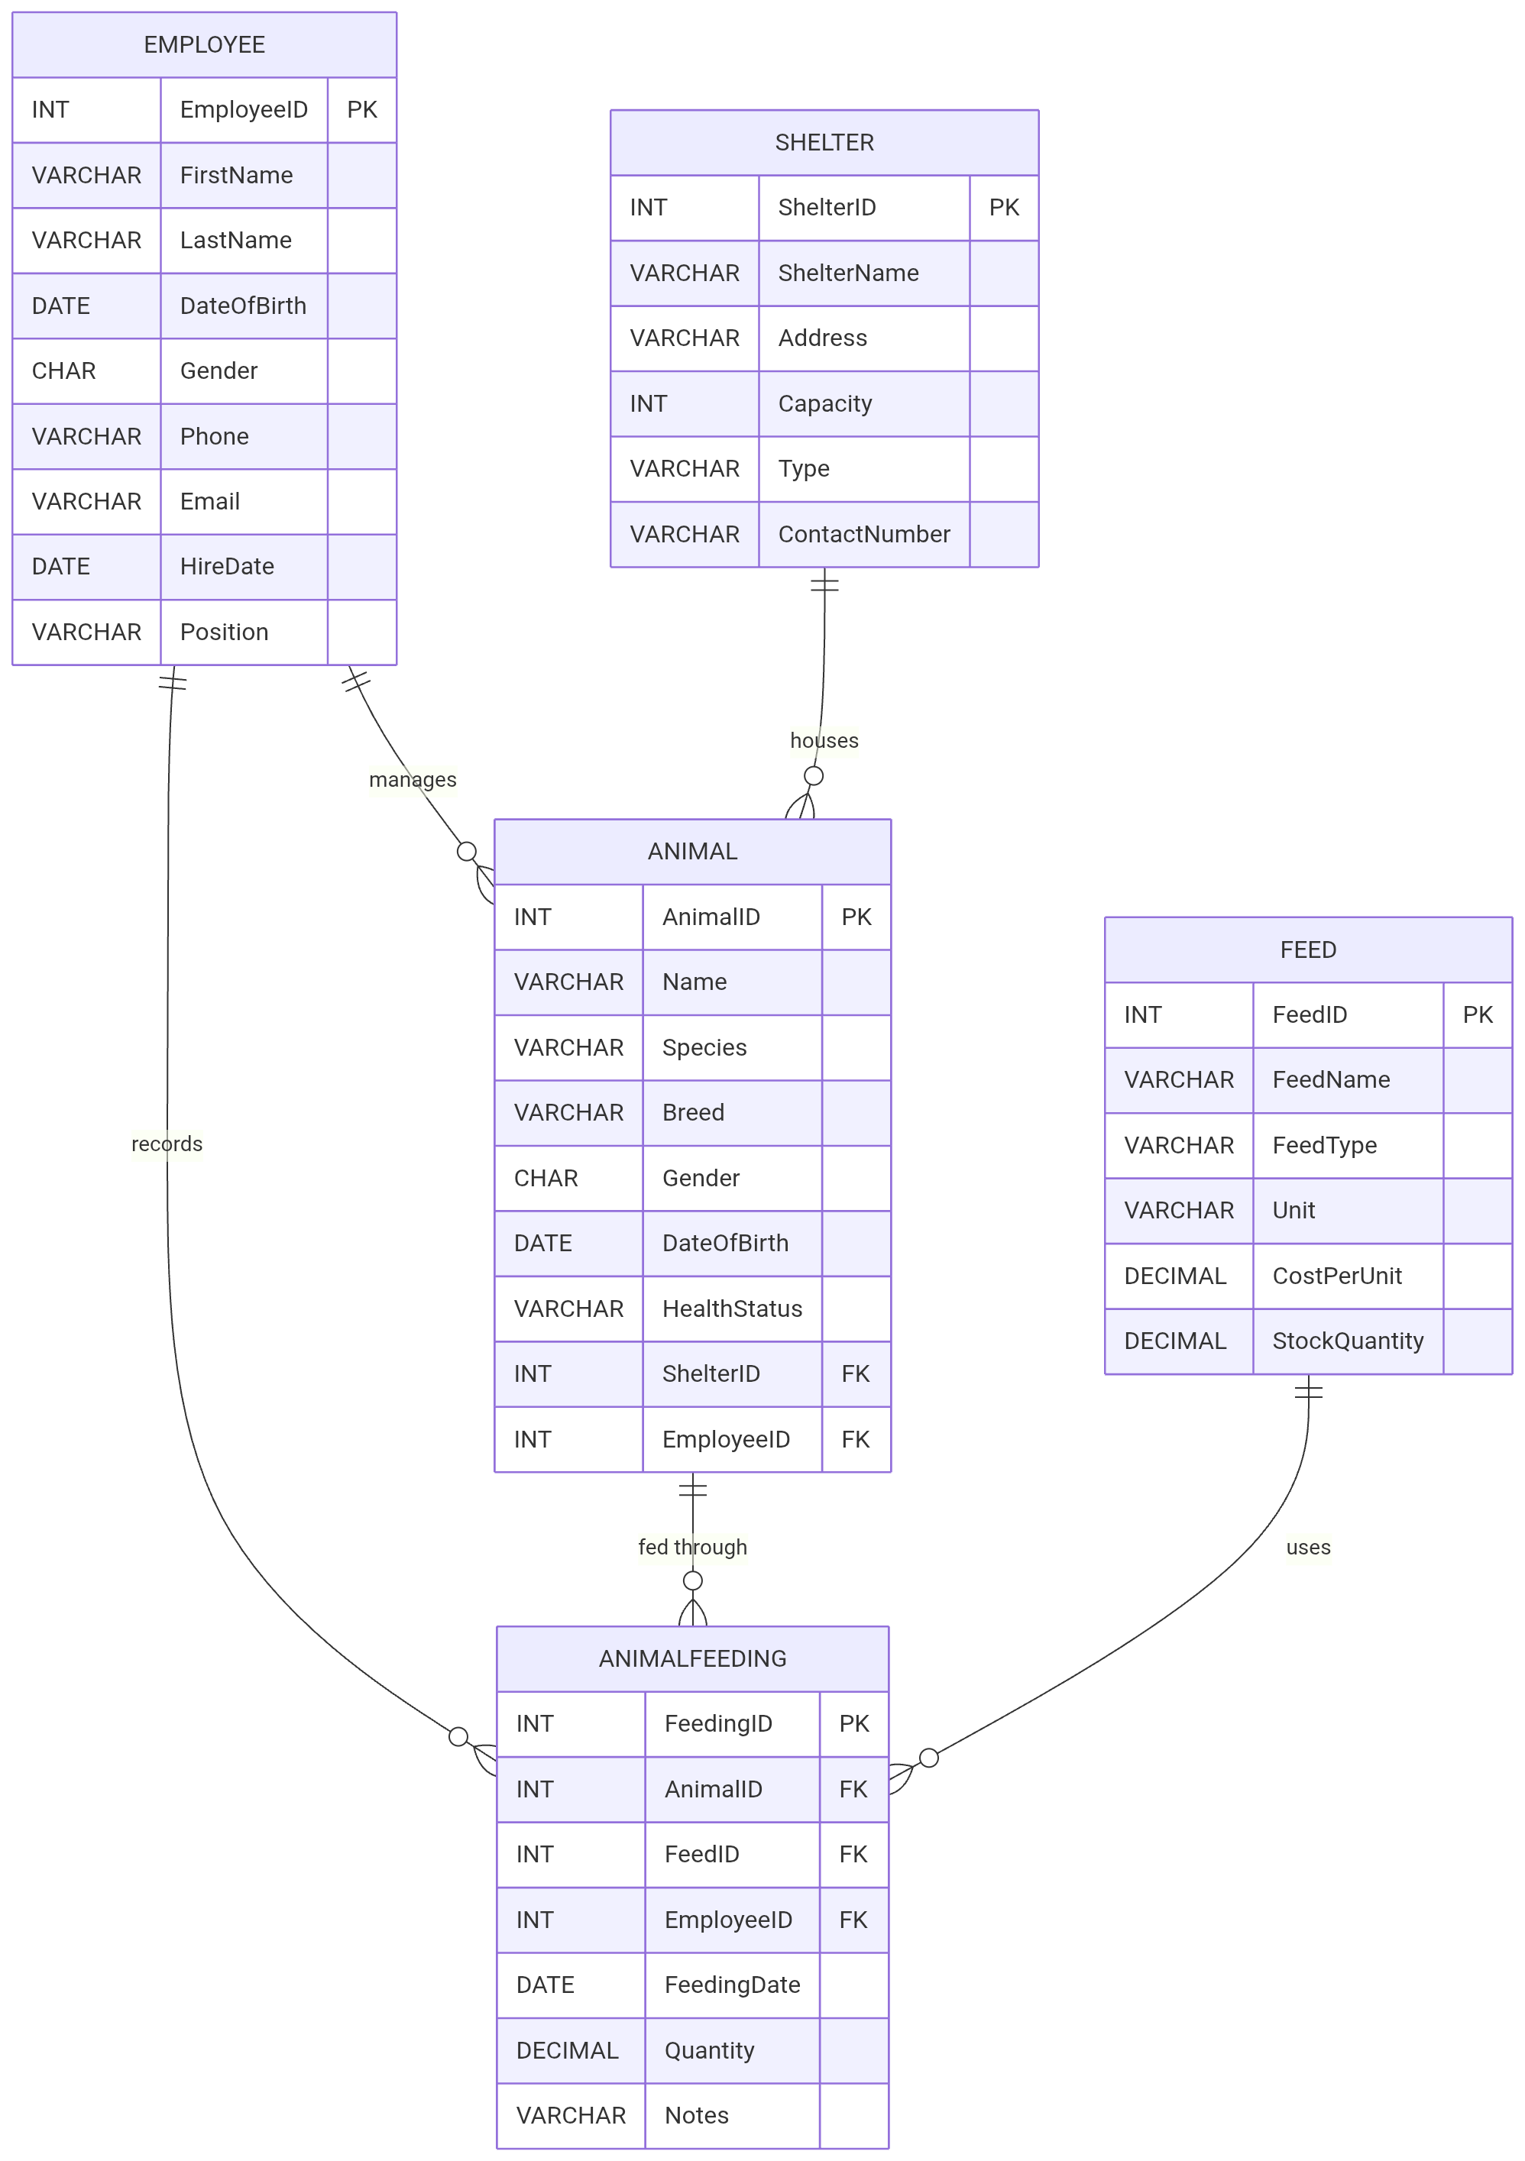
ER Diagram

Slide 23
Tables & Schema
Animal (animal_id, breed, age, farmer_id)
Farmer (farmer_id, name, location)
Health (record_id, animal_id, vaccination, date)
Production (prod_id, animal_id, milk_output)

Slide 24
Normalization
1NF, 2NF, 3NF
Removes redundancy
Improves consistency

Slide 25
Queries & Operations
Insert, Update, Retrieve data
Example:
SELECT * FROM Animal;
SELECT * FROM animalfeeding;

Slide 26
Implementation
Tools: XAMPP, phpMyAdmin
Languages: Java, PHP, Python
Connected to UI

Slide 27
Logical design
Entities and Attributes:
Animal: animal_id, species, breed, gender, dateofbirth, health_status, shelter_id, employee_id.
Feed: feed_id, feed_name, feed_type, quantity.
Employee: employeeid, firstname, lastname, role, phone, employmentdate.
Shelter: shelter_id, shelter_name, location, capacity, sheltertype.
Animal_feeding: feeding_id, animal_id, feed_id, emp_id, feeding_date, quantity_kg, notes.

Slide 28
Limitations
Limited access for non-digital users
There is dependence on user inputs.
Language barrier.
There is biased feedback from the community.
Database design based on the requirements.

Slide 29
Challenges
Designing relationships
Handling large data
Ensuring accuracy

Slide 30
User issues about the system.
There is need for basic computer skills. A phpMyAdmin GUI is used.
There is resistance to change from paper work. A demonstration can be made for a week or a month for them to realize the resources saved.
Users may not mind about auditing

Slide 31
Risks that are involved with the system.
• Data breaching or unauthorized access.
• Incorrect or inaccurate feedback
• Technical failures like maintenance of the machines for example laptops and phones.

Slide 32
Results
Better organization
Faster retrieval
Improved decisions

Slide 33
Conclusion
DBMS improves efficiency
Reduces redundancy
Supports modern farming

Slide 34
Recommendations
Add mobile access
Use IoT sensors
Include financial tracking

Slide 35
References
Books, tutorials, lecture notes

