Slide 1
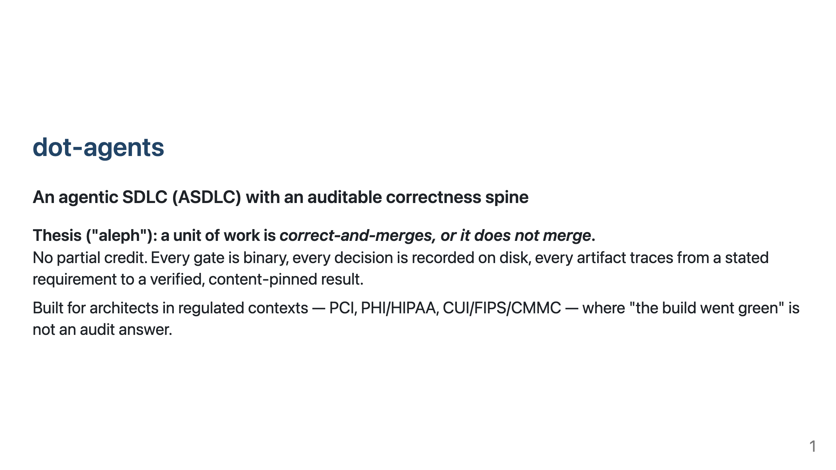
Notes:
Talk track: One CLI (`da`) projects one canonical config to six AI platforms AND runs a bounded, gated, durable workflow over the work agents produce. This deck shows the spine and walks one real feature through it.

Slide 2
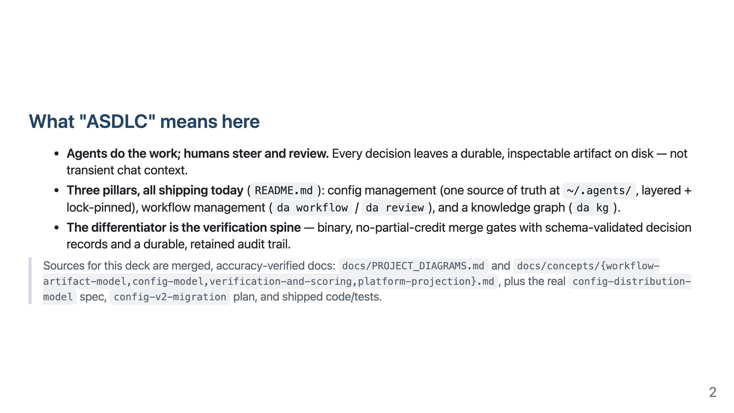

Slide 3
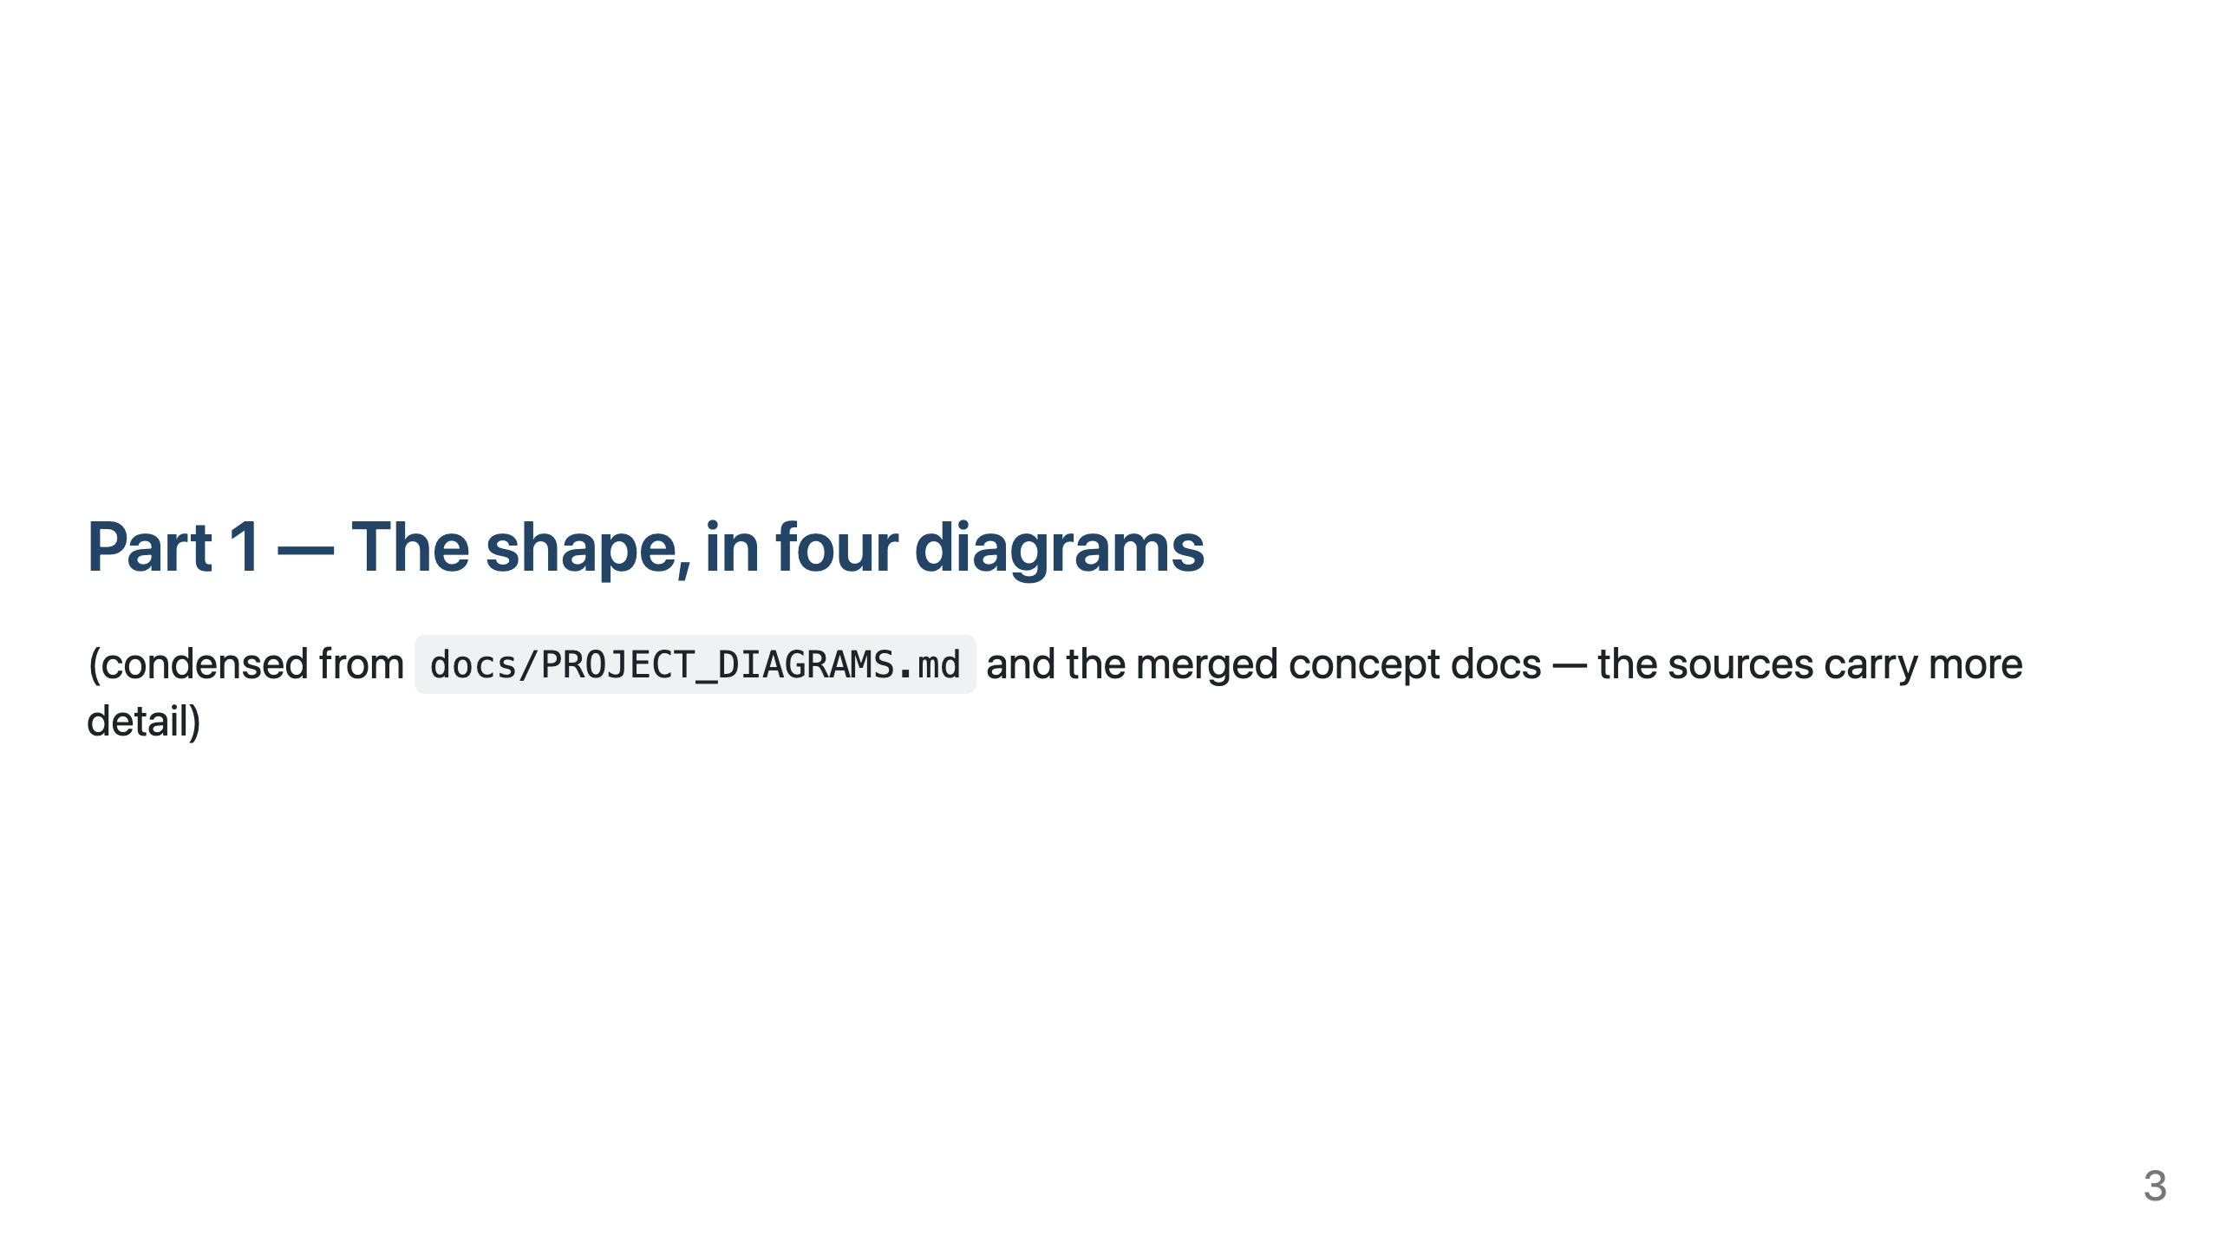

Slide 4
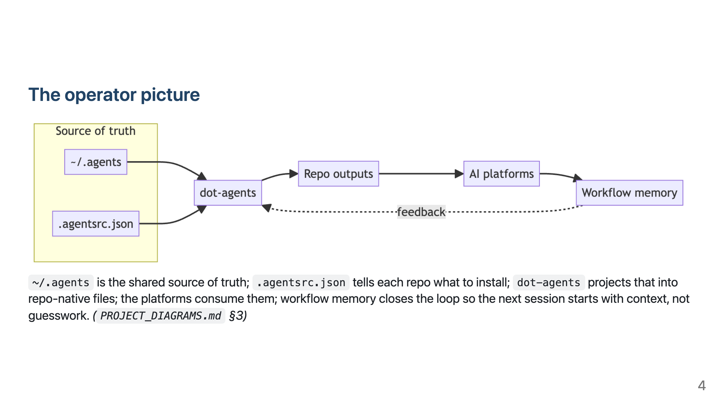

Slide 5
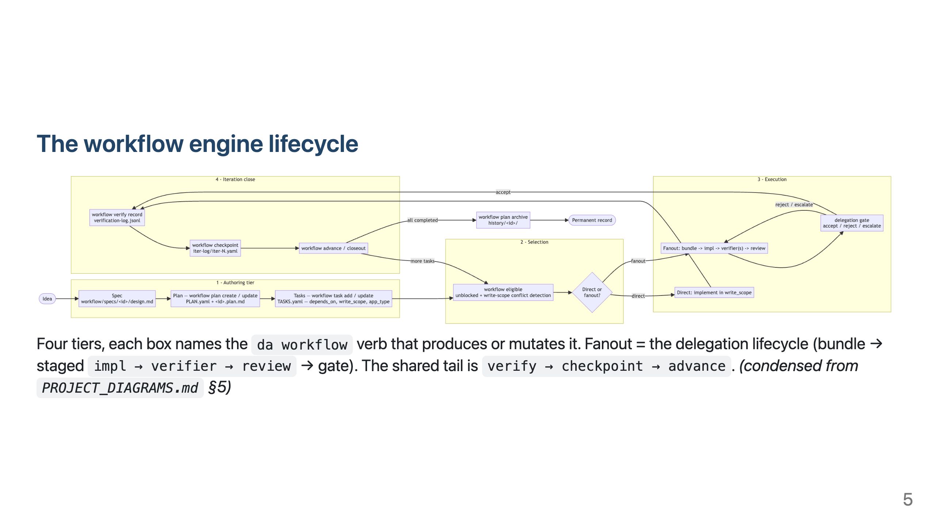

Slide 6
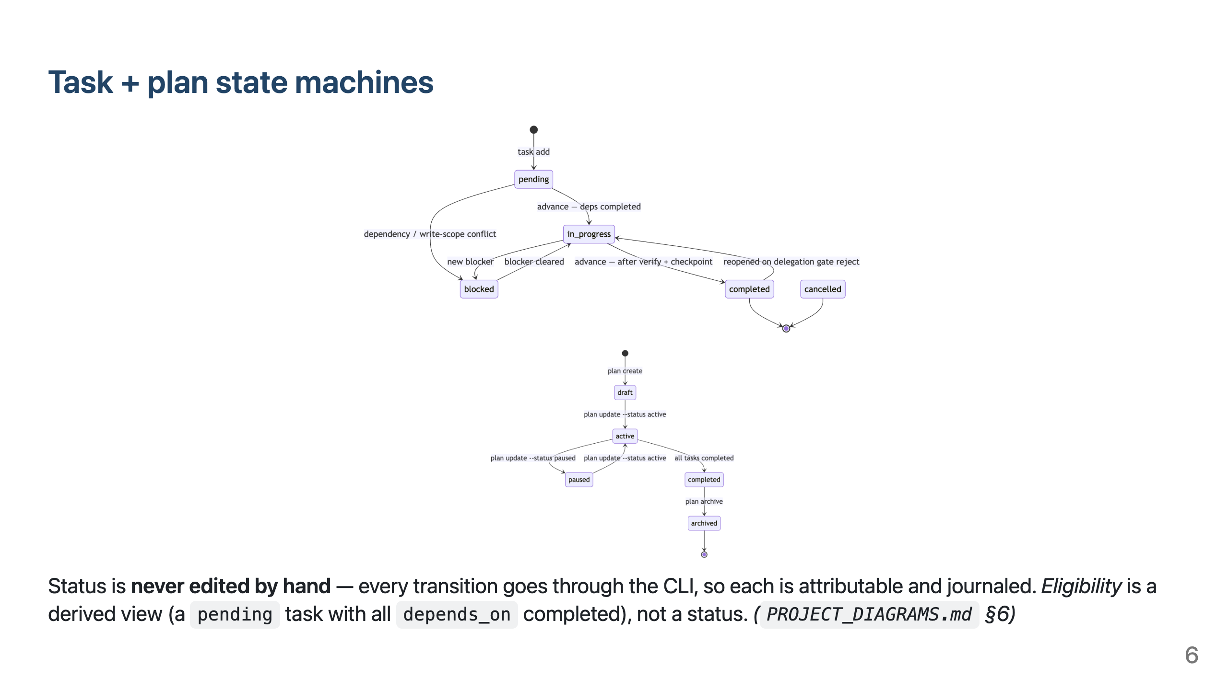

Slide 7
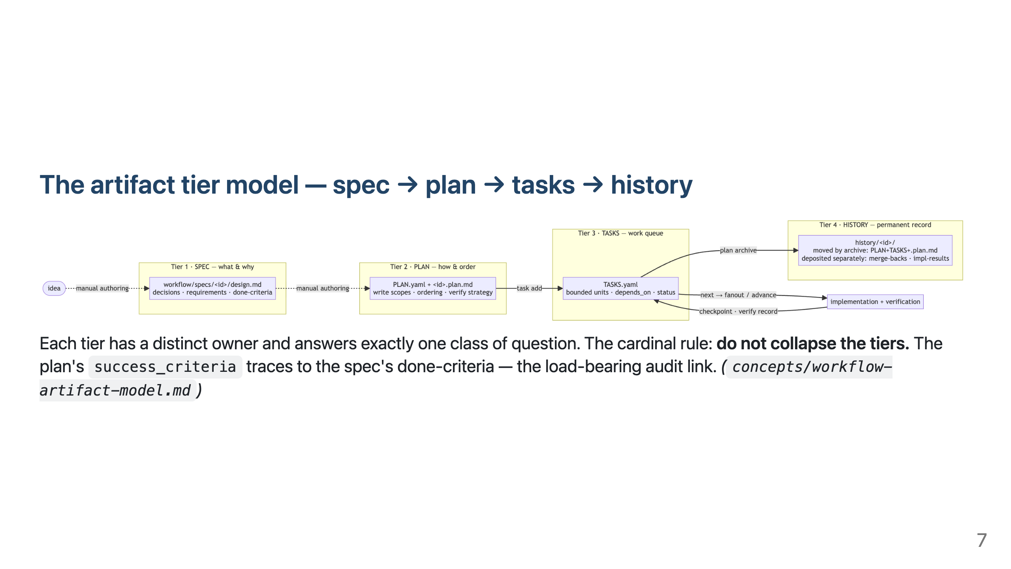

Slide 8
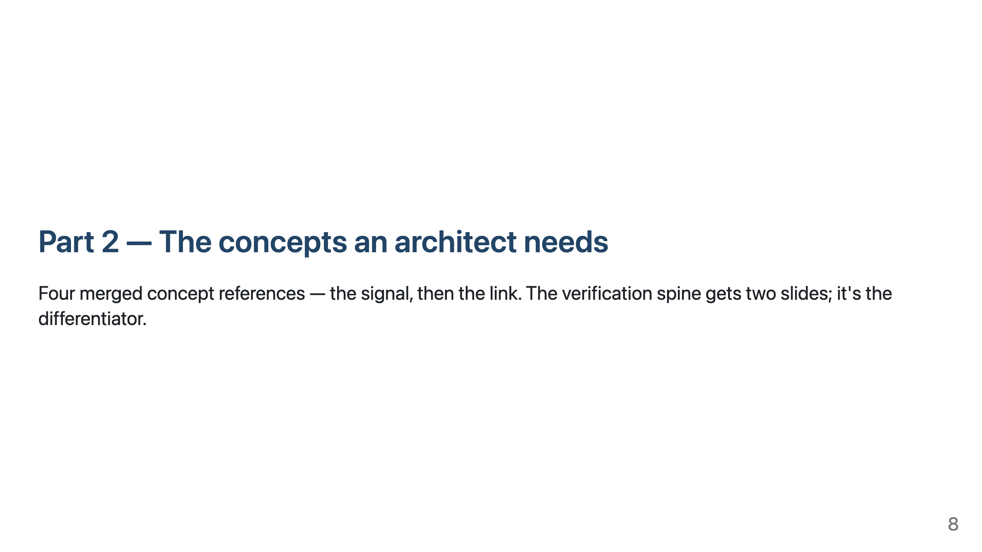

Slide 9
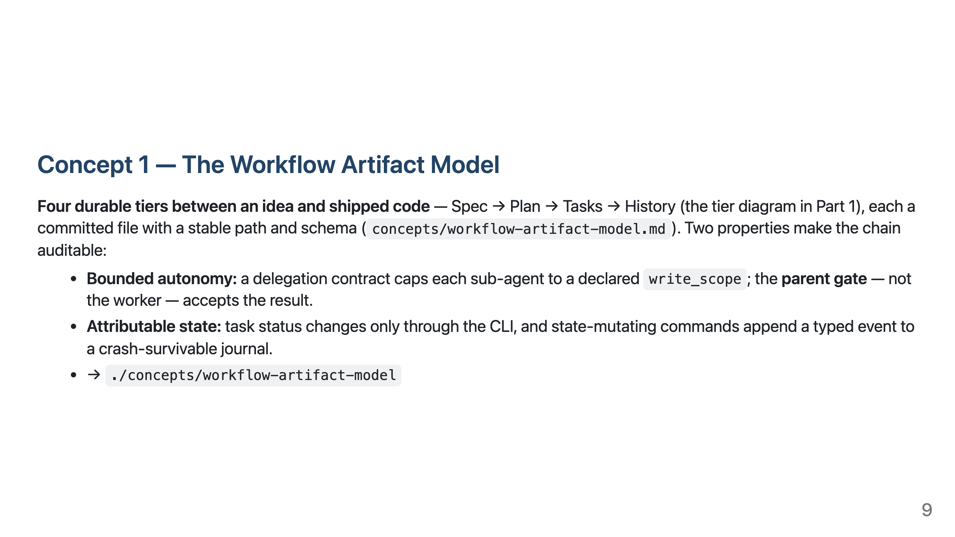

Slide 10
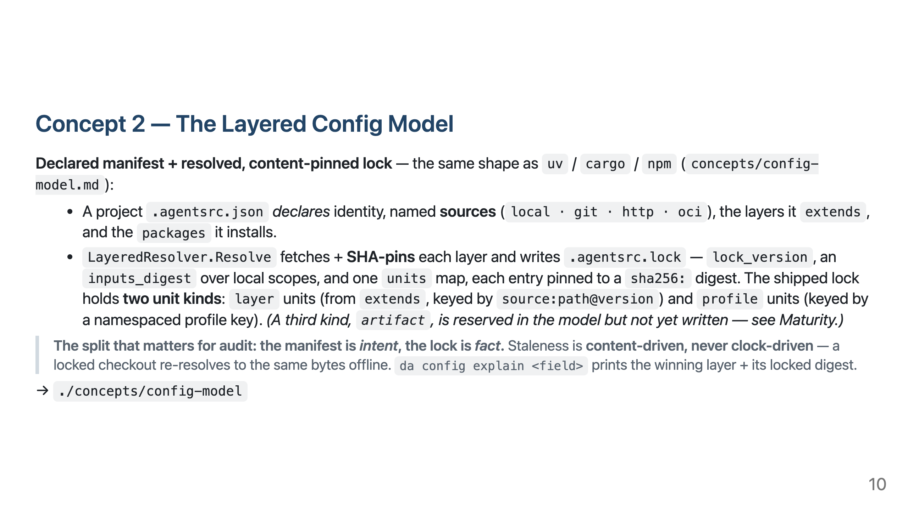

Slide 11
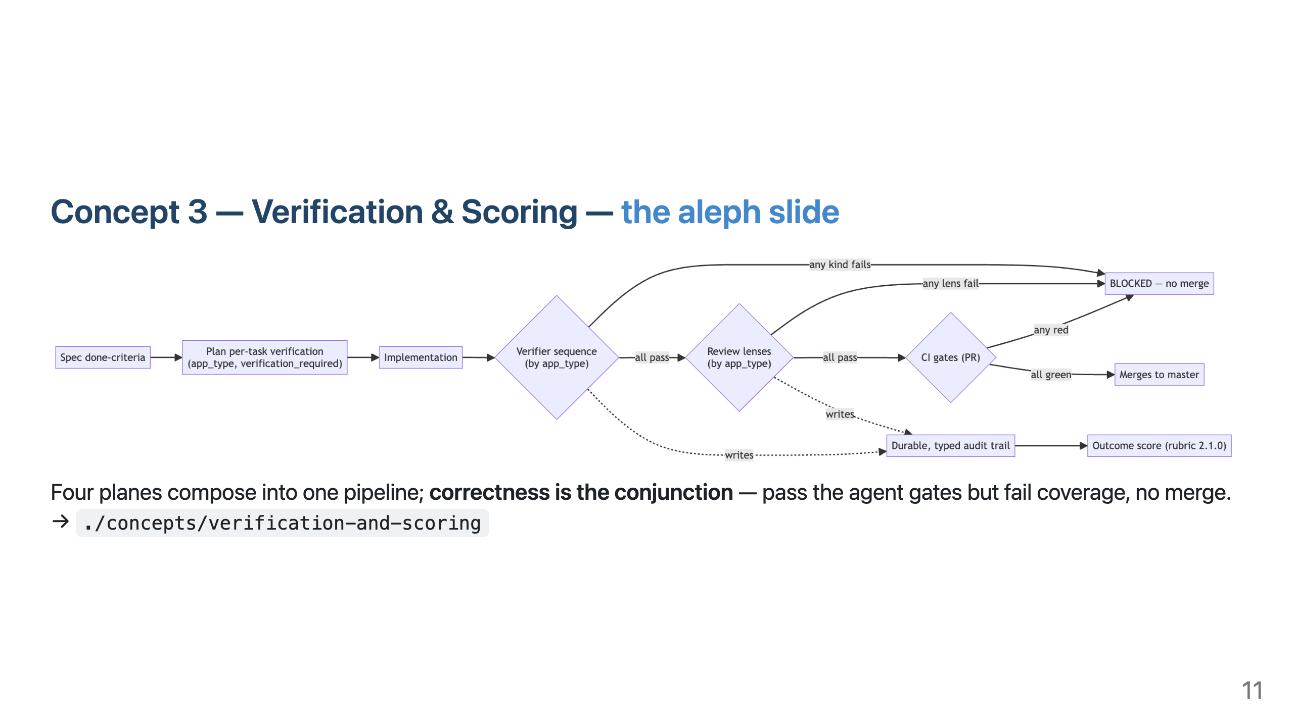

Slide 12
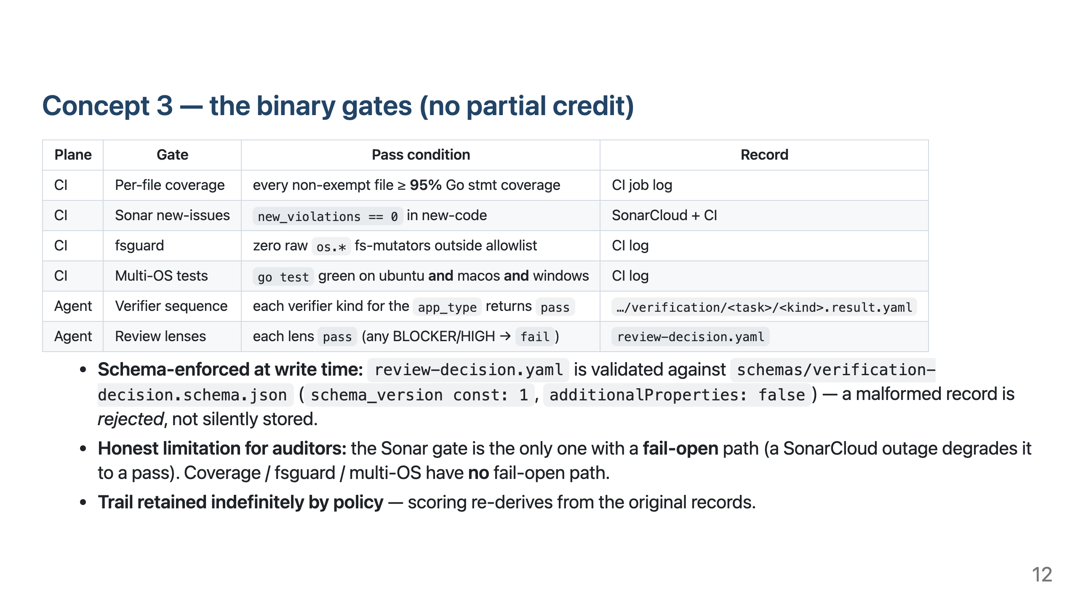

Slide 13
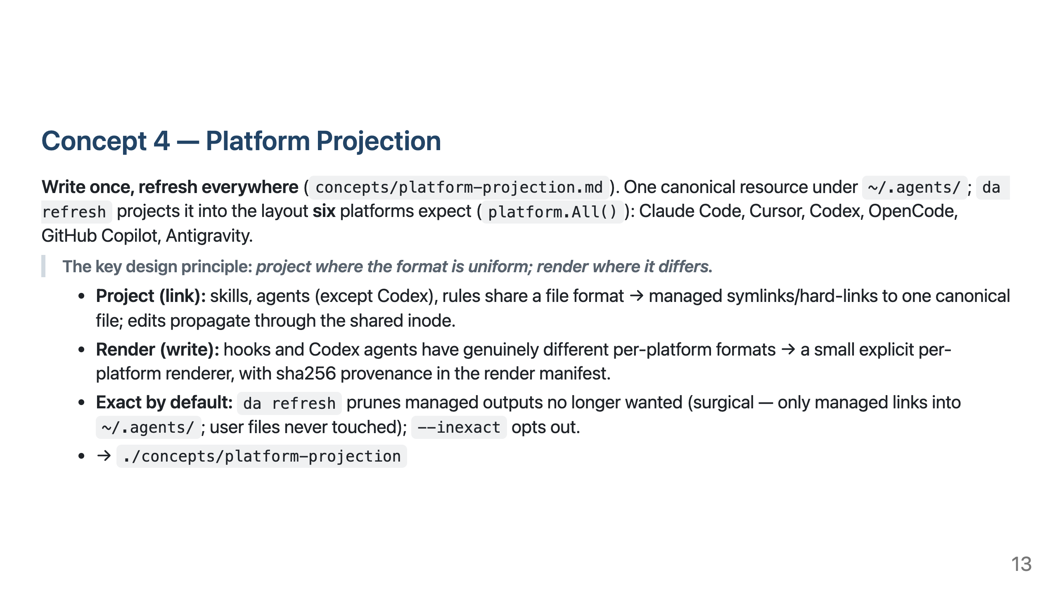

Slide 14
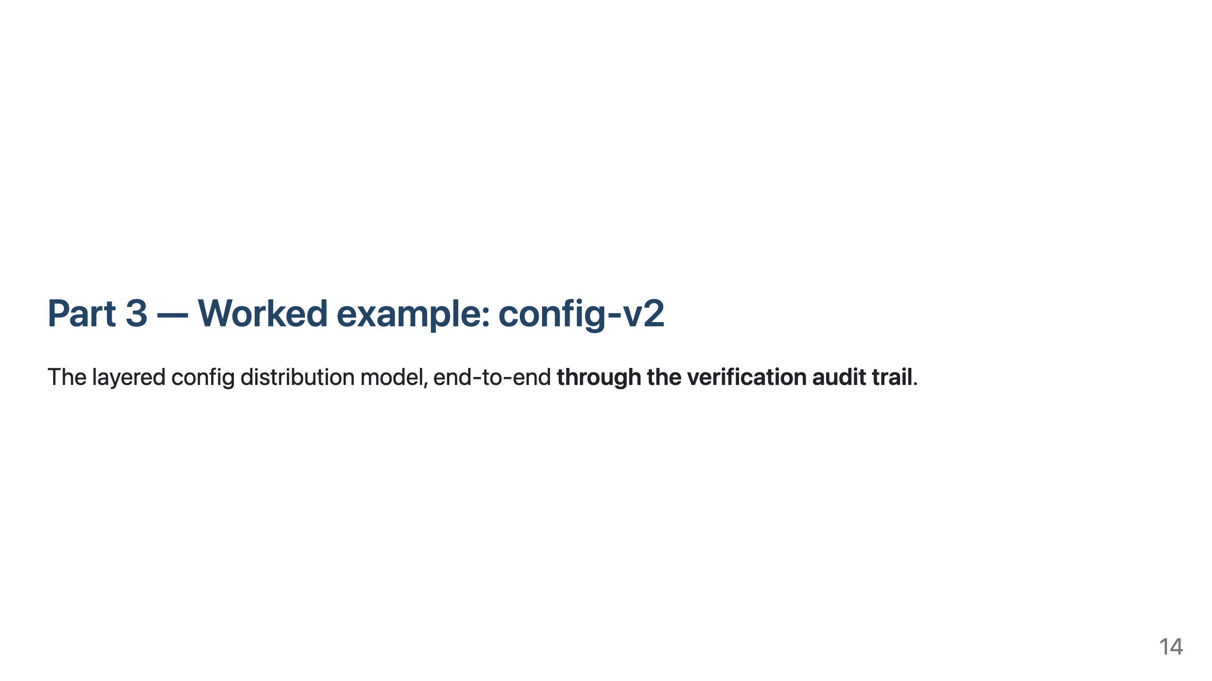

Slide 15
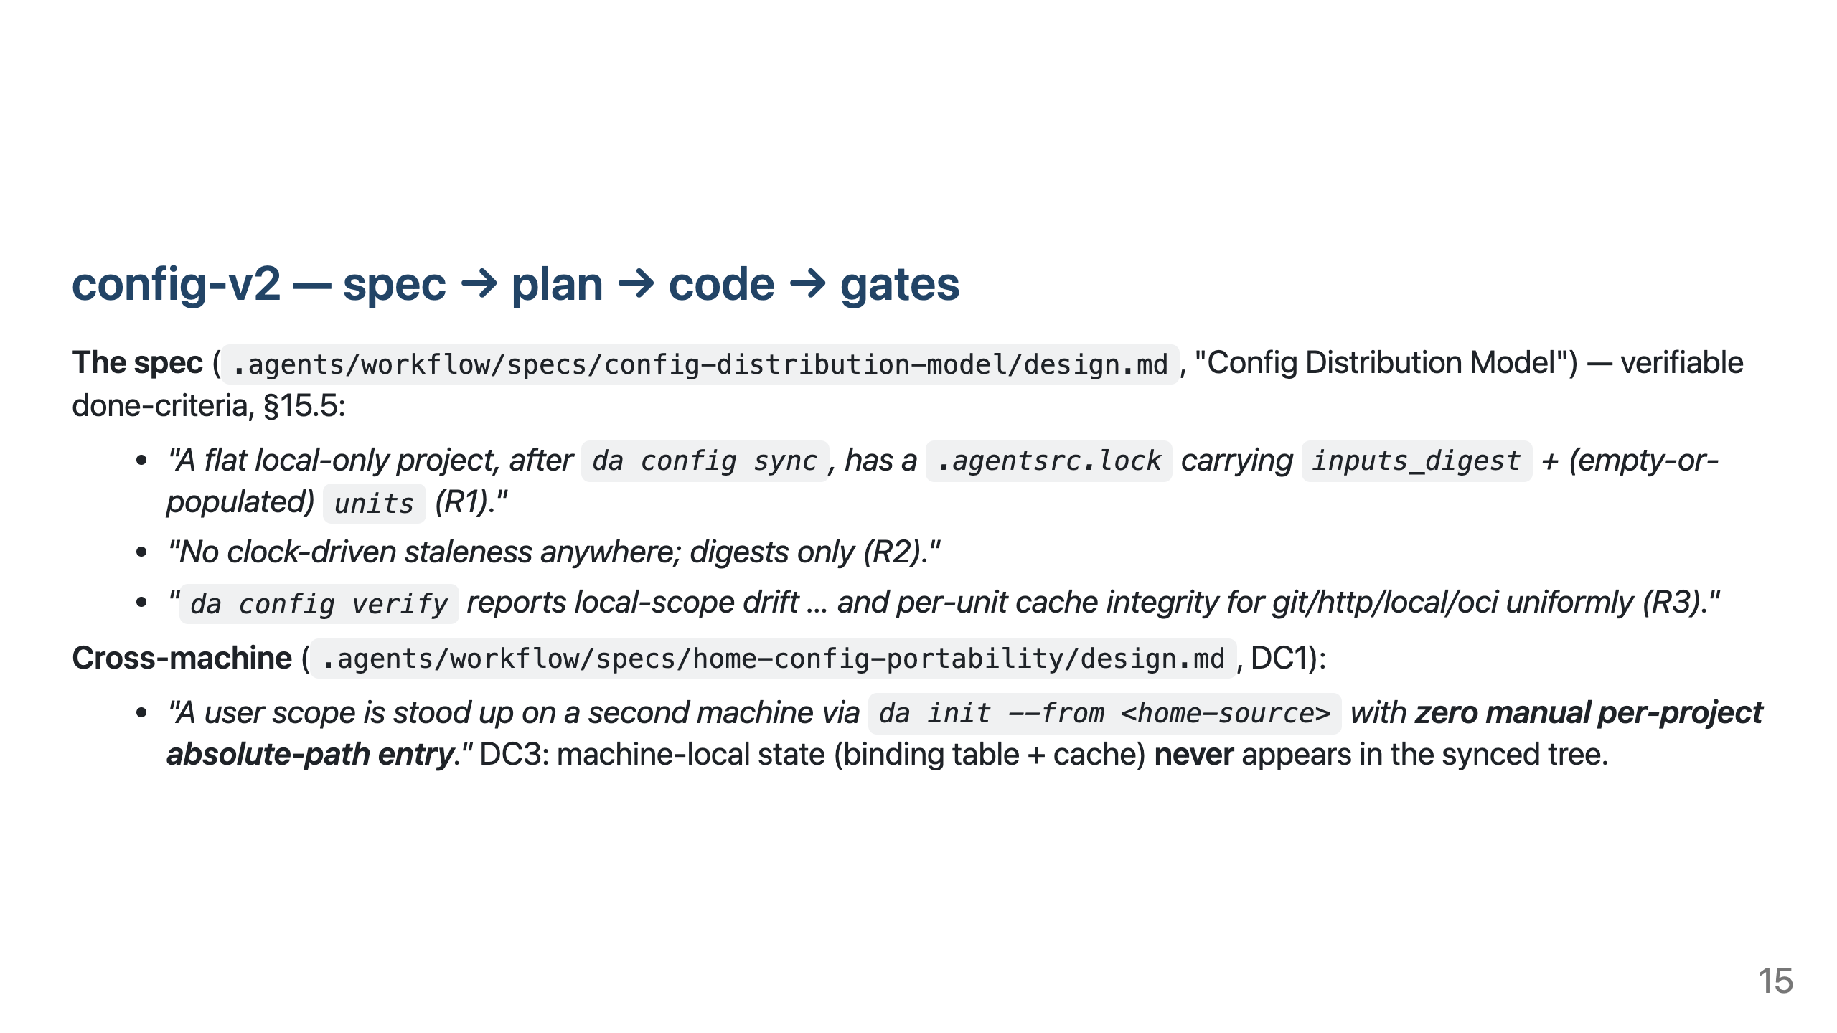

Slide 16
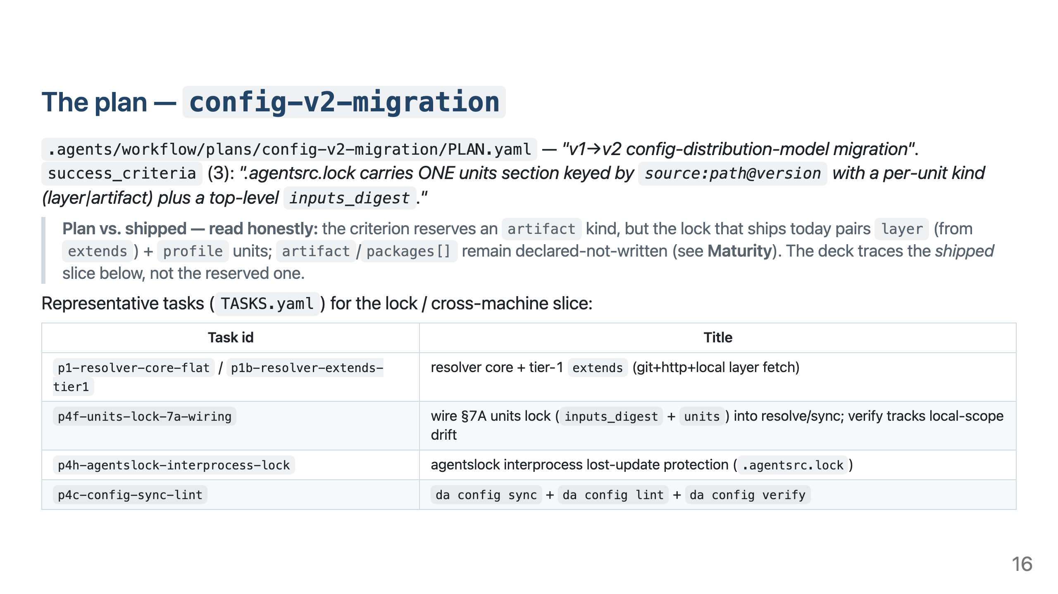

Slide 17
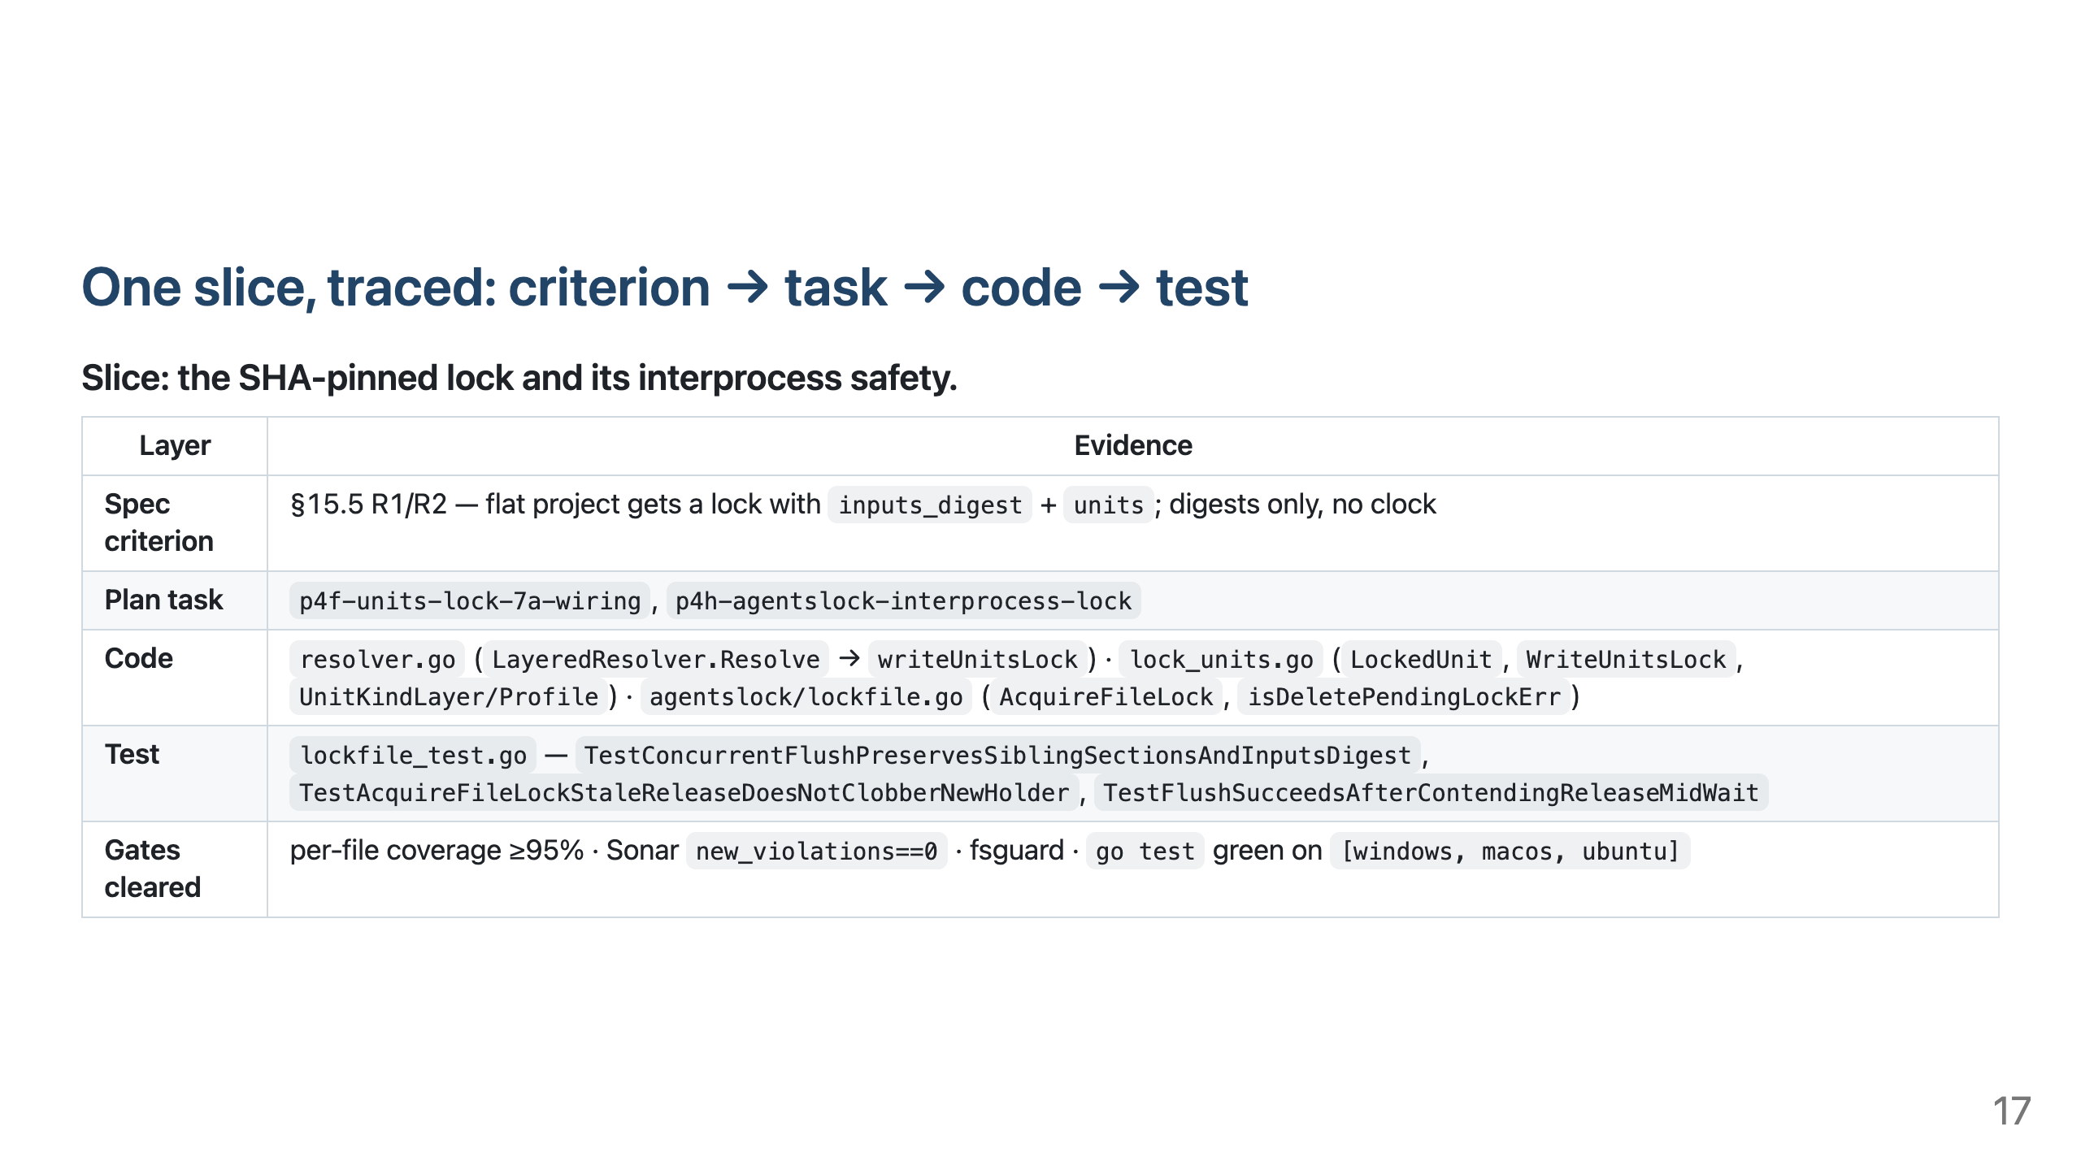

Slide 18
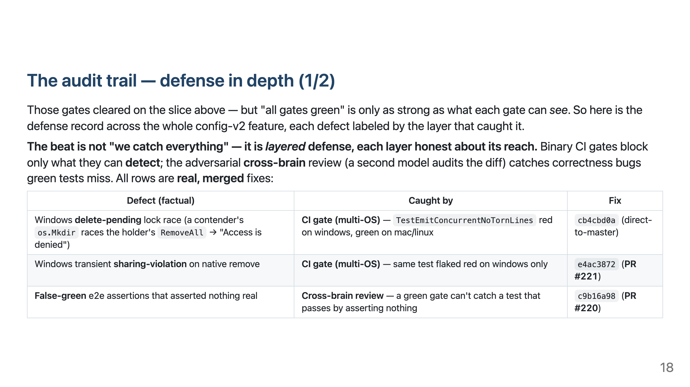
Notes:
Talk track: the multi-OS matrix DOES catch Windows races a mac/linux-green run hides — but only when a test exercises the path (delete-pending, sharing-violation went red on windows-latest). The adversarial cross-brain lens catches the false-greens that green tests structurally can't. Continues on the next slide.

Slide 19
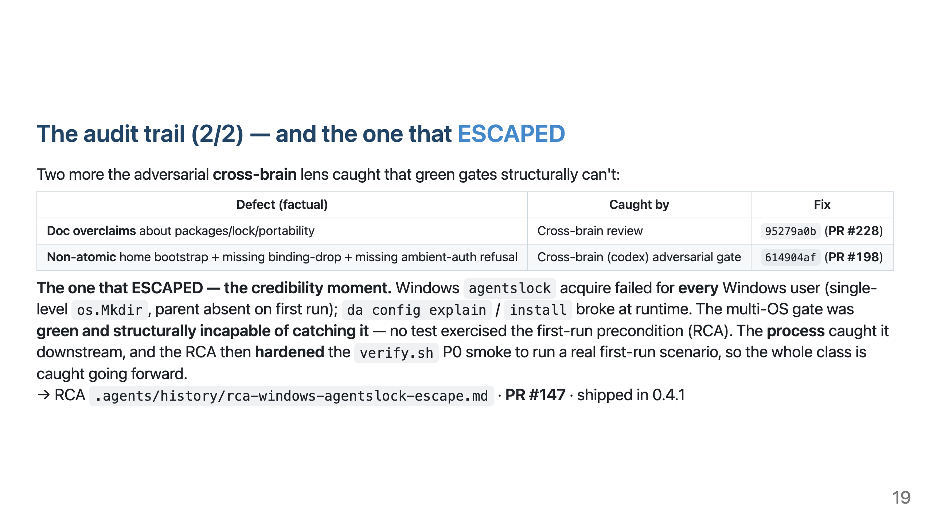
Notes:
Talk track: the agentslock acquire race had NO test hitting its first-run precondition, so it passed a green multi-OS gate and ESCAPED — caught later by the process, after which the RCA hardened the smoke to catch the class. "Green tests" was necessary, never sufficient; defense in depth is what makes the chain auditable.

Slide 20
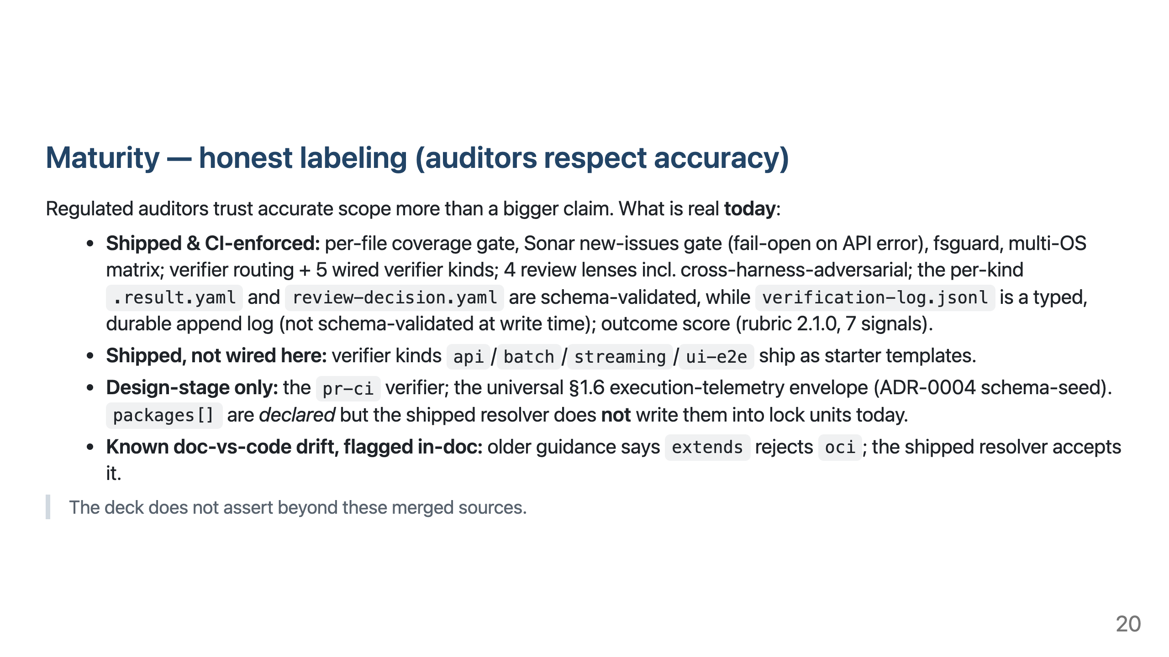

Slide 21
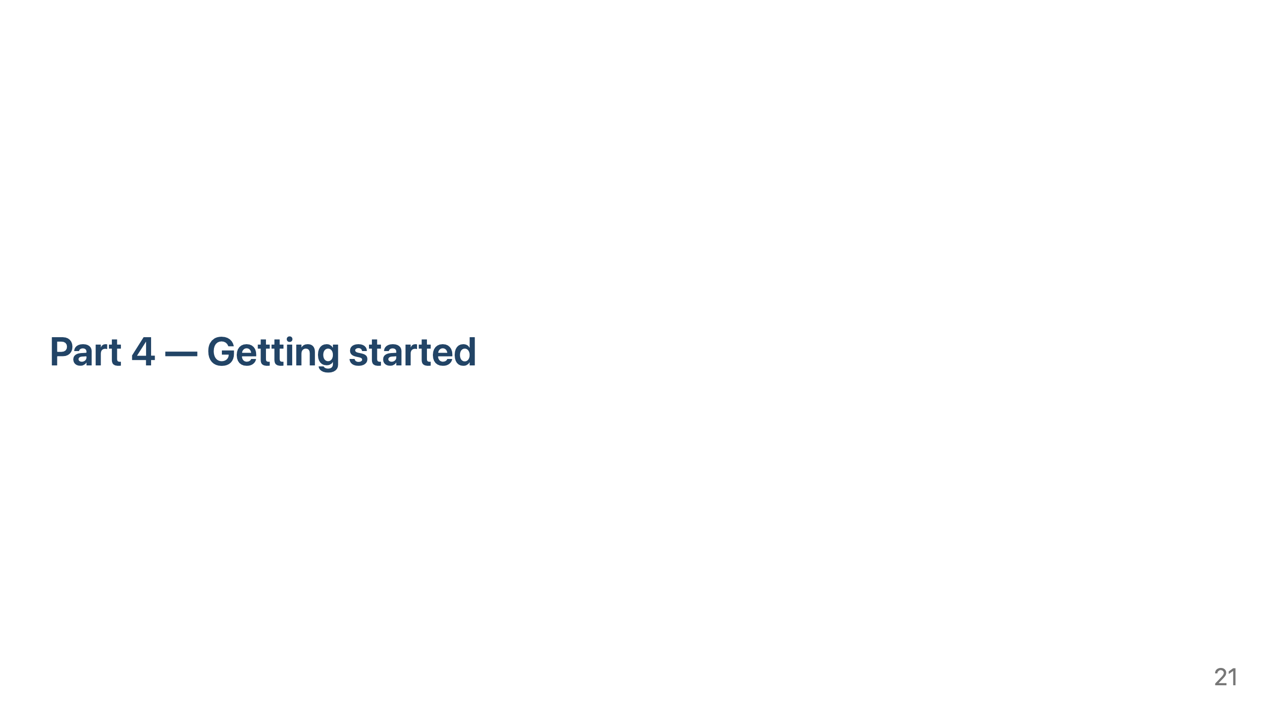

Slide 22
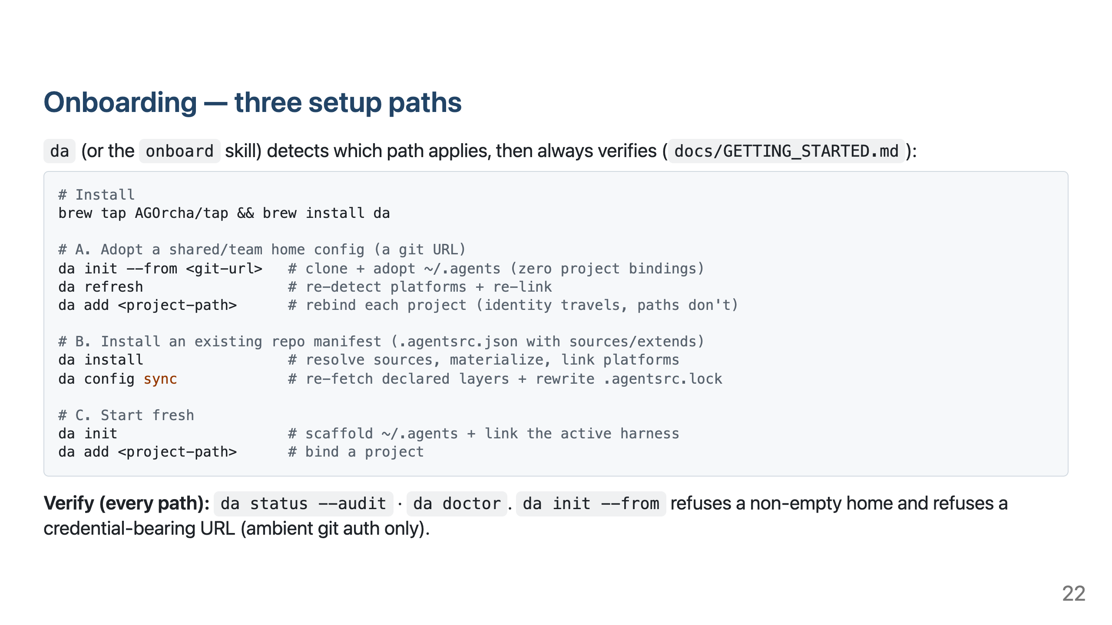

Slide 23
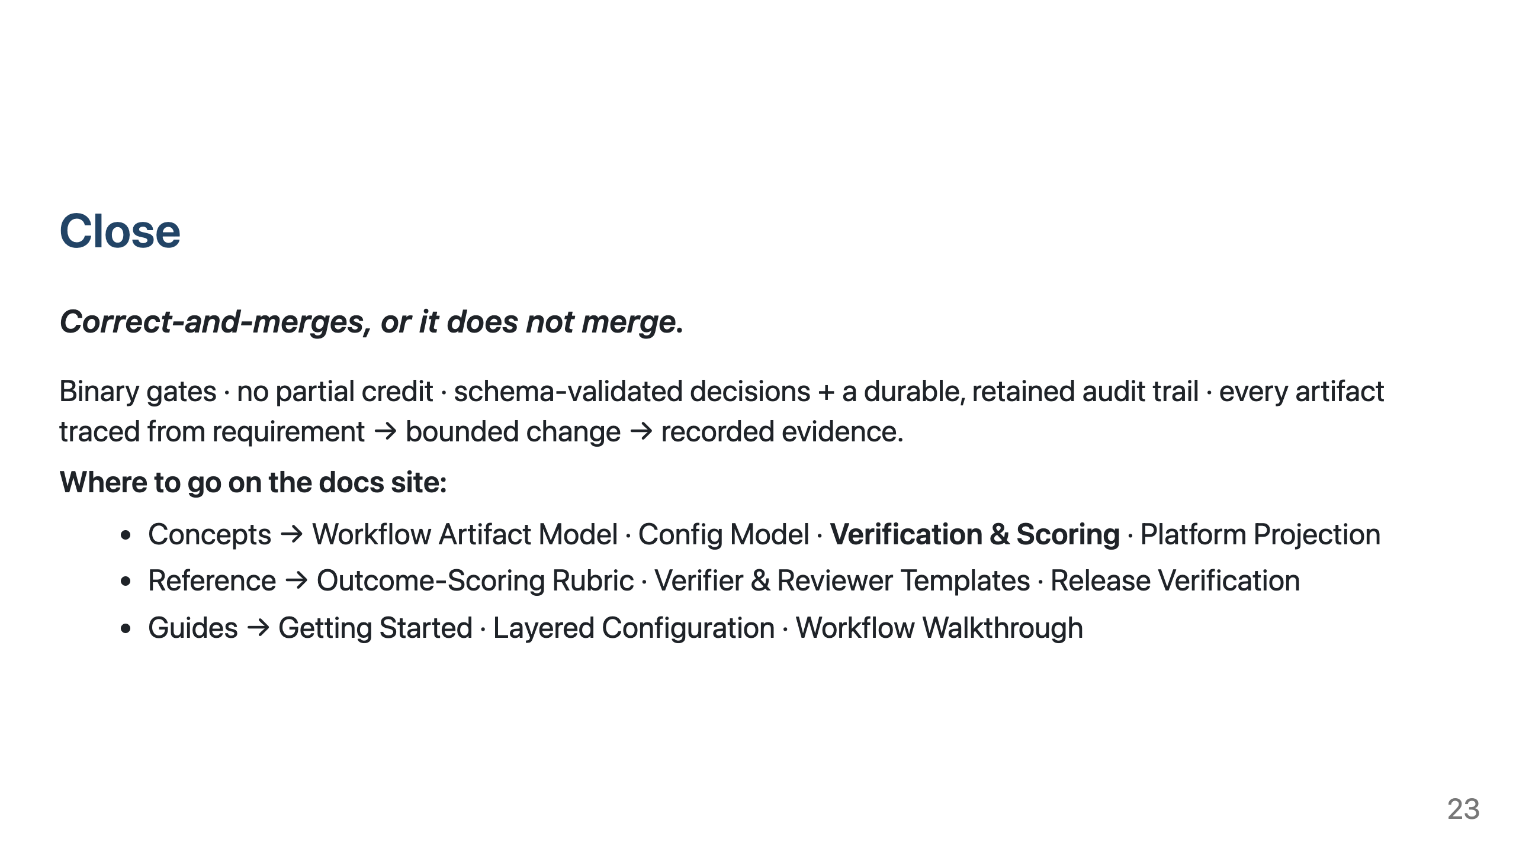
Notes:
Talk track: the verification spine is the differentiator for regulated buyers — it turns "an AI changed the code" into a reconstructable, auditable chain.

