Slide 1
Customer Shopping Behavior
Used 3,900 purchases to align on the biggest growth, loyalty, and margin opportunities.

Slide 2
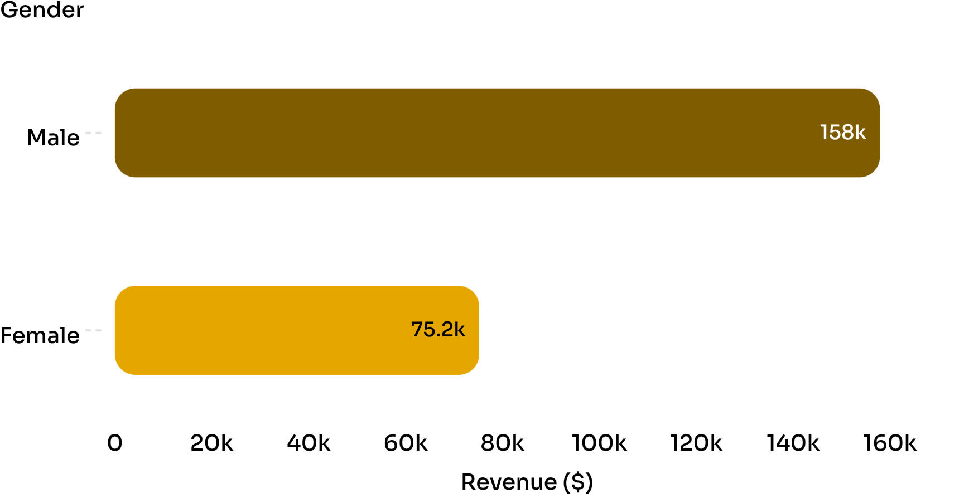
REVENUE CONCENTRATION
The customer base is broad, but revenue is concentrated
$233.08K
Total revenue
$59.76
Average purchase
3,900 purchases across 25 products, 4 categories, and 50 locations.

Slide 3
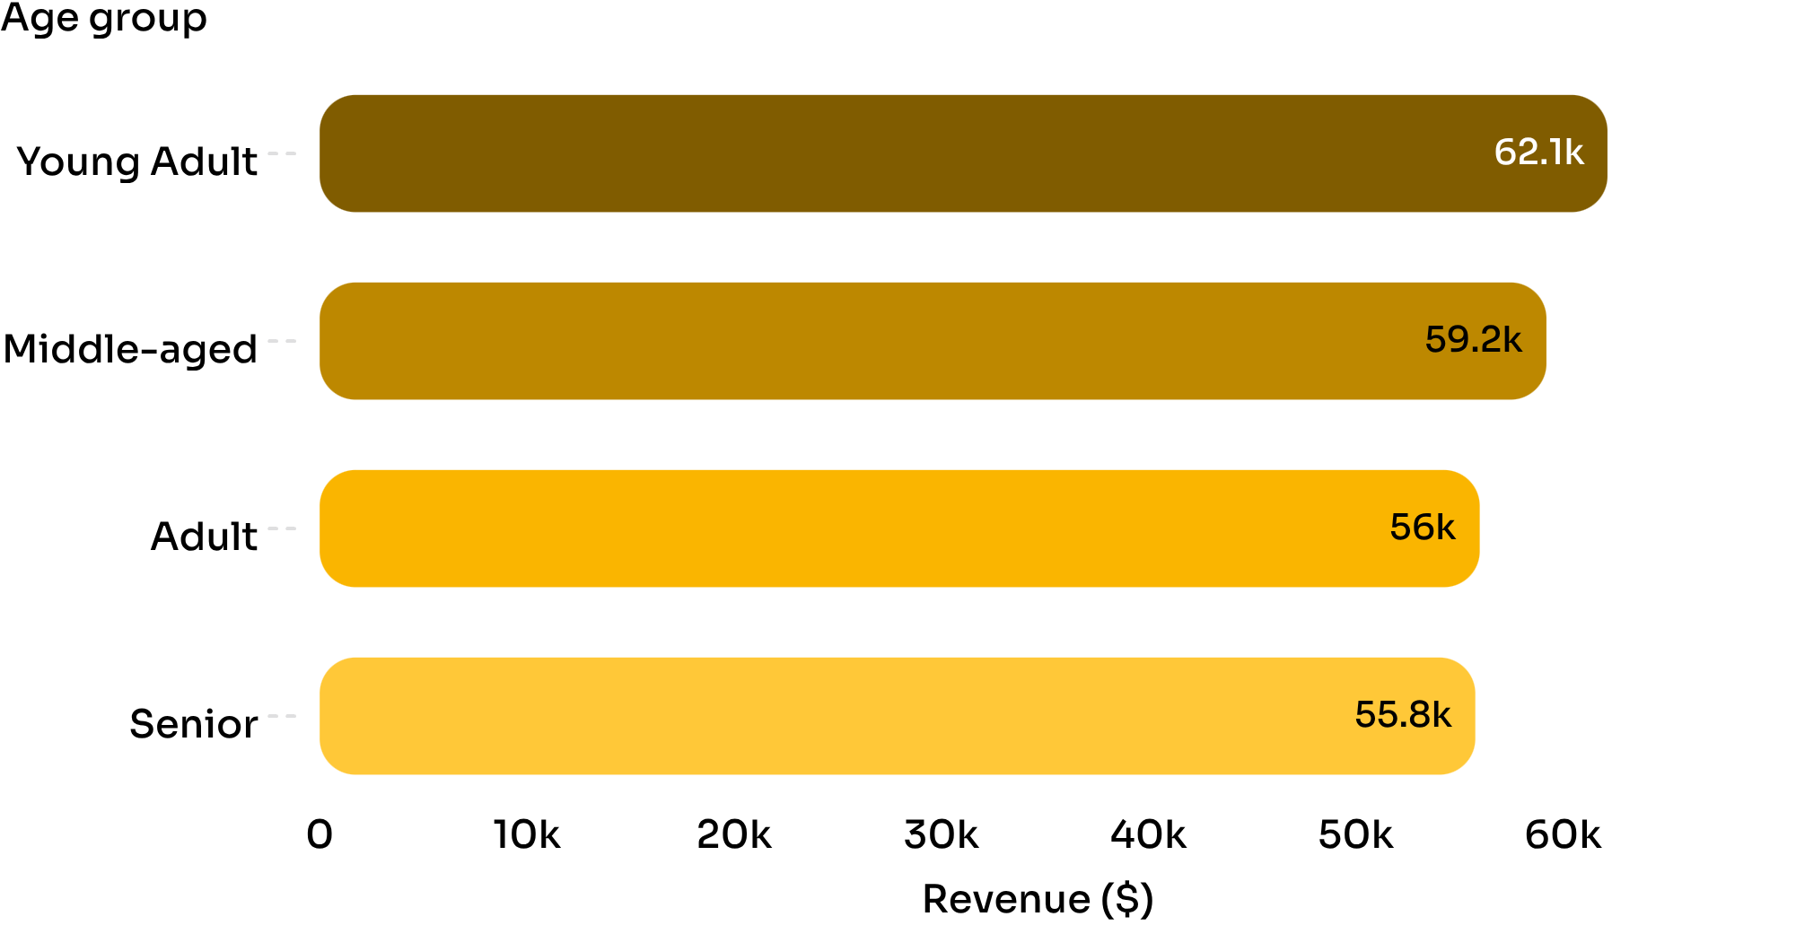
AGE GROUPS
Young adults lead revenue, but every age group contributes
26.66%
Young Adult share of revenue
Prioritize young-adult growth while keeping broad relevance.

Slide 4
LOYALTY & SUBSCRIPTION
Loyal customers are the engine; subscriptions are the gap
3,116
701
83
Loyal customers
Returning customers
New customers
27%
$59.49 average spend for subscribers
$59.87 average spend for non-subscribers
Subscription benefits should build loyalty, not simply lower prices.
of the base subscribes
1,053 customers

Slide 5
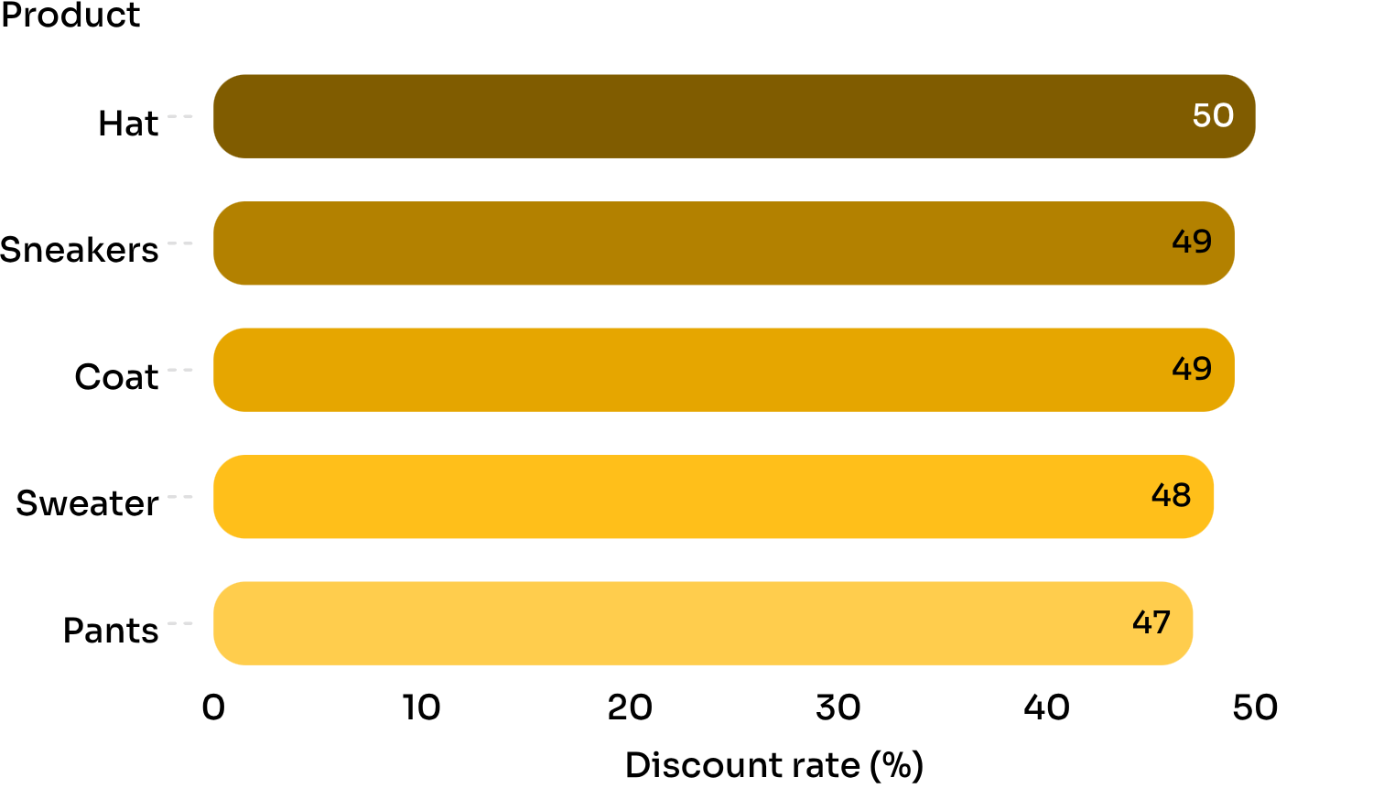
DISCOUNT EXPOSURE
Discounts can drive volume without guaranteeing lower spend
839
customers used discounts and still spent above the average purchase amount.
Discuss where discounts create incremental demand versus margin leakage.

Slide 6
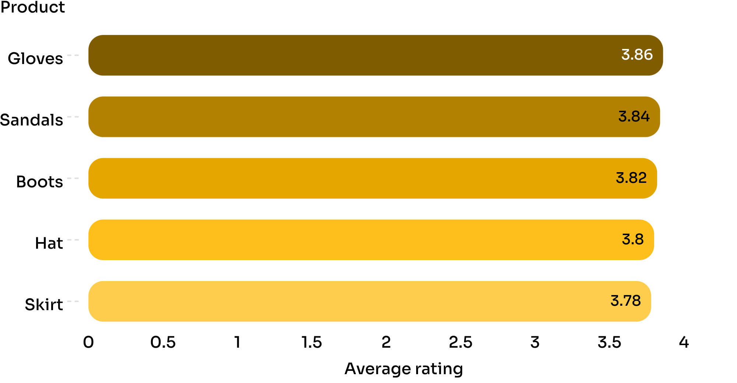
PRODUCT SIGNALS
Product signals point to clear campaign priorities
Campaign priorities
Use ratings to build trust.
Use purchase volume to shape availability.
Best-selling products by category include Jewelry, Blouse, Sandals, and Jacket.

Slide 7
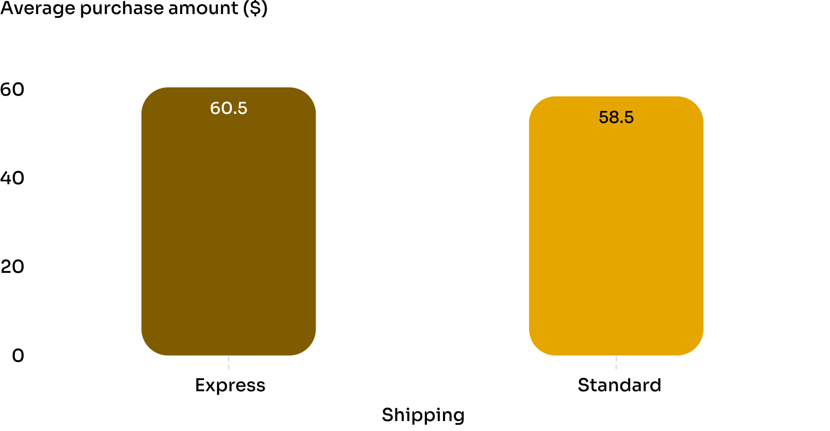
SHIPPING VALUE
Shipping is a small but visible value lever
$2.02
higher average purchase with Express shipping
Express shoppers may be a useful audience for convenience-led offers.
Test whether faster delivery increases conversion or simply attracts higher-intent buyers.

Slide 8
ALIGNMENT
Three actions to align on next
01
02
03
Subscription benefits
Tailored campaigns
Margin guardrails
Design subscription benefits around loyalty, not just lower prices.
Target young adults and high-value repeat buyers with tailored campaigns.
Review discount exposure by product and pair it with margin guardrails.

Slide 9
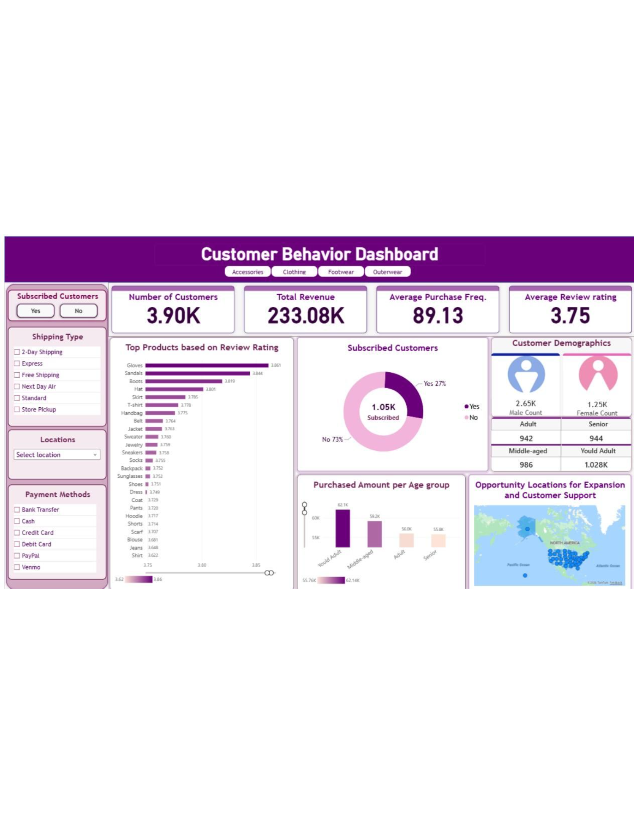
DISCUSSION
What should we
test first?
Choose one subscription, targeting, or discount experiment to prioritize for the next planning cycle.

