Slide 1

Instagram Post Engagement Classification
Using Data & Machine Learning to Understand What Drives Engagement
Final Assignment — Fundamentals of AI and Data Analytics

Slide 2


The Problem
What we're solving
Predict whether an Instagram post will get “High” or “Low” engagement (likes), based on posting time, caption length, and media type.
70
Instagram posts analyzed
10
Why it matters
Engagement drives how many new people Instagram's algorithm shows content to. Understanding what works replaces guessing with evidence.
data columns captured
1
real-world question to answer
2

Slide 3



The Dataset
Personal Instagram account data, exported via the Instagram Graph API
like_count
comments_count
reach / views
saved
Number of likes
Number of comments
Accounts reached & views
Times post was saved
Plus: media_type (VIDEO / IMAGE / CAROUSEL_ALBUM), timestamp, caption text, and permalink — 10 columns total, 70 rows.
Variable Types
Numeric:
likes, comments, reach, saved, views
Categorical:
media_type
Date/time:
timestamp
3

Slide 4

Data Quality: Identify & Handle
Missing Values
caption (6), reach (3), saved (3), views (10) — imputed with median; views=0 is structural (non-video posts).
Duplicates
0 found — checked both full rows and post IDs.
Inconsistent Categories
media_type has 3 clean values — no typos found.
Outliers
4 high-performing posts flagged (IQR method) — kept, since virality is the signal being studied.
Wrong Formats
timestamp was text → converted to real datetime, enabling hour/weekend features.
4

Slide 5

Data Analysis: The Numbers
Metric | Mean | Median | Std Dev
Likes | 137.1 | 103.5 | 167.3
Comments | 27.0 | 3.0 | 179.8
Reach | 4,184.2 | 2,133.0 | 6,281.3
Saved | 10.4 | 5.0 | 18.4
Views | 5,745.5 | 2,731.5 | 10,522.3
Key Statistical Insight
Every metric is right-skewed — mean is well above median across the board.
Comments show the most extreme case: mean (27) is 9× the median (3) — driven almost entirely by one outlier post with 1,508 comments.
Correlation with likes:
Reach 0.92 • Views 0.85 • Saved 0.82 • Comments 0.18
Category Counts
5

Slide 6
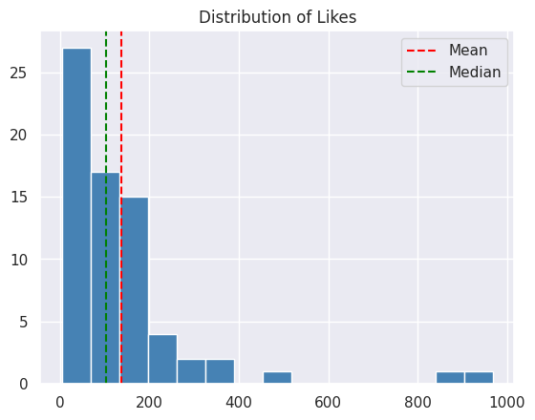
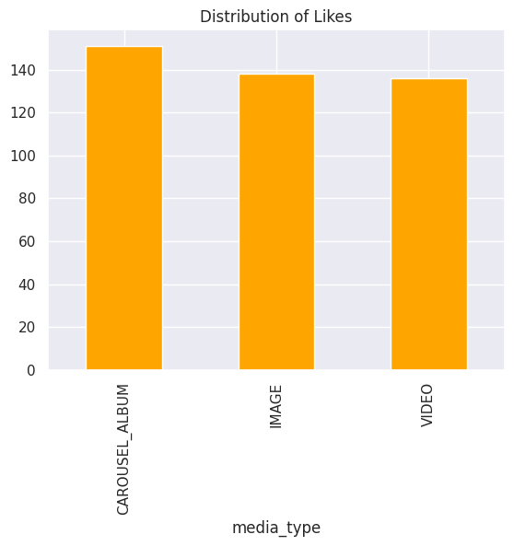
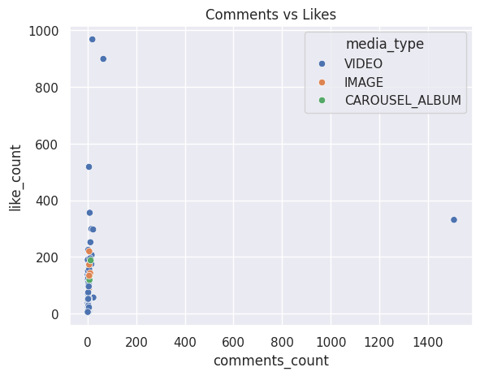
Visualizing the Findings
Likes are right-skewed — a few viral posts pull the mean above the median.
CAROUSEL_ALBUM posts average the most likes (151) — based on only 4 posts.
One outlier post (1,508 comments) distorts the comments-likes relationship.
Together, these three charts show engagement on this account is driven by a small number of standout posts — not a steady, predictable pattern.
6

Slide 7



The Model: Decision Tree Classification
What we predict
Data split
Features used
High vs Low engagement (split at the median like count)
80% train (56 posts) / 20% test (14 posts), stratified
Comments, saves, views, caption length, hour, weekend, format
Why a Decision Tree? Engagement likely follows threshold-like rules (“if saves are high enough→High”) rather than a smooth straight-line relationship — exactly what this model captures.
7

Slide 8
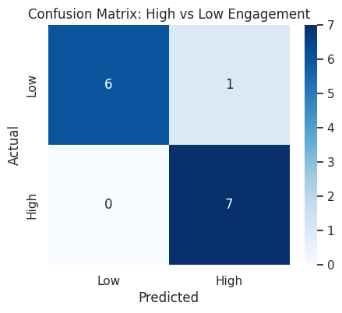
Model Results
13 of 14
test posts correctly classified
Precision & Recall:
0.86 – 1.00 across both classes
Well above the 50% random-guess baseline
92.9%
Accuracy
Explanation: the model correctly separates High and Low engagement posts almost every time, confirming that post-level features carry real, usable signal — not just noise.
8

Slide 9
Insights & What They Mean
The median (103.5), not the mean (137.1), is the realistic “typical” outcome to expect from a post.
Saves and views are the strongest, most trustworthy engagement signals — stronger than comments.
Comment count alone is unreliable on this account due to one spam-like outlier post.
The model reliably separates high and low performers, giving a data-backed way to predict a post's potential before posting.
9

Slide 10
Final Conclusion
Engagement on this account is measurable and predictable — not random.
A Decision Tree model reached 92.9% accuracy predicting High vs Low engagement from post-level features, using data cleaned and analyzed from scratch.
Limitation: only 70 posts — this is a strong first baseline, not a mature system.
Thank you

