Slide 1

Instagram Post Engagement Classification
Using Data & Machine Learning to Understand What Drives Engagement
Final Assignment — Fundamentals of AI and Data Analytics

Slide 2


The Problem
What we're solving
Predict whether an Instagram post will get “High” or “Low” engagement (likes), based on media type, posting time, caption length, reach, saves, and views.
140
Instagram posts analyzed
10
Why it matters
Engagement drives how many new people Instagram's algorithm shows content to. Understanding what works replaces guessing with evidence.
data columns captured
1
real-world question to answer
2

Slide 3



The Dataset
Personal Instagram account data, exported via the Meta Graph API (Jan 2024 – Jul 2026)
like_count
comments_count
reach / views
saved
Number of likes
Number of comments
Accounts reached & views
Times post was saved
Plus: media_type (VIDEO / IMAGE / CAROUSEL_ALBUM), timestamp, caption text, and permalink — 10 columns total, 140 rows.
Variable Types
Numeric:
likes, comments, reach, saved, views
Categorical:
media_type
Date/time:
timestamp
3

Slide 4

Data Quality: Identify & Handle
Missing Values
caption (8), reach (4), saved (4), views (31) — imputed with median; views=0 is structural (non-video posts).
Duplicates
0 found — checked both full rows and post IDs.
Inconsistent Categories
media_type has 3 clean values — no typos found.
Outliers
3 high-performing posts flagged (IQR method) — kept, since virality is the signal being studied.
Wrong Formats
timestamp was text → converted to real datetime, enabling hour/weekend features.
4

Slide 5

Data Analysis: The Numbers
Metric | Mean | Median | Std Dev
Likes | 165.4 | 132.0 | 146.2
Comments | 21.4 | 7.5 | 126.9
Reach | 4,777.8 | 3,040.0 | 5,187.2
Saved | 14.6 | 8.0 | 19.0
Views | 5,318.3 | 2,857.0 | 8,341.9
Key Statistical Insight
Every metric is right-skewed — mean is well above median across the board.
Comments show the weakest correlation with likes of any metric — one outlier post with 1,508 comments distorts the relationship.
Correlation with likes:
Reach 0.91 • Views 0.75 • Saved 0.74 • Comments 0.13
Category Counts
5

Slide 6
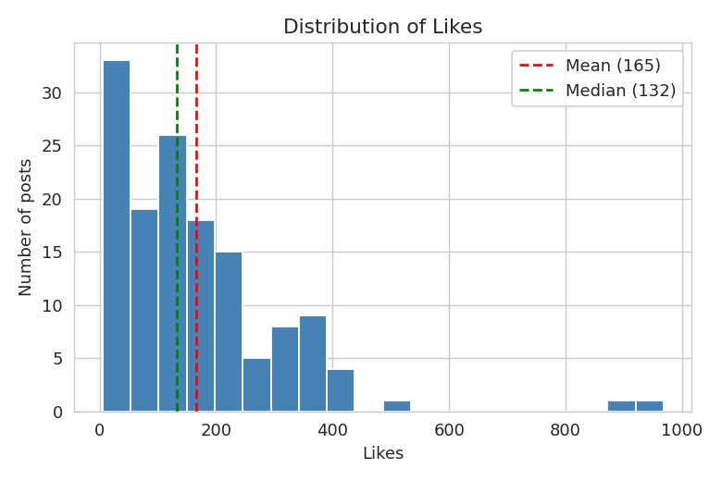
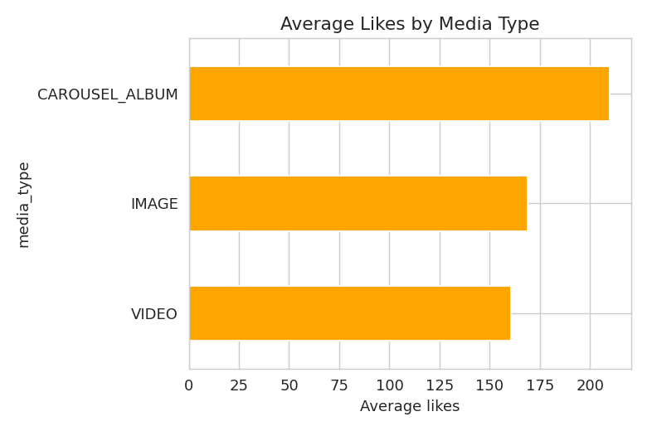
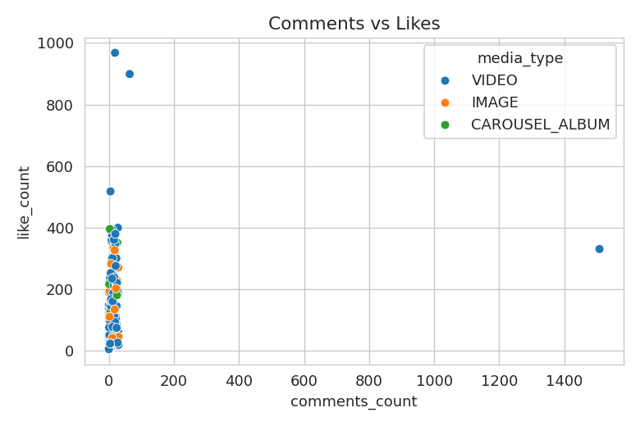
Visualizing the Findings
Likes are right-skewed — a few viral posts pull the mean above the median.
CAROUSEL_ALBUM posts average the most likes (210) — based on 10 posts.
One outlier post (1,508 comments) distorts the comments-likes relationship.
Together, these three charts show engagement on this account is driven by a small number of standout posts — not a steady, predictable pattern.
6

Slide 7



The Model: Comparing Six Classifiers
What we predict
Data split
Features used
High vs Low engagement (split at the median like count)
80% train (112 posts) / 20% test (28 posts), stratified
Comments, saves, views, caption length, hour, weekend, format
Why compare six models? Engagement could follow threshold-like rules, linear patterns, or distance-based groupings — testing Random Forest, KNN, Logistic Regression, XGBoost, AdaBoost, and SVC side by side reveals which structure actually fits, instead of assuming one.
7

Slide 8
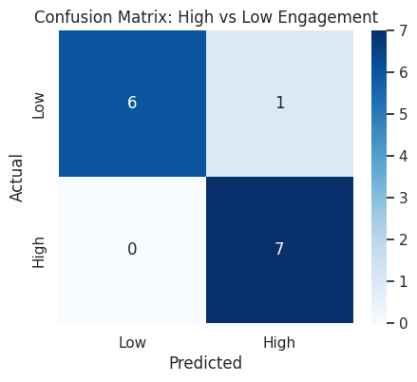
Model Results
24 of 28
test posts correctly classified
Precision & Recall:
85.7% each (XGBoost) — most balanced of six models tested
Well above the 50% random-guess baseline
85.7%
Accuracy
Explanation: Six classifiers were compared on the same split — Random Forest, KNN, Logistic Regression, XGBoost, AdaBoost, and SVC. XGBoost came out on top with balanced precision and recall, while SVC collapsed entirely without feature scaling — confirming post-level features carry real, usable signal, but model choice matters.
8

Slide 9
Insights & What They Mean
The median (132), not the mean (165.4), is the realistic “typical” outcome to expect from a post.
Saves and views are the strongest, most trustworthy engagement signals — stronger than comments.
Comment count alone is unreliable on this account due to one spam-like outlier post.
The best models reliably separate high and low performers, giving a data-backed way to predict a post's potential before posting.
9

Slide 10
Final Conclusion
Engagement on this account is measurable and predictable — not random.
Comparing six classifiers, XGBoost reached 85.7% accuracy with the most balanced precision and recall predicting High vs Low engagement from post-level features, using data cleaned and analyzed from scratch.
Limitation: only 140 posts — this is a strong first baseline, not a mature system.
Thank you

