Slide 1


Where to Open a new Peruvian Restaurant
Adolfo G. Ramirez-Aristizabal

Slide 2
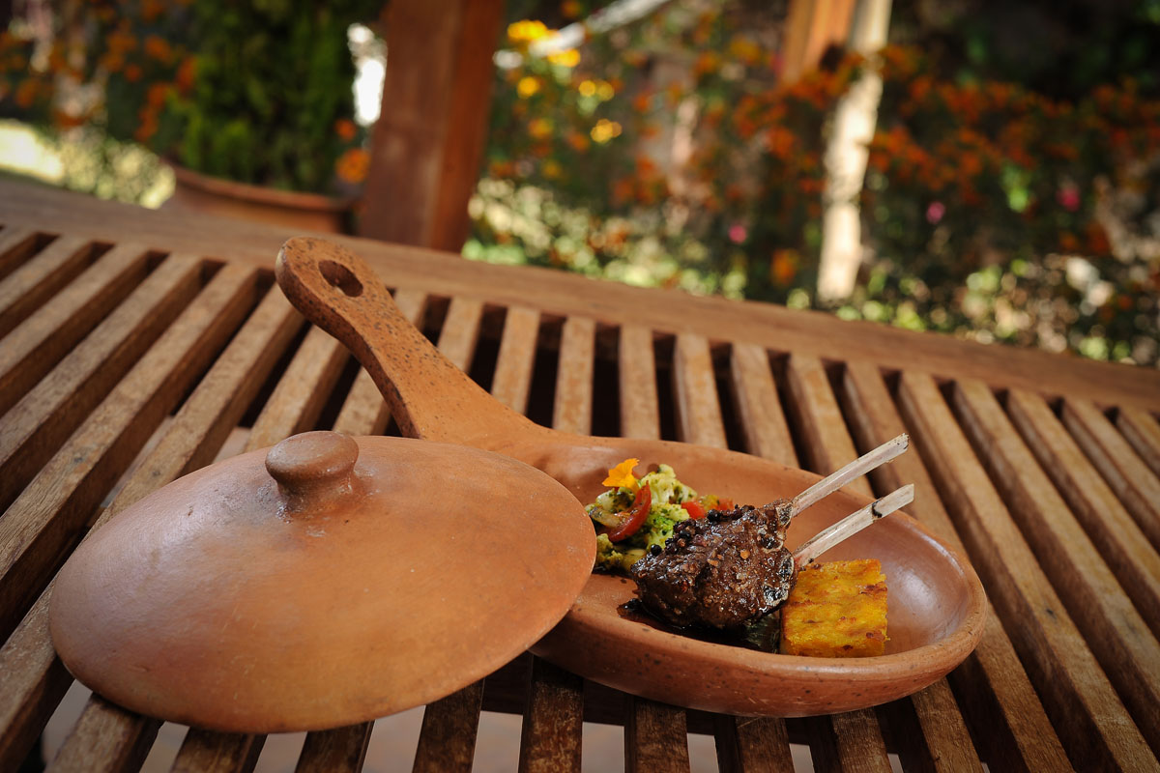

Expanding a business
Good food and good service make a restaurant successful
A local restaurant owner seeks to expand their business
The success of the second location is crucial to attract investors to commit to a chain restaurant
We use Four Square data to refine options for expansion into new locations

Slide 3

What are the challenges
The new restaurant location will be in Los Angeles County
The challenge is the size and diversity of venues that are already here
The business will need to consider competition and relevant locations
Peruvian food is popular but there is room in the market for a restaurant chain

Slide 4
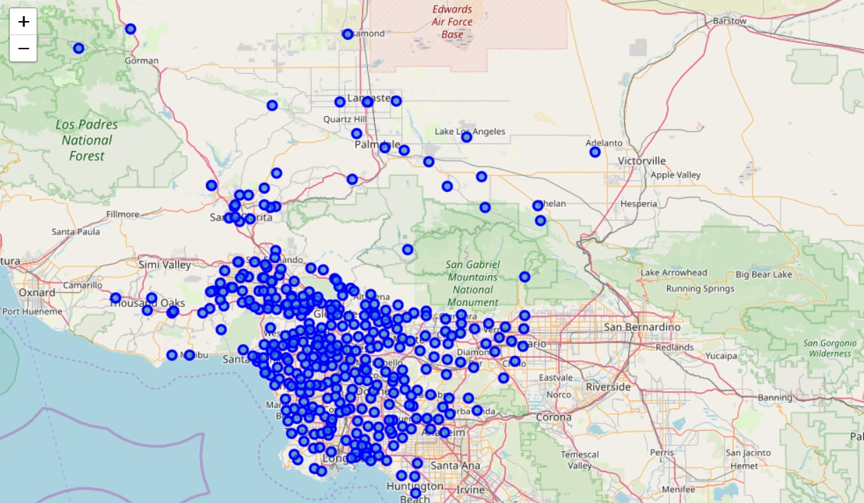
The Data
Our first data set comes from lacounty.gov
Contains 370 cities with data columns [Zipcode, Latitude/Logitude, City]
Plotted is a geographic map of the city locations from the data set

Slide 5

Four Square Data
We use Four Square API and reference our LA county data to retrieve nearby venues
Columns from the retrieved data include [Venue Name, Venue Location, and Venue category]
We were able to retrieve a total of 7296 venues from the 370 cities in LA county

Slide 6
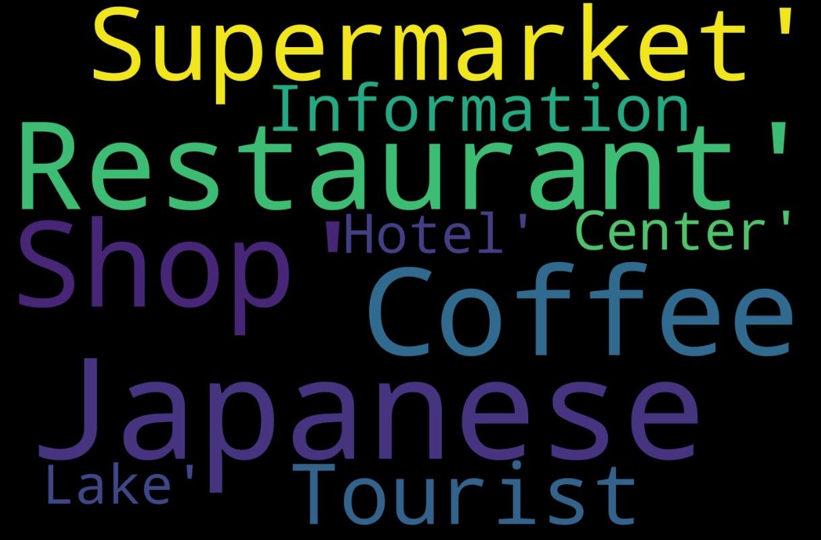
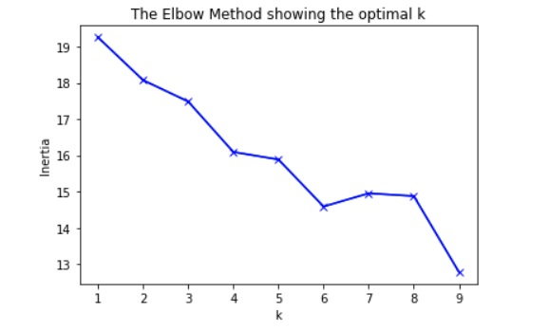
Clustering As is
Without any prior analysis, we take the retrieved venue data and cluster venues
This includes all venues which include gyms, supermarkets, coffee shops etc..
Using the elbow method we choose a k=6 parameter

Slide 7
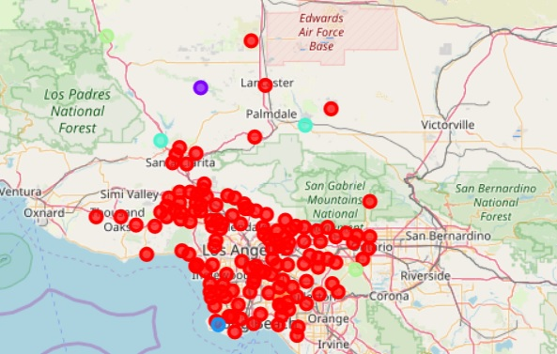
Clustering As is
Red cluster is for food related venues
Other clusters do not seem very informative in their associations
The food cluster is too broad for our search purposes

Slide 8
Semantic clustering
To remedy our first run issues we use the venue category data to cluster our venues
Tokenization of text data was done via Term Frequency Inverse Document (TFID)
This allows us to use semantic associations in the venue description to better group venues
New clusters now give us relevant associations of venue types

Slide 9
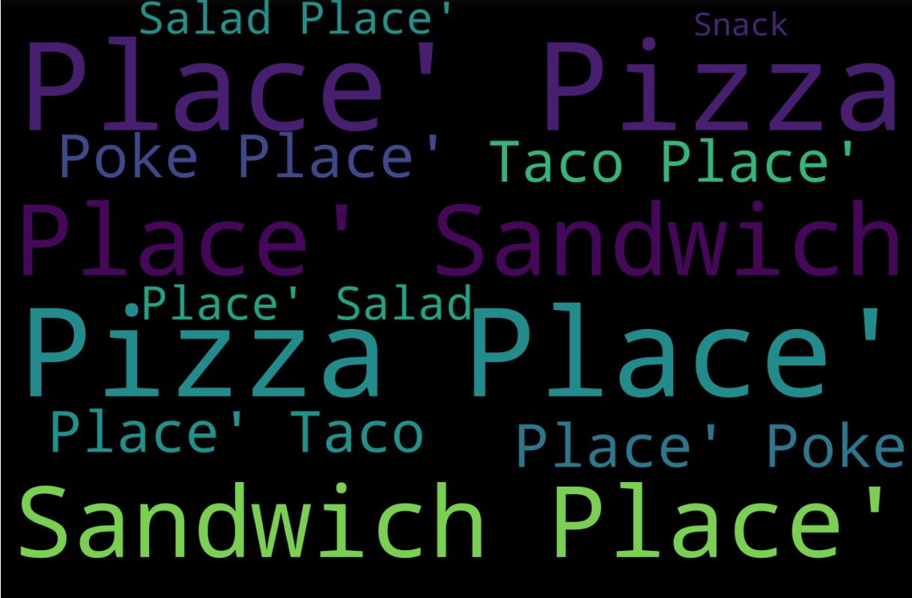
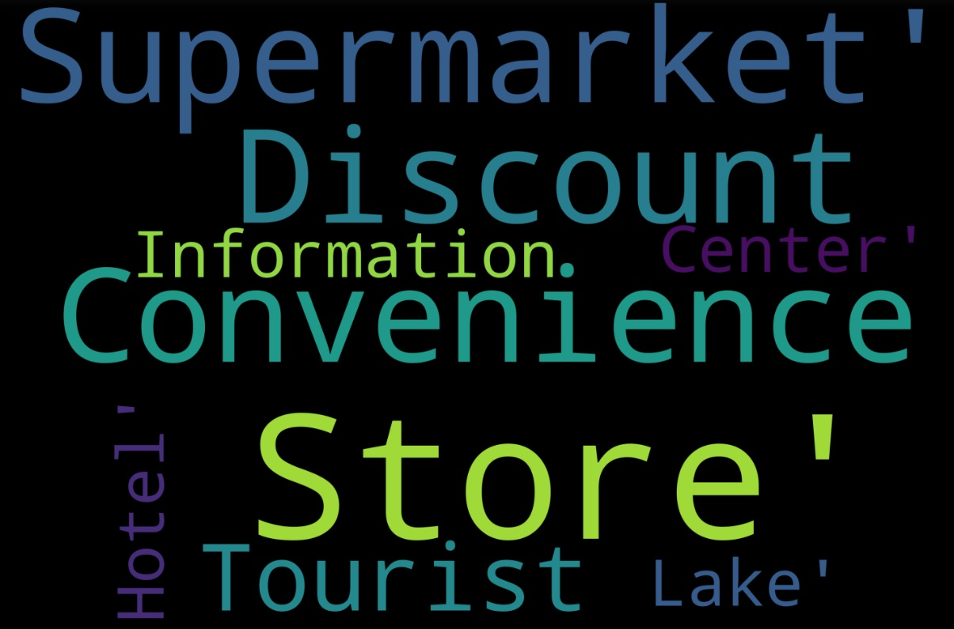
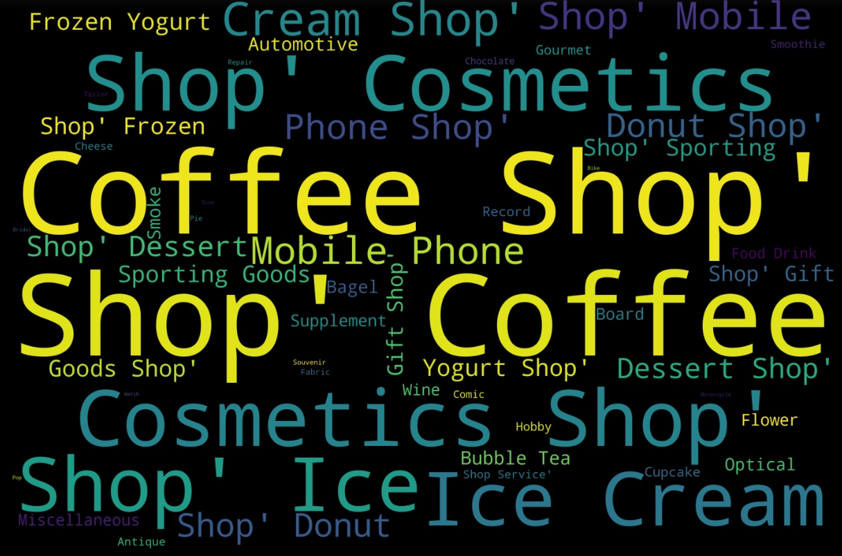
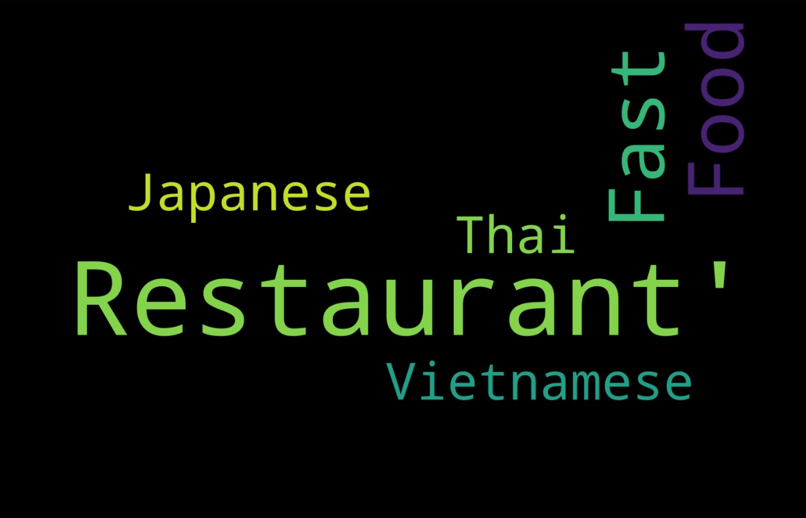
Semantic clustering

Slide 10
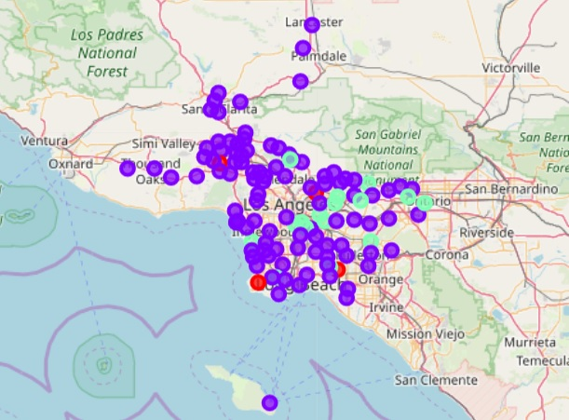
Semantic clustering
We now have a restaurant venue cluster separated from other food venues
We now add more resolution to our grouping and do K-means on just the restaurant cluster
Our restaurant cluster gives us three new restaurant categories based on restaurant type frequencies across cities
Fast Food-Asian(Purple),Mexican-Asian (Cyan), Diverse (Red)

Slide 11
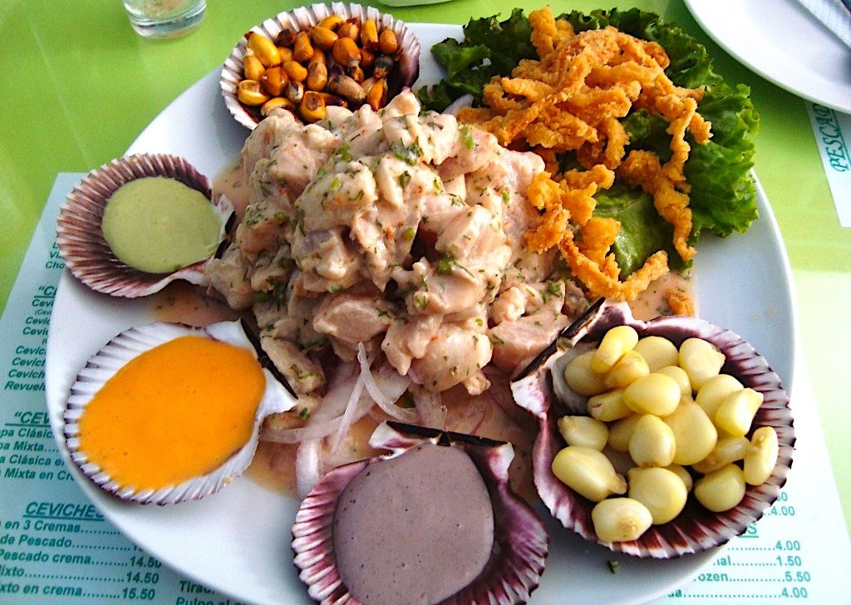
Insights
The project succeeded in providing a method to explore relevant locations for a new restaurant opening
We provide 3 options for the business owner and investors to think about
The 3 options balance out the scale of restaurant competition and location relevance
Further inferential statistics can be done but is not needed to understand the quality of a possible new location
We recommend that these 3 new data clusters be used to retrieve supplemental information about consumer traffic and social media interaction for brand growth

Slide 12
Thank you

